Slide 1
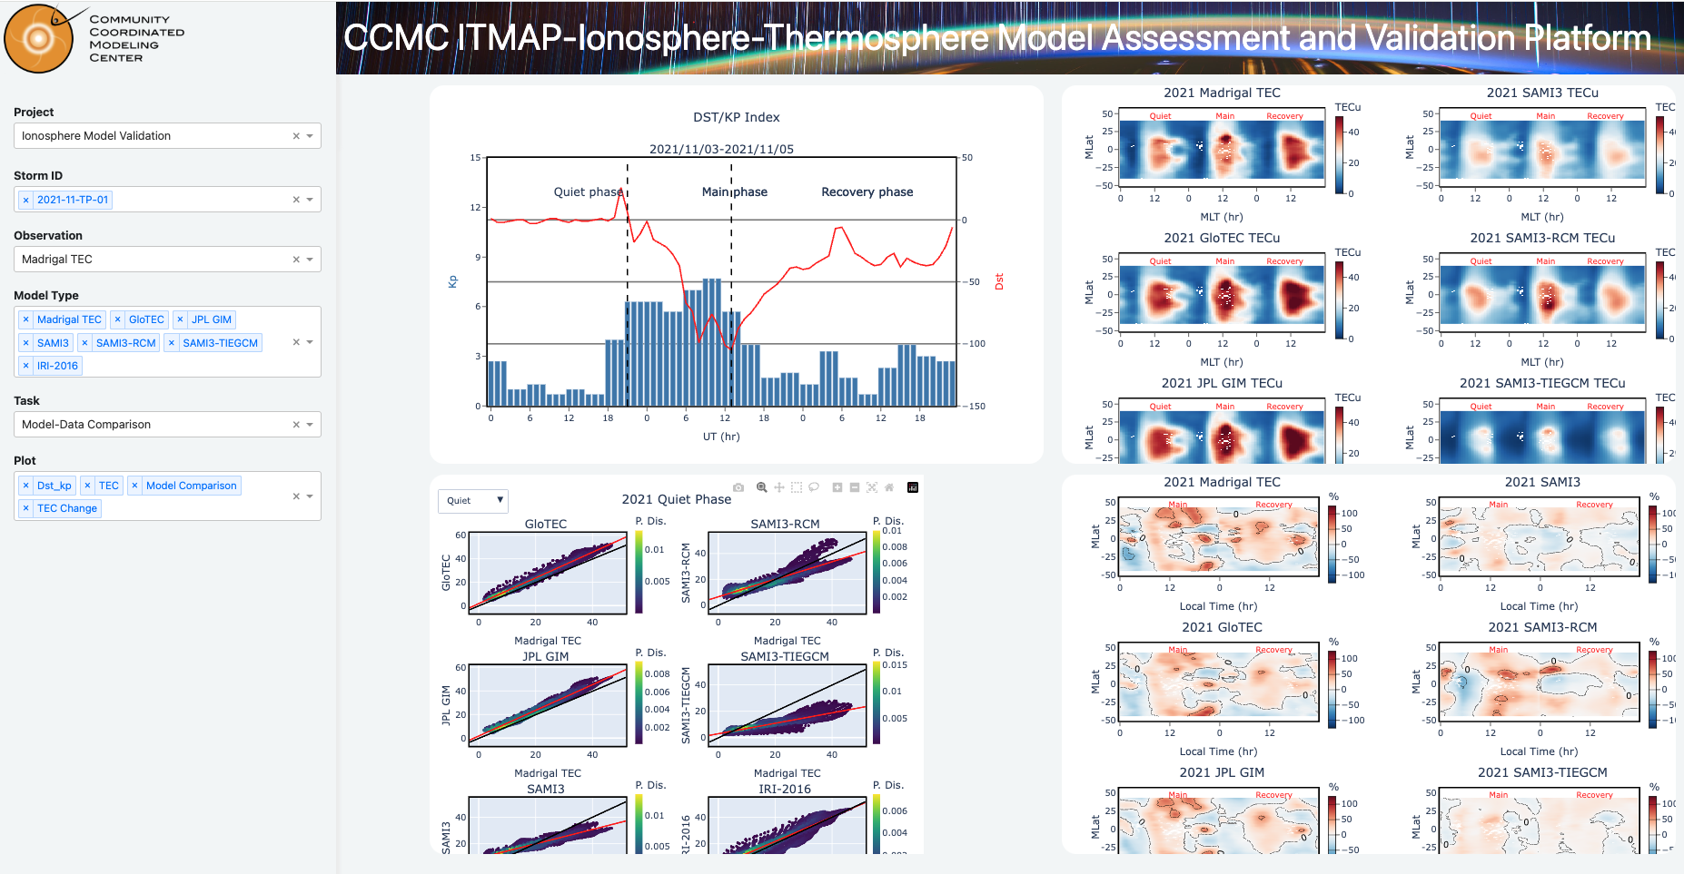
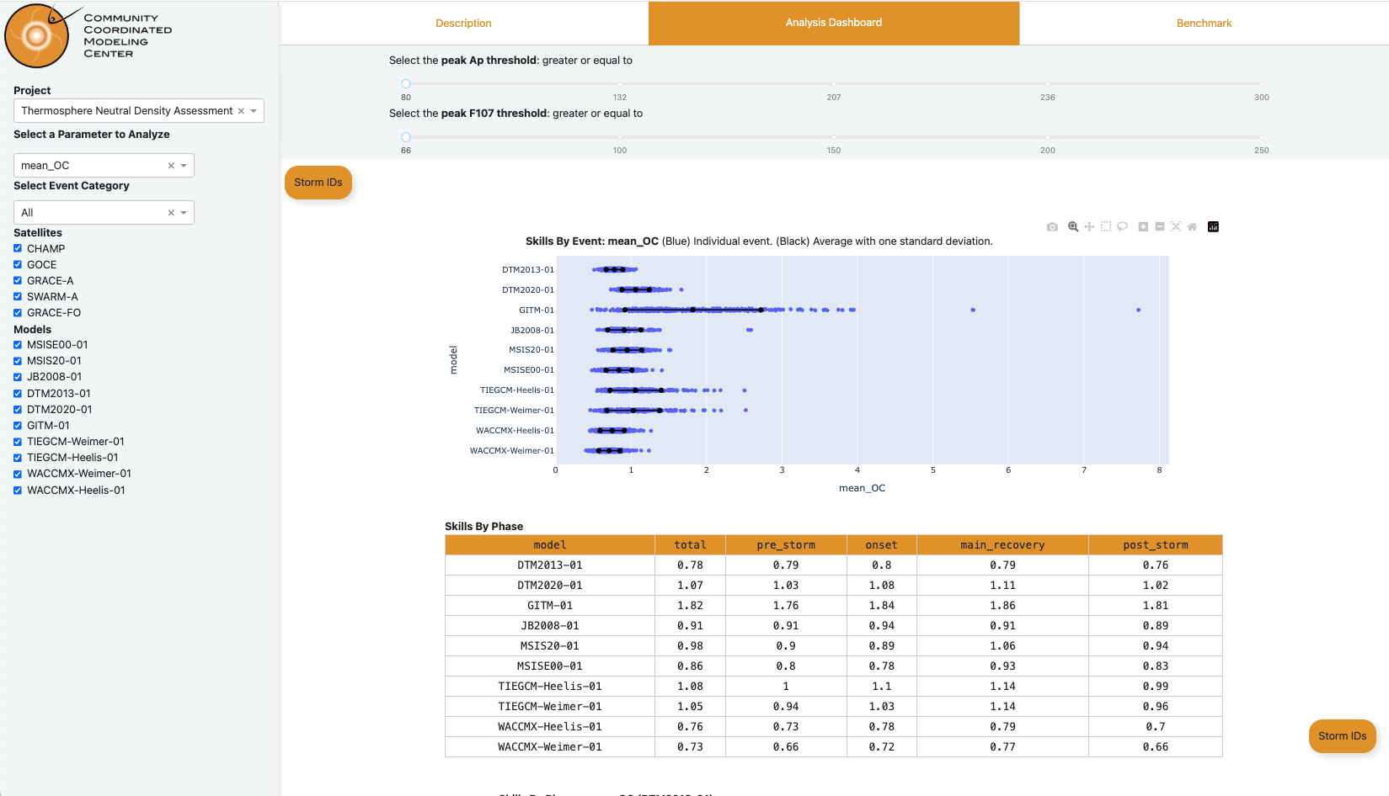
CCMC Ionosphere-Thermosphere Model Assessment and Validation Platform (ITMAP) Now Available.
The CCMC ITMAP is designed to showcase validation projects for ionosphere-thermosphere (IT) models by comparing model outputs with a wide range of ground-based and spaceborne observations, such as GNSS TEC, FORMOSAT-7/COSMIC2, CHAMP, GOCE, GRACE-A, SWARM-A, and GRACE-FO. These comparisons enable comprehensive assessments of IT model performance during historic geomagnetic storm events. The current ITMAP projects focus on key parameters including:
Total Electron Content (TEC)
Critical frequency of the F2 layer (foF2)
Peak height of the F2 layer (hmF2)
Thermospheric Neutral density
Future expansions will include model performance evaluations in support of navigation and communication applications, utilizing single frequency GNSS precise point positioning and HF raytracing tools.

