Slide 1



Community Coordinated Modeling Center (CCMC)
Introduction to Space Weather:
Tools and Concepts
Solar Energetic Particles (SEPs) and Impacts
Yihua Zheng & CCMC Team
Science for Space Weather, Jan 24 – 29, 2016, Goa, India

Slide 2
SEPs – important source of space radiation: hard to predict
Galactic Cosmic Radiation (another source)
Notes:
The main contributors to space radiation are Galactic Cosmic Rays (GCRs) and Solar Energetic Particles (SEPs).
The earliest detection of SEPs by Forbush (1946) led to the term ‘solar cosmic rays’. With what we know now about physical processes involved in the generation, acceleration and transport of GCRs and SEPs, the similarities in their initial names are more than just superficial. SEPs are usually associated with solar eruptions such as flares and Coronal Mass Ejections (CMEs).
Besides similarities, there are number of differences. GCRs have energies ( 10^8 – 10^20 eV/nucleon) much higher than SEPs ( 10^6 – 10^10 eV/nucleon). GCRs ions are typically GeV (giga electron volt) and above while SEP ions are in the energy range of a few MeV to hundreds MeV. For some extreme SEP events, ions can be accelerated to GeVs and higher. In the near-Earth’s environment, GCR flux is at continuous background levels while SEP fluxes are highly dynamic and can vary several orders of magnitude in a short timescale. During large solar energetic particle (SEP) events the intensity of >100 MeV protons hitting the upper atmosphere can be >1000 times that of GCR protons.

Slide 3
SEPs: What are they?
Definition:
Energetic charged particles (such as electrons protons and other heavy ions) traveling much faster than ambient particles in the space plasma, at a fraction of the speed of light (relativistic!).
They can travel from the Sun to the Earth in one hour or less!
The term “SEP” usually refers to protons.
Notes:
An SEP event is an enhancement in the radiation environment.
SEPs are usually associated with solar eruptions such as flares and Coronal Mass Ejections (CMEs). Even though historically SEP events have been classified into two groups only with the impulsive ones that are associated with flares and gradual ones associated with CMEs [e.g., Reames, 1999]. Later research [e.g., Kallenrode, 2003, Cane et al., 2010] shows that rather than a simple dichotomy of two classes of SEP events, both flare and CME shock acceleration can contribute in the largest SEP events. Regardless of the roles of flares and CMEs in leading to a SEP event, both these phenomena obtain their energy from the same solar magnetic field, very similar to particle acceleration process associated with GCRs where particles gain energies from strong magnetic fields at supernova remnant shocks.

Slide 4
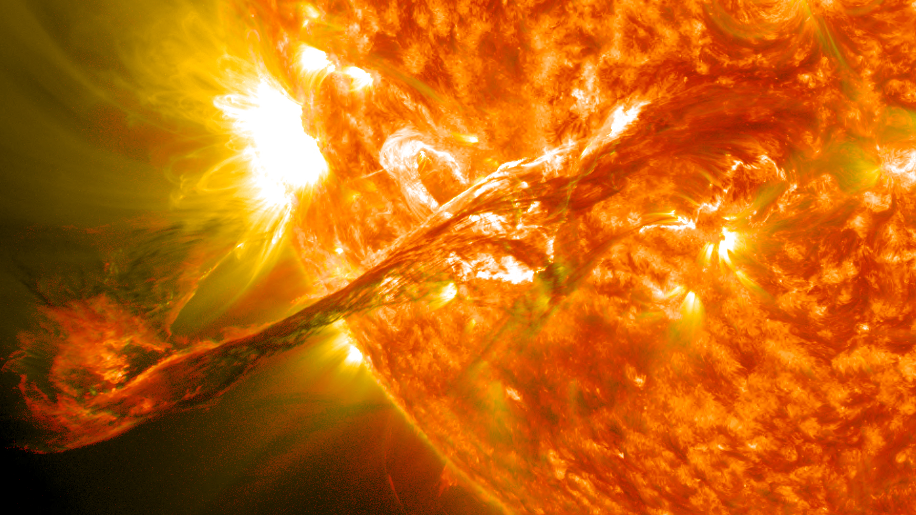
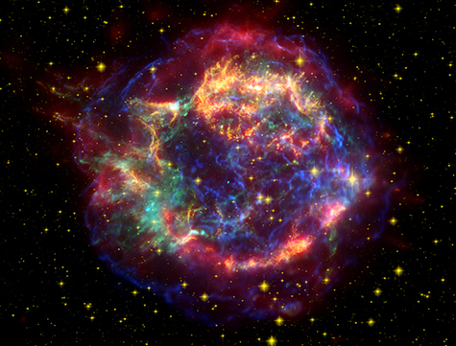
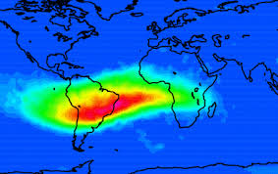
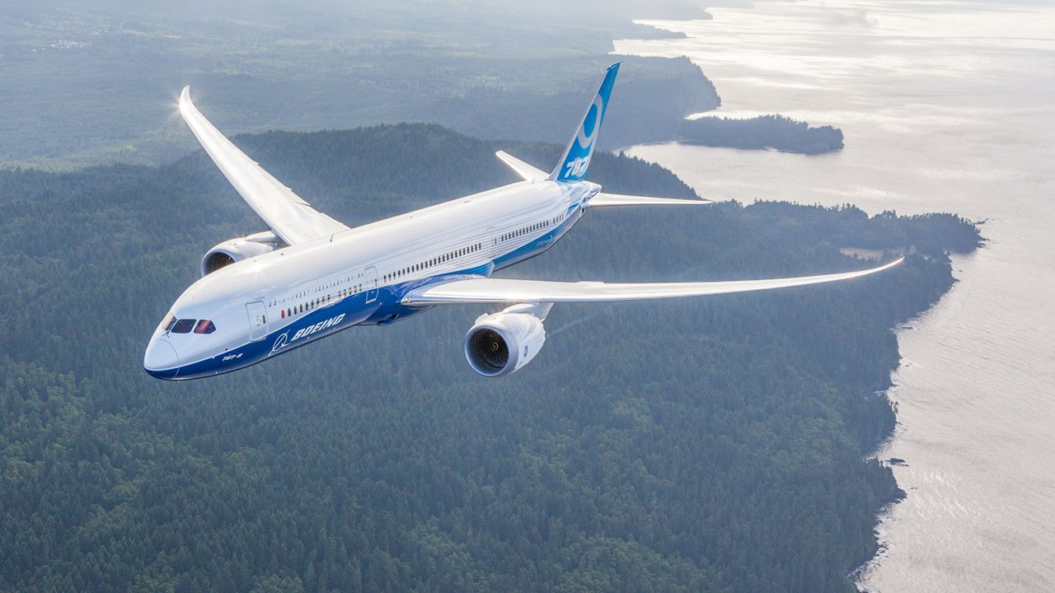
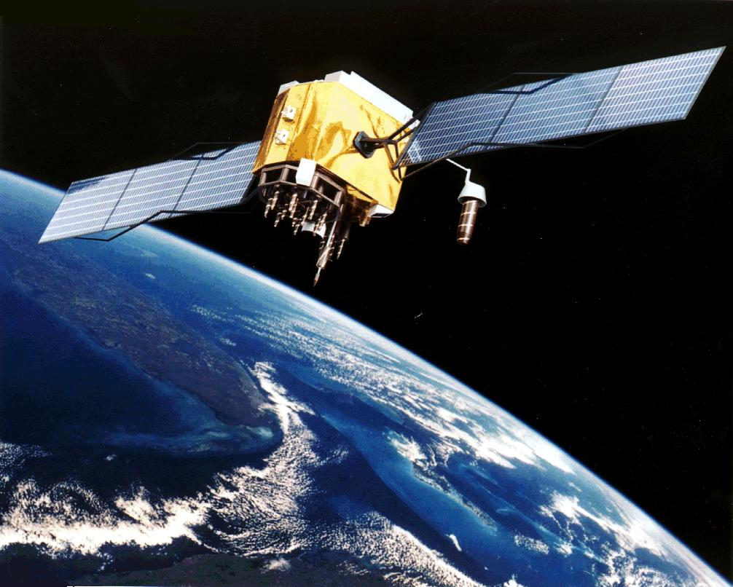
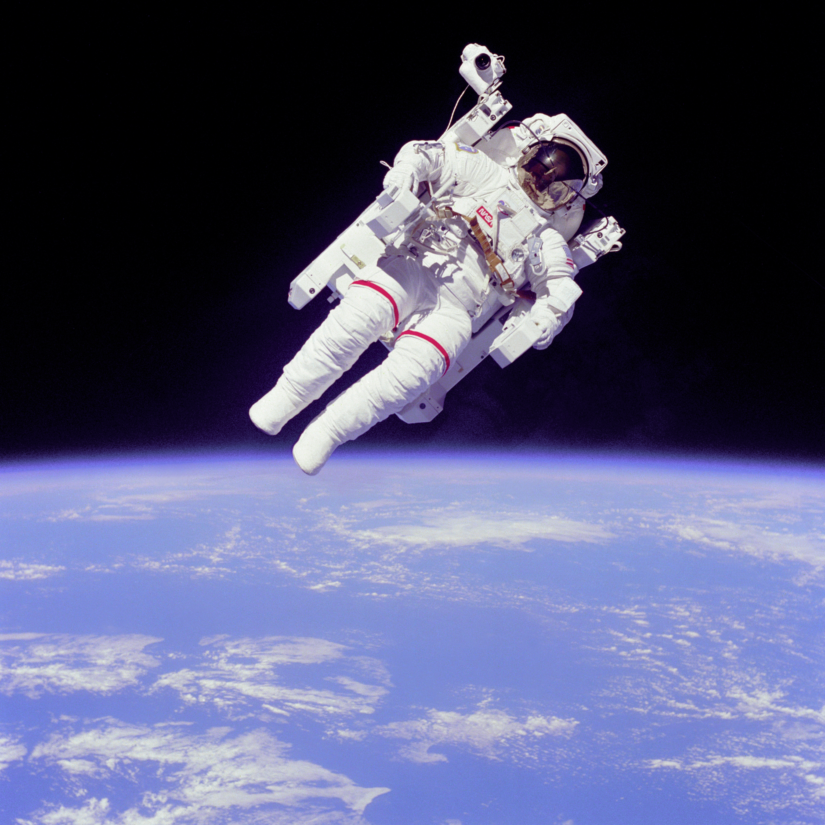
Why do we care?
Ionizing radiation storms
SEPs
GCRs
SAA
Polar cap absorption
Acute and long term risks
Single event effects
Commu and Nav.
Human in space
Spacecraft
Also: Total ionizing dose (TID) and displacement damage dose (DDD)
Notes:
The main contributors to space radiation are Galactic Cosmic Rays (GCRs) and Solar Energetic Particles (SEPs). Both can have deleterious effects on humans and technological assets/spacecraft components in space. From human perspective, space radiation can have acute in-flight effects, long-term cancer risks and risks on CNS (Central Nervous System) and cardiovascular system. From space hardware/components perspective, space radiation can cause cumulative degradation such as total ionizing dose (TID) and displacement damage dose (DDD) and transient effects such as single event effects (SEEs), all of which can be destructive. Supernova Remnants are believed to be the most plausible sources of GCRs. GCRs can have particles up to very high energies ( - eV/nucleon). The latter is the more unpredictable of the two and is associated with most energetic solar eruptions: flares and coronal mass ejections; at the same time, SPEs are capable of inducing acute and profound effects on humans and on spacecraft components. Penetrating particle radiation from SPEs adversely affects aircraft avionics, communication and navigation, and potentially the health of airline crews and passengers on polar flights. SPEs also constitute major hazards for astronauts performing EVAs (Extra-Vehicular Activities) on board the International Space Station (ISS).
SAA: Since the geomagnetic field is not a perfect dipole, the inner radiation belt gets closer to the Earth over the South Atlantic Ocean, which is called the South Atlantic Anomaly (SAA).
Trapped proton sources are cosmic ray albedo neutron decay (CRAND). Calculated intensities at energies ≤100 MeV and for L ≥ 1.3 are dominated by solar protons, CRAND being the dominant source otherwise.
Qin, M., X. Zhang, B. Ni, H. Song, H. Zou, and Y. Sun (2014), Solar cycle variations of trapped proton flux in the inner radiation belt, J. Geophys. Res. Space Physics, 119, 9658–9669, doi:10.1002/2014JA020300.
Selesnick, R. S., M. D. Looper, and R. A. Mewaldt (2007), A theoretical model of the inner proton radiation belt, Space
Weather, 5, S04003, doi:10.1029/2006SW000275.
total ionizing dose (TID) and displacement damage dose (DDD)

Slide 5
Space Environments and Effects on Spacecraft
Plasma
Particle
radiation
Neutral
gas particles
Ultraviolet & X-ray
Micro-
meteoroids & orbital debris
Ionizing &
Non-Ionizing
Dose
Single
Event
Effects
Surface
Erosion
Charging
Drag
Impacts
Biasing of instrument readings
Pulsing
Power drains
Physical damage
Degradation of micro-
electronics
Degradation of optical components
Degradation of solar cells
Data corruption
Noise on Images
System shutdowns
Circuit damage
Torques
Orbital decay
Degradation of thermal, electrical, optical properties
Degradation of structural integrity
Structural damage
Decompression
Space Radiation Effects
Shaded in yellow
after J. Barth
Notes:
This is overview of spacecraft environments and effects on satellites. The yellow highlighted region pertains to effects of space radiation from SEPs and GCRs.

Slide 6
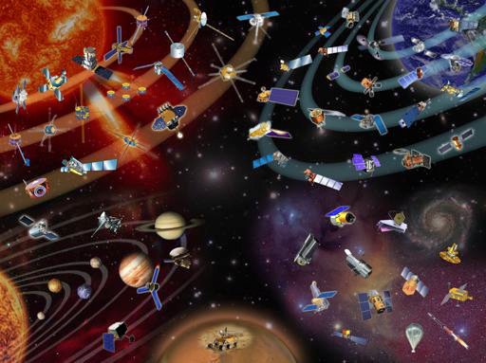
Flares
Solar energetic particles (SEPs)
Coronal Mass Ejections
Notes:
At the SWRC, our goal is to monitor the space environment for NASA robotic mission operators.
For spacecraft outside of a protective planetary magnetosphere, the energetic particles very potential for damage.
The sources are both flares, CMEs. You remember that a flare is a rapid release of energy, which can be transferred to particles as kinetic energy. CMEs can drive shock waves, and shock waves are also efficient particle accelerators.
Note: for all the SEP events that exceed our threshold, there is accompanying CME(s). CMEs are very important for those SEP events of space weather significance.

Slide 7
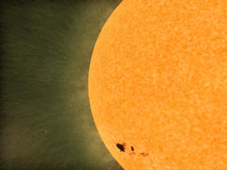
SEPs: ion radiation storms
Potentially affect everywhere in the solar system
Courtesy: SVS@ NASA/GSFC
7
Notes:
SEPs: applicable and potentially damaging everywhere that they have influence

Slide 8
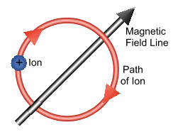
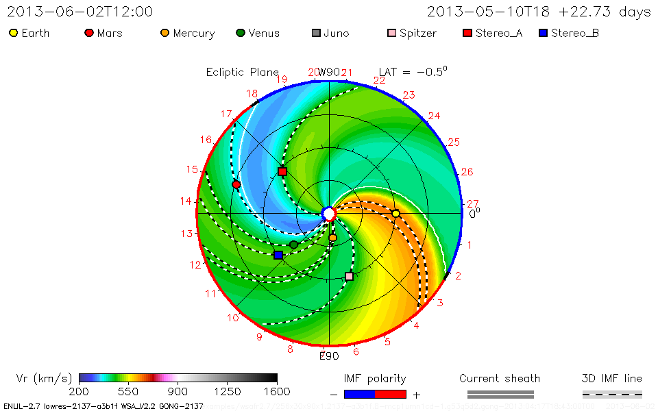
Magnetic fields guide SEPs
Charged particle motion* is confined by the magnetic field.
+90°
This means that the source is very important.
0°
-90°
*in a substantially strong B
Notes:
ENLIL
Charged particles, when the magnetic field is above some certain threshold, are tied to magnetic field lines. They will propagate along the magnetic field lines.
As we discussed earlier, because the Sun rotates, the interplanetary magnetic field takes a spiral shape in the equatorial plane. Use these lines to see where the soure regions can be for these spacecraft.
Just flares/source region connection

Slide 9
Magnetic fields guide SEPs/magnetic connectivity
Charged particle motion* is confined by the magnetic field.
+90°
This means that the source is very important.
0°
-90°
*in a substantially strong B
Notes:
ENLIL
Charged particles, when the magnetic field is above some certain threshold, are tied to magnetic field lines. They will propagate along the magnetic field lines.
As we discussed earlier, because the Sun rotates, the interplanetary magnetic field takes a spiral shape in the equatorial plane. Use these lines to see where the soure regions can be for these spacecraft.
Just flares/source region connection

Slide 10
Magnetic fields guide SEPs
Charged particle motion* is confined by the magnetic field.
+90°
This means that the source is very important.
0°
-90°
*in a substantially strong B
Notes:
ENLIL
Charged particles, when the magnetic field is above some certain threshold, are tied to magnetic field lines. They will propagate along the magnetic field lines.
As we discussed earlier, because the Sun rotates, the interplanetary magnetic field takes a spiral shape in the equatorial plane. Use these lines to see where the soure regions can be for these spacecraft.
Just flares/source region connection

Slide 11
Magnetic fields guide SEPs
Charged particle motion* is confined by the magnetic field.
+90°
This means that the source is very important.
0°
-90°
*in a substantially strong B
Notes:
ENLIL
Charged particles, when the magnetic field is above some certain threshold, are tied to magnetic field lines. They will propagate along the magnetic field lines.
As we discussed earlier, because the Sun rotates, the interplanetary magnetic field takes a spiral shape in the equatorial plane. Use these lines to see where the soure regions can be for these spacecraft.
Just flares/source region connection

Slide 12
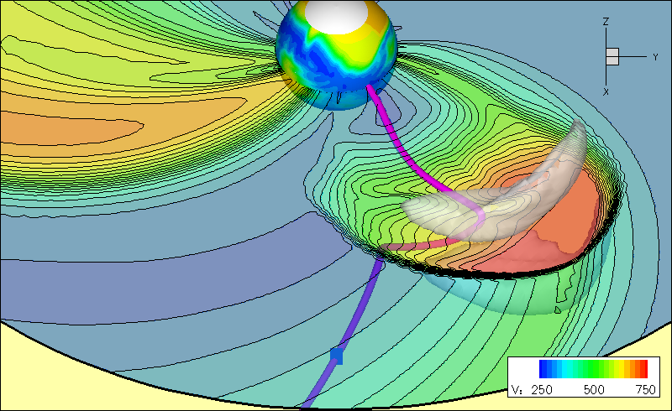
CMEs Can Widen Longitudinal Extent of SEP Events
Magnetic field lines are the road for charged particles
Notes:
If particles do not easily cross from one magnetic field line to another, it may seem like all SEP events would then be very narrow in longitude.
However, a CME can play a role not only in accelerating the particles, but also in distributing them over a wide range of longitudes, as we can see here in this simulation.
Here is a simulation that shows us what that might look like.
So, remember, when there is a cme, it can widen the area of the SEPs.

Slide 13
CMEs Can Widen Longitudinal Extent of SEP Events
Notes:
If particles do not easily cross from one magnetic field line to another, it may seem like all SEP events would then be very narrow in longitude.
However, a CME can play a role not only in accelerating the particles, but also in distributing them over a wide range of longitudes, as we can see here in this simulation. Sandro said how CMEs can be greater than 100 in width, so it is possible for the same SEP event to be seen at multiple locations.
Here is a simulation that shows us what that might look like.
So, remember, when there is a cme, it can widen the area of the SEPs.

Slide 14
How Do We Monitor SEP Levels?
(1 pfu = 1 particle flux unit= 1/cm^2/sec/sr)
Track the particle flux at different locations.
Flux units: pfu, pfu/MeV
  Heliosphere with STEREO In-situ Measurements of Particles and CME Transients (IMPACT)
    Differential energy band; Units measured, some energy ranges are:
  Upstream of Earth with SOHO/COSTEP
    Units measured, some energy ranges are:
  Geostationary Orbit with GOES
    Integral flux, Units measured, some energy ranges are: pfu particle flux unit
Another useful quantity:
Fluence = flux integrated over the entire event.
Important for biological effects (flights)
Notes:
SEP intensity is usually measured in differential flux, differential energy flux or fluence
Converting between the two is important to know in order to quantify the relative strengths.

Slide 15
SEP Intensity
Event magnitudes:
  > 10 MeV/nucleon integral fluence: can exceed 10⁹ cm⁻²
  > 10 MeV/nucleon peak flux: can exceed 10⁵ cm⁻²s⁻¹
Notes:
SEP intensity is usually measured in differential flux, differential energy flux or fluence
The extreme values of SEP events

Slide 16
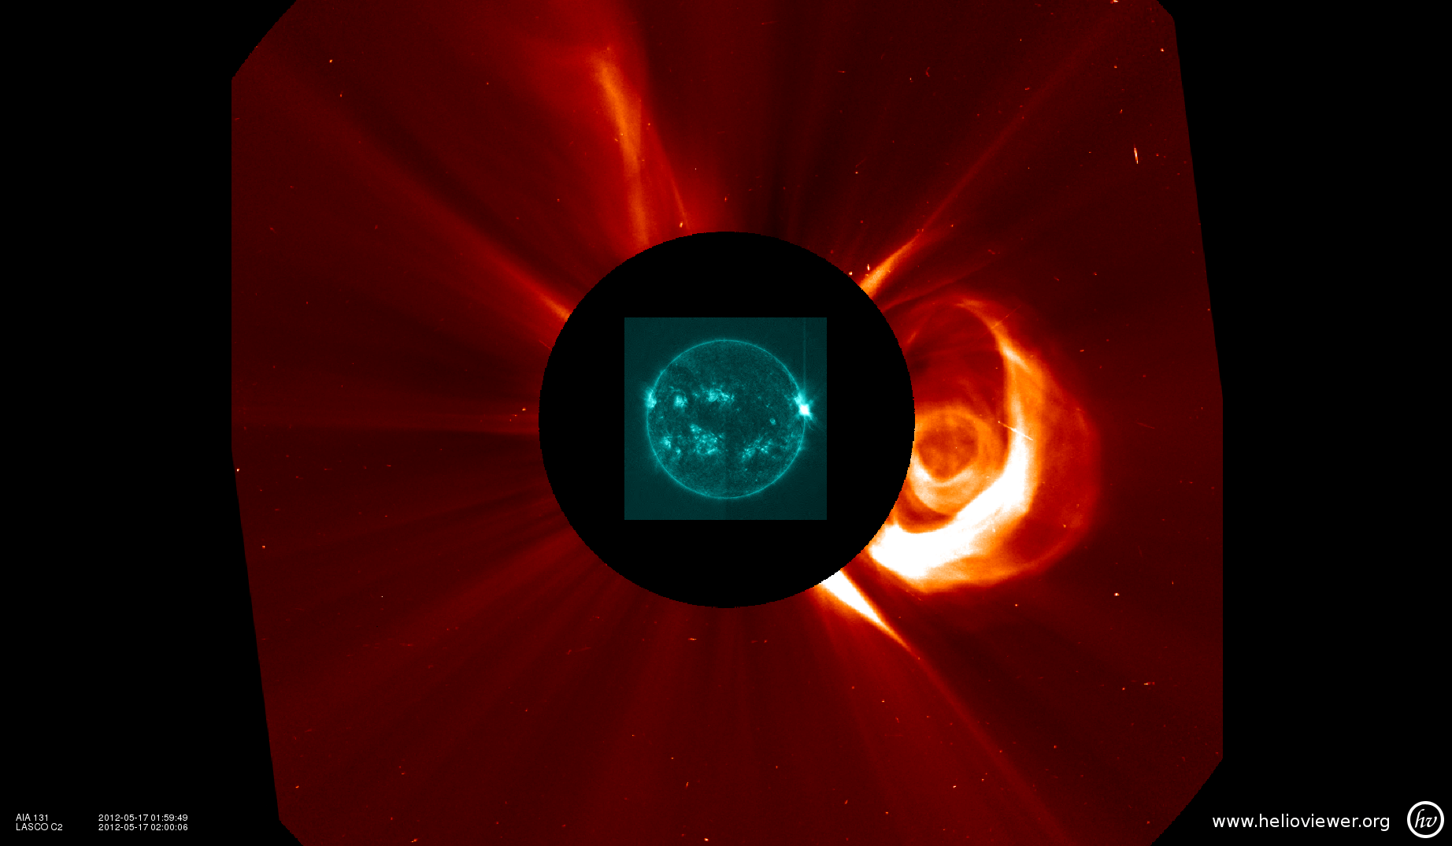
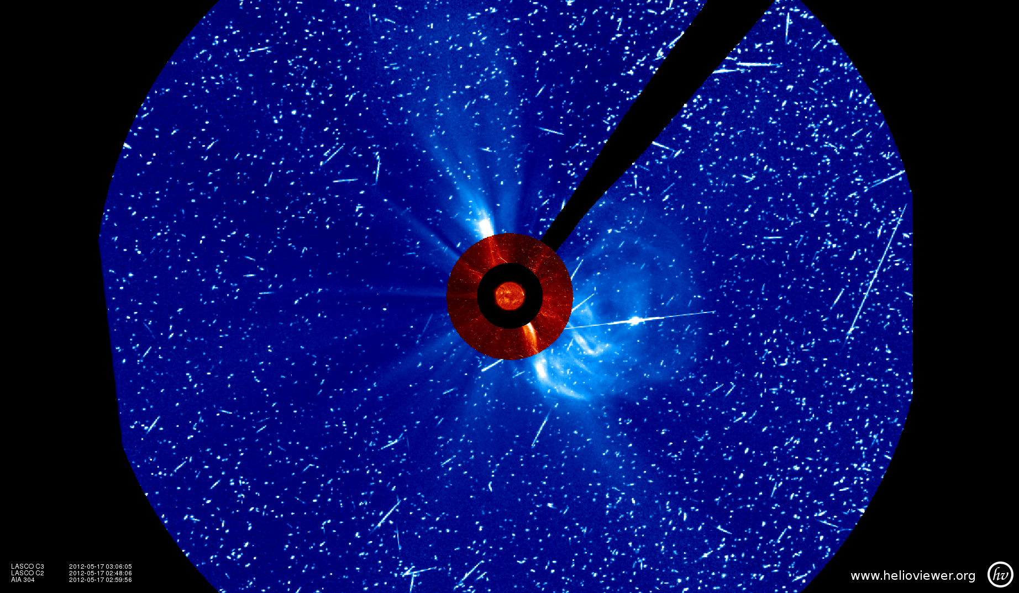
PARTICLE SNOW!
Coronagraph acting as particle detector ☺
Flare peaked at 01:47 UT
One hour later
SDO AIA 131 Å + SOHO/LASCO C2
May 17 02:00 UT
SOHO/LASCO C3
May 17 03:00 UT
Notes:
Another way that we “see” SEPs are in images, for example, coronagraphs. Here you can see the ‘snow’ of particles hitting the detector.

Slide 17
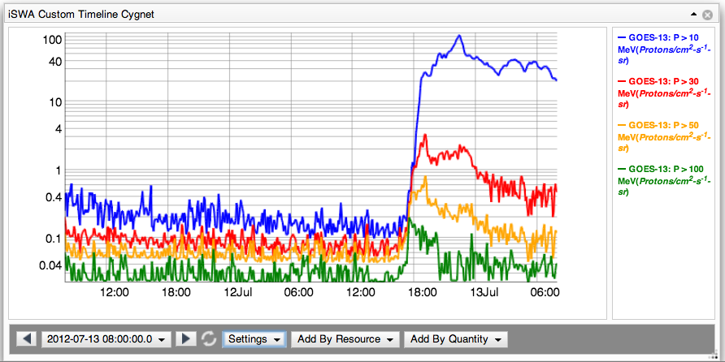
How do we define an SEP Event?
SWRC: SEP event detections are defined as:
GOES Proton E > 10 MeV channel > 10 pfu
GOES Proton E > 100 MeV channel > 1 pfu
Notes:
Here is an example of an event where the 10 MeV limit was met, but not the 100 MeV.
SOHO: > 15.8 MeV proton channels 0.1 pfu/MeV.

Slide 18
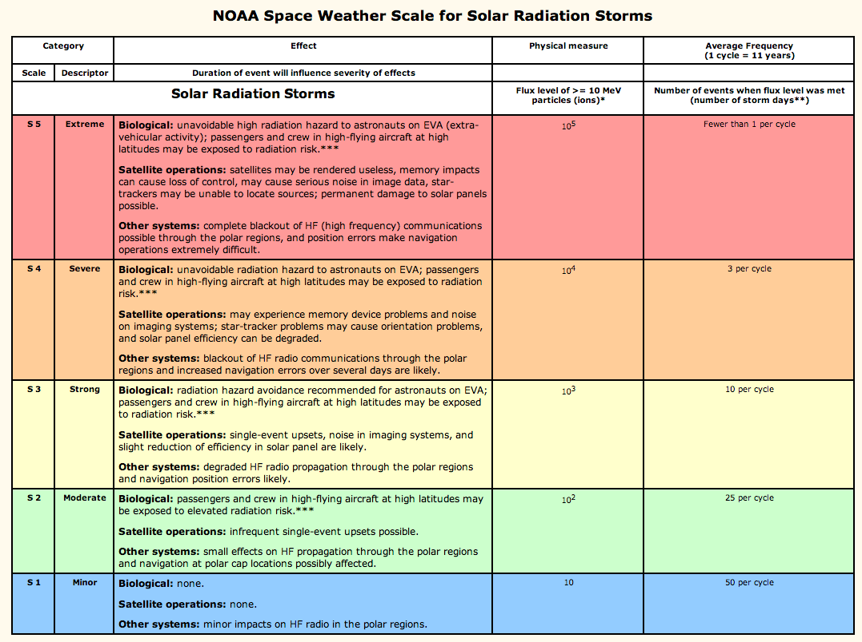
How Do We Quantify an SEP Event?
Notes:
NOAA/SWPC’s classification of SEP events – based on the flux level of the >10 MeV integral proton flux level.
Note: this is a simplified classification system. Impacts depend on multiple factors, such as spectra of an event.

Slide 19
Human Safety in Space
GCR
SEP
Johnson Space Center/Space Radiation Analysis Group (SRAG)
Limit: the > 100 MeV flux exceeding 1pfu
(1 pfu = 1 particle flux unit= 1/cm^2/sec/sr)
All clear (EVA –extravehicular activity)
Notes:
For humans in space, higher energy particles are more relevant. The >100 MeV proton flux is used.

Slide 20
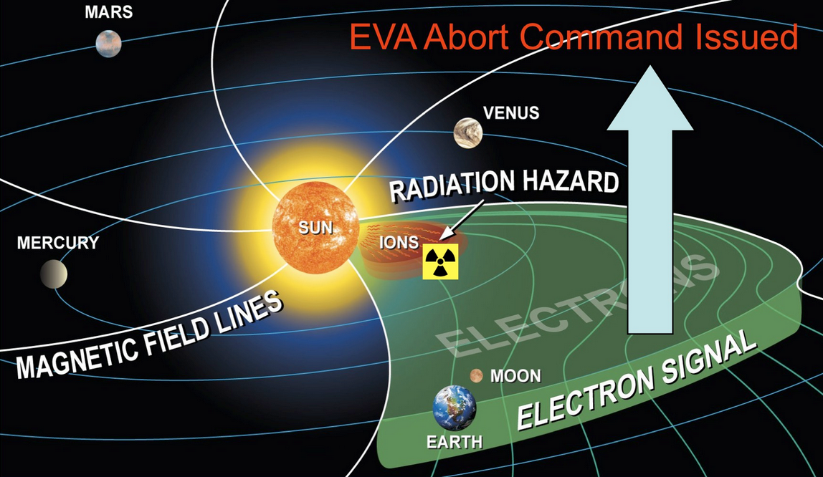
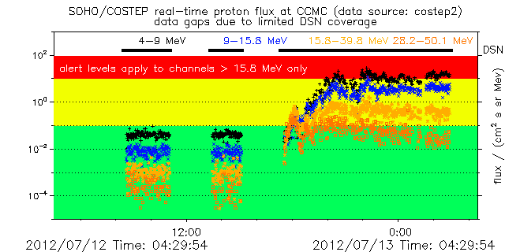
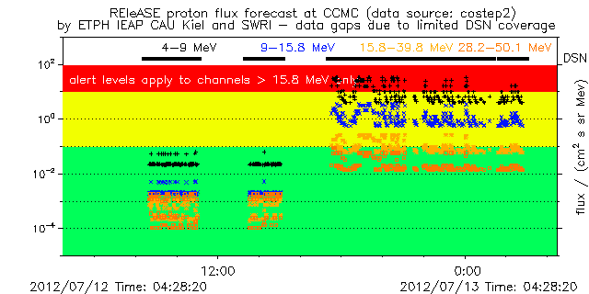
Can we predict SEP events?
Uses detection of high energy *electrons* to predict arrival of high energy *protons*
Data source: SOHO COSTEP
REleASE Model
Notes:
http://iswa.gsfc.nasa.gov/wiki/index.php/SOHO/Costep_Proton_Flux_-_Forecast

Slide 21
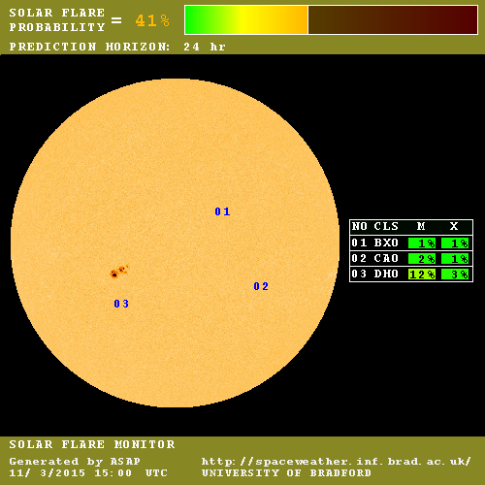
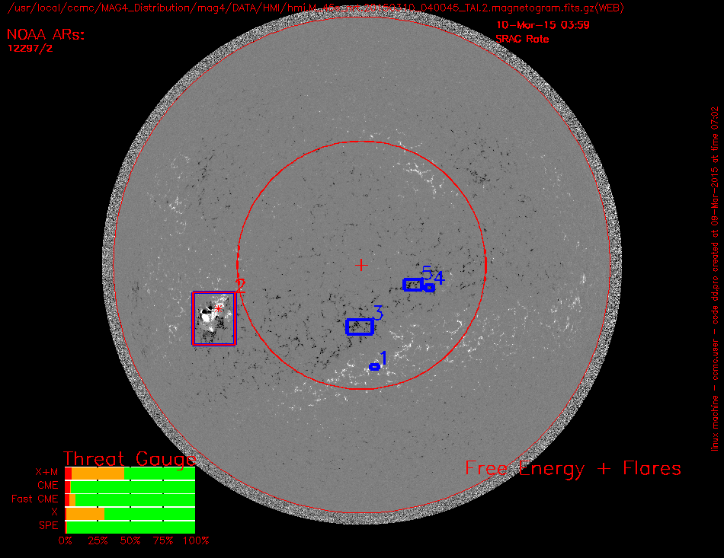
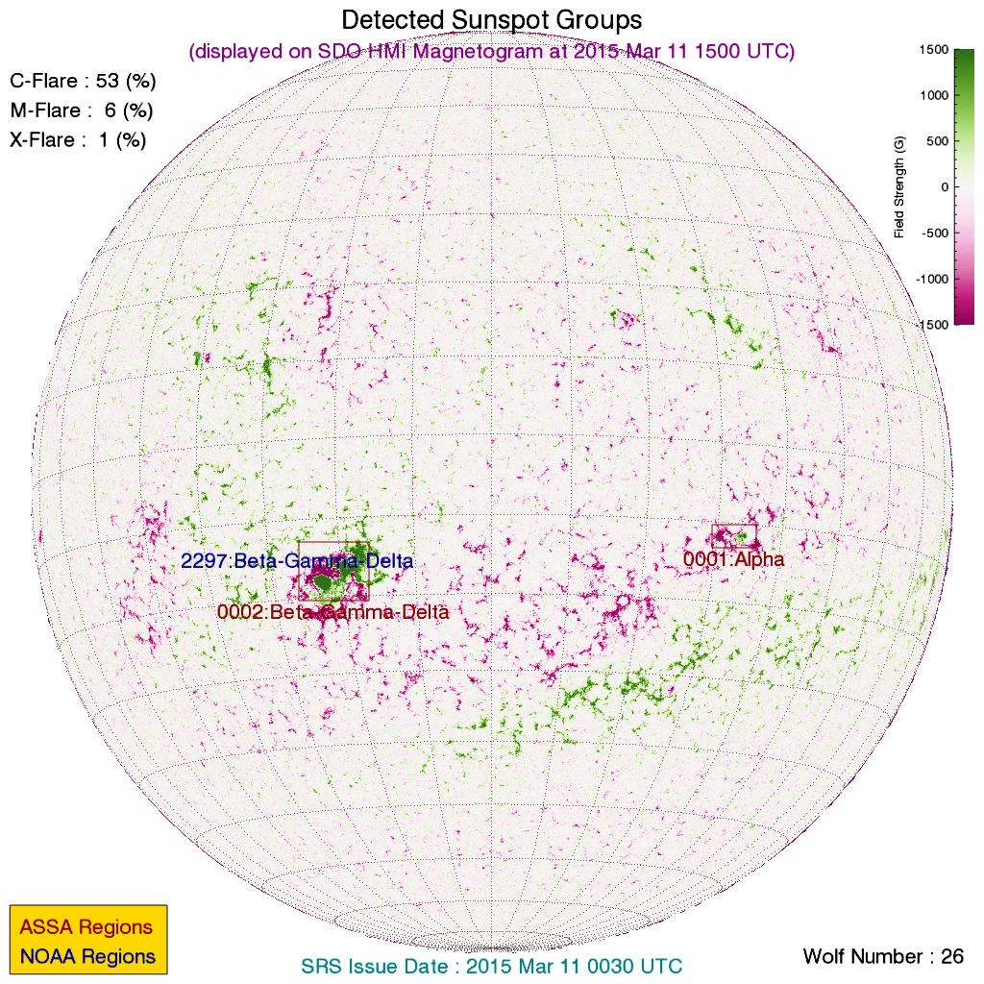
SEP Prediction (active region)
x2.2 flare on march 11, 2015
MAG4
ASAP
ASSA
Notes:
Intensity: X2.2 class
Source region S16E26 (12297)
SEP prediction – characterization of active regions, not so accurate/reliable
This event: strong flare – little enhancement in SEP fluxes

Slide 22
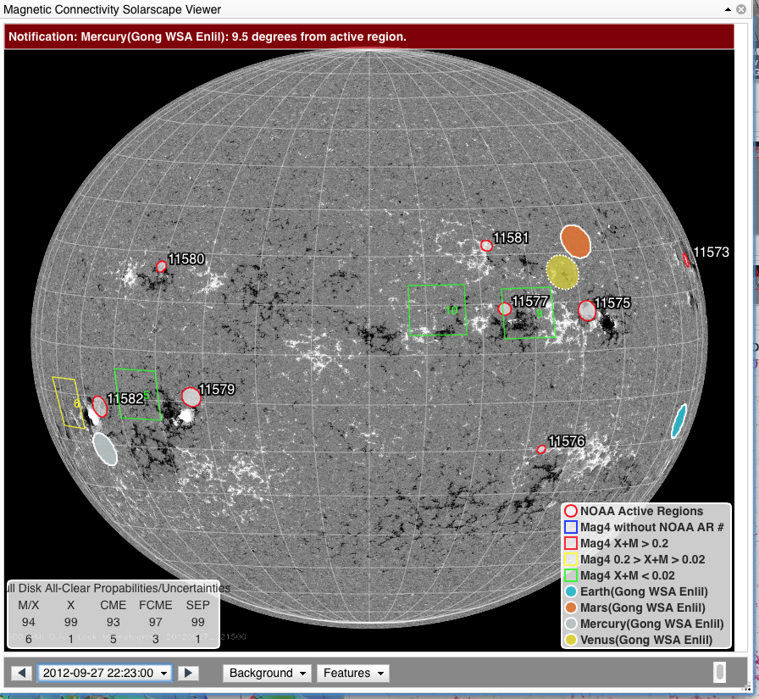
Solarscape/magnetic connectivity
C3.7 class flare
AR 11577
Notes:
20120927_2336 2012/09/27 23:36:00 00:34:00 23:57:00 C3.7 N09W32 ( 1577 ) LDE: long duration event N09W32
This C-class flare and CME result in a SEP event at STEREO A and Earth
Earth-directed. Hemispheric wave, asymmetric halo

Slide 23
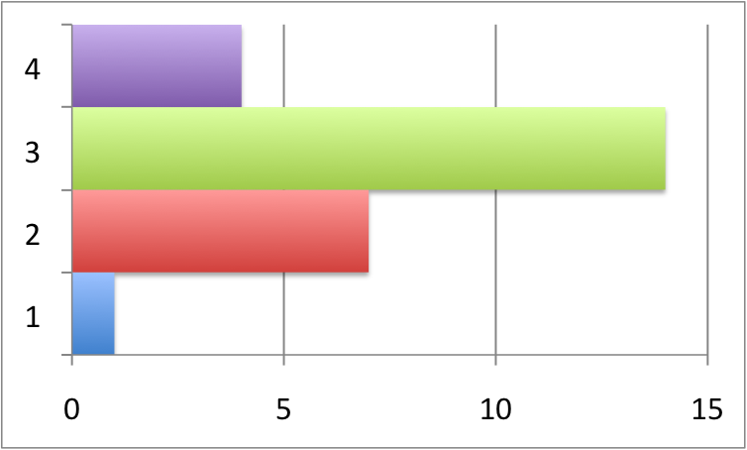
How Often Do SEP Events Occur?
SEP event detections in the near-Earth environment
(GOES 13, Proton E > 10 MeV channel)
2007-2009: Zero Events - Solar Minimum Indeed!
Total Events
2013 (Jan-May)
2012
Since March 2011
STEREO A: 16
STEREO B: 11
2011
2010
Notes:
If you are speaking about one specific location in the heliosphere, for example, just at the Earth, then during solar minimum, there can be only a few or even none in a year. During higher activity times, there can be about one per month or so.
However, there can be many more SEP events happening at other locations, or that we simply are not measuring – remember how that sometimes events can be focused in space!
With only four events in the first 5 months of 2013, things are a little more quiet than we would have guessed.

Slide 24
Recognizing profile shapes of SEP flux and associating it with the source/driver

Slide 25
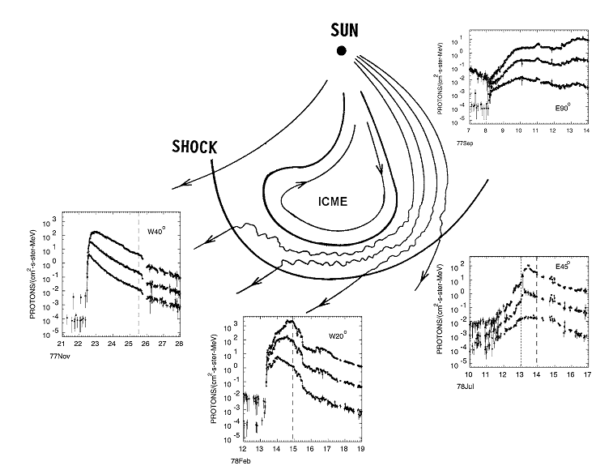
East-West Asymmetry in Solar Proton Events; Intensity Profiles at ~5, ~15 and ~30 MeV (adapted from Cane et al., 1988)
Western event;
S/C is well connected to solar event; prompt particle rise to peak then decay; weak shock flank may be encountered.
Far Eastern event: S/C is very poorly connected. Gradual rise, may have extended duration as populated field lines corotate to S/C.
Shock
Shock
Shock
Near Central Meridian event;
Reasonably prompt rise; Peak, especially at lower energies, is typically near shock passage.
Eastern event: S/C is poorly connected to solar event. Gradual rise, peak near/after shock flank passage.
Synthesis of observations of 235 events over 20 years. Different intensity-time profiles are ordered by the varying connection to the solar event and shock.
Notes:
The profile of a proton event depends on the longitude of the solar event relative to the observer.
The major controlling agent is the existence of an interplanetary (IP) shock.
Cane and Lario, 2006
Cane et al., 1988

Slide 26
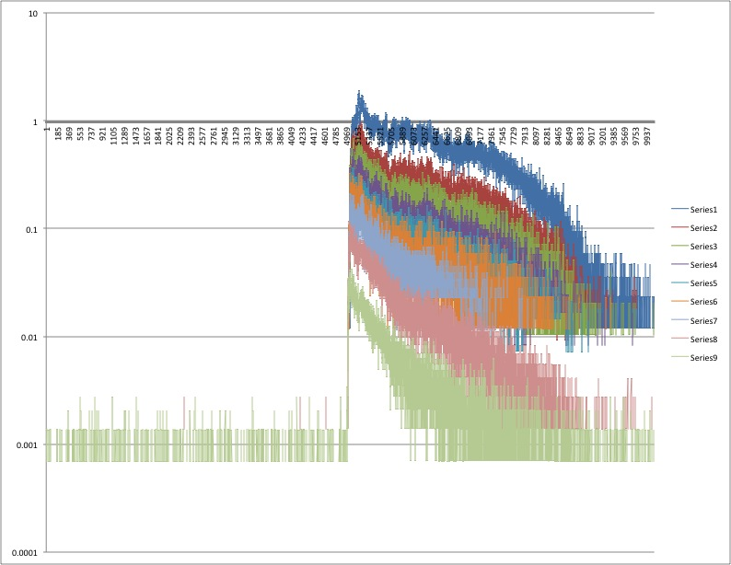
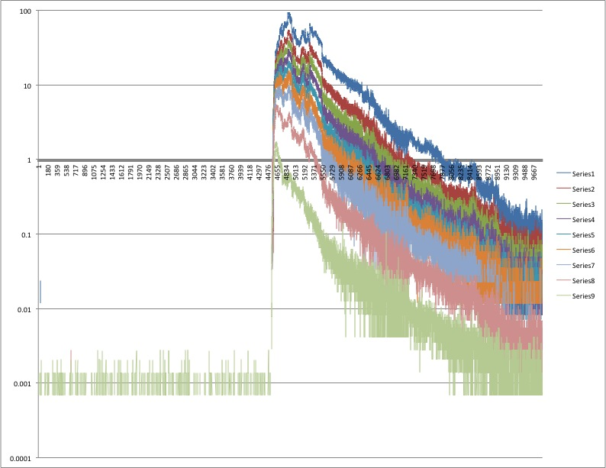
Impulsive: The “peak at the beginning due to flare, fall off” – indicates how well connected you are to the source (timing)
Notes:
Well-connected events

Slide 27
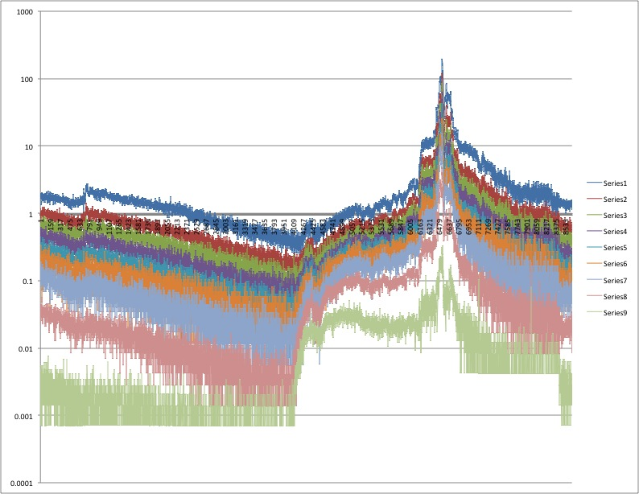
Gradual: The “jump up from flare/CME, slow rise
Then peak when the ICME passes the spacecraft”
Notes:
The peak is often called ESP – (Energetic Storm Particles) component (due to the CME arrival).

Slide 28
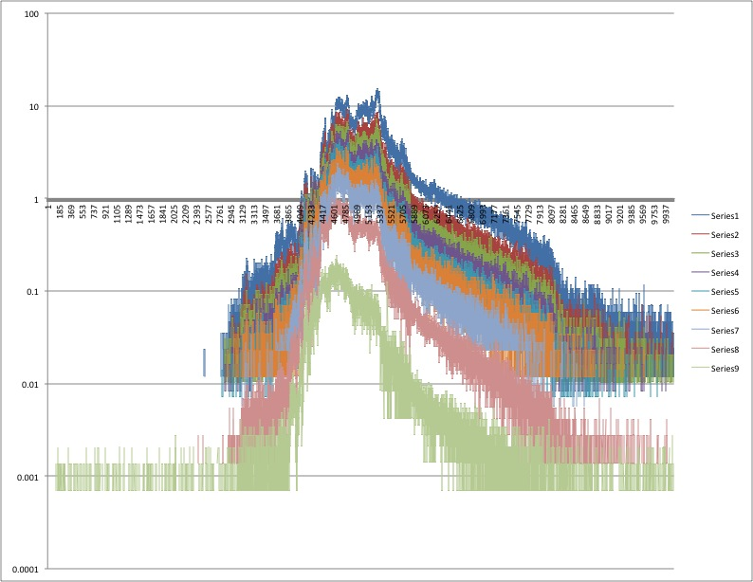
The “slow rise then peak, (slow rise can let you know that you are not well connected
ICME doesn’t hit spacecraft so falls off”
Notes:
When the observer is not magnetically well-connected to the source region - an eastern event

Slide 29
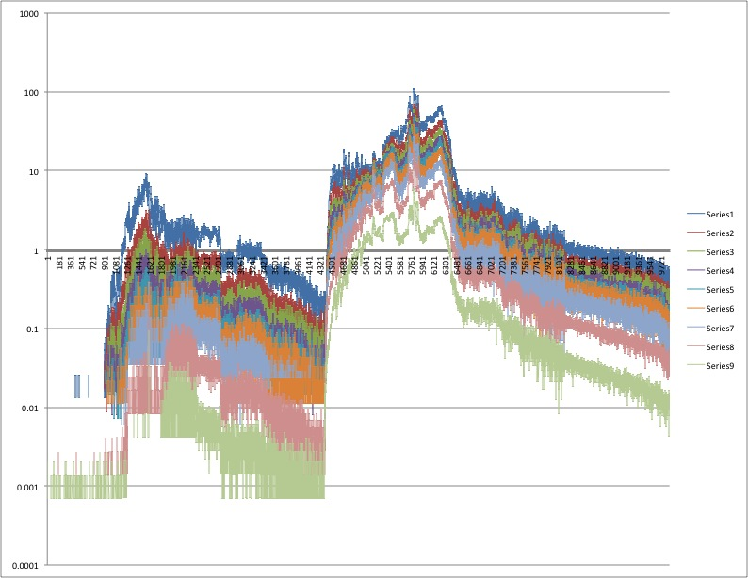
The “multiple event weirdness”
Notes:
Temporal profile can be complicated with a series of SEP events – multiple events in a row

Slide 30
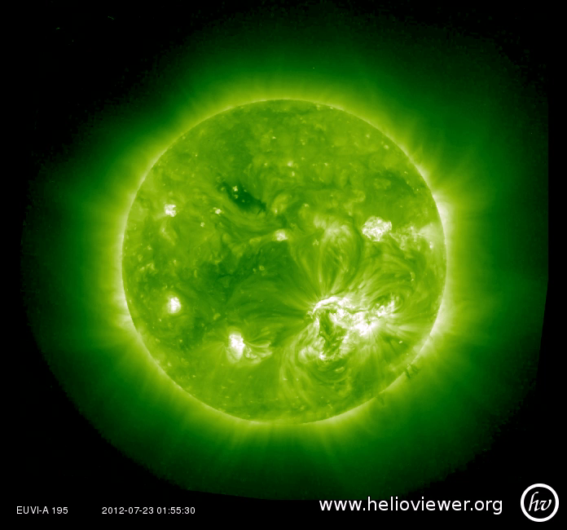
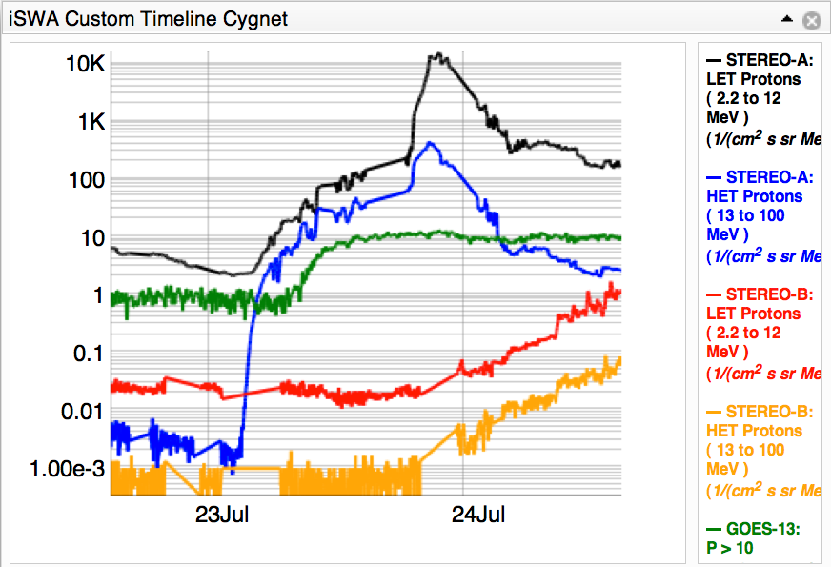
July 23, 2012
Example where is reaches one spacecraft, then later another…
Increase of more than 5 orders of magnitude at STEREO A
SEP event also detected by GOES, and later enhancement seen at STEREO B (possibly due to IPS)
July 23 flare as seen in STEREO A EUVI 195
Notes:
On July 23rd it really put on a show.

Slide 31
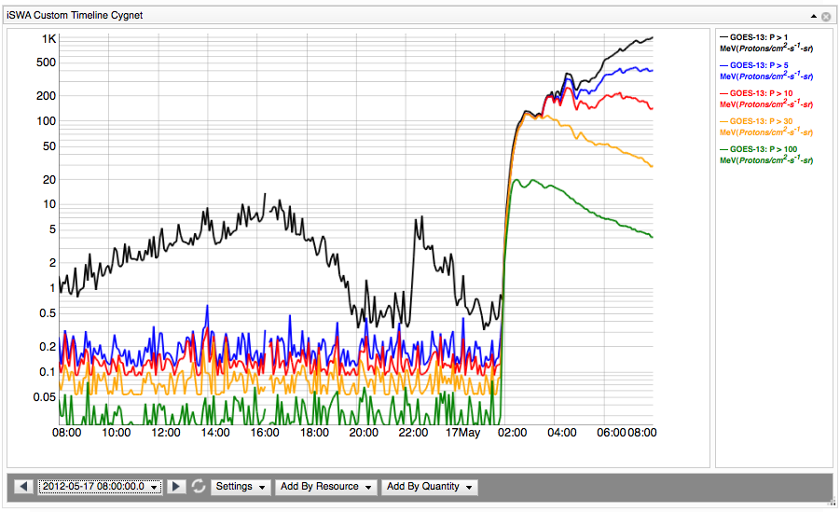
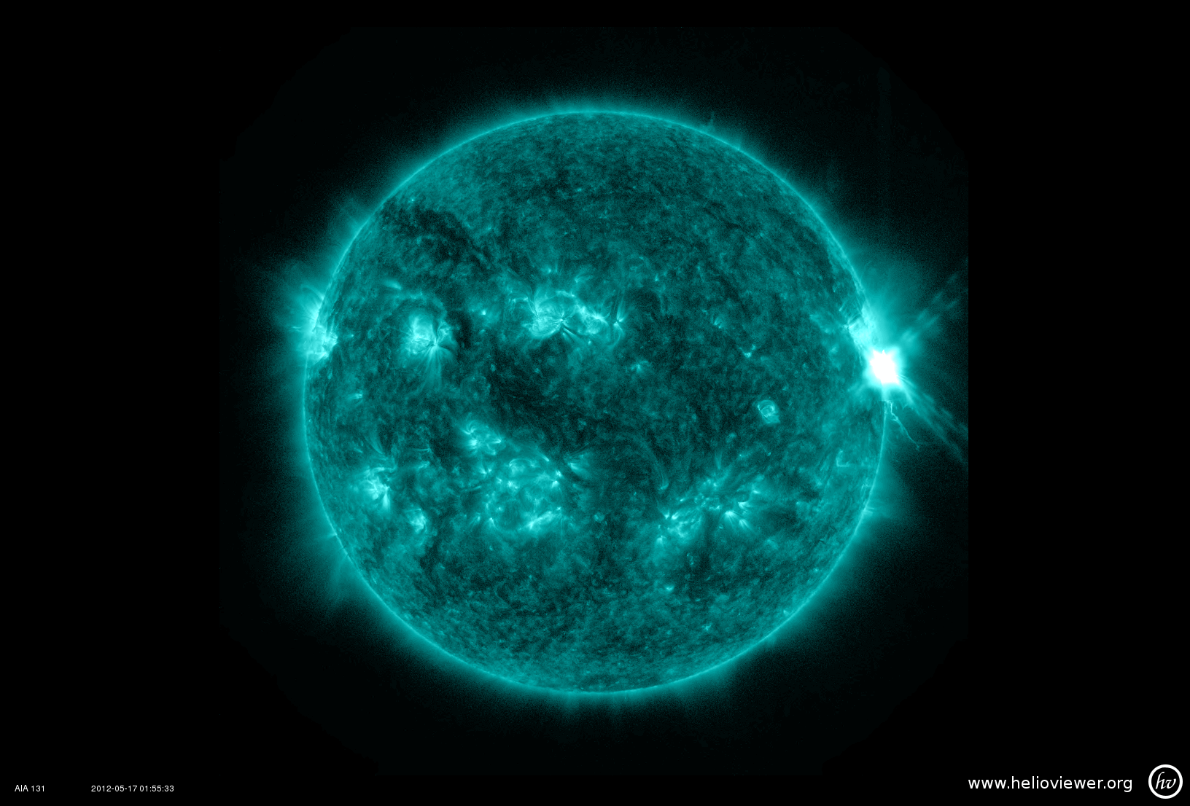
For Earth – Best Connection is 45-60 degree west
GOES-13
01:55 UT
Energetic proton fluxes
elevated for >12 hours
SDO AIA 131 Å
Notes:
Not only were the >10 Mev channel elevated well above our threshold, but the >50 and >100 channels as well, which tell us that this event was very efficient at accelerating the highest energy particles.

Slide 32
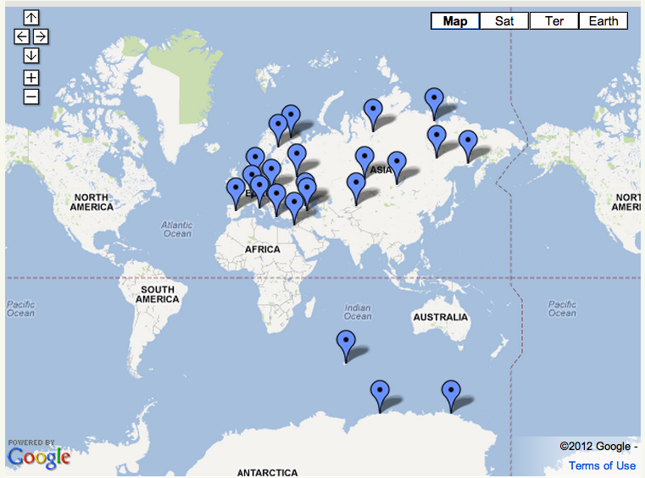
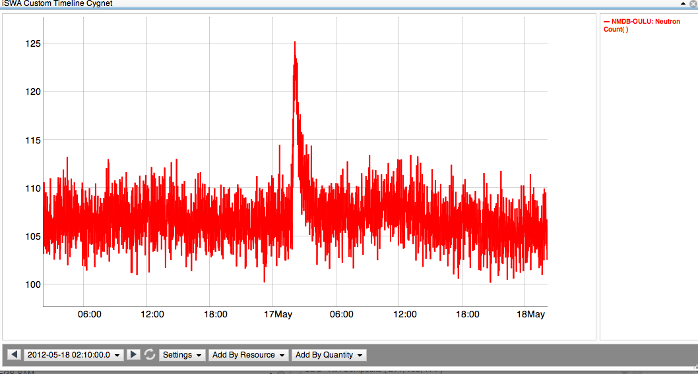
Ground Level Enhancement
A subset of SEP events, a GLE event occurs when extremely high energy protons (>500 MeV/nuc) penetrate the Earth’s atmosphere. Collisions with atoms generate secondary particles that are measured at neutron monitoring (NM) stations on the ground.
Neutron Monitoring Station in Oulu, Finland
Enhancement to ~125
NM Stations (http://www.nmdb.eu)
Background ~105
Notes:
The most extreme events…
This suspicious was confirmed by the detection of neutron enhancement at 4 stations. Those neutrons are reaction particles from relativistic protons
Add arrows to mark stations that observed May 17 GLE – what WAS THE TIME????
Save discussion of GLE events in SC 23 and characteristics of GLEs until 2nd half of talk. First half should only be observations!

Slide 33
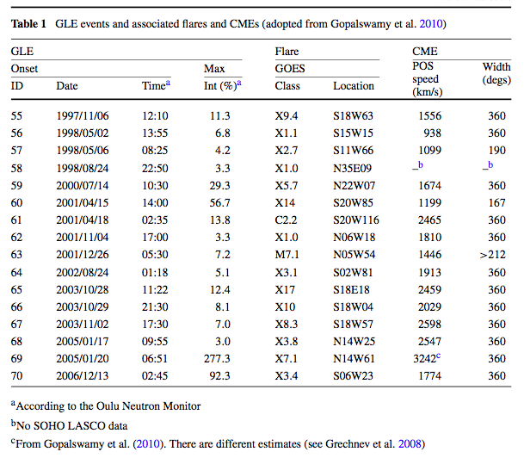
What causes strongest SEP events?
Or, how do the drivers relate to the SEP Flux?
Difficult to distinguish GLE from traditional SEP events:
Complexity of Active Region (AR)
  Most young, more compact
Magnetic connectivity of AR
  About ~50% are well connected
Magnitude of flare
  Average X3.8, but as low as M7.1
  Long duration
Magnitude of CME
  Range of speeds (~2,000 km/s average, but four events <1,500 km/s)
Seed particles
  Known to have harder spectrum
Sol
Nitta et al. 2012
Gopalswamy et al. 2012, Li et al. 2012, Mewaldt et al. 2012
CME-driven shocks are thought to play important role in low (<3R_{s}) corona
- Only imaged in mid-high corona (Ontiveros & Vourlidas 2009)
- Type II radio bursts
- Multiple CME events – doesn’t apply for May 17 event
Notes:
Like I said, these events prompt more questions and more questions, so we want to look at all of the extreme events (GLE) and see if any characteristics of the solar part of the storm can tell us about what is happening. And the answer is that while there are trends, it’s not true that strong flare cause GLEs, as you saw only M5 cause the May event, it’s not the fastest and biggest CMEs.
Again I want to emphasize that these are all just speculations because most of the interesting stuff is happening in a region that is not well covered by coronagraphs.
End with: And so we are motivated to model the acceleration of particles by CME driven shocks in the low corona…
Comparing to previous AR1476 flares: Longer duration, but similar magnitude
March 7th event: flare and CME weaker, SEPs at Earth 20x weaker
Solar Cycle 23 GLE events: no CME in previous 24 hours (to generate seed particles)
What was special about this flare and CME to generate a GLE?
Timing: CME erupted during rise time of flare
Connectivity: AR well connected to Earth
CME speed 1,500 km/s sufficient to drive shock in low corona (Evans et al. 2008)
Must have been very wide CME (to impact STEREO A and Earth)
As is common, they were not geoeffective (Kp max =4)
Possible Type II radio burst indicates CME driven shock

Slide 34
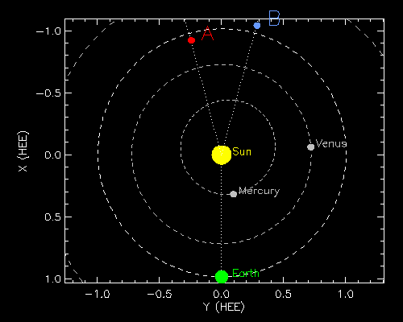
Where are NASA assets now?
Jan 18, 2016
Notes:
Explain the figure set up.

Slide 35
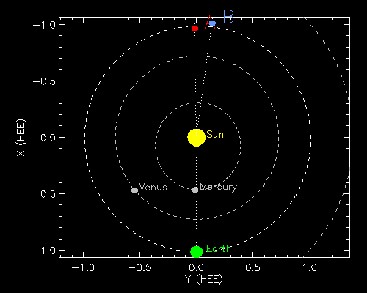
Where are NASA assets now?
May 29, 2015
Notes:
Explain the figure set up.

Slide 36
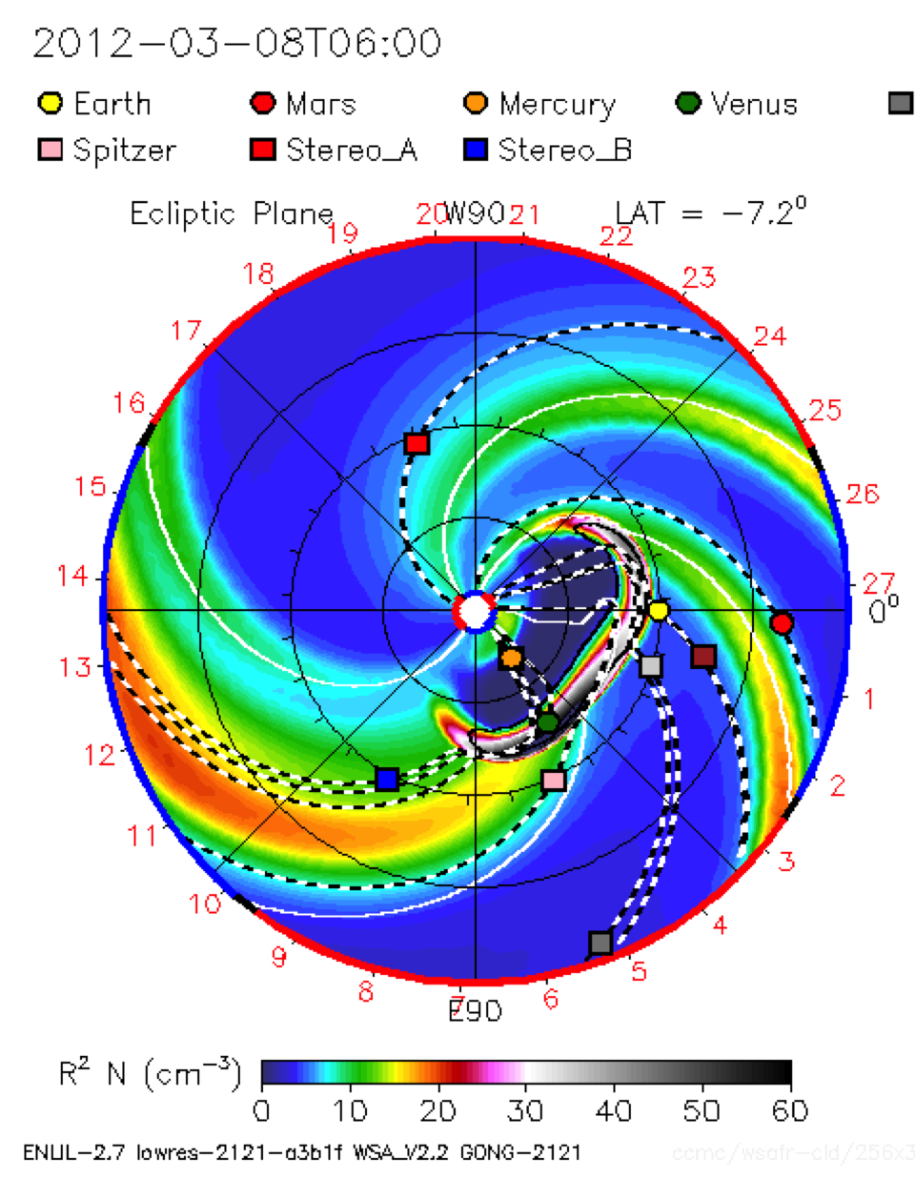
Orientation
West 90
Earth
East 90
Notes:
Simulation result of the March 7 2012 CMEs

Slide 37
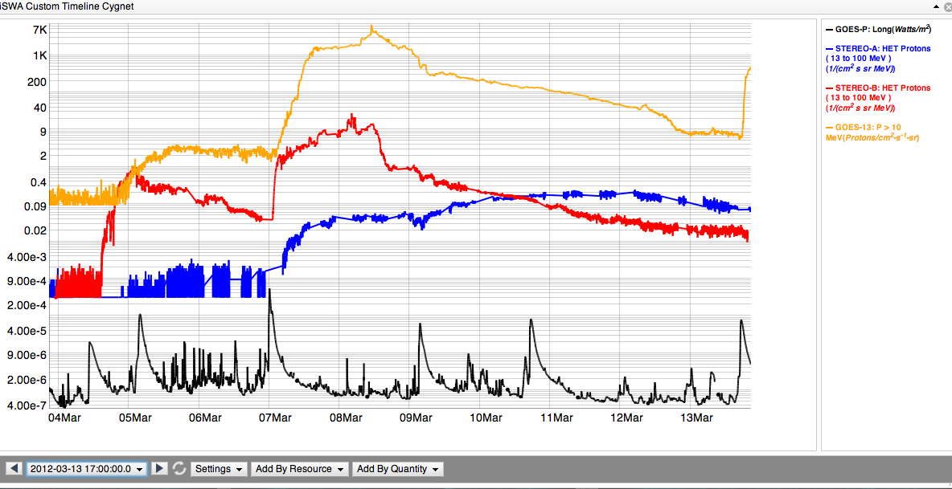
SEP: proton radiation
Both the CME(s) and flare(s) contribute to the SEP enhancement
GOES >10 MeV
13-100 MeV STEREO B
13-100 MeV STEREO A
X5.4/2200 km/s
X1.3/1800 km/s
M7.9
VCME=2100 km/s
X1.1
VCME=1360 km/s
M8.4
VCME=1500 km/s
M2.0
VCME=1540 km/s
M6.3/CME=1125 km/s
GOES x-ray
Notes:
Timeline of the event and SEP enhancement at multiple spacecraft for the 7 March 2012 event

Slide 38
SEP Layout
http://bit.ly/alert_SEP_layout
Get rid of ‘:8080’ after ‘iswa.gsfc.nasa.gov’
http://bit.ly/SEP_layout_20150316event
Notes:
10/29/2015 SEP event
http://go.nasa.gov/1n8uRtV
http://bit.ly/SEP_layout_20151029event
The 03/16/2015 SEP event
http://go.nasa.gov/1JWW5OH
http://bit.ly/SEP_layout_20150316event
iswa summary
http://go.nasa.gov/1ZLdGAl
http://bit.ly/summary_new
CME monitoring
http://go.nasa.gov/1KpSljx
http://bit.ly/CME_monitoring
Local network
http://10.0.1.5:8080/IswaSystemWebApp/index.jsp?i_1=205&l_1=1056&t_1=1586&w_1=500&h_1=475&s_1=2015-03-14%2022:36:00.0_0_10_3&i_2=14&l_2=538&t_2=1585&w_2=500&h_2=475&s_2=2015-03-15%2002:36:00.0_0_10_3&i_3=233&l_3=382&t_3=1052&w_3=504&h_3=504&s_3=2015-03-15%2002:21:07.0_0_10_3&i_4=241&l_4=908&t_4=1051&w_4=500&h_4=485&s_4=2015-03-15%2002:23:46.0_0_10_3&i_5=388&l_5=340&t_5=310&w_5=894&h_5=433&s_5=2015-03-17%2018:29:00.0!3!1!GOES-P.Long_Wave!GOES-13.P10!GOES-13.P100!STEREO-A.SFHETProtons!STEREO-B.SFHETProtons!ACE.IntegralProtonFlux_10!&i_6=399&l_6=542&t_6=2071&w_6=696&h_6=464&s_6=2015-03-15%2006:46:00.0_12&i_7=30&l_7=322&t_7=746&w_7=559&h_7=286&s_7=2015-03-16%2018:25:24.0_0_10_3&i_8=31&l_8=886&t_8=749&w_8=520&h_8=297&s_8=2015-03-16%2018:26:27.0_0_10_3&i_9=17&l_9=27&t_9=1577&w_9=500&h_9=500&s_9=2015-03-13%2015:20:00.0_0_10_3&i_10=15&l_10=25&t_10=2064&w_10=500&h_10=475&s_10=2015-03-15%2004:54:00.0_0_10_3
http://bit.ly/20150316_SEPevent_localnetwork
HSS
http://bit.ly/HSS_20150607_extended

Slide 39
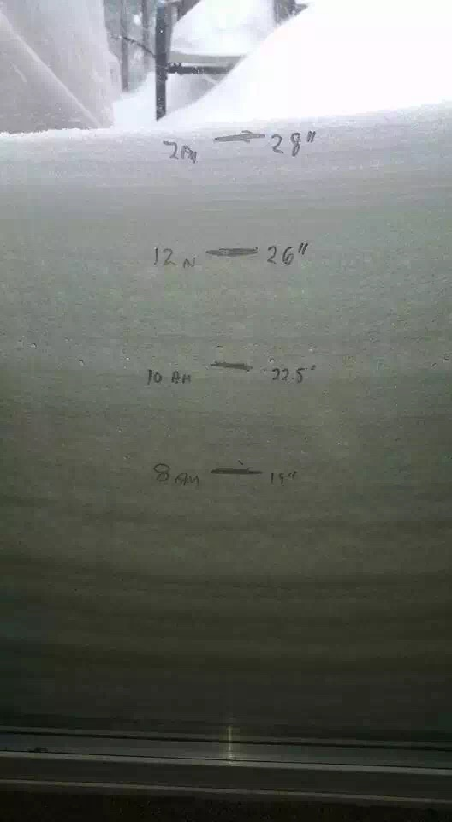
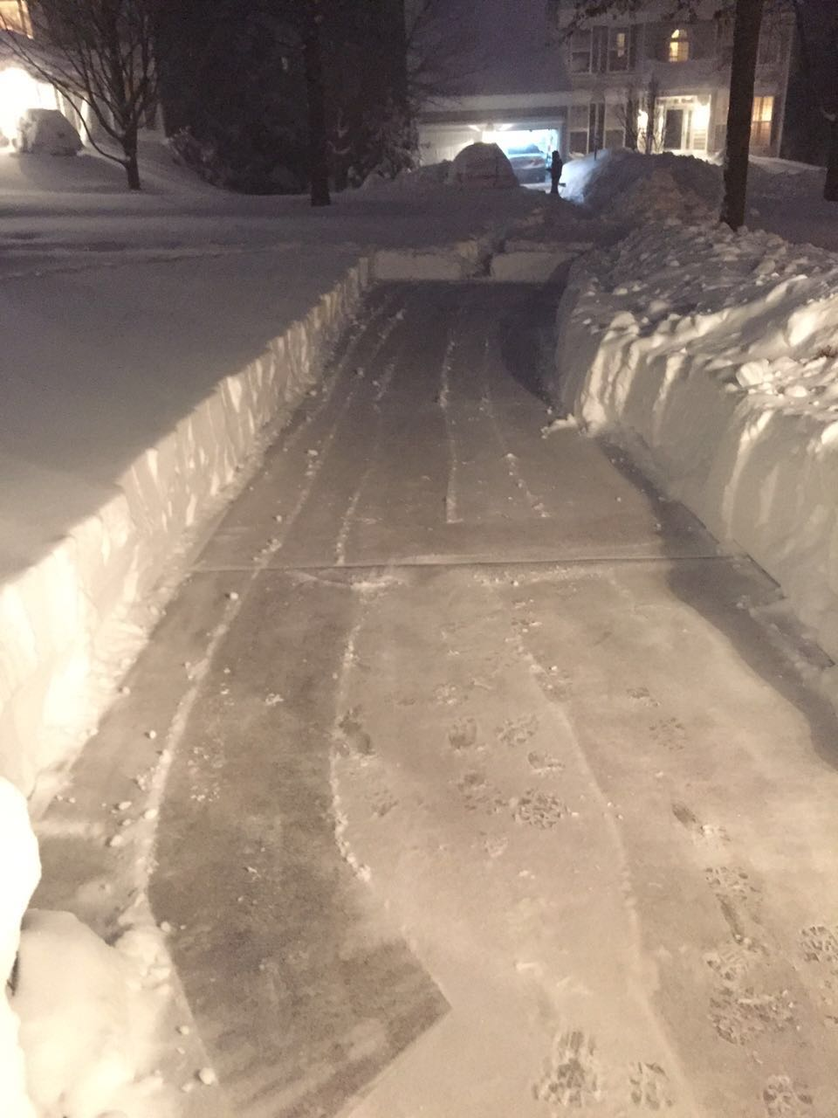
Blizzard

