Slide 1



Community Coordinated Modeling Center (CCMC)
Introduction to Space Weather:
Tools and Concepts
Space Weather Tools/Products
Yihua Zheng & the CCMC team
Science for Space Weather, Jan 24 – 29, 2016, Goa, India

Slide 2
Outline
Tools available at CCMC
  Stereo CAT
  Coned tool
  Space Weather scoreboard
    CME scoreboard
    Flare scoreboard
    SEP scoreboard
  DONKI
  SEA^5
Others
  ISES (International Space Environment Services)
    NOAA/SWPC
    Belgium/SIDC
    Japan/NICT
    Australia/BoM
    …
  ESA/SPENVIS
  Other space weather prediction/operation centers

Slide 3

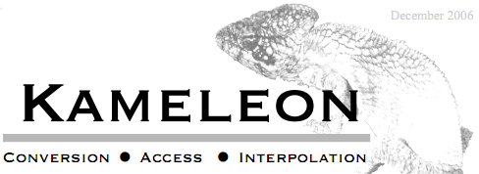
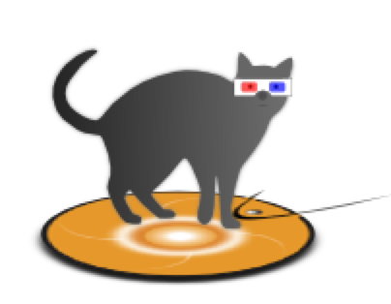
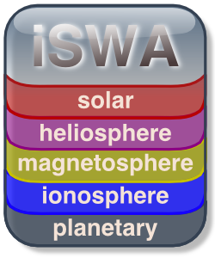
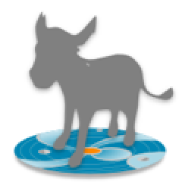
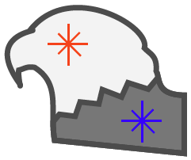
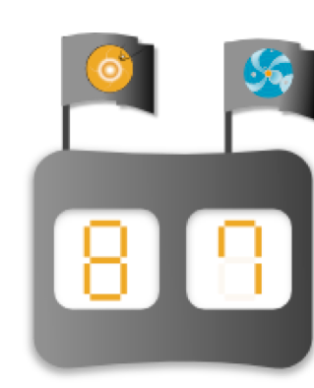

Multipurpose Tools, Systems, Databases, Interfaces
Data Management, Metadata, Standardization, Access
Flexible Data Ingestion Tool
Science Data Formats, Metadata
Data Conversion
Access & Interpolation Library
Reusable Data Model/Framework
Designed to facilitate ingestion of disparate time series data from a variety of sources into CCMC’s existing infrastructure
Describe input data via XML for efficient dataset imports
Generalized parser works with a variety of formats
Integrated Space Weather Analysis System
StereoCAT CME Analysis Tool
Web-Based Space Weather Dissemination System
User Configurable, Interactive Products
Web Services
Real-Time & Historical Model + Observational Data
Determine CME kinematic parameters
Create CME height-time measurements
Create an ensemble of CME measurements
Save and share measurement sessions
Database Of Notifications, Knowledge, Information
EEGGL Eruption Event Generator (Gibson & Low )
Catalog of space weather phenomena
Knowledgebase of interpretations, simulation results, and forecasting analysis
Online tool for dissemination of forecasts, notifications, & archiving event-focused information
Use observations defining the CME source region (location and flux rope orientation,
Generate Gibson-Low flux rope parameters for the flux rope emergence models.
Space Weather Scoreboard
Space Environment Automated Alerts, Anomaly Analysis Assistant ( SEA⁵ )
Research-based forecasting methods validation
Scientific community submits forecasts in real-time
View and Compare all forecasting methods
Mission/Location Specific Space Environment Tool
Automated/Custom Alerts & Notifications
Assimilate & Display Anomaly Information

Slide 4
STEREO CAT

Slide 5
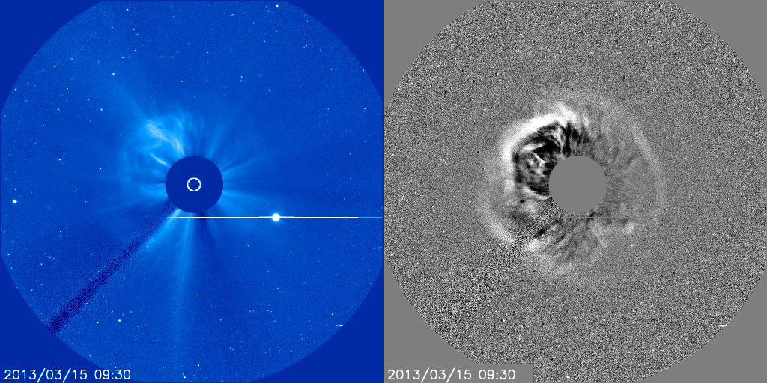
Halo CMEs are CMEs that appear to surround the occulting disk of the coronagraph. The CME can originate from the front or back side of the Sun, and therefore are travelling either towards or away from the observer.
Due to scattering and projection, the CME sides or flanks are detected in these images
Notes:
Halo CMEs are CMEs that appear to surround the occulting disk of the coronagraph. The CME can originate from the front or back side of the Sun, and therefore are travelling either towards or away from the observer.
Here is an example of a halo CME in SOHO LASCO C3, direct image on the left, difference image on the right. The difference image was created by subtracted the previous frame from the current frame. Some differences are subtracted from a “base” frame a few hours prior to the event.
Due to scattering and projection, the CME sides or flanks are detected in these images, not the leading edge (nose) of the CME.

Slide 6
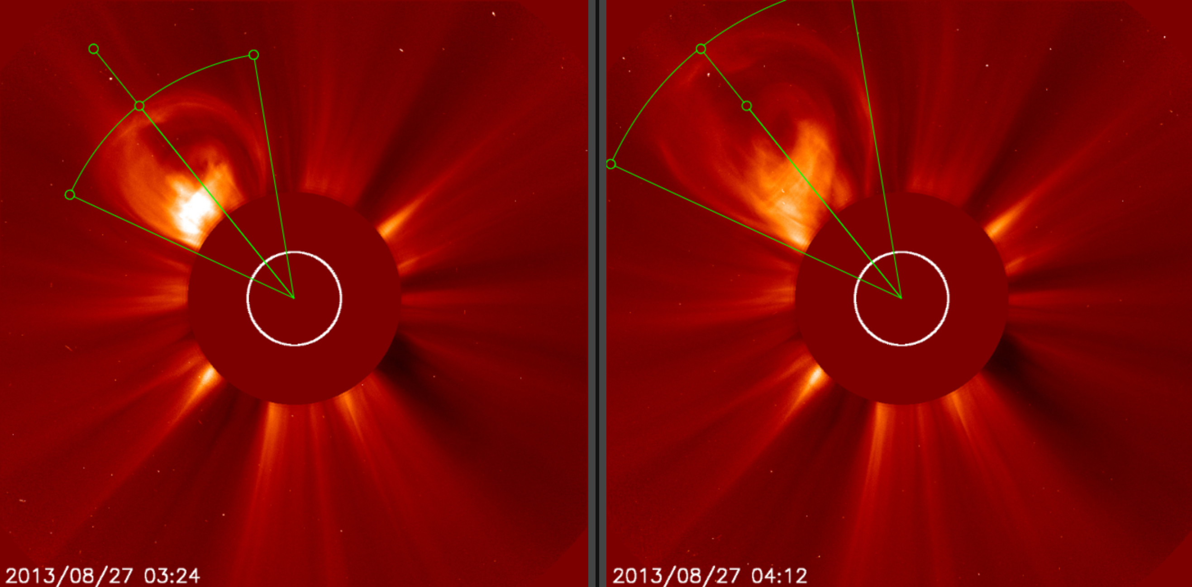
With coronagraph data you can measure the leading of the CME at different times. From this you can determine the “plane-of-sky” speed by measuring the position of the leading edge of the CME at two times. By using coronagraphs on various spacecraft, you can get a measurements of this projected speed from various viewpoints.
north
east
west
south
Notes:
With coronagraph data you can measure the leading of the CME at different times. From this you can determine the “plane-of-sky” speed by measuring the position of the leading edge of the CME at two times. By using coronagraphs on various spacecraft, you can get a measurements of this projected speed from various angles.
Here are coronagraph images from STEREO Ahead COR2, at two different times. You can the leading edge has been marked in each image. By knowing the height of the CME leading edge at two times, the speed in the plane of the image can be determined.

Slide 7
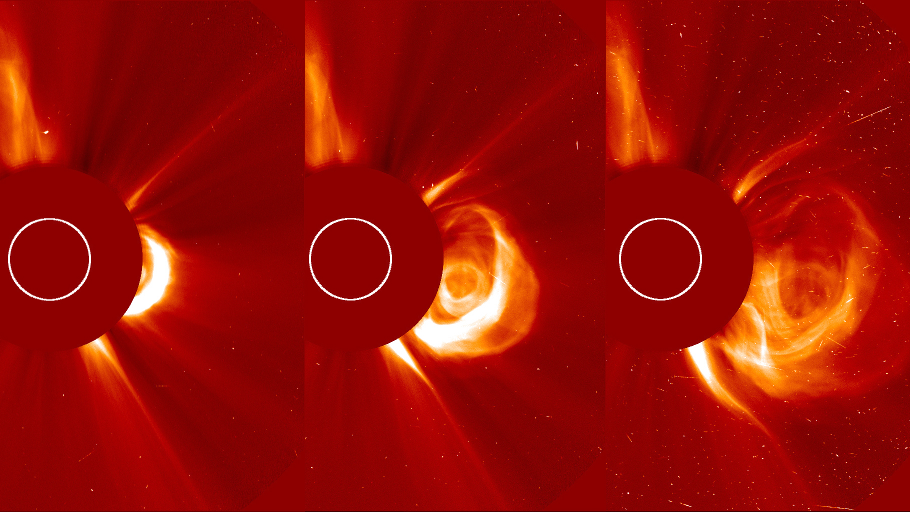
Time progression -> plane-of-sky speed

Slide 8
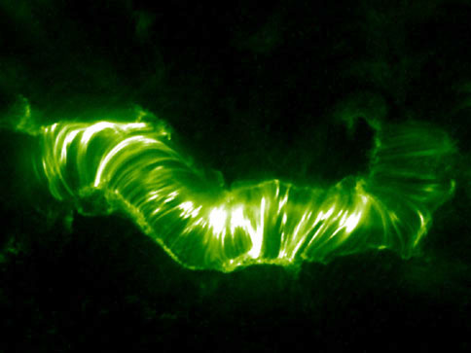
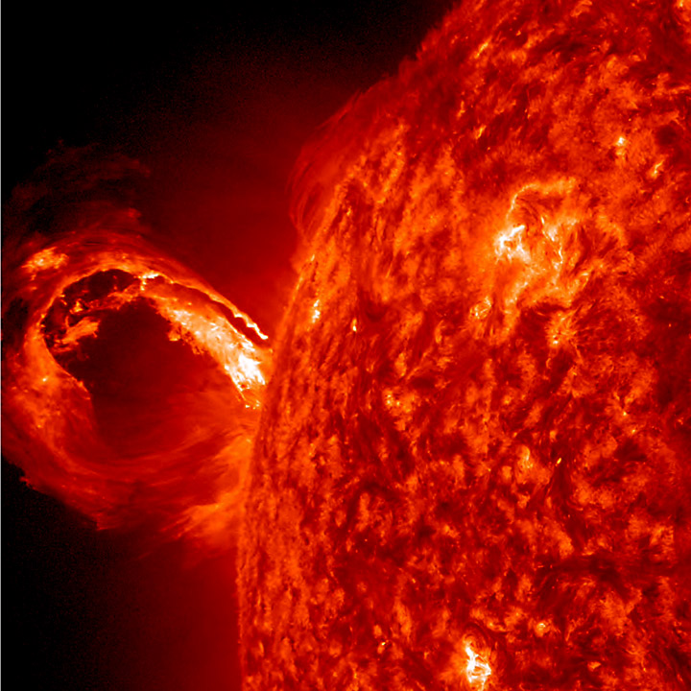
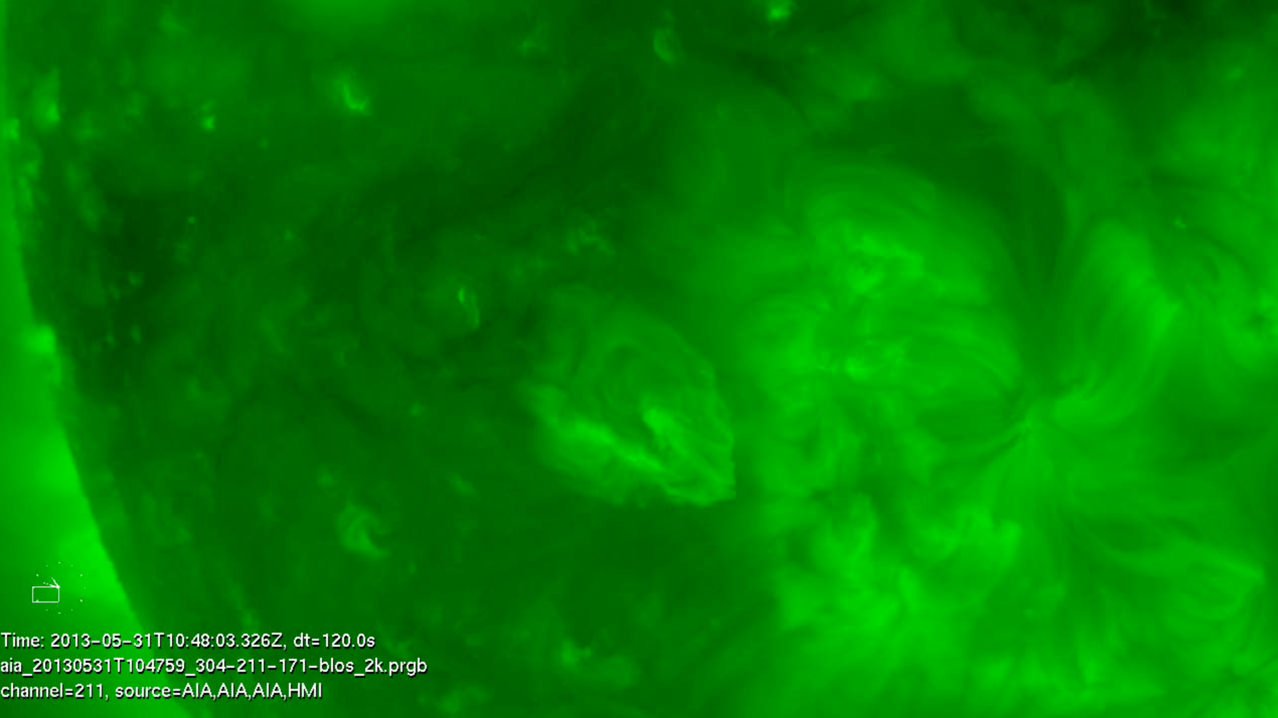
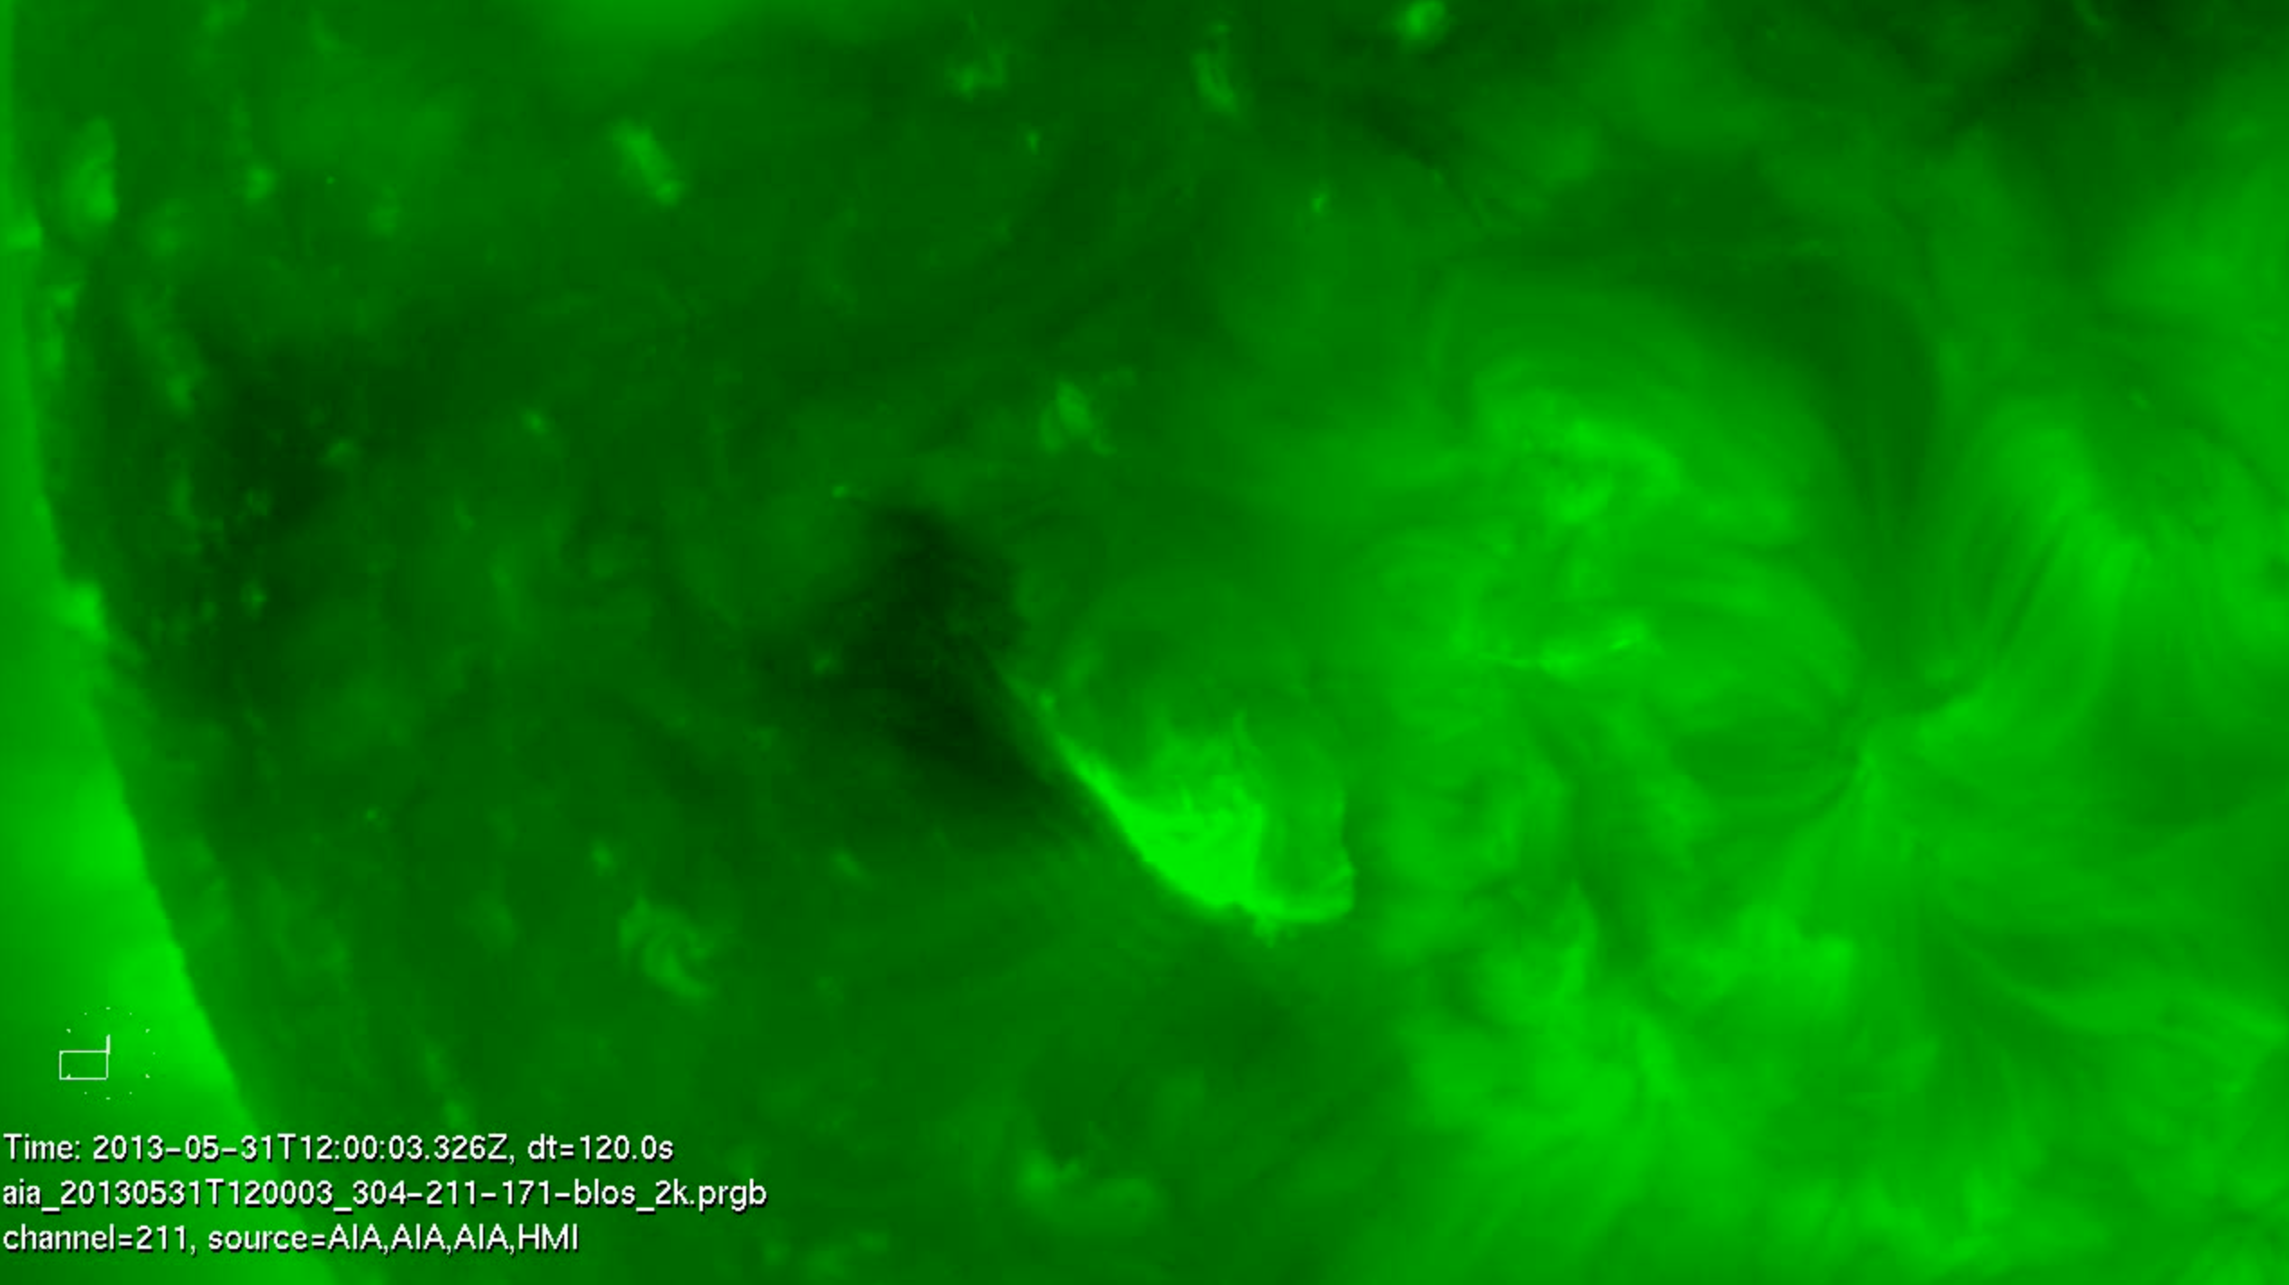
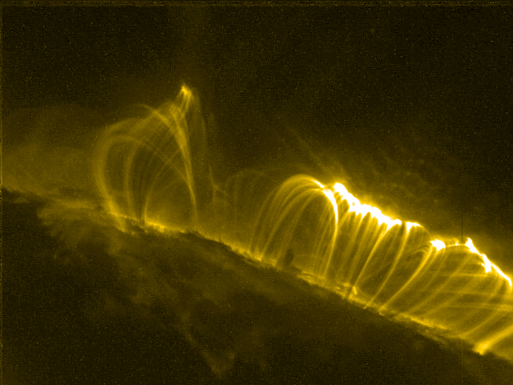
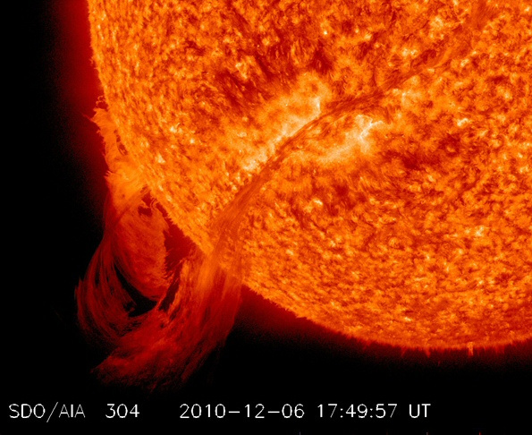
CME source locations/EUV lower coronal signatures of CMEs
* CMEs can originate from active regions and/or from filament eruptions.
* Some CMEs are associated with flares.
* EUV signatures include post eruption arcades, rising loops, coronal dimming, and prominence eruptions (click for example movies).
Important! Always determine the source location of every CME you analyze.
This can help you decide which coronagraph combinations to choose, and assess the accuracy of the CME parameters you obtain.
Sun Primer: Why NASA Scientists Observe the Sun in Different Wavelengths
post eruption arcade
prominence eruption
coronal dimmings.
filament eruption
More on this topic next Thursday!
Notes:
CME source locations/EUV lower coronal signatures of CMEs
* CMEs can originate from active regions and/or from filament eruptions.
* Some CMEs are associated with flares.
EUV signatures include post eruption arcades, rising loops, coronal dimming, and prominence eruptions (click for example movies).
Important! Always determine the source location of every CME you analyze.
This can help you decide which coronagraph combinations to choose, and assess the accuracy of the CME parameters you obtain.
Sun Primer: Why NASA Scientists Observe the Sun in Different Wavelengths
EUV lower coronal signatures of CMEs movies
post eruption arcadehttp://cdaw.gsfc.nasa.gov/movie/make_javamovie.php?img1=sta_e195&img2=sta_cor2&stime=20130526_1500&etime=20130527_0000
prominence eruptions http://go.nasa.gov/19Dni3v
http://cdaw.gsfc.nasa.gov/movie/make_javamovie.php?img1=lasc2rdf&img2=sdo_a304&stime=20130430_2200&etime=20130501_0800
filament eruptions http://go.nasa.gov/12qcWDO
http://www.lmsal.com/hek/gallery/podimages/2013/06/01/pod_malanushenko_anna_2013-06-01T02:24:03.851/anny_AIA-304_20130531T113203-20130531T185203_120s_made_20130601T022253_720p.mpg
coronal dimmingshttp://www.lmsal.com/hek/gallery/podimages/2013/06/01/pod_malanushenko_anna_2013-06-01T00:52:07.870/anny_AIA-211_20130531T094003-20130531T145203_120s_made_20130601T005102_720p.mpg
http://cdaw.gsfc.nasa.gov/movie/make_javamovie.php?img1=stb_cor2&img2=stb_e195&stime=20120527_0300&etime=20120527_1600

Slide 9
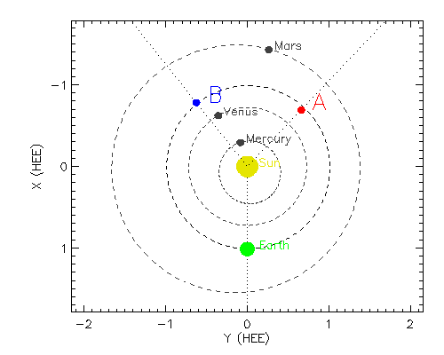
Know where the coronagraph images are made/location of the spacecraft
http://stereo-ssc.nascom.nasa.gov/where.shtml
Click “STEREO Orbit Tool”
May 14, 2013
Longitude is measured
0 to 180˚ counterclockwise
0 to -180˚ clockwise
HEEQ:
Heliocentric Earth Equatorial
Z=North pole of solar rotation axis
X=intersection between solar equator and solar central meridian as seen from Earth
Notes:
Use there STEREO website orbit tool (http://stereo-ssc.nascom.nasa.gov/where.shtml) to find the HEEQ coordinates of the STEREO spacecraft and see a graph. This will help you determine which quadrants the CME longitude could be in just by looking at the geometry.
HEEQ coordinates is defined as:
X=intersection between solar equator and solar central meridian as seen from Earth
Z= North Pole of the solar rotation axis.
Earth is at 0 degrees longtiude in this coordinate system. Longitude is measure from 0 to 180 degrees counterclockwise and 0 to -180 degrees clockwise.
For example, on this date (14 May 2013) STEREO A is at 136 degrees longitude. A CME seen going to the right (west) in a SOHO LASCO image which is seen going to the left (east) in a STEREO COR2A image, must have a longitude between these two spacecraft, so between 0 and 136 longitude. If this CME is also observed by STEREO COR2B as moving to the left (east), this further constrains the longitude to be the eastern side of STEREO B’s view. STEREO B is at -141 degrees longitude on this date, so the eastern quadrant is between 39 degrees and -141 degrees. So putting this all together, the CME longitude must be between 39 and 136 degrees longitude.
Example 2: (On this date) if you view a full symmetric halo in SOHO LASCO and the source location is on the backside of the Sun, the longitude is likely near 180 degrees. If you view a full symmetric halo in STEREO A, but the source is on the front side of the sun (visible in SDO), the the longitude is likely near the opposite of STEREO A (located at 136 deg), so about -44 degrees.

Slide 10
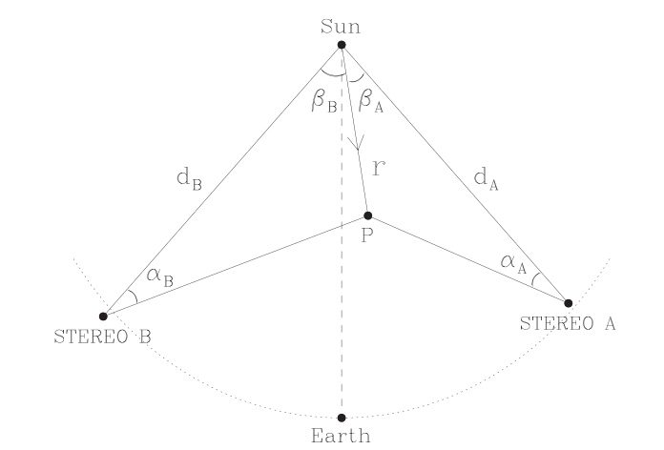
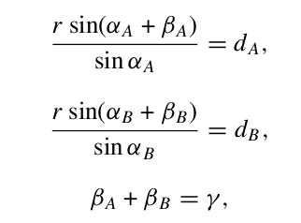
Geometric Triangulation
Measuring the same feature (assumption) in two coronagraphs and using simple geometric relations to derive CME position and speed
Observations are integrated line-of sight information through a 3D structure – projection effects, and scattering amplitudes impact the feature being measured!
Note: StereoCAT does not use the edge locations (width) when triangulating the feature.
Notes:
Very important! The main assumption of geometric triangulation is that you are measuring the same feature (assumption) in two coronagraphs and using simple geometric relations to derive CME position and speed. But remember observations are integrated line-of sight information through a 3D structure – projection effects, and scattering amplitudes impact the feature being measured!

Slide 11
CME analysis Procedure with StereoCAT
* Identify the CME and the start time. (The CME start time is the time it is first observed by any of the four coronagraphs)
* Observe all available coronagraph images in motion. Look for the same CME leading edge feature in various spacecraft.
* Look at EUV images in motion near the CME start time and identify the source location and any lower coronal signatures (post eruption arcade, dimming, rising loops, filament eruption).
Go to StereoCAT: http://ccmc.gsfc.nasa.gov/analysis/stereo/
* Select two overlapping times for each spacecraft pair available. Times should be around 45-75 minutes apart, and try to choose times just before the CME leading edge has left the field of view. It is useful to refer back to the CME movies while selecting images.
* Perform plane of sky measurements CME leading edge and obtain triangulation results if appropriate. Determine final CME parameters (radial speed, half width, longitude, latitude, and time at 21.5 Rs (solar radii)).
Resources & iSWA layouts
* StereoCAT: http://ccmc.gsfc.nasa.gov/analysis/stereo/
* 40 Frame coronagraph and EUV movies http://go.nasa.gov/16bTvzK
* Where is STEREO? http://stereo-ssc.nascom.nasa.gov/where.shtml
and http://stereo-ssc.nascom.nasa.gov/cgi-bin/make_where_gif
* Solar Images with grid overlays http://www.solarmonitor.org/
Notes:
CME analysis Procedure
* Identify the CME and the start time. (The CME start time is the time it is first observed by any of the four coronagraphs)
* Observe all available coronagraph images in motion. Look for the same CME leading edge feature in various spacecraft.
* Look at EUV images in motion near the CME start time and identify the source location and any lower coronal signatures (post eruption arcade, dimming, rising loops, filament eruption).
Go to StereoCAT: http://ccmc.gsfc.nasa.gov/analysis/stereo/
* Select two overlapping times for each spacecraft pair available. Times should be around 45-75 minutes apart, and try to choose times just before the CME leading edge has left the field of view. It is useful to refer back to the CME movies while selecting images.
* Perform plane of sky measurements CME leading edge and obtain triangulation results if appropriate. Determine final CME parameters (radial speed, half width, longitude, latitude, and time at 21.5 Rs (solar radii)).

Slide 12
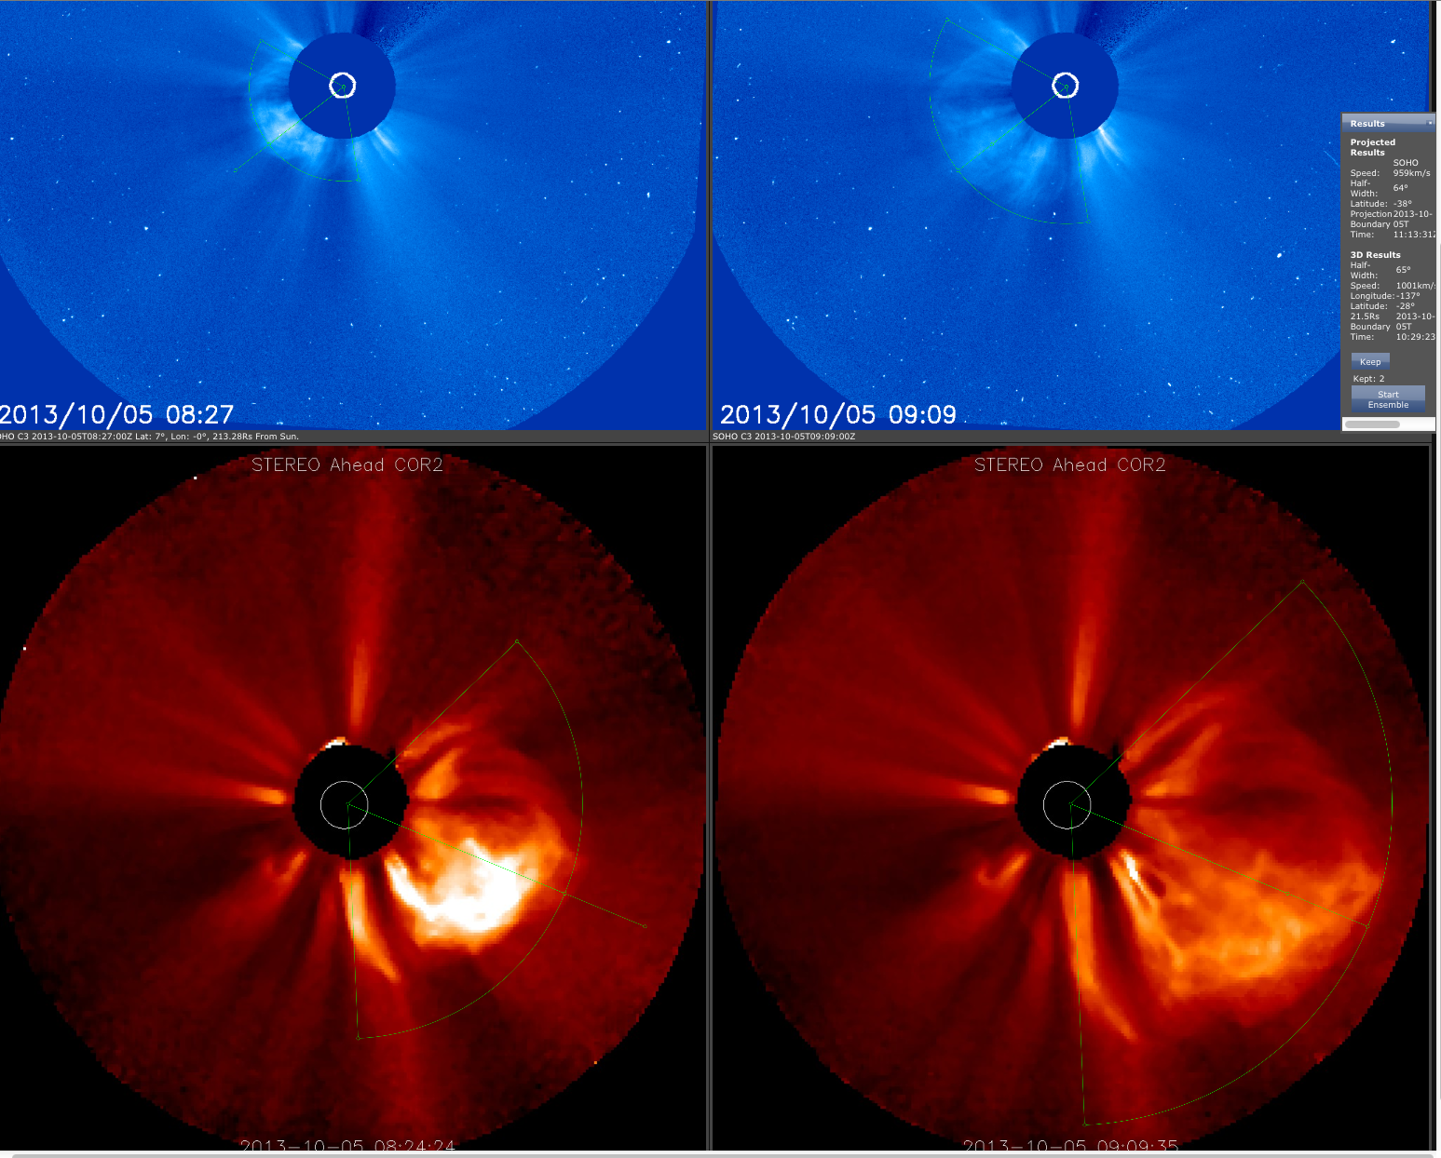
StereoCAT example
Notes:
Oct 5, 2013 CME
http://ccmc.gsfc.nasa.gov/analysis/stereo/?s=iswa.ccmc.gsfc.nasa.gov&v=3&c=_2__t_t_OJNbhwI_OJNpIZO_0_1rLi_0_2Vvq_0_1rLi_0_-M1a_0_-V86_0_-M1a__5_UY_WC_5rFM_3nb_5rFM_4s9_5rFM_2d6_UY_WC_8Urj_3nb_8Urj_4s9_8Urj_2d6_V0_V0_7WDA_5tI_7WDA_lR_7WDA_4kr_V0_V0_AIe7_5tI_AIe7_lR_AIe7_4kr_t____t_t_OJNbhwI_OJNpIZO_0_1rLi_0_2Vvq_0_1rLi_0_-M1a_0_-V86_0_-M1a__5_UY_WC_5kJH_3oP_5kJH_4uB_5kJH_2d6_UY_WC_8Sw1_3oP_8Sw1_4uB_8Sw1_2d6_V0_V0_78xa_61Q_78xa_h3_78xa_5Ac_V0_V0_AK9F_61Q_AK9F_h3_AK9F_5Ac_t___0_0_0_--__t_t_OJNbhwI_OJNpIZO_0_1rLi_0_2Vvq_0_1rLi_0_-M1a_0_-V86_0_-M1a__5_--___2__t_

Slide 13
CME Scoreboard

Slide 14
CME Arrival Time Scoreboard developed at the CCMC
The CME scoreboard is a research-based forecasting methods validation activity which provides a central location for the community to:
submit their forecast in real-time
quickly view all forecasts at once in real-time
compare forecasting methods when the event has arrived
http://swrc.gsfc.nasa.gov/main/cmemodels
http://kauai.ccmc.gsfc.nasa.gov/SWScoreBoard
Currently registered models include:
Anemomilos, ESA Model, H3DMHD (HAFv.3 +3DMHD), HAFv.3, STOA, WSA-Enlil + Cone Model, BHV Model, DBM, ECA Model, HelTomo, HI J-map technique, TH Model
The scoreboard also includes predictions from the SWRC (Space Weather Research Center) which is a CCMC branch carrying out in-house research-based space weather ops team

Slide 15
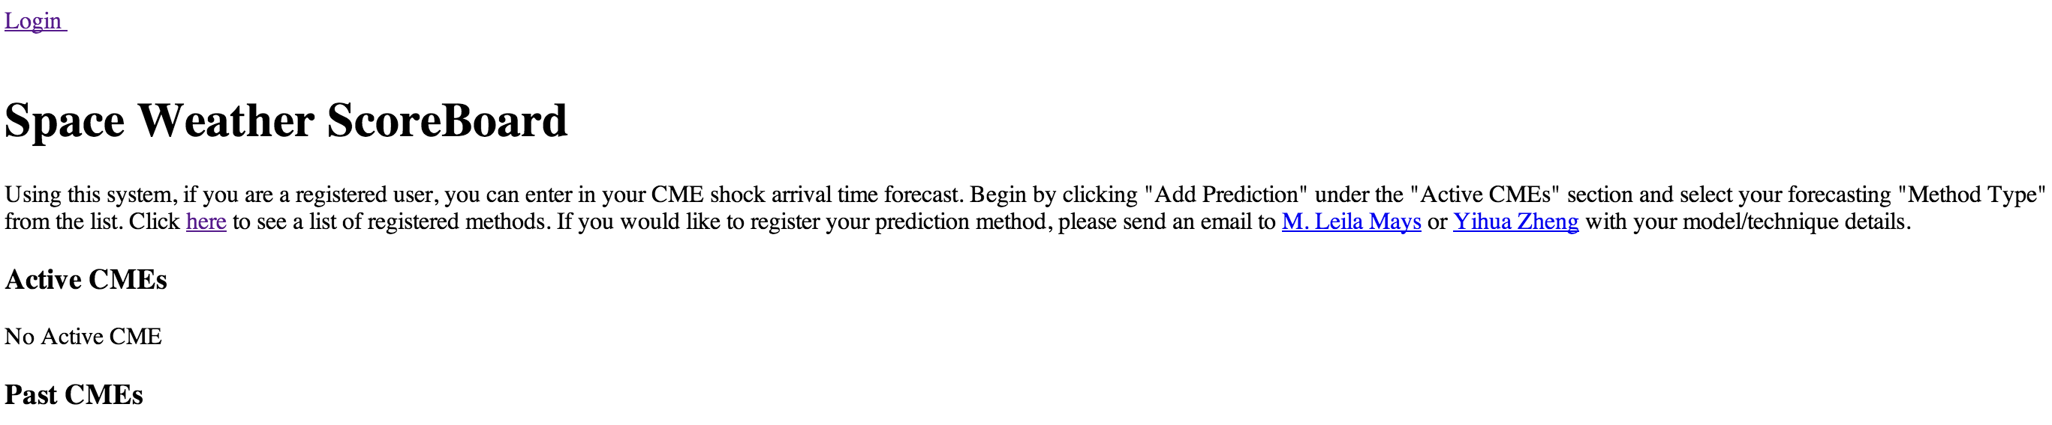
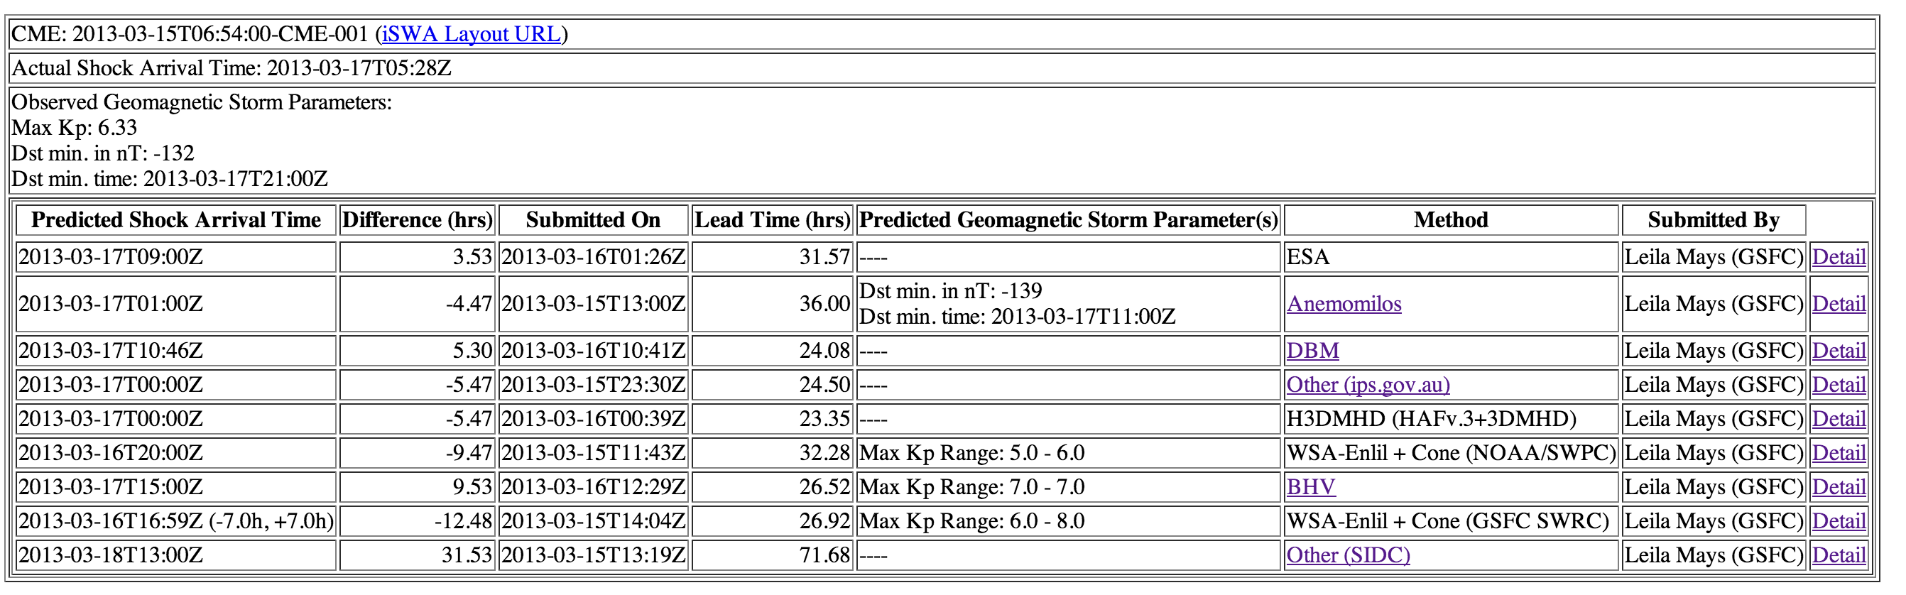
http://kauai.ccmc.gsfc.nasa.gov/SWScoreBoard
Anyone can view predictions, please register to submit predictions.
Columns are sortable

Slide 16
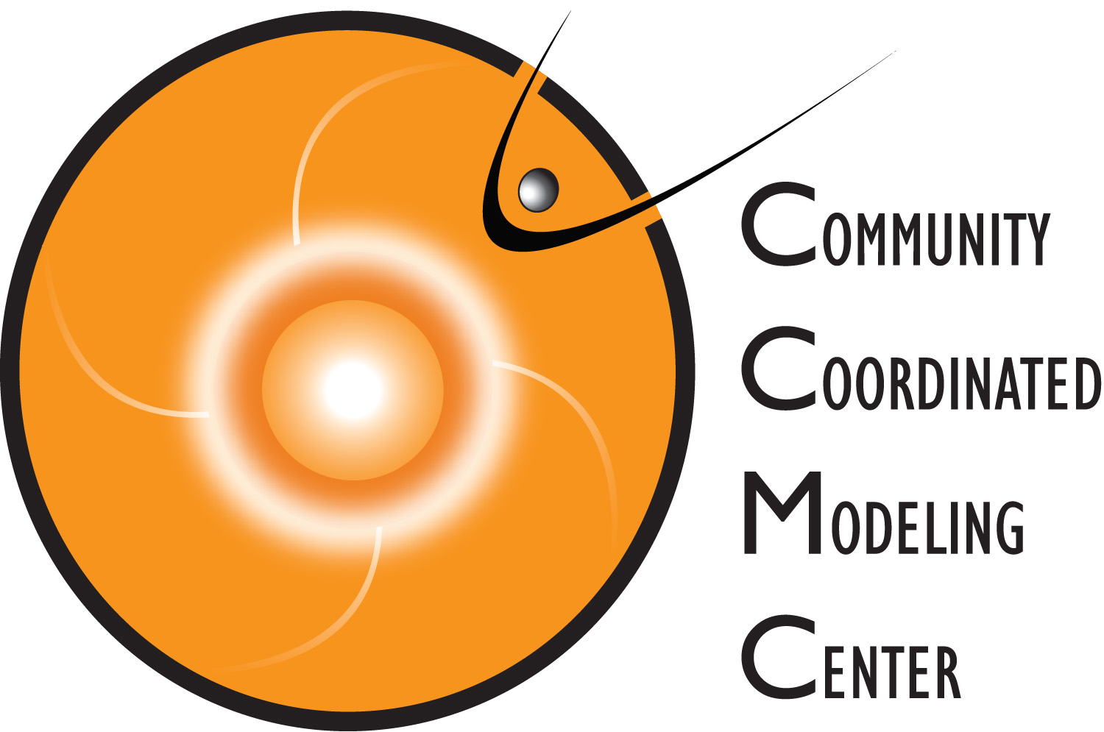
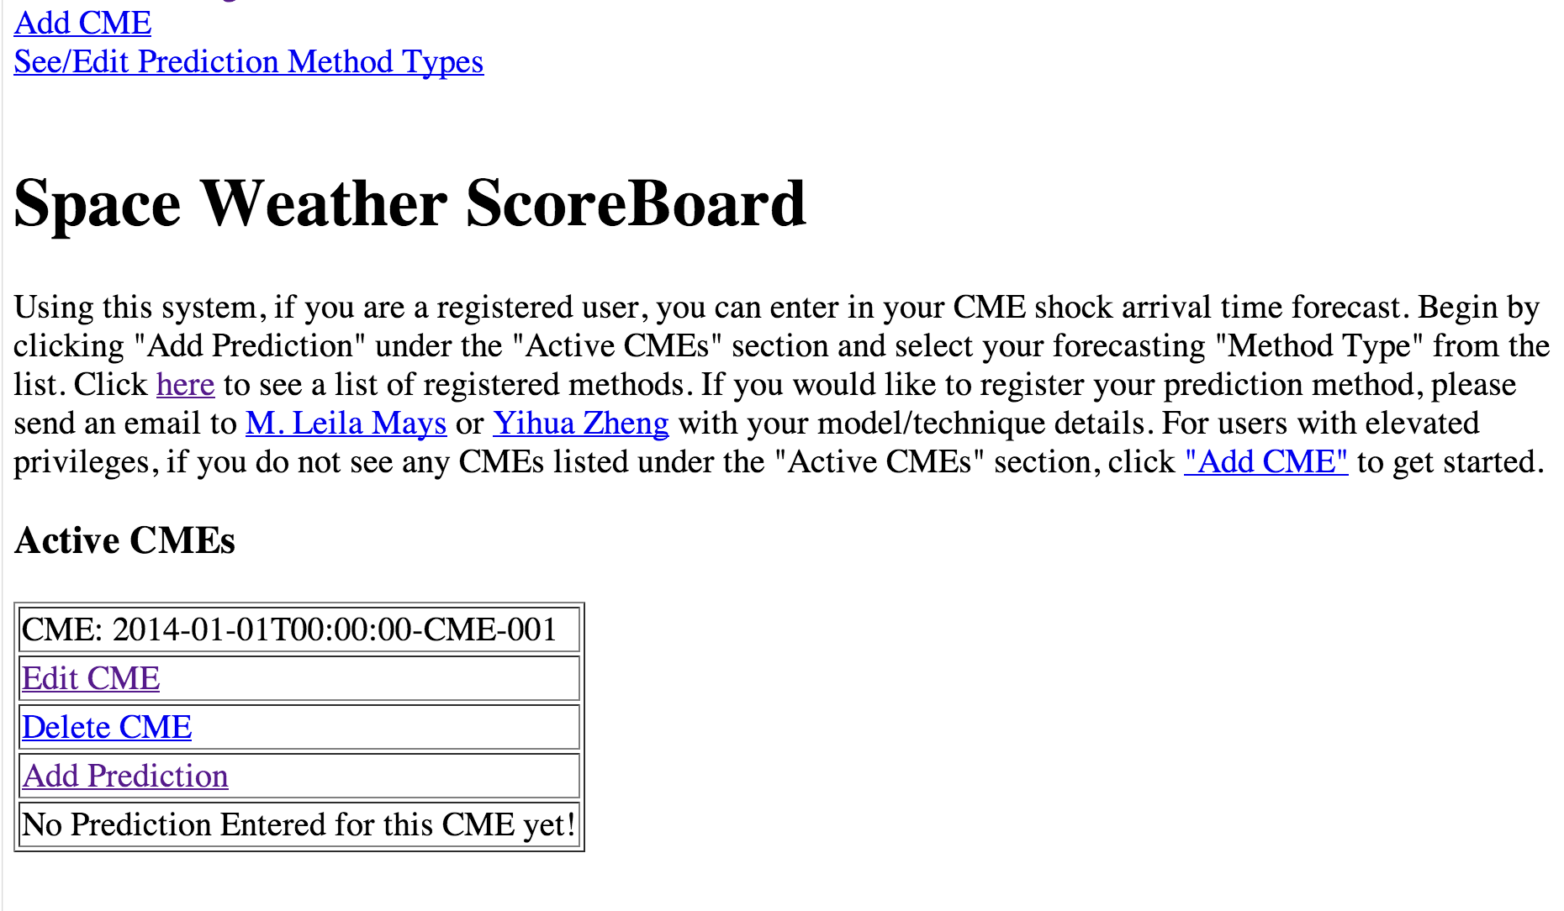
Begin by clicking Add Prediction under the "Active CMEs" section and select your forecasting "Method Type" from the list.
While logged in, if you do not see any CMEs listed under the "Active CMEs" section, click Add CME to get started.
http://kauai.ccmc.gsfc.nasa.gov/SWScoreBoard

Slide 17
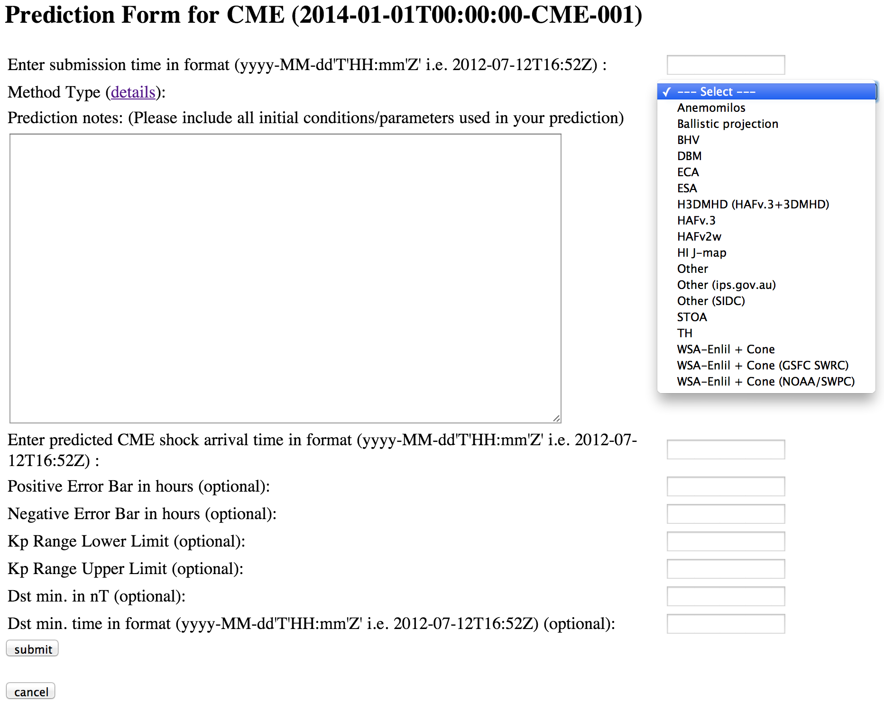
http://kauai.ccmc.gsfc.nasa.gov/SWScoreBoard

Slide 18
DONKI (Database of Notifications, Knowledge, Information) facilitate connecting space weather phenomena to satellite effects
Catalog of space weather phenomena.
Chronicles the daily interpretations of space weather observations, simulation results, forecasting analysis, and notifications.
Intelligent linkages, relationships, cause-and-effects between space weather activities (will add spacecraft anomaly/interesting spacecraft event info)
Comprehensive search functionality to support anomaly resolution and space science research:
  Space weather activity archive (flares, CME parameters and simulation results, SEPs, geomagnetic storms, radiation belt enhancements) with links between activities
  SWRC’s space weather notification and weekly report archive
…
http://kauai.ccmc.gsfc.nasa.gov/DONKI/

Slide 19
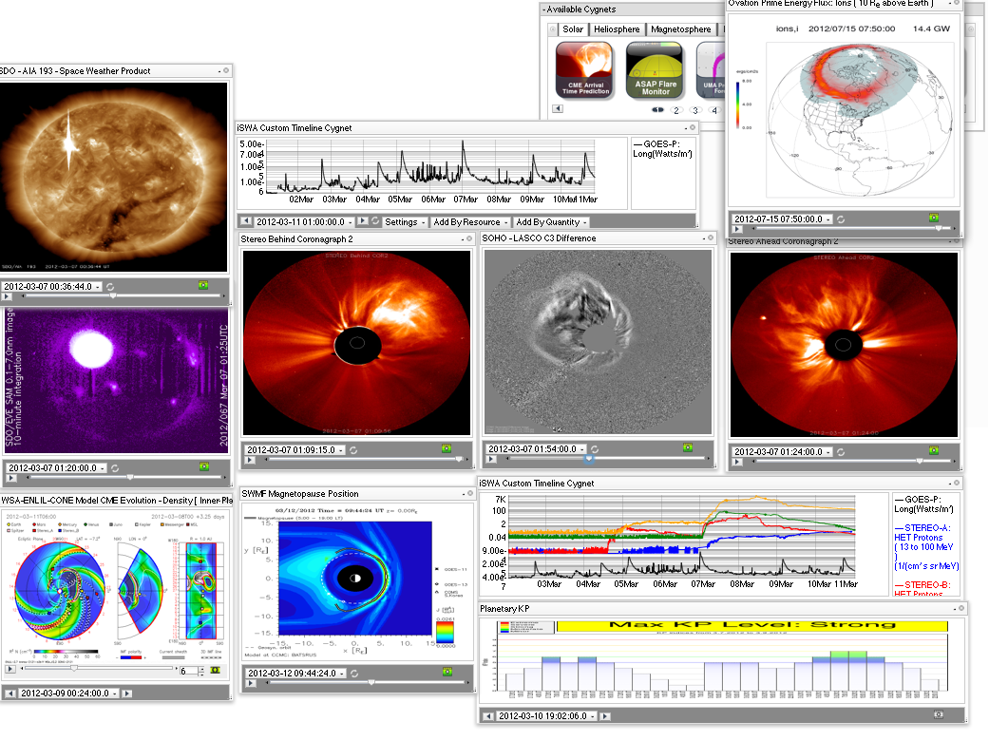
iSWA & Layouts

Slide 20
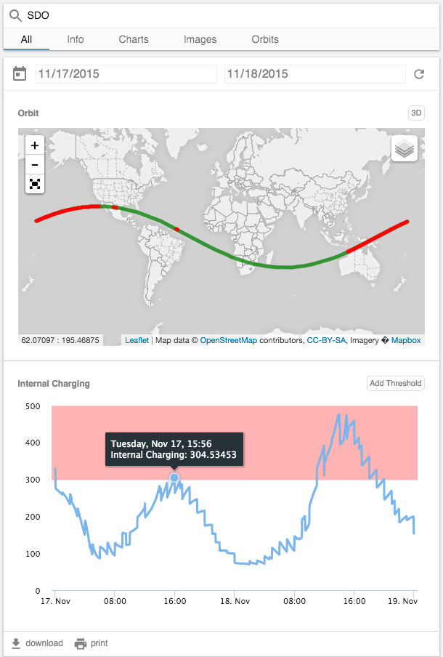
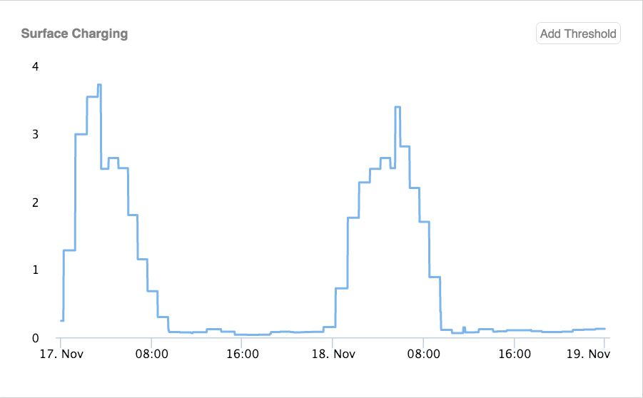
The Space Environment Automated Alerts Anomaly Analysis Assistant (SEA5)

Slide 21
Non CCMC Tools
From the international community
By no means an exhaustive list

Slide 22
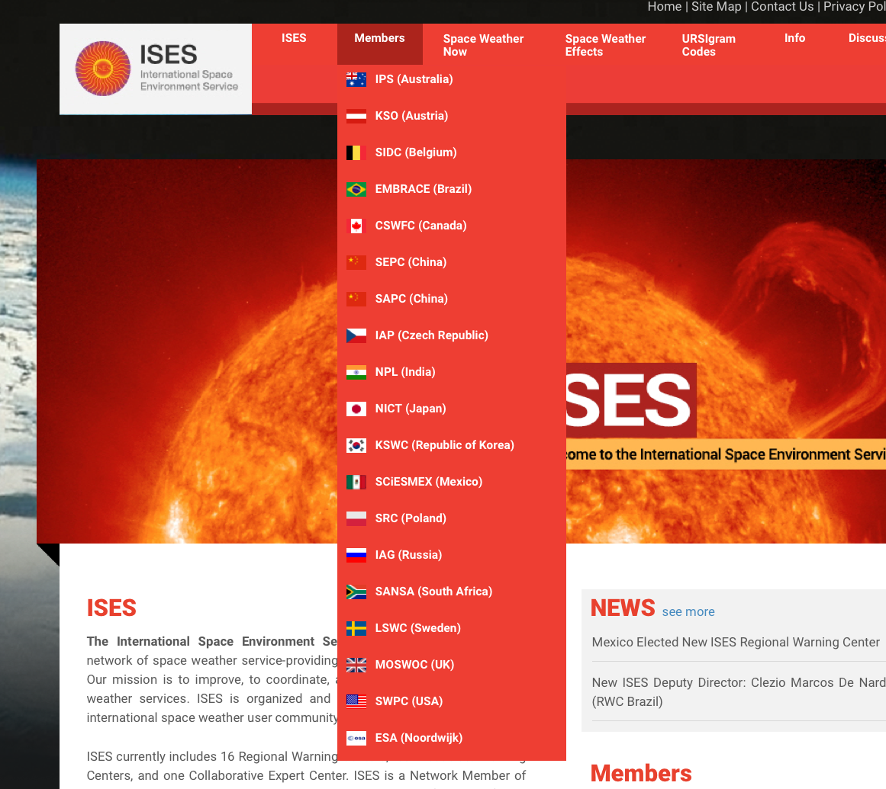
International Space Environment Service
http://www.spaceweather.org/index.jsp

Slide 23
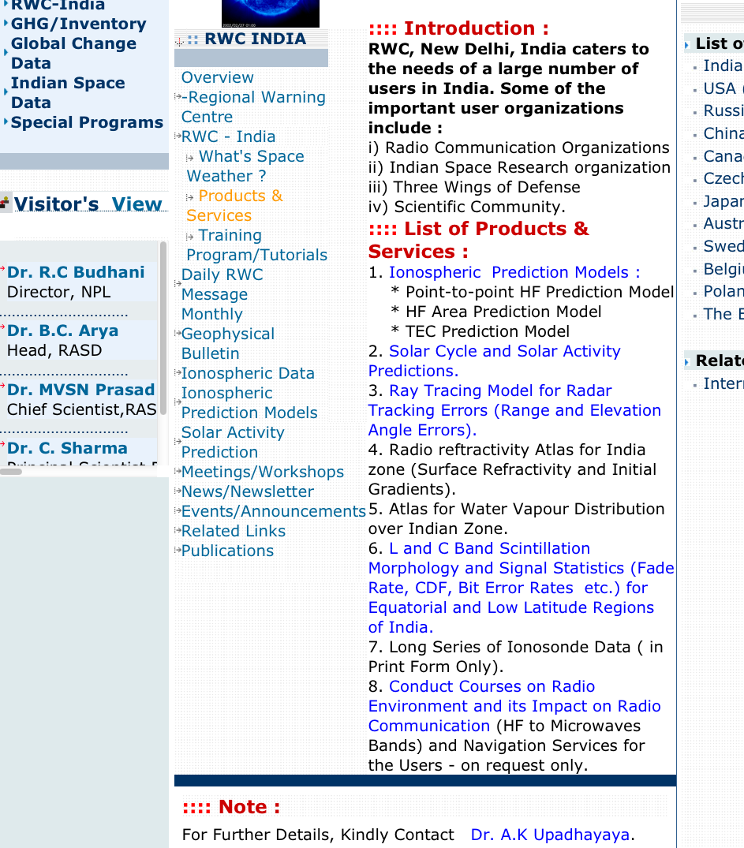
RWC in India
National Physical Laboratory, New Delhi
http://cgc.nplindia.org/atul/cgc/rwc/product.htm

Slide 24
Highlights of Space Weather Service Products
NOAA SWPC
  http://www.swpc.noaa.gov/
SIDC
  http://sidc.oma.be/
Japan/NICT
  http://swc.nict.go.jp/contents/index_e.php

Slide 25



SPENVIS
The SPace ENVironment Information System
coordinate generators
radiation sources and effects
spacecraft charging
atmosphere and ionosphere
magnetic field
meteroroids and debris
data base queries
Miscellaneous
Geant4 tools
ECSS space environment standard
  http://space-env.esa.int/ECSS/ecss_10_04.html
Planetary environment
Particularly popular for engineers
https://www.spenvis.oma.be/models.php
Notes:
http://space-env.esa.int/ECSS/ecss_10_04.html
The European Co-operation for Space Standardization
http://www.spaceweather.eu/sl/model_access_interface

Slide 26
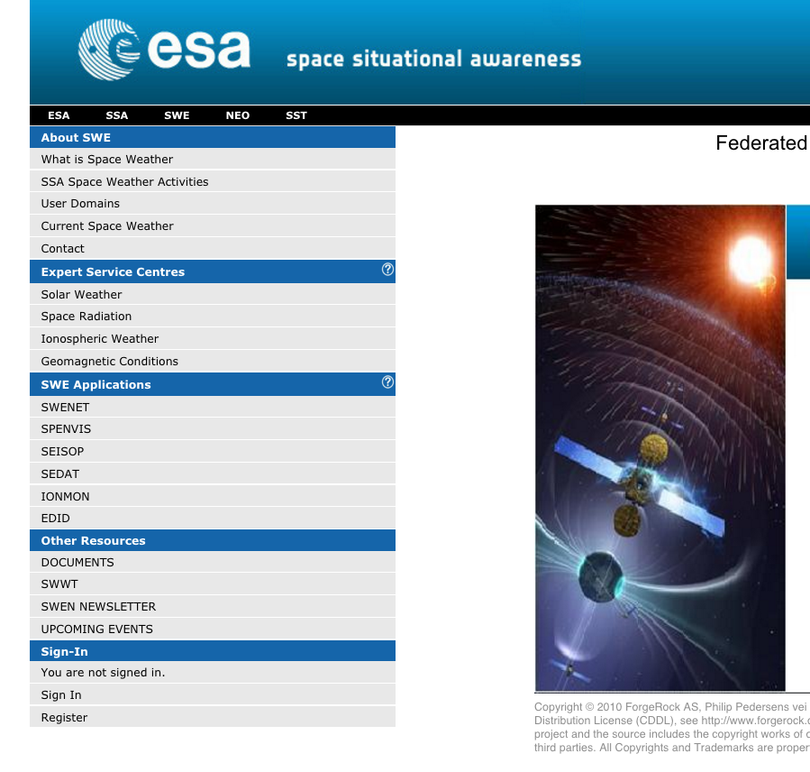
ESA’s space weather portal

Slide 27
SWE applications
The Space Weather European Network
  http://www.spaceweather.eu/sl/node/234
SEISOP (Space environment information system for opearations)
  http://www.esa.int/Our_Activities/Space_Engineering_Technology/SEISOP_Space_Environment_Information_System_for_Operations
  SEDAT (space environment data system)
  IONMON(the IONosphere MONitoring facility)
  EDID (European Debris Impact Database)
Notes:
Space weather related applications

Slide 28
Space Radiation Products/sites
AVIDOS (radiation dosimetry for aviation)
ANeMOS (Ground Level Enhancement (GLE) event alert – using multistation neutron monitor data)
SEPsFLAREs (García-rigo, A et al.)
FORSPEF (Anastasiadis, A et al.)
KREAM (Korean Radiation Exposure Assessment Model for Aviation, Huang 2014)
WASAVIES (Kataoka et al., 2014)
PANDOCA (Matthia et al., 2014)
SEPEM (Crosby et al, 2015)
Solar Particle Radiation SWx (SPARX)
Notes:
Hwang, J., K. Dokgo, E. Choi, K.-C. Kin, H.-P. Kim, and K.-S. Cho (2014), Korean Radiation Exposure Assessment Model for aviation route dose:
KREAM, KSS Fall meeting, Jeju, Korea, 29–31 Oct.
Tobiska, W. K., et al. (2015), Advances in Atmospheric Radiation Measurements and Modeling Needed to Improve Air Safety, Space Weather, 13, 202–210, doi:10.1002/2015SW001169.
Matthiä, D., M. M. Meier, and G. Reitz (2014), Numerical calculation of the radiation exposure from galactic cosmic rays at aviation altitudes
with the PANDOCA core model, Space Weather, 12, 161–171, doi:10.1002/2013SW001022.
Crosby, N., D. Heynderickx, P. Jiggens, A. Aran, B. Sanahuja, P. Truscott, F. Lei, C. Jacobs, S. Poedts, S. Gabriel, et al. (2015), SEPEM: A tool for statistical modeling the solar energetic particle environment, Space Weather, 13, 406–426, doi:10.1002/2013SW001008.
Marsh, M. S., S. Dalla, M. Dierckxsens, T. Laitinen, and N. B. Crosby (2015), SPARX: A modeling system for Solar Energetic Particle Radiation Space Weather forecasting, Space Weather, 13, 386–394. doi:10.1002/2014SW001120.

Slide 29
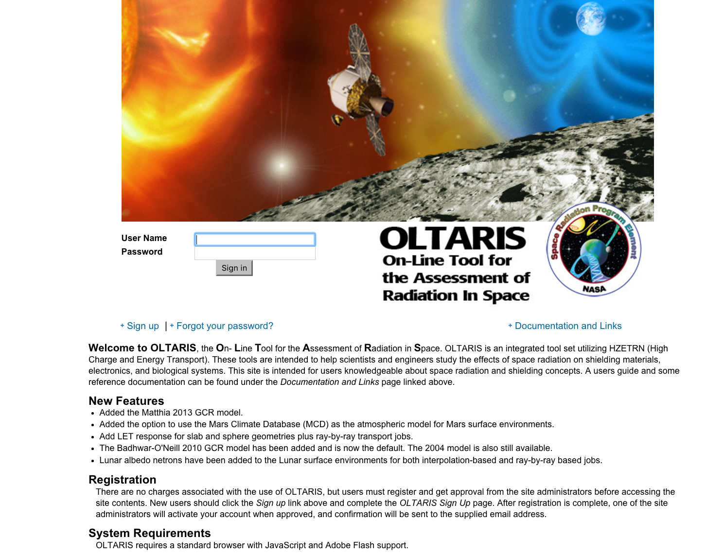
OLTARIS: On-Line Tool for the Assessment of Radiation in Space

Slide 30
