Slide 1



Community Coordinated Modeling Center (CCMC)
Introduction to Space Weather:
Tools and Concepts
Setting the Scene:
Space Weather Phenomena, Spatial Domains and Models
Masha Kuznetsova & CCMC Team
Science for Space Weather, Jan 24 – 29, 2016, Goa, India
Notes:
Welcome to the “Introduction to Space Weather: Tools and Concepts” School. My name is Masha Kuznetsova. I am leading the Community Coordinated Modeling Center (CCMC). The CCMC (http://ccmc.gsfc.nasa.gov) is an asset of US multi-agency partnership including sponsoring agencies NASA and National Science Foundation. CCMC is also an asset of the entire space science and space weather community world-wide. Several members of the CCMC team came to this workshop to provide support for this school. You will learn more about CCMC, its tools and services during this school and workshop.
CCMC Staff: http://ccmc.gsfc.nasa.gov/staff/index.php
CCMC Staff attending the Workshop (at your service):
Masha Kuznetsova (magnetosphere scientist, CCMC director)
Marlo Maddox (lead developer of CCMC Integrated Space Weather Analysis System http://iswa.ccmc.gsfc.nasa.gov)
Yihua Zheng (magnetosphere and space weather scientist and analyst, lead of CCMC Space Weather Research, Education and Development Initiative (Space Weather REDI, http://ccmc.gsfc.nasa.gov/support/SWREDI/swredi.php)
Sandro Taktakishvili (solar and space weather scientist and analyst)
Ja Soon Shim (ionosphere scientist)
Satabjit Bakshi (CCMC IT Infrastucture engineer)
Alex Glocer (magnetosphere scientist, CCMC advisor)

Slide 2
What is Space Weather?
Space weather refers to the variable conditions on the Sun and in the space environment that can
influence the performance and reliability of technological systems in space and on the ground,
endanger human life or health.
Space weather field is multidisciplinary as it encompasses
space and plasma physics,
computational science,
engineering.
Notes:
Space weather refers to the variable conditions on the Sun and in the space environment that can influence the performance and reliability of technological systems and critical infrastructure in space and on the ground, and can endanger human life or health.
Space weather is an emerging research area within space science that is rapidly gaining importance and public recognition because of its technological and societal impact.
Space scientist status is changing from “satisfying curiosity” to “developing forecasting capabilities to help mitigate space environment impacts”.
Space weather is multidisciplinary field. Space weather encompasses
- space and plasma physics (coupled across a variety of spatial and temporal scales),
- computational science,
- engineering (as its ultimate goal is to protect technological and biological systems in space and on the ground).

Slide 3
Heliosphere:
Our Space Environment,
Our Home and Science Laboratory
In August 2012 (35 years after the launch)
NASA's Voyager 1 spacecraft exited the Solar System.
Heliosphere
spatial scale:
~ 100 au
1 au ~ 150 mln km
At heliopshere boundary (~100 a.u. from the Sun)
a stream of charged particles flowing outward from the Sun
(Solar Wind) is stopped by the interstellar medium
Notes:
Our terrestrial weather atmosphere is about 30 km thick wrapped around the Earth (about 12,000 km in diameter). Typical clouds extend no further than only 10 km, about the height of Mt. Everest. While our space weather environment is heliosphere.
The image is a perspective visualization of the global simulations of the heliosphere boundary, where the stream of the charged particles flowing outward from the Sun is stopped by the interstellar medium.
Heliospere is extended atmosphere of our sun. The Earth and other planets are embedded into the solar atmosphere. Heliosphere bubble is our home and our science laboratory for studies of fundamental process in plasma physics.
In August 2012 (35 years after the launch) NASA's Voyager 1 spacecraft exited the solar system.
Voyger 1 is the first manmade object that reached that far to cross the heliosphere boundary, There are other missions throughout the heliosphere: e.g., New Horizons, STEREO, Cassini, Juno, Mars missions, ..).

Slide 4
A Fly Though the Heliosphere:
AMNH Digital Atlas of Universe
Carter Emmart, American Museum of Natural Hystory .
Notes:
To get a feel of the size of our home heliopshere and diversity of spatial scales let’s fly from the heliopshere outer boundary towards our Sun using video based on Digital Atlas of Universe developed at the American Museum of Natural History
Space is NOT empty. Space is full of plasma
Planets are mostly located in one plane – called *ecliptic plane*.
Several satellites orbiting the sun are taking images of the sun upper atmosphere, the Corona, Its outer layers are escaping in continue solar wind.
Trails and orbits around the Earth show paths of satellites. You can see satellites at geosynchtoneous orbit as well as Low orbiting satellites. So the environment relatively close to the Earth is becoming crowded.
The sun is more than a simple ball of gas but a dynamic magnetic beast.
The stream of the charged particles flowing outward from the Sun in the so-called solar wind.

Slide 5
SDO Images of Solar Flare
March 2012 flares
Notes:
NASA satellite Solar Dynamic Observatory (SDO) brings us more amazing high resolution images revealing dynamics nature of the Sun.
You can see dark areas (so called coronal holes) and brightening or explosions, accompanied by sudden release of large amount of energy. These are the so-called solar flares. On this slide you can see images of solar flares observed by SDO (in different wave lengths).

Slide 6
SDO Images of Solar Flare
March 2012 flares
Notes:
The solar flare are also detected by increases in X-ray fluxes by instruments at GOES satellite.

Slide 7
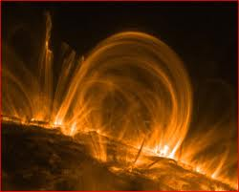
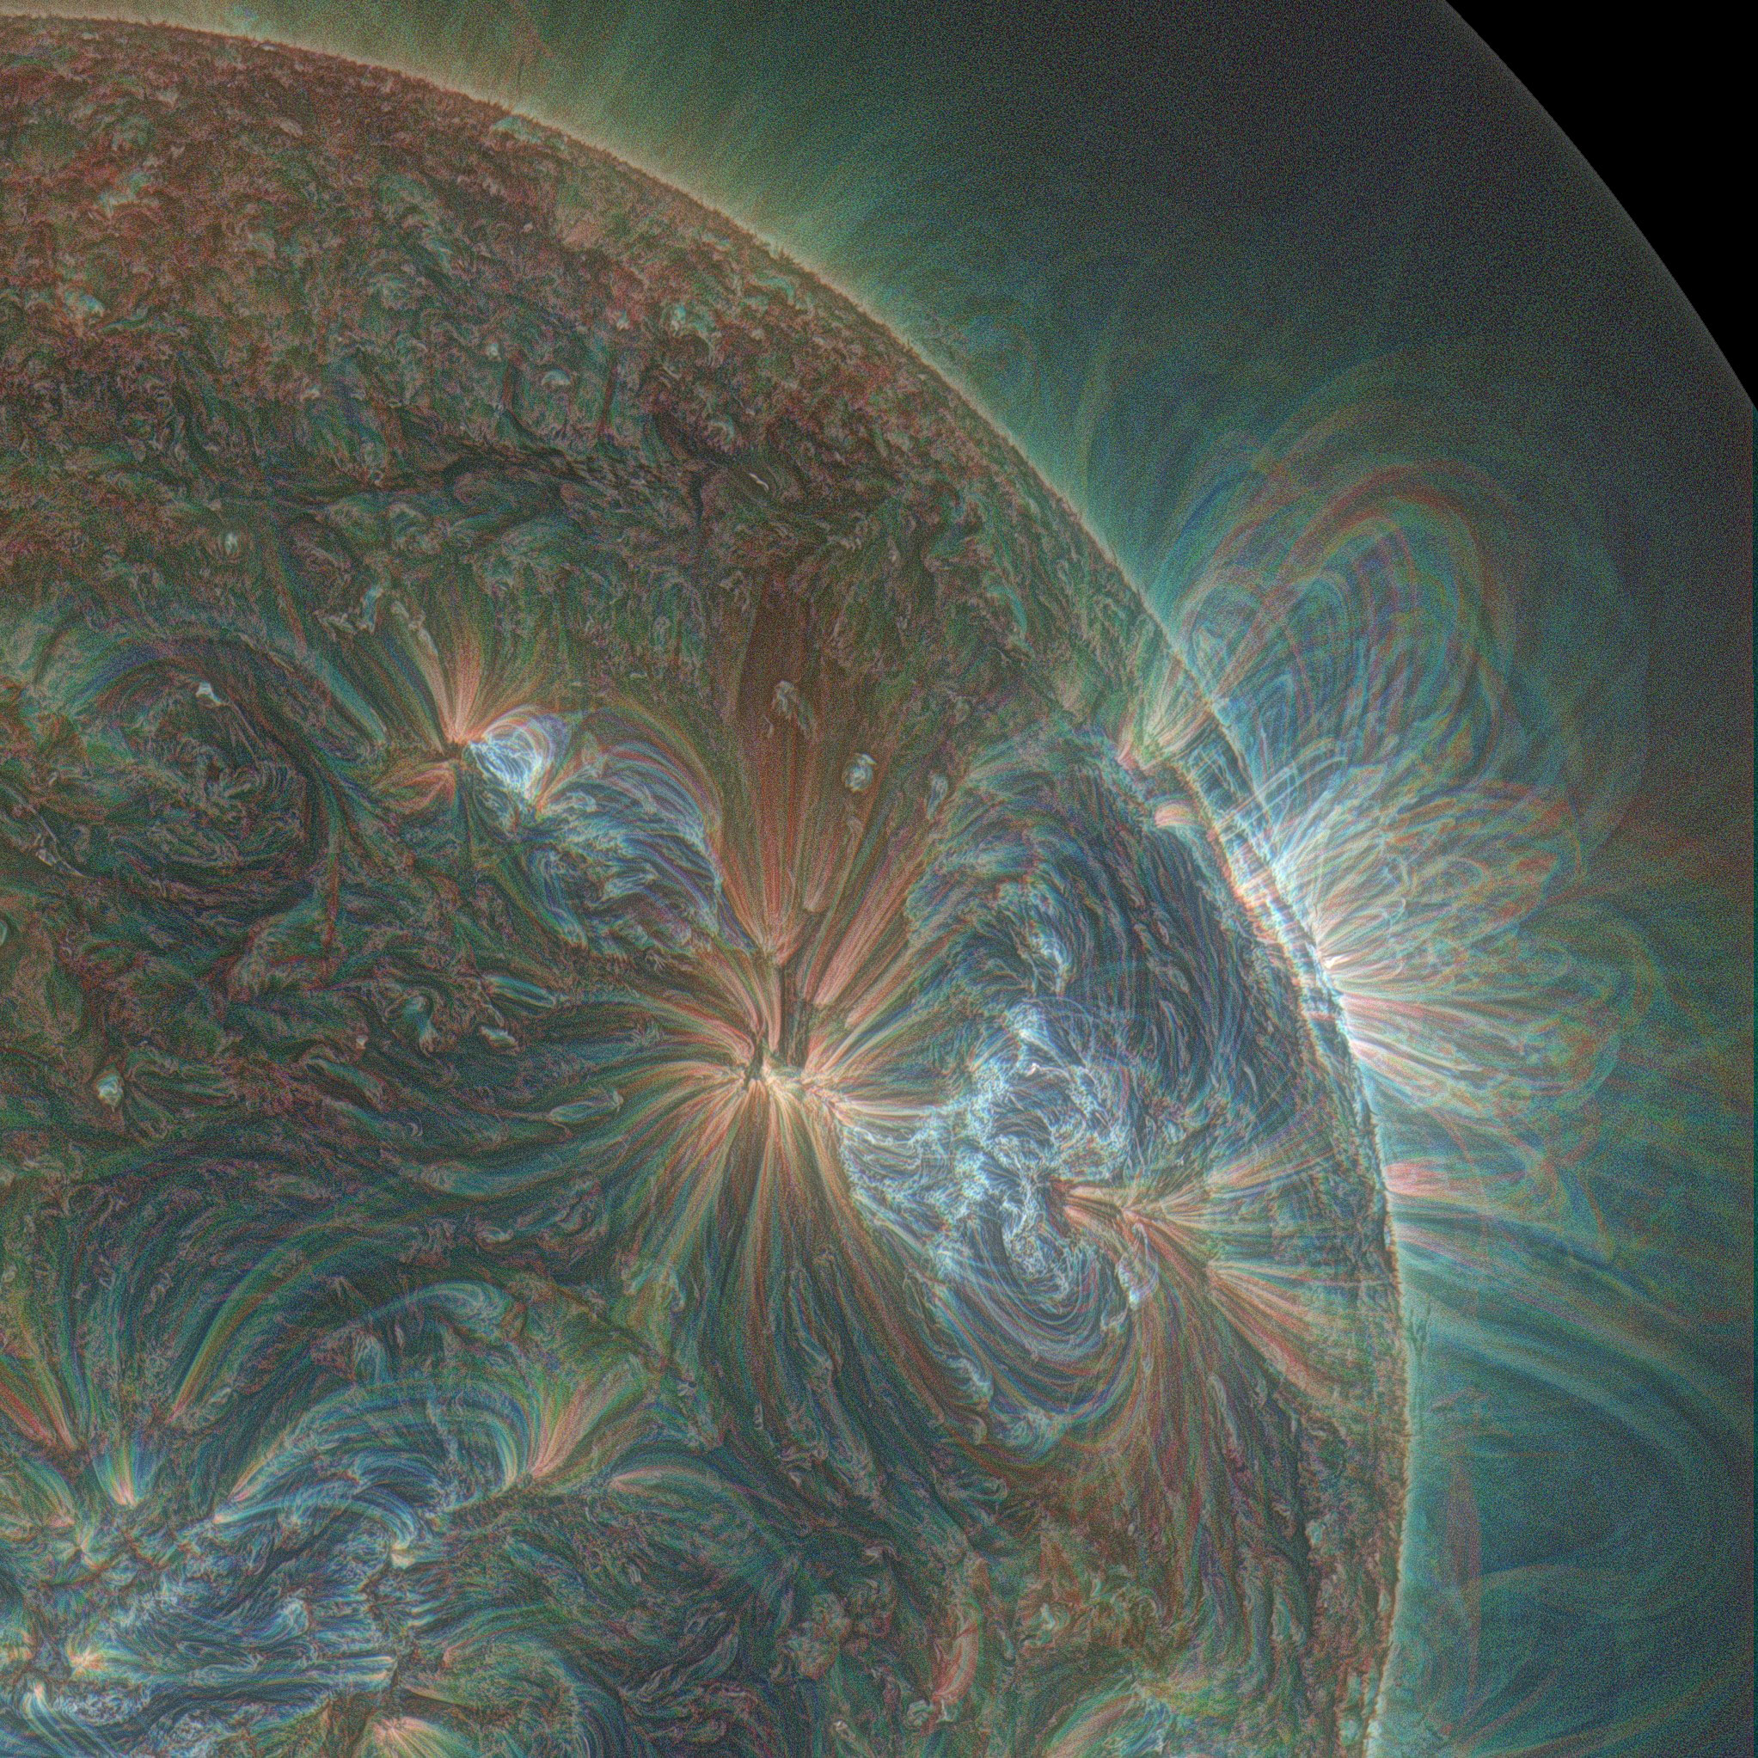
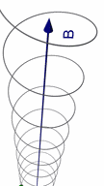
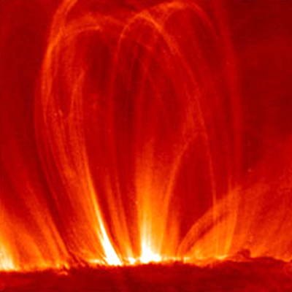
Solar Magnetic Field
In SDO Images
Notes:
Let’s zoom even closer. These are SDO images that reveal the complicated loop-like structure of the magnetic field in the solar corona. Some people say that we are seeing magnetic field lines here. Actually you can not see magnetic field lines and those are just line of force.
The images are showing plasma particles that are moving along the magnetic field lines.
Gyro-radius depends on particle mass, energy,
and the local strength of the magnetic field.
Spatial scales varies througout the Heliosphere:
e.g., 100 m – 1000 km

Slide 8
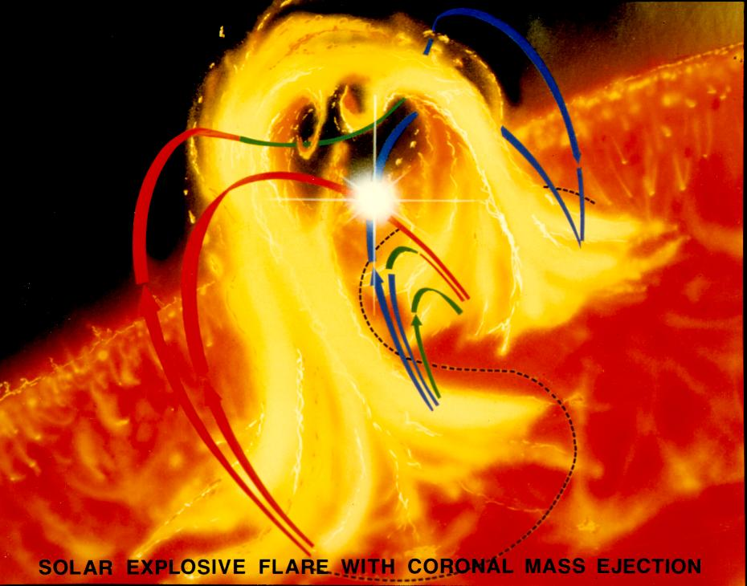
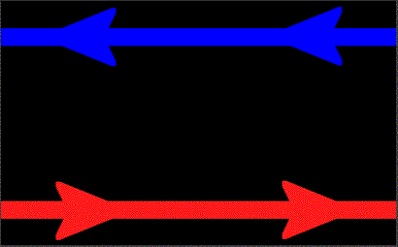

Magnetic Reconnection as a Key Mechanism of Energy Release
Observations
Interpretation
Oppositely directed magnetic fields meet, break and reconnect.
Kinetic effects on scales less than particle gyro-radius are important.
Notes:
It is widely believed that energy during solar eruptions is associated wthe the so-called magnetic reconnection, which happen when oppositely directed magnetic field lines come close to each other causing magnetic energy to convert ot kinetic energy.

Slide 9
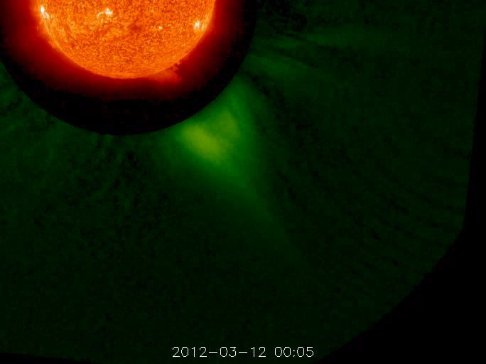
Solar Eruption accompanied by
Coronal Mass Ejection (CME)
A view from STEREO A: 304A and coronagraph –
line of sight perpendicular to Earth-Sun line
Notes:
Solar flares are usually accompanied by Coronal Mass Ejections (CMEs). A movie shows solar eruption accompanied by CME.
The line of sight from STEREO A spacecraft (that is orbiting the Sun ahead of the Earth) is perpendicular to the Earth-Sun line. So the CME is propagating towards the Earth.
Coronal Mass Ejection propagates through the heliosphere and impact magnetized planets.

Slide 10
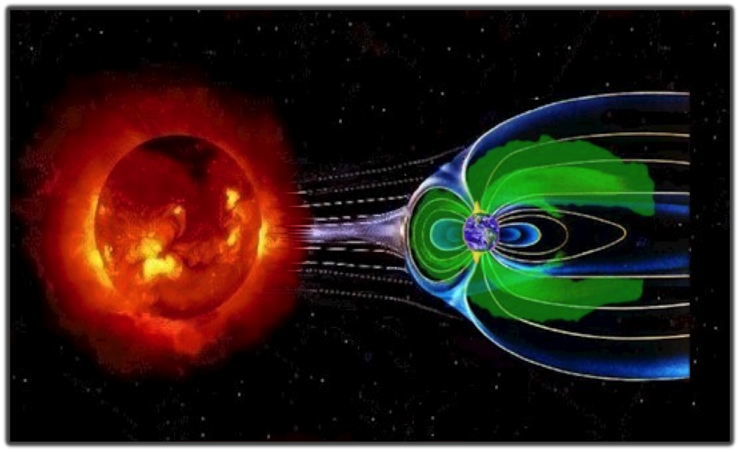
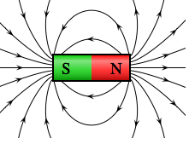
Earth Magnetic Field – Our Shield
(not to scale)
Magnetosphere
Magnetopause Sub-solar point
Earth
The solar wind pushes and stretches Earth’s magnetic field into comet-shaped region called the magnetosphere. The magnetosphere and Earth’s atmosphere protect us from the solar wind and other kinds of solar and cosmic radiation.
Notes:
The stream of the charged particles flowing outward from the Sun, the so-called solar wind, interacts with Earth’s magnetic field (and other magnetized planets). The Earth's magnetic field is similar to that of a bar magnet tilted 11 degrees from the spin axis of the Earth.
The magnitude of the magnetic field varies over the surface of the Earth in the range 0.3 to 0.6 Gauss. The solar wind pushes and stretches Earth’s magnetic field into a vast, comet-shaped region called the magnetosphere. The magnetosphere and Earth’s atmosphere protect us from the solar wind and other kinds of solar and cosmic radiation. Solar wind – Earth’s magnetic field field interaction flatten the nose (dayside – towards the sun) and drag field lines to the tail (night-side – away from the sun).
The magnetopause separates Earth's magnetic domain from the solar wind and its embedded interplanetary field (IMF). The three-dimensional location of the magnetopause represents a balance of pressures: Pressures of solar-origin (predominantly solar wind flow ram pressure) balance pressures of Earth-origin (predominantly outward magnetic pressure) at the magnetopause.
The magnetic field is the shield that protects the Earth from the solar plasma particles because they have difficulty in moving across the magnetic field lines. If the Earth did not have the magnetic field, continuously blowing solar wind and CMEs would most likely wipe out all the life forms on the Earth. Scientists speculate that something like this could have happened on Mars, who lost its magnetic field over the time.
The Sun-Earth line cross the magnetopause at the Sub-solar point. Magnetopause stand-off distance is the distance to the magnetopause sub-solar point. Under quiet conditions the magnetopause sub-solar point is about 10 to 12 Earth’s radii away from Earth. 1 R_{E} (Earth’s radius) = 6370 km. In dense solar wind or in the presence of a strong and negative solar wind magnetic field component B_{z}, the magnetopause can move closer and even cross geosynchronous orbit (distance about 6.7 R_{E}).

Slide 11
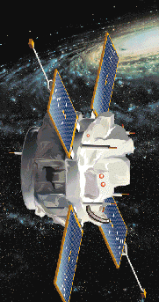
Solar Wind Monitors at L1 (Lagrangian Point 1)
Advanced
Composition
Explorer
DSCOVR
L1 (Solar Wind Monitor ACE location): ~ 200 R_{E} sunward
You can fit 1 Sun between the Earth and L1.
2 R_{S} (Solar diameter) ~ 220 R_{E}
Notes:
CME impact is detected my Solar Wind Monitors upstream of the Earths magnetopause at L1.
The Lagrangian points (/L-points) are the five positions in an orbital configuration where a spacecraft affected only by gravity can
maintain its position relative to the two massive bodies (the Earth and the Sun).
Lagrangian points are perfect for continuous monitoring of Solar activity and solar wind.
You can almost fit 1 solar diameter (~ 200 R_{E} ) between the Earth and L1.
Solar wind monitor ACE is positioned at L1 point. DISCOVR is coming soon.
It takes about 30 – 60 min (depending on the speed of the solar wind) for the disturbance observed at L1 to reach the Earth.
It would be nice to have monitor at other Lagrangian points (e.g. at L5).

Slide 12
Solar Wind Parameters at ACE on 04/05/2010
Magnetic field
B_{x}, B_{y,} B_{z}
nT
X: Earth to Sun
Z: South to North
km/s
Velocity
Density
part/cm³
Notes:
1 nT = 10 ⁻⁵ Gauss

Slide 13
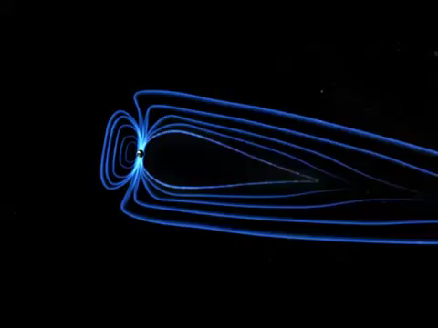
CME Impact on Heliosphere and Geospace
Impact is felt by extensive
fleets of satellites orbiting
the Earth
+ in-situ observations by interplanetary missions
Geo-effectiveness of CME impact strongly depends on orientation of interplanetary magnetic field (IMF) with respect to the Earth’s field.
Geomagnetic storms are likely for southward IMF
Notes:
CME impact is also felt by extensive fleet of satellites orbitind the Earth
+ in-sity observations by intenplanetary missions
The video show artistic presentation of CME impact on the Earth.
Orientation of IMF with respect to the Earth’s magnetic field and magnetic reconnection control the geo-effectiveness of the CME impact.
The most geo-effective is southward IMF.
Geomagnetic storms are likely for southward IMF

Slide 14
Kp - index
"planetarische Kennziffer
" ( = planetary index).
9
Geomagnetic activity
index
range from 0-9 disturbance levels of magnetic field on the ground – currents
8
7
Kp > 4 : storm (see NOAA scale)
Kp < 5 quiet

Slide 15
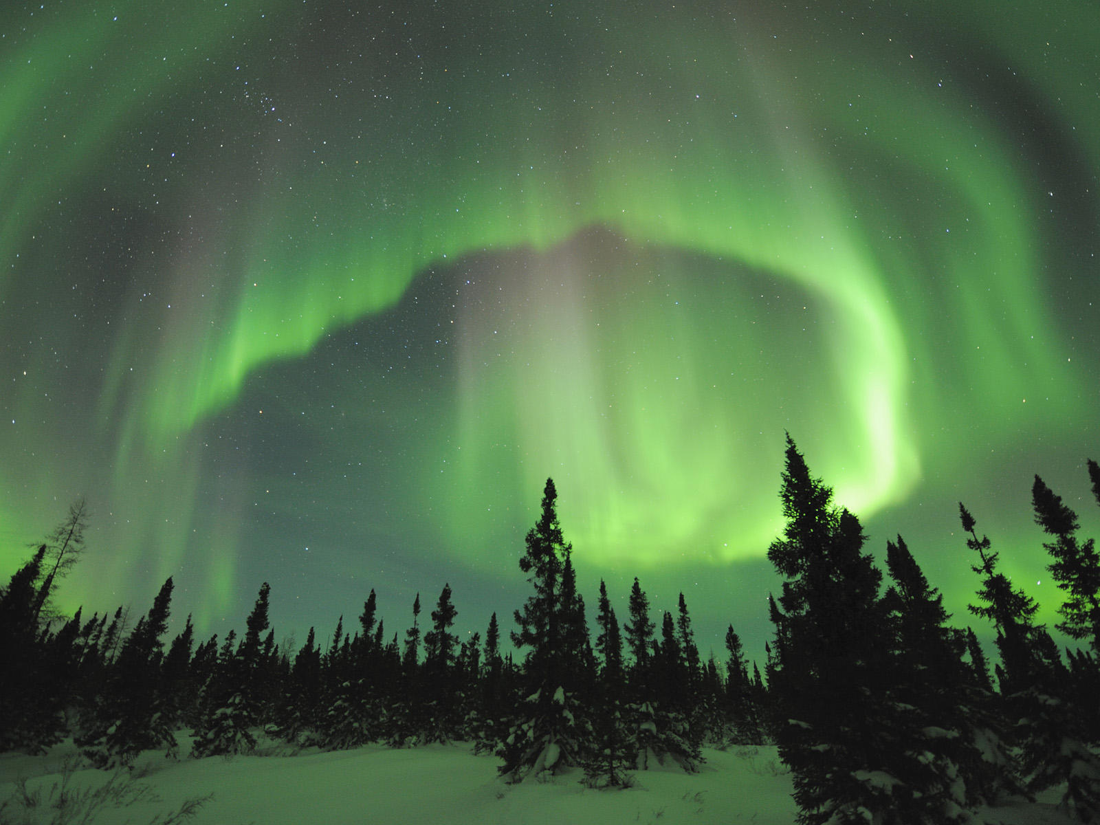
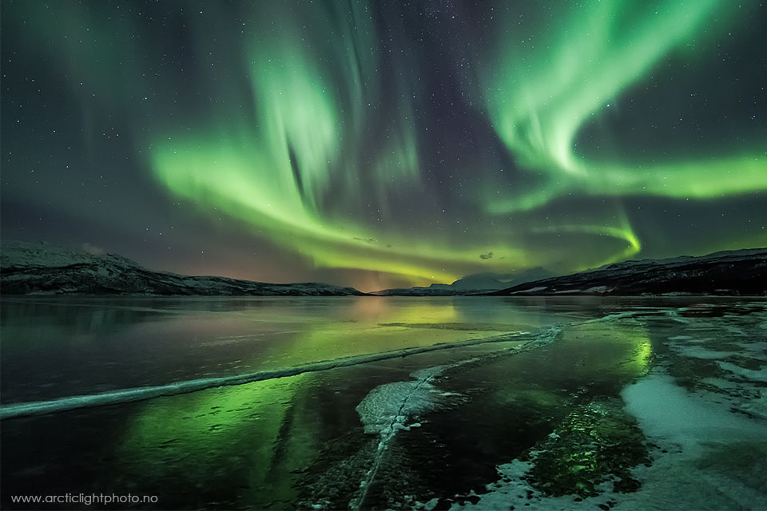
CME Impact on Geospace: Aurora

Slide 16
What are Impact of Space Weather?
Power Grids
Human
Space
Exploration
Satellite
Operations
Navigation
GPS
Aviation
Surveying
GPS
HF
Communications
Notes:
Check NOAA booklet and e-poster in your e-material

Slide 17
Key Elements of Space Weather
Forecasting and Analysis Capability
Knowledge/
Understanding
Observational Data
Models
Dissemination
Notes:
The scheme shows key elements of the space weather forecasting and analysis capability package. “Science for Space Weather” is in the top box.
To advance our understanding of space weather wen need information (observation data) and models. Easy access to models and data (disseminations) is important to maximize return on investment and to speedup the progress. All components are interconnected.

Slide 18


Dissemination of Space Weather Resources:
CCMC Runs-on-Request (RoR) System
Knowledge/
Understanding
Observational Data
Models
Dissemination
Models are served to the international research community
MODELS
DATA
http://ccmc.gsfc.nasa.gov
Notes:
Dissemination of simulation results was an issue prior to CCMC (before 2000).
The CCMC brings you the power to access state of the art modeling capabilities through your laptop.
During one of the hands-on sessions you will learn how to use CCMC Runs-on-Request system.

Slide 19
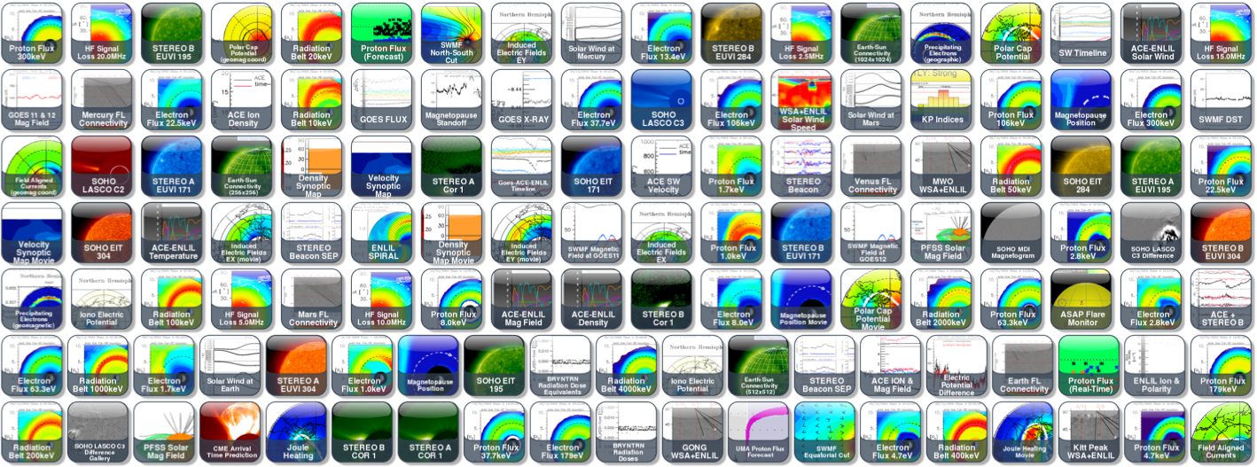
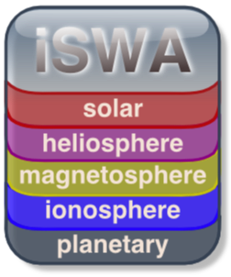
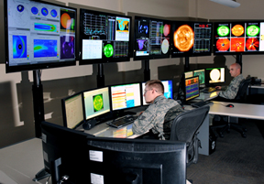
Dissemination of Space Weather Resources:
iNtegrated Space Weather Analysis ( iSWA ) System
Knowledge/
Understanding
Observational Data
Models
A tool for real-time space environment monitoring, historical event analysis, decision making
USAF Space Weather
Ops room
Notes:
Model output data cubes with visualization software tailored for research in most cases are not that useful for space weather operators. There is a need for actionable products, easy-to-use forecaster tools (derived from models and observational data) tailored to specific applications and end-user needs.
During one of the hands-on sessions you will learn how to use CCMC iNtegrated Space Weather Analysis (iSWA) system – a tool for real-time space environment monitoring, historical event analysis, system science, informed decision making, forecaster training, and education.
The photo on the right shows iSWA system in US AF Space Weather Operations room.

Slide 20

Dissemination of
Space Weather Resources and Information
Knowledge/
Understanding
Observational Data
Models

Slide 21
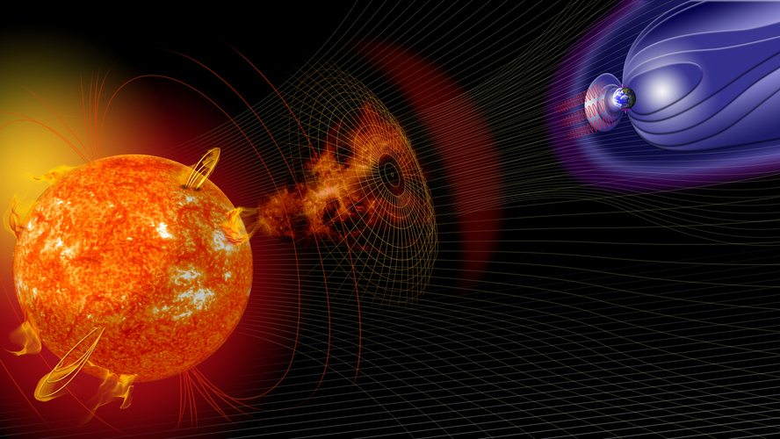
Space Environment Spatial Scales
Heliosphere: ~ 100 au ~ 100 au
From Sun to Saturn: ~ 10 au
From Sun to Earth: 1 au ~ 150,000,000 km
1 a.u ~ 200 Solar radii (Rs)
Earth
Ionosphere/
Thermosphere
Earth Magnetosphere
Sun
1 Solar radius ~ 110 Earth radii (Re)
1 Earth’s radius (Re) = 6370 km
Geosynchronous orbit 6.6 Re
Kinetic scales: ~100 m – 0.1 Re
Plasma structures
in ionosphere: ~ 1 m – 100 m
Diversity of spatial scales : > 10¹⁰
There is a strong coupling between the scales
Notes:
To summarize our ran through the space weather phenomena in heliopshere let’s review spatial scale of the space weather system.
Heliosphere: ~ 100 au
From Sun to Saturn: ~ 10 au
From Sun to Jupiter: ~ 5 au
From Sun to Earth: 1 au ~ 150,000,000 km
1 a.u ~ 200 Solar radii (Rs)
1 Solar radius ~ 110 Earth radii (Re)
1 Earth’s radius (Re) = 6370 km
Geosynchronous orbit 6.6 Re
Kinetic scales: ~100 m – 0.1 Re
(depending on particle mass, energy, local magnetic field strength)
Diversity of spatial scales (more that 10 orders of magnitude).
For comparison: terrestrial weather spatial domain is about 30 km thick (wrapped around the Earth).
Typical clouds extend no further than only 10 km, about the height of Mt. Everest.
No wonder that understanding and forecasting space weather is a serious challenge.

Slide 22
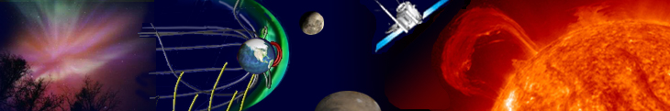
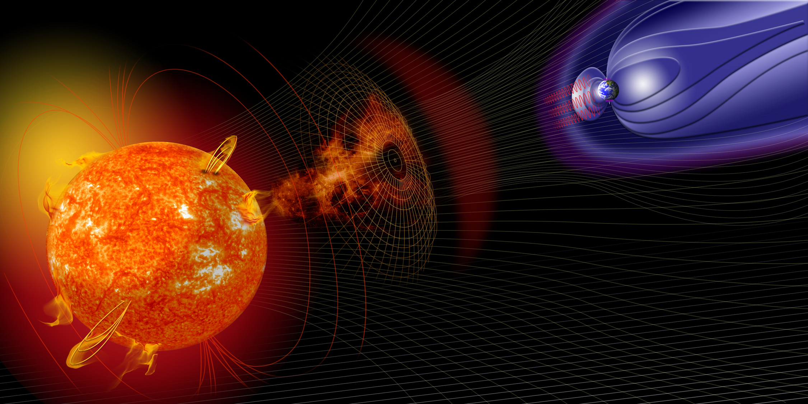
Expanding Collection of Models at CCMC: > 80
LFM-TING
GUMICS
SAMI-2
SAMI-3
SWMF.SC
LFM-MIX
TIE-GCM
PFSS.Petrie
GIC
ENLIL
CTIPe
IRI
PFSS.Macneice
OpenGGCM
Posner SEP
USU-GAIM
PFSS.Luhmann
SWMF+RCM+deltaB
RCM
ANMHD
PREDICCS
SWMF+RCM
Fok.CIMI
SWACI-TEC
MODEL ZOOM IN HERE
EXO Solar Wind
SWMF+RCM+RBE
Fok.RC
ABBYNormal
UMASEP
EMMREM
SWMF+RCM+CRCM
UPOS RB
MSIS
SRPM
LFM-MIX-TIEGCM
CORHEL
AE-8/AP-8
GITM
MAG4
WINDMI
LANLstar
Heltomo SMEI
AE-9/AP-9
PBMOD
ASAP
IGRF
Tsyganenko
ENLIL+Cone
VERB
TRIPL-DA
WSA
Fok RBE
Weigel-deltaB
Heltomo IPS
Weimer IE
MAGIC
PS VP
Apex
BRYNTRN
Weimer-deltaB
AACGM
Ovation Prime
ASSA
SNB3GEO
SWMF.SH
JB2008
NLFFF.Wiegelmann
COSGROVE-PF
Corona
Heliosphere
Magnetosphere
Inner
Magnetosphere
Ionosphere/Thermosphere
Notes:
Expanding collections of space environment models and model chains cover the entire domain from the solar corona to the Earth’s upper atmosphere.
In the next slide I will present a few examples illustrating different sub-domain using simulation results of different models.

Slide 23
Type of Models
Empirical Models
Physics-based (first principle models with different approximations). Examples:
- Magnetohydrodynamics (MHD) – single species fluid
- Multi-fluid, Hall MHD
- Kinetic (particles)
Data assimilative

Slide 24
Modeling Sub-Domains
Solar Corona [ Rs ]: 1-2.5 Rs, 1-20 Rs
Heliosphere [au]: 1-2 au, 1-10 au +
Global Magnetosphere [Re]: 2-1000 Re
Inner Magnetosphere [Re]: 1-8 Re
- ring current ( 1- 8 Re)
- radiation belts
Ionosphere [km]: 80 – 1000 km
Multi-scale models, coupled model chains and adaptive simulation grids are required to model impacts from the Sun
Example: Space Weather Modeling Framework (SWMF), Gombosi et al, U. Mich.
Notes:
To address the issue of diversity of special scales the heliosphere is divided (for modeling purposes) into subdomains.
Different levels of approximations is required in different sub-domains depending on the underlying physical process.
There is a strong coupling between some subdomains
To trace CME propagation from the solar corona to the Earth’s upper atmosphere – coupling model chain are required.
Community is building “Space Weather Modeling Frameworks”.

Slide 25
Expanding Collection of Models at CCMC: > 80
LFM-TING
GUMICS
SAMI-2
SAMI-3
SWMF.SC
LFM-MIX
TIE-GCM
PFSS.Petrie
GIC
ENLIL
CTIPe
IRI
PFSS.Macneice
OpenGGCM
Posner SEP
USU-GAIM
PFSS.Luhmann
SWMF+RCM+deltaB
RCM
ANMHD
PREDICCS
SWMF+RCM
Fok.CIMI
SWACI-TEC
MODEL ZOOM IN HERE
EXO Solar Wind
SWMF+RCM+RBE
Fok.RC
ABBYNormal
UMASEP
EMMREM
SWMF+RCM+CRCM
UPOS RB
MSIS
SRPM
LFM-MIX-TIEGCM
CORHEL
AE-8/AP-8
GITM
MAG4
WINDMI
LANLstar
Heltomo SMEI
AE-9/AP-9
PBMOD
ASAP
IGRF
Tsyganenko
ENLIL+Cone
VERB
TRIPL-DA
WSA
Fok RBE
Weigel-deltaB
Heltomo IPS
Weimer IE
MAGIC
PS VP
Apex
BRYNTRN
Weimer-deltaB
AACGM
Ovation Prime
ASSA
SNB3GEO
SWMF.SH
JB2008
NLFFF.Wiegelmann
COSGROVE-PF
Notes:
Models sorted by domain at the CCMC website:
http://ccmc.gsfc.nasa.gov

Slide 26
Solar Magnetograms: Input for Models of Solar Corona
Notes:
Solar magnetograms are used as input for models of Solar Corona

Slide 27
Nonlinear Force-Free 3-D
Coronal Magnetic Field Reconstruction
Solar Corona:
1-2.5 Rs, 1-20 Rs
NLFFF
Wiegelmann
Model
Notes:
Solar Corona models
Solar Corona [ Rs ]: 1-2.5 Rs, 1-20 Rs

Slide 28
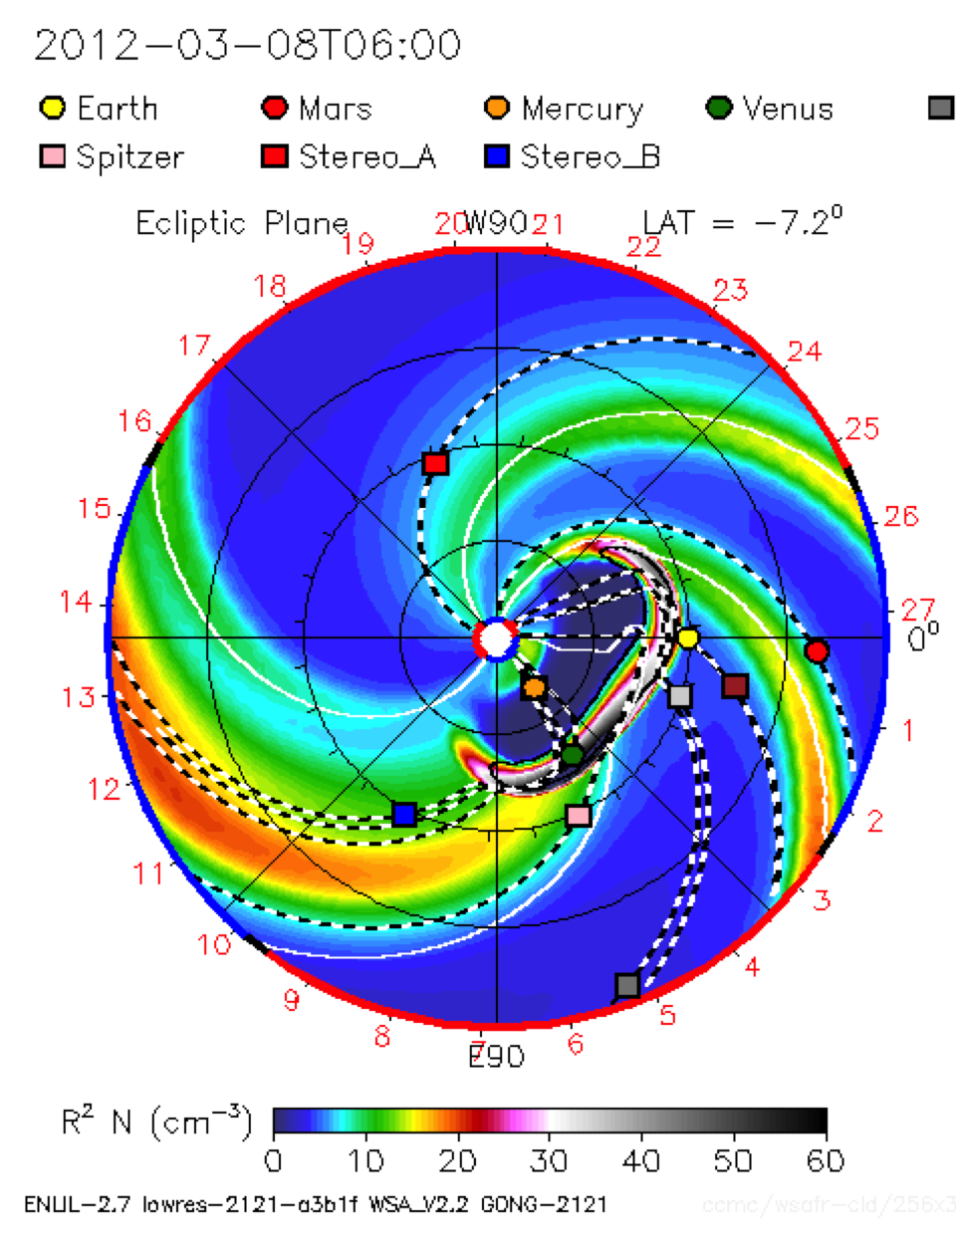
Heliospheric Model Enlil
Inner
Heliosphere:
21.5 Rs – 2 a.u.
Spiral (IMF field-line)
Sun
Earth
Solar Equator
Lat=0
CME
Enlil Cone Model,
D. Odstrcil
MHD
Notes:
Enlil = Sumerian god of wind

Slide 29
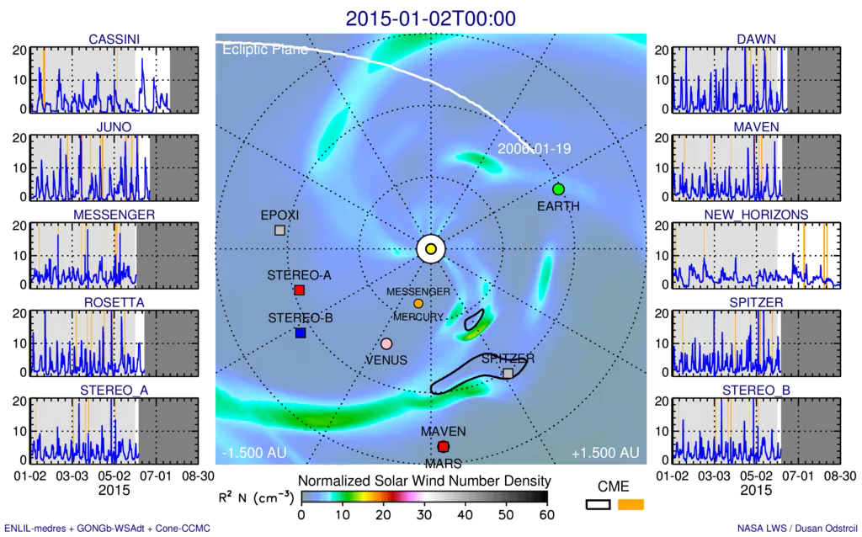
Interplanetary Space Weather:
New Horizon Modeling Challenge
Simulations and visualization by Dusan Odstrcil
120 CMEs: kinematic parameters estimated by the Space Weather Research Center team at CCMC
Heliosphere:
21.5 Rs – 40 a.u.
Notes:
The animation illustrate the prediction of the solar wind parameters at the New Horizons spacecraft during its cruise phase to Pluto. Numerical simulations of more than 120 Coronal Mass Ejections (CMEs) during first six months on 2015 were performed using the heliospheric code ENLIL (Sumerian god of wind), developed by Dr. Dusan Odstrcil. ENLIL is implemented at the Community Coordinated Modeling Center (CCMC) located at NASA GSFC and utilized by NOAA Space Weather Prediction Center (SWPC) in operational space weather forecasting. Kinematic parameters of all CMEs are measured and stored in the web-accessible Database Of Notifications Knowledge Information (DONKI) by the CCMC's Space Weather Research Center (SWRC) team, while continuously monitoring space environment conditions in inner heliopshere in support of NASA's missions. Application to the outer helioshere is beyond the model's current capabilities and this simulation serves as an estimate. Solar wind would need around 4-5 months to propagate from the Sun to Pluto. All CMEs fitted by CCMC/SWRC in the last six months were used by ENLIL to estimate the disturbed solar wind parameters up to four months in the future.
Waiting for observational data from New Horizons.

Slide 30
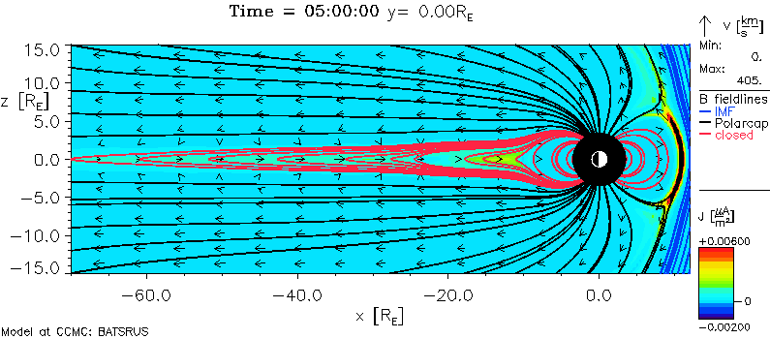

Magnetosphere Model SWMF/BATSRUS (MHD)
Magnetosphere:
2 Re – 1000 Re
Sun
Space Weather Modeling Framework (SWMF), Gombosi et al, U. Michigan
Red lines (closed): Magnetic field (MF) lines with both ends connected to the Earth
Black lines (open): MF lines with only one end a the Earth
Blue lines (interplanetary): MF lines with both ends in the interplanetary space

Slide 31
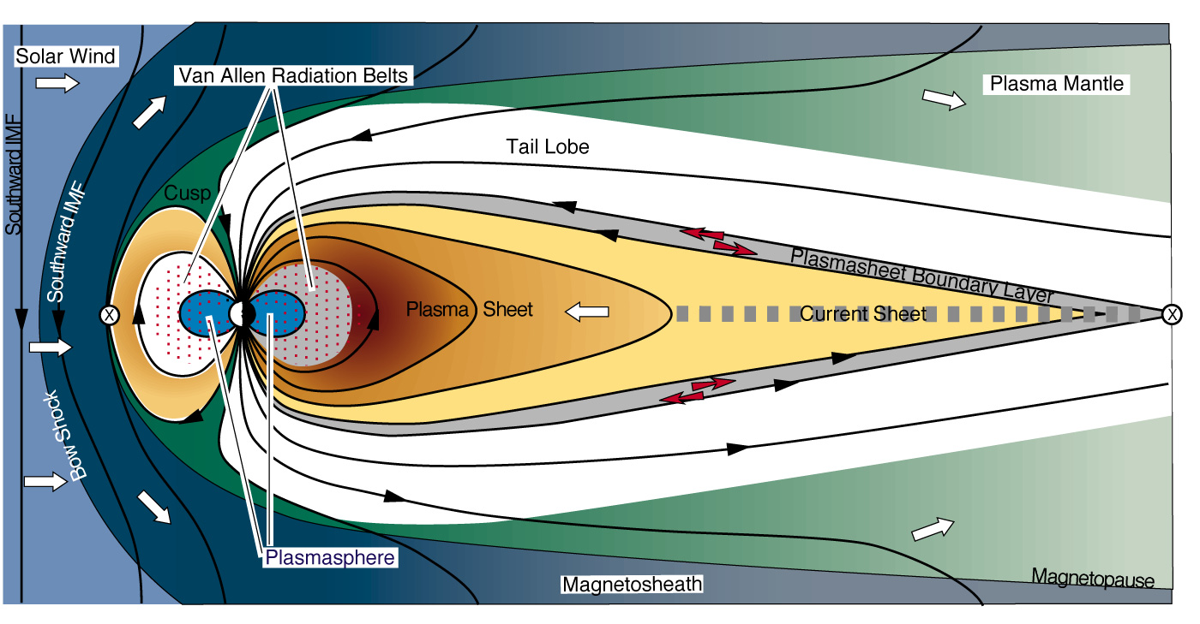
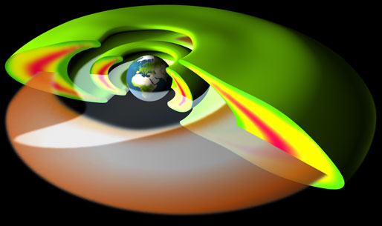
Inner Magnetosphere
(up to ~ 10 RE)
Van Allen Belts
400 keV – 6 MeV
Plasmasphere
1-10 eV
Ring Current
1-400 keV
APL

Slide 32
The charged particles that make up the inner magnetosphere current system are trapped in the Earth's magnetic field, bouncing back and forth along the magnetic field lines between "mirror points" in the northern and southern hemispheres.
MHD
Ring current circles the Earth in the equatorial plane and is generated by the longitudinal drift of energetic (10 to 200 keV) charged particles trapped on field lines.

Slide 33
Inner Magnetosphere Model
Fok Ring Current
Inner Magnetosphere:
1 Re – 10 Re
Electron Total Flux. Energy 22.45 keV.
Equatorial Plane
Magnetopause
Sun
Geosynch. Orbit
Electron Flux increase
at the geosynch. orbit
in response to
geomagnetic storm

