Slide 1
Tutorial: Coronal holes and space weather consequences
Manuela Temmer
Institute of Physics, University of Graz, Austria
Notes:
Especially in the low activity phases of the solar cycle, high speed solar wind streams (HSSs) and related corotating interaction regions (CIRs), become a dominant factor in geomagnetic activity, hence cause Space Weather effects (see studies by e.g., Legrand and Simon, 1981, 1991; Tsurutani et al., 1995; Gonzalez, Tsurutani, and Gonzalez, 1999). The long-duration geoeffectiveness of CIR – HSSs is due to the enhanced plasma velocity and magnetic field, and as such are associated to magnetic field fluctuations, hence, Alfven waves (see Burlaga and Lepping, 1977; Tsurutani and Gonzalez, 1987; Gonzalez, Tsurutani, and Gonzalez, 1999; Xie et al., 2006).
In general, the Earth is embedded in corotating streams 60% of the time, 30% in the slow solar wind, and 10% is affected by CMEs (Richardson, Cliver, and Cane, 2000). Presumably, the overall contribution of CIR – HSSs to geomagnetic activity is comparable to, if not even more important than, that of interplanetary coronal mass ejections (ICMEs). This is given in numerous publications such as e.g., Paulikas and Blake, 1976; Legrand and Simon, 1981, 1991; Tsurutani et al., 2006).

Slide 2
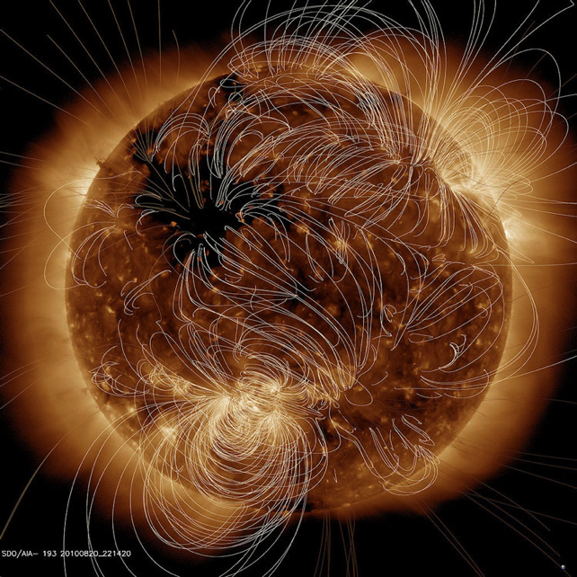
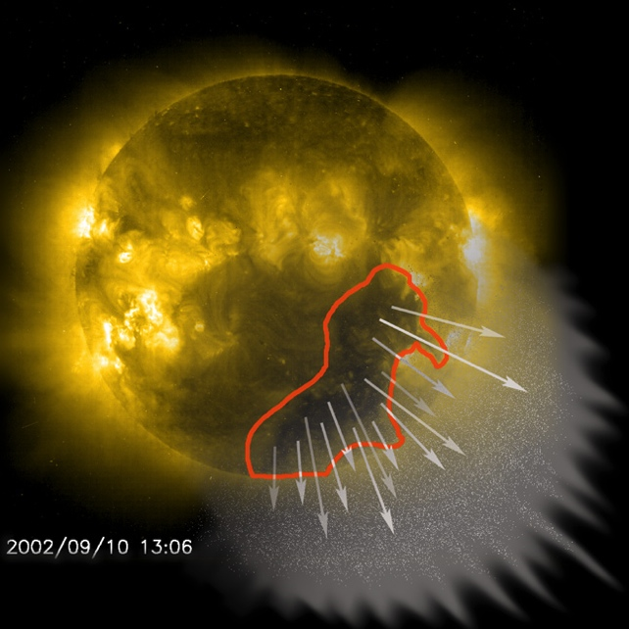
Characteristics of Coronal Holes (CHs)
SDO+PFSS
EUV observations: CHs appear dark in the solar corona since they are less dense
have an open magnetic field - ionized atoms (protons and alpha-particles) and electrons escape to IP space.
generate a faster than average solar wind flow (300 km/s vs. 800 km/s), so-called high speed solar wind streams (HSS)
interaction of fast and slow solar wind streams compresses plasma / magnetic field
different patterns of solar wind are observed with in-situ instruments at Earth
shape the conditions in IP space for the propagation of CMEs; may affect propagation direction of CMEs
SoHO
Notes:
The solar wind is a stream of charged particles (protons, electrons, Helium ions) that is constantly emanating from the Sun with typical speeds around 400 km/s. High-speed solar wind streams (HSSs), originating from coronal holes on the Sun, may reach speeds up to 800 km/s. Coronal holes are associated with rapidly expanding "open" magnetic fields along which the solar wind flow can easily escape. They appear as dark regions in solar extreme ultraviolet (EUV) and X-ray images due to the lower density and temperature compared to the surrounding corona. Studying coronal holes and their associated HSSs is an important task, since in combination with the Sun's rotation they shape the solar wind distribution in interplanetary space and are the dominant contribution to space weather disturbances at times of quiet solar activity, due to recurrent geomagnetic storm activity.
Top figure: The Solar Dynamics Observatory (SDO) does daily observations of the solar corona (EUV 193 A). Overlaid is a potential field source surface extrapolation showing open (pale yellow) and closed (white lines) magnetic field lines represent. As can be seen, the open field lines match the regions of dark areas, i.e. coronal holes, where the solar wind is able to easily escape from the Sun.
Bottom figure: Cartoon depicting the stream of charged particles emanating from the coronal hole. The solar wind streams take about 4 days to travel from the Sun to Earth.

Slide 3
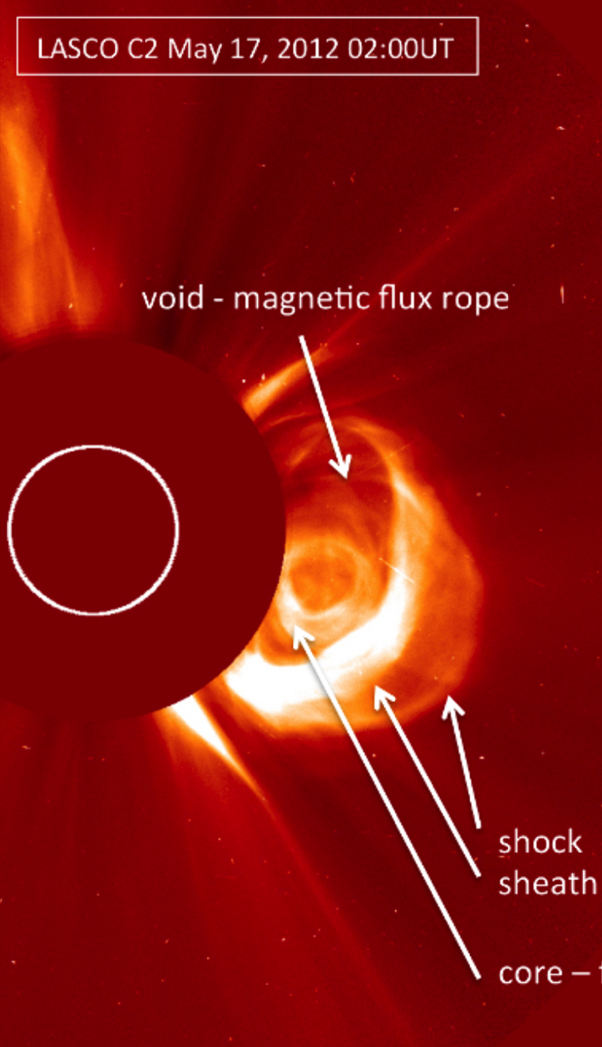
Importance of solar wind distribution in IP space
High speed solar wind streams: HSS
Corotating interacting regions: CIR
HSSs-CIRs shape the solar wind in interplanetary (IP) space.
CMEs propagating from Sun to Earth, are strongly affected by the ambient solar wind flow. Slow CMEs are accelerated, fast ones decelerated – drag force of solar wind (Gopalswamy et al., 2001).
Interaction of CMEs with HSSs may change their bulk speed (Opitz et al., 2012).
Slow CMEs propagating ahead of fast CMEs represent the most dramatic change in the ambient flow conditions (e.g., Temmer et al., 2012).
two ribbon flare
Notes:
As a CME propagates into interplanetary (IP) space it interacts with the ambient medium and transfers momentum and energy in the form of magnetohydrodynamic (MHD) waves (e.g., Jacques 1977). The interaction of the CME with the solar wind results in the adjustment between the speed of the CME and the solar wind flow.
High speed solar wind streams (HSS) emanating from coronal holes and related corotating interacting regions (CIR) greatly shape the solar wind in IP space.
The interaction of CMEs with strong variations of the solar wind, in density or speed, may change quite dramatically the kinematical behavior of a CME (and also its direction of propagation). CME –CME interaction events are known to be most geoeffective but also most difficult to predict since the changes in the CMEs magnetic field properties (e.g., merging) shock kinematics etc are not directly observable, hence, insight in the processes are greatly missing! We only observe the consequences of CME-CME interaction, scenarios like elastic or inelastic collision are not appropriate (see e.g.Temmer et al., 2014).

Slide 4
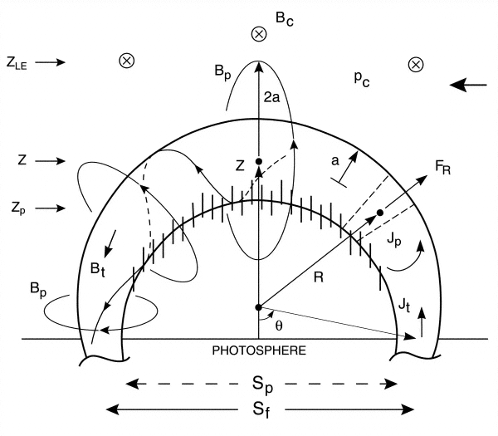
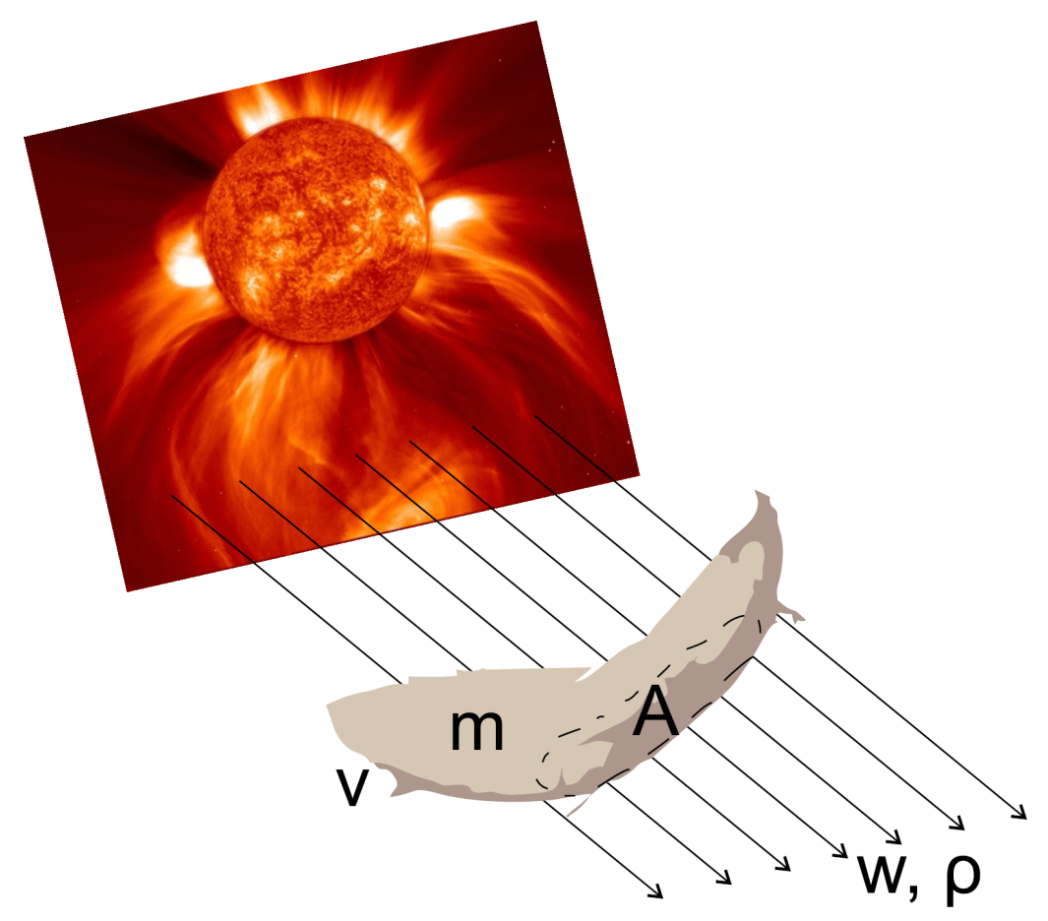
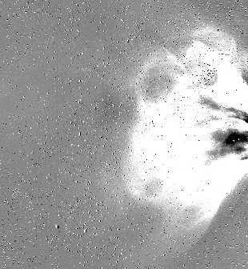
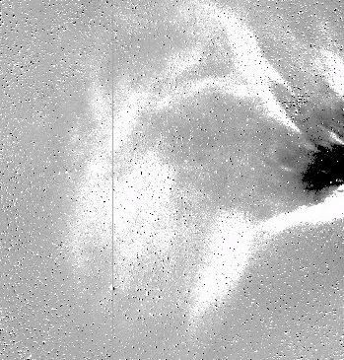


CME dynamics: Lorentz vs. drag force
Close to the Sun propelling Lorentz force as consequence of magnetic reconnection (e.g. Chen 1989,1996; Kliem & Török 2006)
SoHO
STEREO
F = F_{L} + F_{G} + F_{D}
In IP space drag acceleration owing to the ambient solar wind flow (e.g. Vršnak 1990; Cargill et al. 1996; Chen, 1996; Cargill 2004; Vršnak et al. 2004; 2013; Maloney and Gallagher 2010, Carley et al., 2012).
Notes:
In slow eruptive prominences, moving at velocities below 100 km s−1, the Lorentz force is not much larger than gravity, i.e., it is close to the equilibrium value. The viscosity plays a minor role in such events. On the other hand, the Lorentz force is much larger than gravity in fast CMEs. This provides the CME acceleration.
Assuming that the main force that governs the propagation behavior of a CME in IP space is the “aerodynamic” drag force (Cargill et al. 1996; Vrsnak 2001; Vrsnak & Gopalswamy 2002; Cargill 2004), we may attempt to simulate the kinematical profile of a CME by using the drag- based model (DBM) proposed by Vrsnak & Zic (2007), and advanced by Vrsnak et al. (2012).

Slide 5
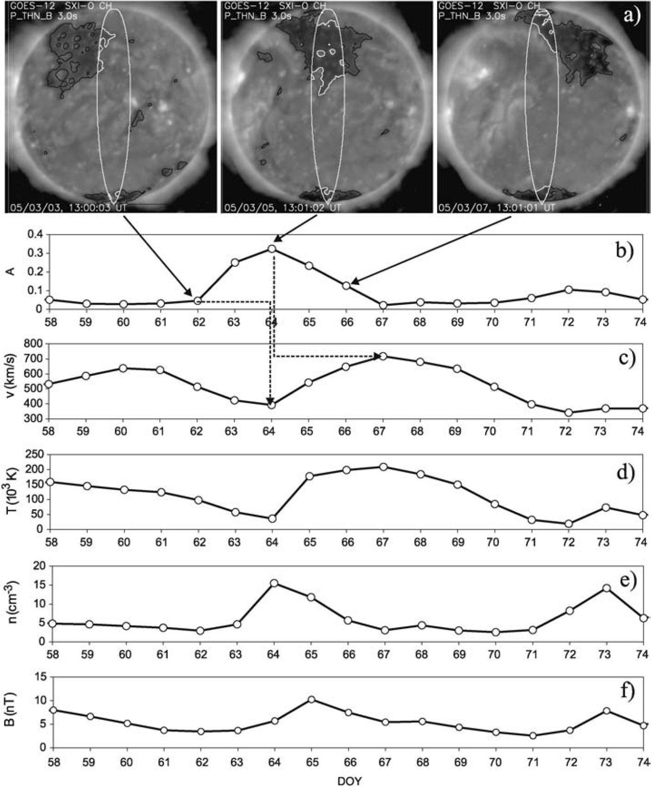

Empirical model – how it works …
Large areas of coronal holes at the central region of the Sun cause, with a delay of about 4 days, an increase in the SW speed close to Earth.
  Solar wind parameters are affected differently.
  Comparison between extracted areas of CHs and in-situ data give important information on how the solar wind evolves.
Vrsnak, Temmer, Veronig, 2007
Notes:
Wang Sheeley Arge model calculates the solar wind speed using an empirical relationship based on the divergence of the magnetic field and the proximity of the selected open field line to the nearest coronal hole boundary.
The coronal holes based empirical solar wind forecast uses the area of coronal holes and an empirical relation based on the area of CHs around the central meridian of the solar surface (+/- 7.5°) and the solar wind speed (high speed streams) at a distance of 1AU. With this we are able to forecast the solar wind speed at 1AU about 4 days in advance.
The processed coronal hole maps are used to derive the fractional coronal hole area A inside a meridional slice of ±7.5 corresponding to the solar rotation over approximately 1 day. A is defined as the sum of all coronal hole pixels located inside the slice divided by the total number of pixels in the meridional slice. Since the images are updated with a cadence of 1h we obtain a time series of fractional coronal hole areas A(t). Each time step A(t) is used as input for the prediction of the solar wind speed v(t + tau) according to the linear relation v(t+tau)=c0 A(t)+c1, (1) where tau is the time lag and c0, c1 designate prediction parameters of the model.

Slide 6
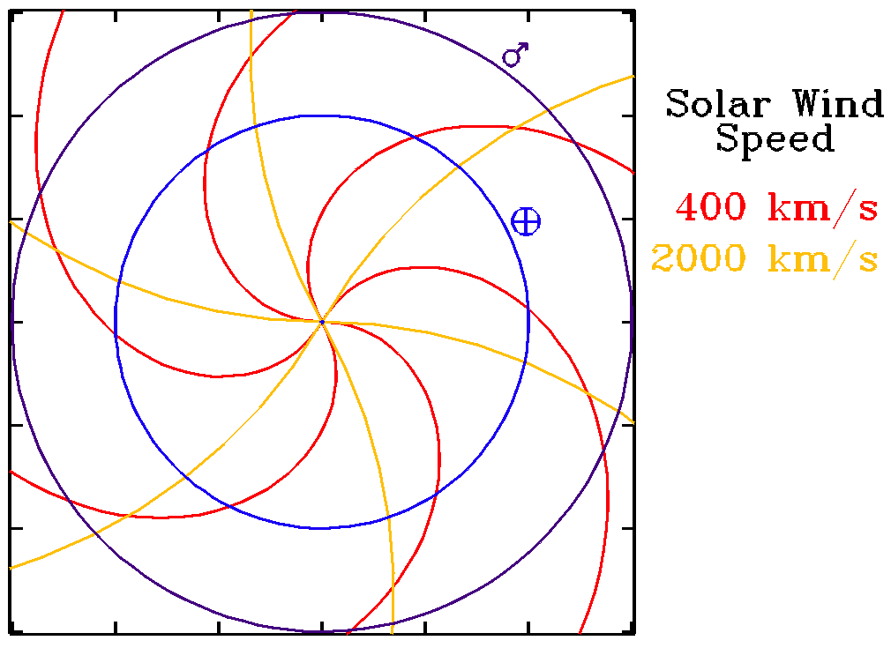
The “classical” 1-to-4‐day time lag
Maximum of CH area measurements roughly corresponds to the center of the CH.
Due to Parker spiral form of ~45° from radial at 1 AU, we expect a delay of ~3 days for solar wind parameters emanating at maximum close to the center of the CH area.
This is obviously the case for speed and temperature for which we find delays of the order of 3.5 and 2.75 days.
Peak in density and magnetic field is of about 0.75 and 1.25 days, due to compression of slow and fast solar wind, occuring close to the border of the CH (Gosling 1996).
Wiki.org
The span of measured delays is wide. Which role plays the lateral extension of the CH for the measured delay of various parameters?
Notes:
The time differences for the various solar wind parameters can be explained as follows. The high-speed solar wind stream emanating from the coronal hole is spatially restricted by the preceding slower ambient solar wind flow to the West, i.e., in the direction of solar rotation. As the faster wind catches up with the slower one, a compression region builds up at the western boundary of the coronal hole. The coronal hole is extended in longitude and we measure its maximum area as its center passes the central meridian of the Sun. Therefore, the compressed region of enhanced density from the western boundary is the first signal arriving at Earth (depending on the longitudinal extent, the time delay may vary). In the high plasma-beta of the solar wind the magnetic field follows the flow, hence, also the magnetic field gets compressed and peaks with the density. The enhancements in solar wind temperature and speed are not subject to compression and peak in the center of the coronal hole. Due to the Parker spiral form of about 45° from radial at 1 AU, a time delay of about 3 days is expected for those solar wind parameters emanating close to the center of the coronal hole (Gosling & Pizzo, 1999).

Slide 7
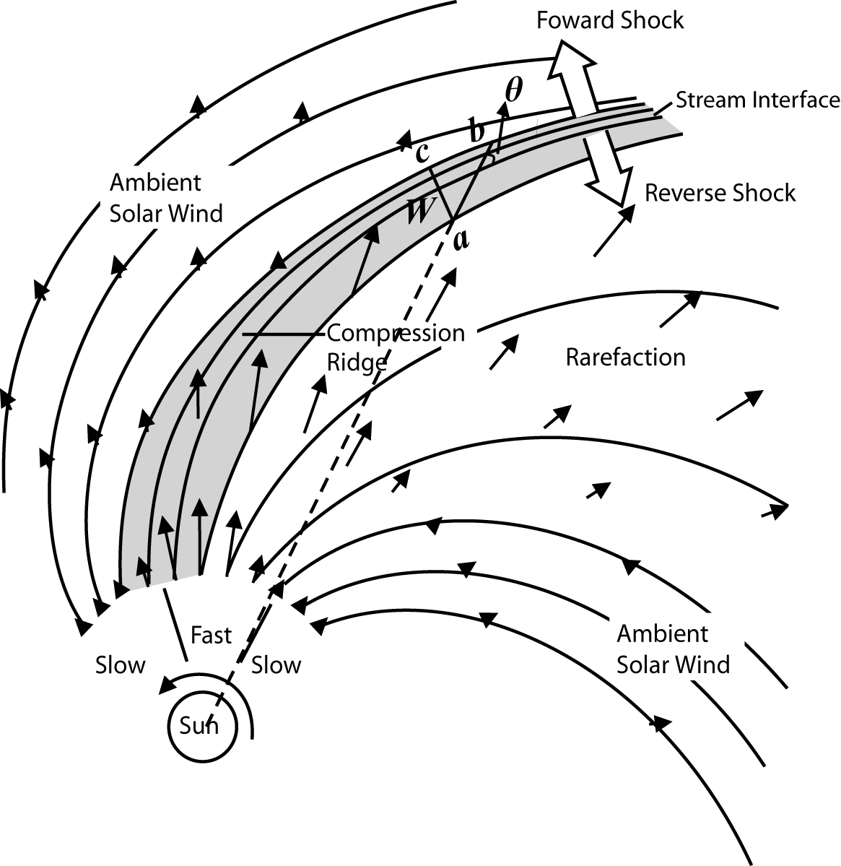
What the ...? HSS, SIR, CIR, CME
SIRs = CIRs + transient & localized stream interactions
(Pizzo, 1978)
(Hundhausen, 1977)
The magnetic structure is asymmetric around the solar equator. As the Sun rotates, fast and slow streams originating from different sources can collide and interact with each other, forming stream interaction regions (SIRs) with a pressure ridge at the stream interface.
For time-stationary conditions: SIR becomes CIR.
What is the relation between coronal mass ejections and CIRs?
Notes:
If the flow pattern is roughly time-stationary, these compression regions form spirals in the solar equatorial plane that corotate with the Sun → Corotating Interaction Regions (CIRs)
SIRs are predominate large-scale solar wind structures during solar min
The pressure waves associated with the collision, steepen with radial distance, eventually forming shocks, sometimes a pair of forward-reverse shocks which can be observed from in-situ data
From Tsurutani et al. 2006: If the holes are long-lasting (more than 27 days), the high- speed streams will reappear each solar rotation, thus giving an impression that the streams are ‘‘corotating’’ with the Sun. If the high-speed streams overtake slower-speed (􏰁300 to 400 km/s) streams, as happens near the ecliptic plane, the high-speed stream–slow-speed stream interactions result in both magnetic field and plasma compressions at their interfaces [Pizzo, 1985; Balogh et al., 1999]. For magnetic storm activity, the most important interplanetary features are these intense magnetic field regions, called ‘‘corotating interaction regions,’’ or CIRs [Smith and Wolfe, 1976; see also Balogh et al., 1999].

Slide 8
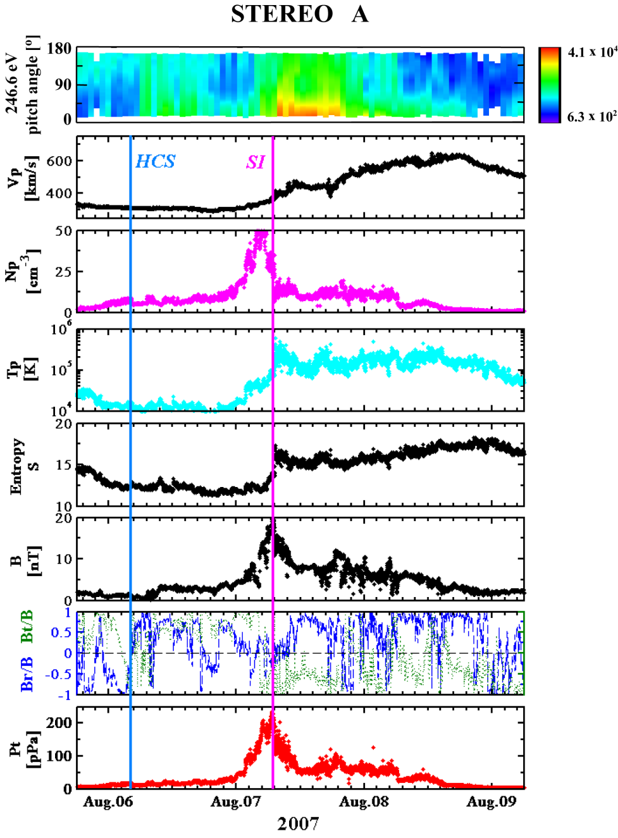
Identification of SIRs (Jian et al., 2009)
* Criteria (by inspection)
  Increase of V_{p}
  A pile-up of P_{t} (sum of magnetic pressure and perpendicular plasma thermal pressure) with gradual declines at two sides
  Increase and then decrease of N_{p}
  Increase of T_{p}
  Compression of B, usually associated with B shear
  Change of entropy ln(T_{p}^{1.5}/N_{p})
* Stream Interface (SI)
at the peak of P_{t}, usually where V_{p} and T_{p} increase and N_{p} begins to drop after a N_{p} compression region
* Heliospheric Current Sheet (HCS)
identified by the change of the suprathermal electron pitch angle and magnetic field polarity
Jian et al. (2009)
Notes:
The SIR include corotating interaction regions (CIRs) and tranisent stream interaction regions. The difference between a CIR and a transient SIR is only that a CIR recurs for two or more solar rotation cycles.
The SIRs are identified based on inspection of the following features: an increase of solar wind speed, a pile-up of total perpendicular pressure (Pt) with gradual decreases at both sides from the Pt peak to the edges of the interaction region, velocity deflections, an increase of proton number density, an enhancement of proton temperature, an increase of entropy, a compression of magnetic field. We require the presence of at least 5 signatures, and identify SIRs with careful consideration of the ambient solar wind.
Wilcox Observatory: The heliospheric current sheet separates regions of the solar wind where the magnetic field points toward or away from the Sun. The complex field structure in the photosphere simplifies with increasing height in the corona until a single line separates the two polarities at about 2.5 solar radii. That line is drawn out by the radially accelerating solar wind to form a surface similar to the one shown in this idealized picture. The surface is curved because the underlying magnetic pattern rotates every 27 days with the Sun. The shape of the current sheet usually evolves slowly - over months - as the large-scale pattern of the Sun's field changes in response to the emergence and decay of solar active regions. Coronal mass ejections often disrupt the background pattern temporarily, but sometimes the changes are permanent. During most of the solar cycle the source of the heliospheric current sheet resembles a slightly tilted dipole with varying degrees of quadrupole distortion. Near solar maximum the polar dipole decays, leaving a much more complicated structure – keyword: ballerina skirt.

Slide 9
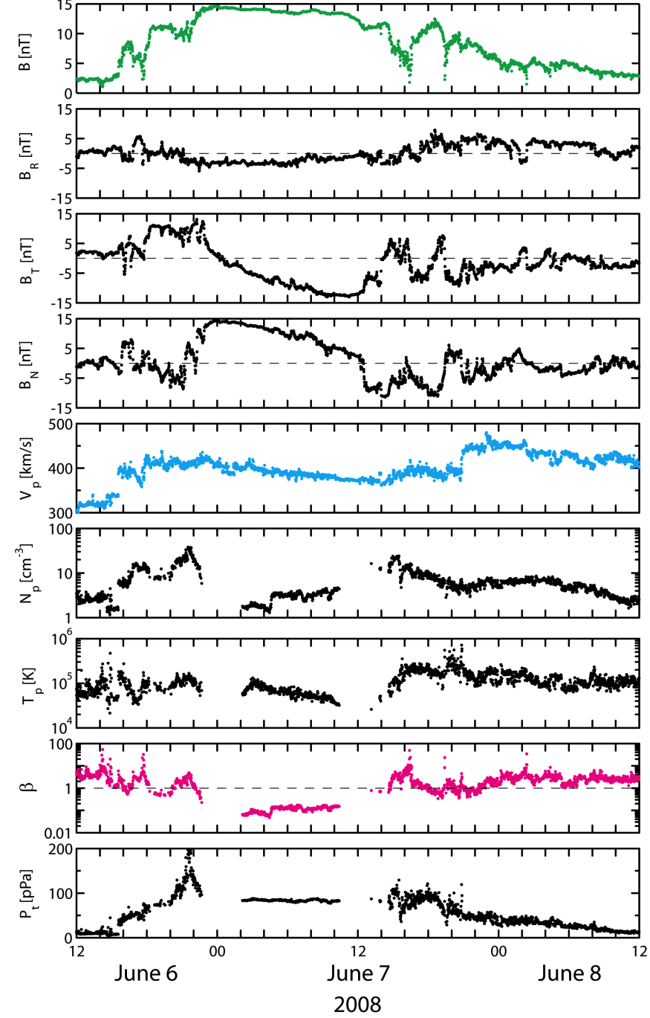
ICME identification (Jian et al., 2009)
Criteria (by inspection)
  a stronger than ambient B
  a relatively quiet B
  relatively smooth B rotations
  low T_{p}
  low β
  bidirectional suprathermal electron fluxes
  P_{t} enhancement
  a declining V_{p}
  CME candidate from solar and heliospheric images
Generally, at least 3 signatures
None of the above criteria is necessary when any 3 signatures in the criteria list are prominent
See more details on ICME identification in Burlaga (1991), and Gosling (1991).
Jian et al. (2009)
Notes:
Russell and Shinde 2002: Interplanetary coronal mass ejections (ICMEs) are the interplanetary manifesta- tions of coronal mass ejections (CMEs) seen in light scattered from enhanced electron densities in the solar corona (Kahler, 1987; Hundhausen, 1988; Gosling, 1990). These structures generally accelerate in the corona to speeds above that of the ambient solar wind plasma. At 1 AU the density enhancement that marks the CME near the Sun is not so evident. Thus ICMEs are usually identified by their characteristic signature in the magnetic field, generally an enhanced magnetic field that rotates slowly over tens of hours (e.g., Gosling, 1990; Burlaga, 1991).
ICME became a synonym for in-situ measurements showing a shock, followed by a sheath, followed by the magnetic cloud, ie..smooth rotation of the magnetic field structure as shown in the Figure.

Slide 10
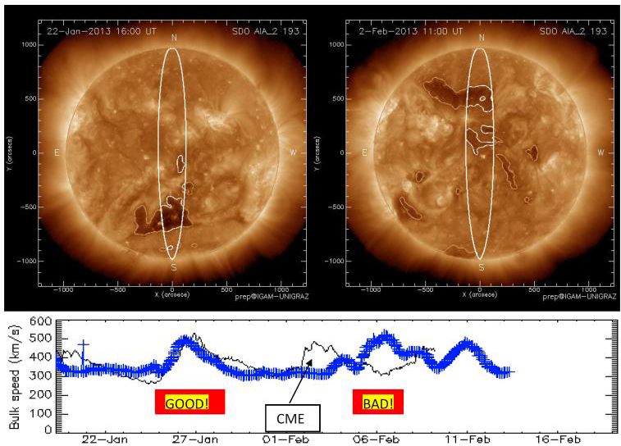
Preconditioning of IP space
  Variation of solar wind in IP space is important to know for
  deriving the propagation behavior of CMEs → Space Weather Forecast!
  For times of low solar activity we find a good match
  CMEs interacting with the quiet solar wind flow: method fails.
Notes:
The structuring of solar wind speed and density in interplanetary space highly influences the CME‘s propagation behavior and hence, their arrival time and impact speed at Earth (Space Weather), e.g.: CMEs may „clear the way“, making follow-up events super-fast (e.g., Liu et al., 2014; Temmer and Nitta, 2015).
By comparing in situ measurements of the solar wind speed with the simulated solar wind speed based on coronal hole areas, we derive in gernal good matches for times of low solar activity, i.e. low amount of CMEs. For times of higher activity the method delivers less reliable results probably due to the occurrence of fast ejecta increasing/compressing the speed of the constant solar wind flow.
On a statistical basis, CMEs occurrance rate: 0.3 per day (solar min) to 4-5 per day (solar max) e.g., St. Cyr et al. (2000), Gopalswamy et al., (2006) with transit time of about 1-4 days (w/ 500-3000km/s). Therefore, during times of high solar activity, preconditioning due to successive CME eruptions is highly likely. In this respect, CME-CME interaction processes play an important role for the propagation behavior of CMEs.

Slide 11
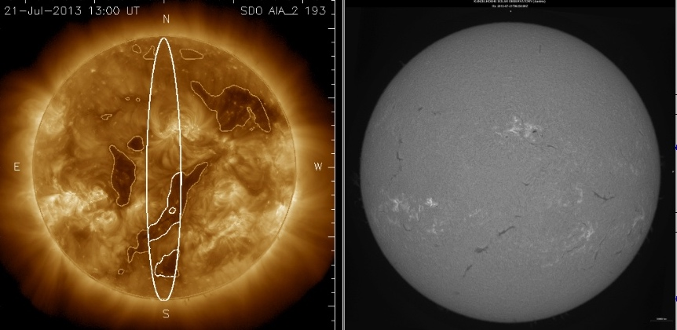
Filament channels vs. coronal holes
Filament channels erroneously extracted by the CH detection algorithm disturb the quality of forecasting the solar wind at Earth.
Kanzelhöhe Observatory UNI Graz
Compared to coronal holes, filament channels also show low intensity, but have a different magnetic configuration of a closed magnetic field structure (Gaizauskas, 1998).
Notes:
The detection of coronal holes purely from their low inten- sity in solar EUV images is a challenging task since filament channels also appear as dark coronal features. Filament channels are usually interpreted in terms of the weakly twisted flux rope model, having a magnetic field which is dominated by the axial component. Dense prominence material is located in the dip of the helical windings leading to the elongated dark structures observed at a similar dark intensity level as coronal holes (Mackay et al. 2010; de Toma 2011).
In the extraction process: Filament channels are sometimes identified by the algorithm as coronal holes, erroneously associated with an increase in the solar wind speed. Compared to coronal holes, filament channels also show low intensity, but have a different magnetic configuration of a closed magnetic field structure (Gaizauskas, 1998). To reject extracted boundaries coming from filament channels, a segmentation algorithm by separately inspecting the extracted boundaries with respect to their underlying magnetic field configuration is developed. From photospheric magnetic field data (MDI/SoHO; Scherrer et al., 1995), over the same time range as the EUV observations (EIT), the “open magnetic flux” covered by each boundary can be calculated from which filament channels and coronal holes can be distinguished. Compared to filament channels, coronal holes show a net open flux of a certain polarity which goes along with the interplanetary magnetic sector structure. The results can be cross-checked with H-alpha data in which filament channels filled with cold plasma (filaments, prominence – off-limb) can be cleraly observed.

Slide 12
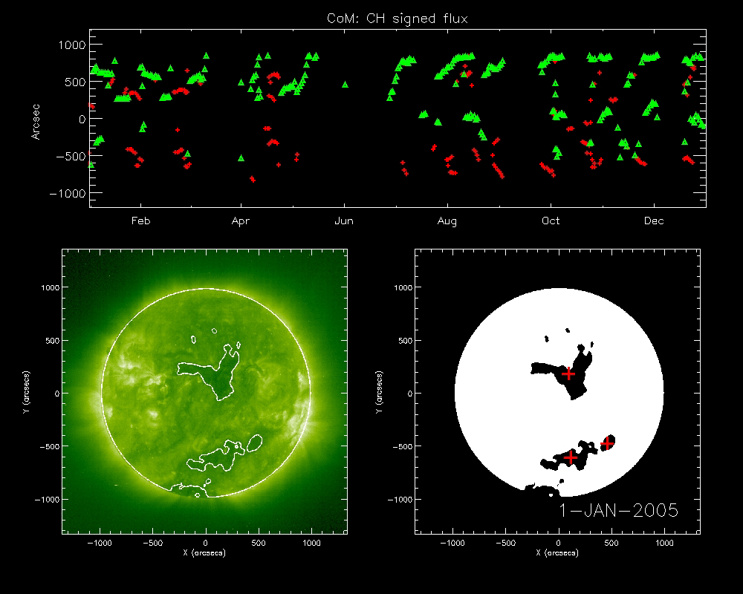
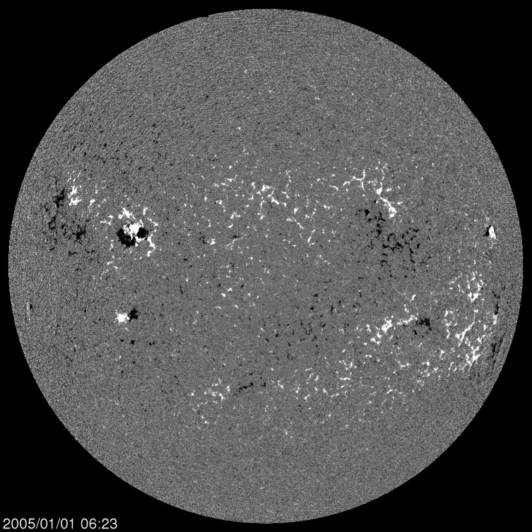
Filament channels vs. coronal holes
Coronal holes are regions of unipolar magnetic field. Filament channels are bipolar fields, consisting of closed (flux rope) magnetic field lines where plasma can be collected to finally form a filament.
ESA-NASA SoHO
Notes:
The signed magnetic flux as extracted from magnetic field data (SoHO MDI) is calculated within the boundary of each CH. As one can see, we derive the evolution of coronal holes as function of time. What is also striking, the polarity in the northern and southern hemisphere is the same. How come?

Slide 13
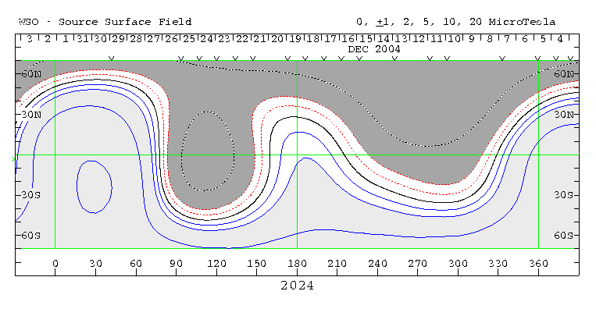
Coronal holes and the interplanetary magnetic field
Wilcox Solar Observatory Source Surface Synoptic Charts displayed using Carrington Coordinates. Each Carrington rotation is centered at a Carrington longitude of 180° (with a full rotation = 360°). Hence, these maps are wrapped onto the solar surface. The coronal magnetic field is calculated from photospheric field observations with a potential field model (PFSS).
Notes:
The distribution of magnetic field is shown here for an entire carrington rotation, PFSS extrapolated for a height of 2.5 solar radii. This directly shows that the coronal holes on either side of the solar equator can have the same (uni)polarity. The red dashed line gives the longitude where to look at (take the date, and then use the position relative to the central meridian. both coronal holes are close to disk center.)
Q: where would i look for the magnetic field distribution if the CH would be at W60°?
Wilcox Observatory: The coronal magnetic field is calculated from photospheric field observations with a potential field model. The field is forced to be radial at the source surface to approximate the effect of the accelerating solar wind on the field configuration. The *classic* computation locates the source surface at 2.5 solar radii, assumes that the photospheric field has a meridional component and requires a somewhat ad hoc polar field correction to more closely match the observations of the interplanetary magnetic field structure at Earth.
http://wso.stanford.edu/synsourcel.html
K.H. Schatten, J.M. Wilcox, and N.F. Ness, Solar Physics, 6, 442, 1969.
M.D. Altschuler, and G. Newkirk, Jr., Solar Physics, 9, 131, 1969.
J.T. Hoeksema, J.M. Wilcox, & P.H. Scherrer, JGR, 88, 9910, 1983.

Slide 14
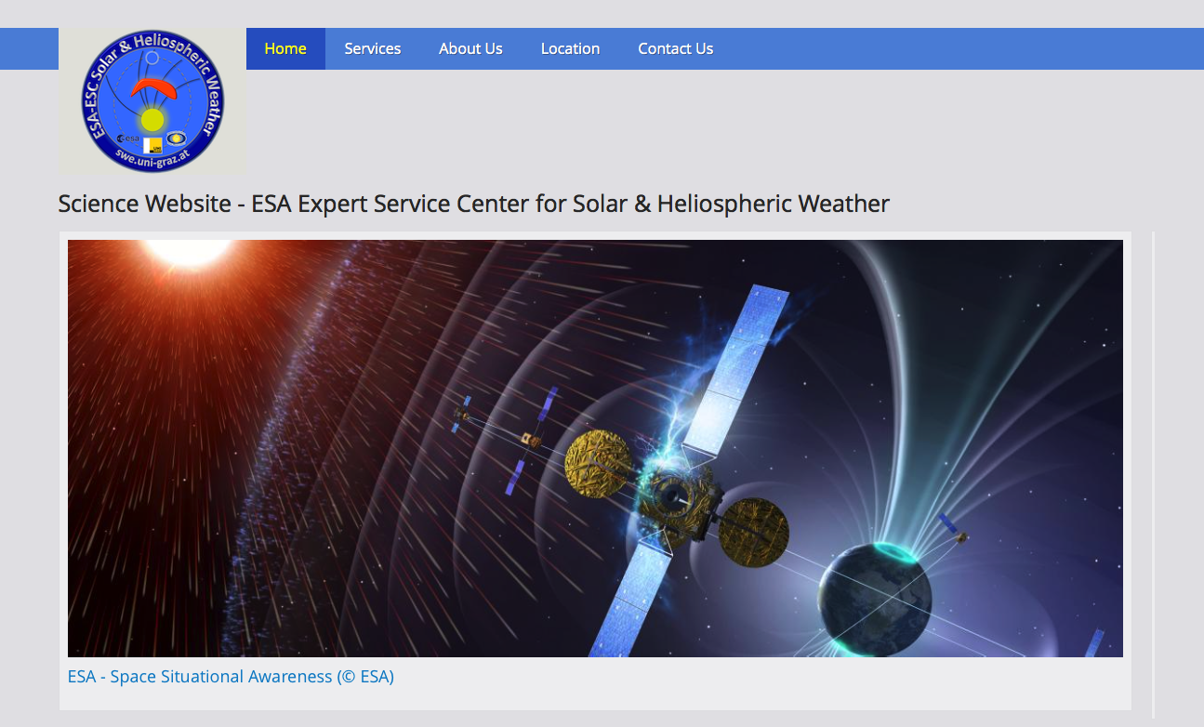
Hands on!
http://swe.uni-graz.at
Notes:
Hands on exercise! (ca 10minutes)
We have now a look how science driven tools are used for Space Weather. Go the the URL: swe.uni-graz.at, under „Services“ you will find an overview of current Space Weather Services provided by the University of Graz for ESA's Space Situational Awareness (SSA) Programme which was authorised at the November 2008 Ministerial Council and formally launched on 1 January 2009.
From ESA: The objective of the SSA programme is to support Europe's independent utilisation of, and access to, space through the provision of timely and accurate information and data regarding the space environment, and particularly regarding hazards to infrastructure in orbit and on the ground. In general, these hazards stem from possible collisions between objects in orbit, harmful space weather and potential strikes by natural objects, such as asteroids, that cross Earth’s orbit.
We will now have a closer look at the „Solar wind forecast“ and the „CME forecast“. Try yourself to use the models and interpret their results!

