Slide 1



Community Coordinated Modeling Center (CCMC)
Introduction to Space Weather:
Tools and Concepts
Flares and CMEs
A. Taktakishvili & CCMC Team
Science for Space Weather, Jan 24 – 29, 2016, Goa, India

Slide 2
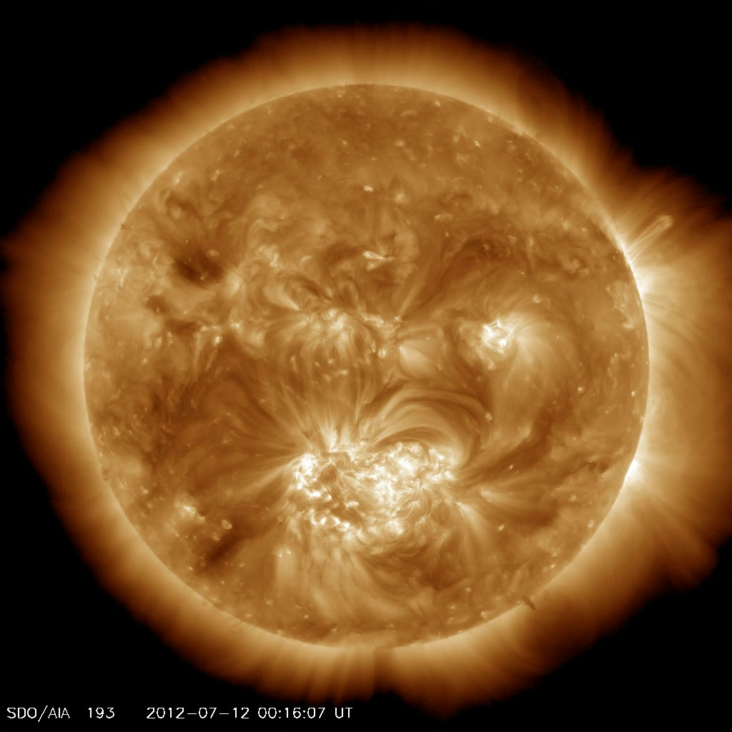
Solar Flare
2012, July 12
X1.4 class flare
X ray
EUV
Notes:
Solar flare is a sudden brightening observed over the Sun's surface or the solar limb, which is interpreted as a large energy release. Flares are mainly followed by a mass ejections from the solar atmosphere called coronal mass ejections. The flare ejects clouds of electrons, ions, and atoms through the corona of the sun into space.
In this slide is shown the solar flare of 2012 July 12.
The three color images show SDO satellite (http://iswa3.ccmc.gsfc.nasa.gov/wiki/index.php/Glossary) images of the same flare in three different wave length intervals: 1) the left is SDO EVE X-ray image (http://iswa3.ccmc.gsfc.nasa.gov/wiki/index.php/Full_iSWA_Cygnet_List
The central panel shows SDO AIA extreme ultraviolet image for 13.1 nm http://iswa3.ccmc.gsfc.nasa.gov/wiki/index.php/SDO_AIA_131
and the right hand side movie - for a shorter longer length of 19.3
nm http://iswa3.ccmc.gsfc.nasa.gov/wiki/index.php/SDO_AIA_193
In this slide is shown also in the lower left corner a magnetogram (
http://iswa3.ccmc.gsfc.nasa.gov/wiki/index.php/Glossary) - magnetic field map - of the solar photosphere for the same period of time. This flare is associated to the large and magnetically complicated active region in the southern hemisphere of the solar surface as is usually takes place.

Slide 3
Solar Flare Class
2012 July 12 X1.4 class flare
0.1-0.8 nm
0.05-0.4 nm
X (extreme)
log(flux)
[Wm^(-2)]
M (moderate)
C (common)
B (bgrnd)
A
X1.4 class: flux(0.1-0.8nm)[Wm^(-2)]=1.4*10^(-4)
Notes:
In this slide is shown the time line for the X-ray flux intensity
(http://iswa3.ccmc.gsfc.nasa.gov/wiki/index.php/GOES_X-RAY) for the same flare of 2012 July 12, in two different wave length intervals . A strong flare usually manifests itself by a sudden a jump of the X-ray intensity.
The flares are characterized by classes according to their X-ray flux intensity in the 0.1 – 0.8 nm wavelength range.
Flux[Wm^(-2)] > 10^(-4) X - (eXtreme), strong
Flux[Wm^(-2)] > 10^(-5) M – (Moderate)
Flux[Wm^(-2)] > 10^(-6) C – (Common)
Flux[Wm^(-2)] > 10^(-7) B – (Background)
Flux[Wm^(-2)] > 10^(-8) A
M1.4 class flare that at the peak the flare intensity was equal to:
flux/Wm^(-2)=1.4*10^(-4)

Slide 4
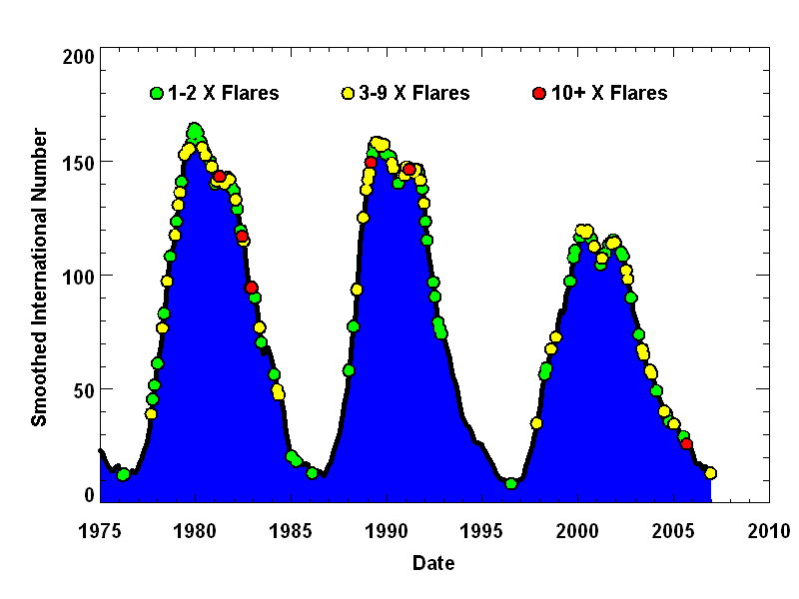
Flares over the Solar cycle
Solar flares have been monitored by x-ray detectors on GOES satellites since 1976. The number of X-Class flares per month increases with the number of sunspots but big flares can occur anytime sunspots are present.
Notes:
Solar flares have been monitored by x-ray detectors on GOES satellites since 1976.
In this plot the frequency of the X-class flares is plotted over the sunspot number plot. Green dots represent 1-2 X-class flares, yellow – 3-9 X-class flares and red – 10+ X class flares.
You can see that the number of X-Class flares per month increases with the number of sunspots, but big flares can occur anytime sunspots are present.

Slide 5
Flare Characteristics
Flares tend to occur in isolation, localized in space and time but with strong correlations.
Typically one active region will produce dozens of flares, especially during periods of flux emergence (often near the beginning of the lifetime of a given region, but not always).
The most powerful events usually occur in active regions.
Notes:
Flares tend to occur in isolation, localized in space and time but with strong correlations; typically one active region will produce dozens of flares, especially during periods of flux emergence (often near the beginning of the lifetime of a given region, but not always). The most powerful events usually occur in active regions.

Slide 6
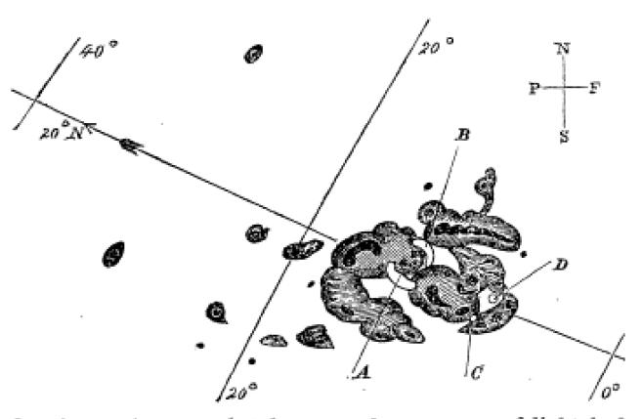
Solar Flare Discovered
In 1859 Richard Carrington reported observing a large sunspot group on the afternoon of September 1st when “…two patches of intensely bright and white light broke out…”
Notes:
In 1859 Richard Carrington reported observing a large sunspot group on the afternoon of September 1st when “…two patches of intensely bright and white light broke out…”. The flare was followed by a major coronal mass ejection (CME) to travel directly toward Earth, taking 17.6 hours. This second CME moved so quickly because the first one had cleared the way of the ambient solar wind plasma.
On September 1–2, 1859, the largest recorded geomagnetic storm occurred. Aurorae were seen around the world, even over the Caribbean; those over the Rocky Mountains were so bright that their glow awoke gold miners, who began preparing breakfast because they thought it was morning. People who happened to be awake in the northeastern US could read a newspaper by the aurora's light.
Telegraph systems all over Europe and North America failed, in some cases shocking telegraph operators. Some telegraph systems continued to send and receive messages despite having been disconnected from their power supplies.

Slide 7
Flare: SWx impacts
Cause radio blackout through changing the structures/composition of the ionosphere (sudden ionospheric disturbances) – x ray and EUV emissions, lasting minutes to hours
Affect radio communications, GPS, directly by its radio noises at different wavelengths
Contribute to SEP – proton radiation, lasting a couple of days
Notes:
Cause radio blackout through changing the structures/composition of the ionosphere (sudden ionospheric disturbances) – x ray and EUV emissions, lasting minutes to hours
Affect radio communications, GPS, directly by its radio noises at different wavelengths
Contribute to Solar Energetic Particle events (SEP) – proton radiation, lasting a couple of days

Slide 8
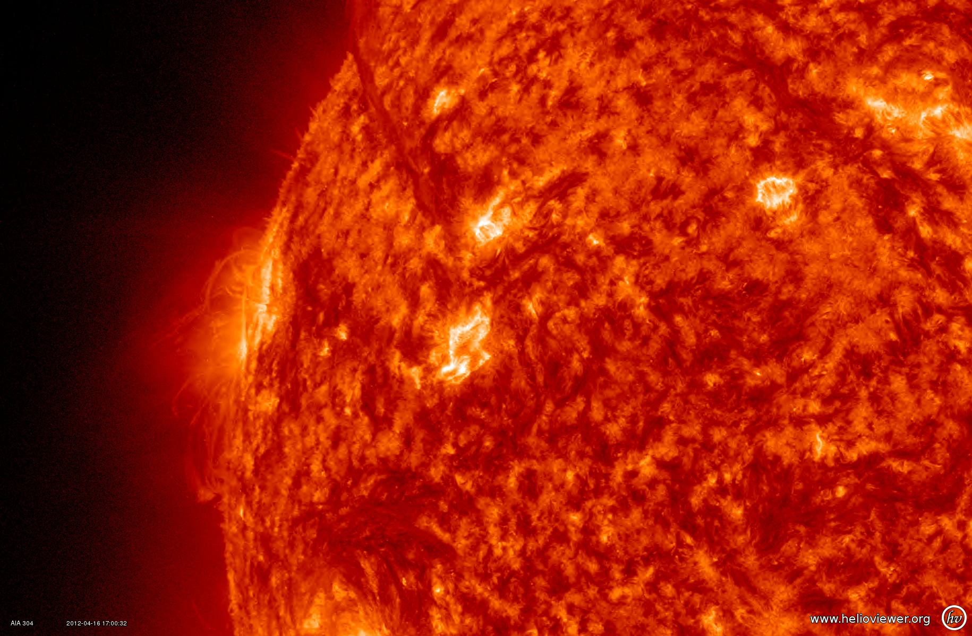
Coronal Mass Ejection
Coronal Mass Ejection – Reaches the Earth in 1-3 days
Notes:
Solar flares are often accompanied by so called Coronal Mass Ejection (CME), when huge mass of solar plasma erupts from the solar atmosphere. http://iswa3.ccmc.gsfc.nasa.gov/wiki/index.php/Glossary ).
If CME is directed towards Earth, it can reach the Earth in 1-3 days, , depending on it’s speed and size. CMEs are usually causing the strongest geomagnetic storms.

Slide 9
CME/flare
The most energetic CMEs occur in close association with powerful flares. Nevertheless large-scale CMEs do occur in the absence of major flares even though these tend to be slower and less energetic.
When strong flare/CME occurs, it gives off emission across the whole electromagnetic spectrum, at the same time energetic particles
Notes:
The most energetic CMEs occur in close association with powerful flares. Nevertheless large-scale CMEs do occur in the absence of major flares even though these tend to be slower and less energetic.
When strong flare/CME occurs, it gives off emission across the whole electromagnetic spectrum, at the same time energetic particles.

Slide 10
Most of the CMEs Originate
From the Active Regions
2012 July 12 X1.4 class flare and a following CME
Notes:
In this slide is shown the solar flare of 2012 July 12 yet again and the following CME in the SDO EUV 193 image.
You can see the motion of the material and opening of the coronal loops in the area adjacent to the flare and the active region.

Slide 11
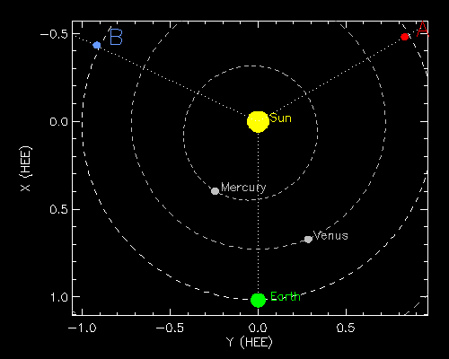
July 12, 2012CME Viewed by
Coronagraph Imagers
Notes:
But the better view of a CME and its motion in the interplanetary space can be obtained from the coronograph images. Coronographs create an artificial eclipse of the sun. Eclipses allow corona to be better viewed, but natural eclipses do not happen often. Occulting disk blocks the bright sun so we can observe corona features.
This slide shows the same CME seen in 3 coronographs located on three different satellites. The schematic in the upper center shows the location of STEREO B, SOHO and STEREO A satellites in the ecliptic plane at the time when the CME occurred.
The CME was moving sort of towards the Earth, so STEREO B sees it moving to the right in its plane of sky, for STEREO A it moves to the left and it’s a halo image for SOHO that is located on a sun-earth line.

Slide 12
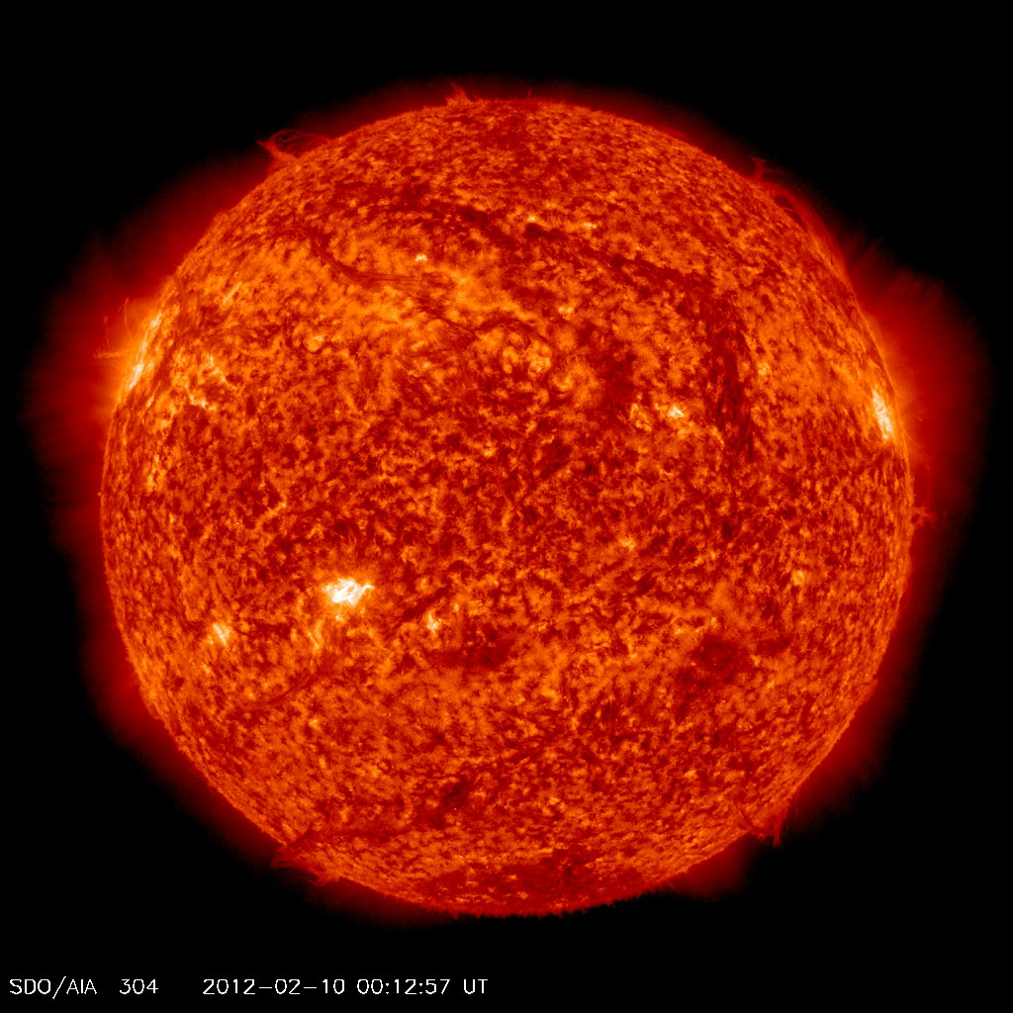
CME from a Filament Eruption
Northeast (upper left) quadrant starting around 19:00 UT on Feb 10, 2012
Notes:
Not all CMEs originate from the active regions. Here is shown an example of a CME caused by so called filament eruption. Filaments are formed in magnetic loops that hold relatively cool, dense gas suspended above the surface of the Sun. Most of the filaments are created by stretching of the active regions with two different polarities due to the differential motion of the solar photosphere material. Magnetic instabilities cause filaments to raise and parts of it disconnect from the solar surface resulting into CMEs.

Slide 13
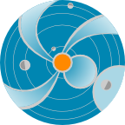

CME Properties
Mass: ~10¹⁵⁻¹⁶ g
Speed: few hundred - 3000km/s
..or
Mass: ~1 million Nimitz-class aircraft carriers
Speed: 1.5 -10 million km/hour
Earth?
Arrives to Earth in 1-2 days
Notes:
CME properties:
Mass: ~10¹⁴kg
Speed: few hundred - 3000km/s
In other words:
Mass: ~1 million Nimitz-class aircraft carriers
Speed: 1.5 -10 million km/hour
If it hits the Earth, it can have a significant impact.

Slide 14
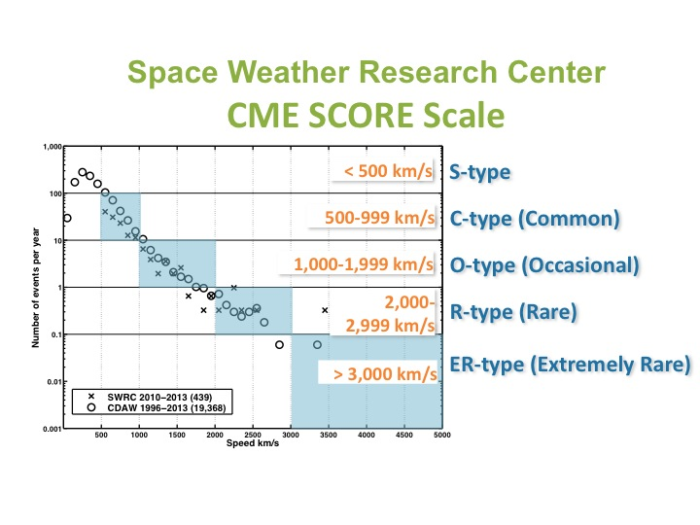
CME SCORE
• A simple new category system for CMEs based on frequency of detection and speed
• Complements Flare Classes
• Applicable in space weather operations and research
Notes:
Recently we, here at SWRC, introduced, as we call it, CME SCORE scale, a simple new category system for CMEs based on frequency of detection and speed.
It complements flare classes and is applicable in space weather operations and research.
The graph here shows the frequency of the CME detection (number of events per year) as a function of the CME speed. Bin size is 100 km/s.
So we have S-type CMEs with the speed less then 500/km/s, C-type (common) for the range 500-999, O-type (occasional) for 1000-1999, R-type (rare) for 2000-2999 and ER-type (extremely rare) CMEs for CME s with the speed more then 3000 km/s.

Slide 15
Geomagnetic Storm Caused
by the CME Arrival
CME Arrival at ACE
Notes:
When the CME arrived to the ACE satellite, close to the Earth, it caused a shock seen here in the magnetic field and the solar wind speed measurements by ACE. This impact caused a strong disturbance in the Earth’s magnetosphere or as they call it geomagnetic storm.

Slide 16
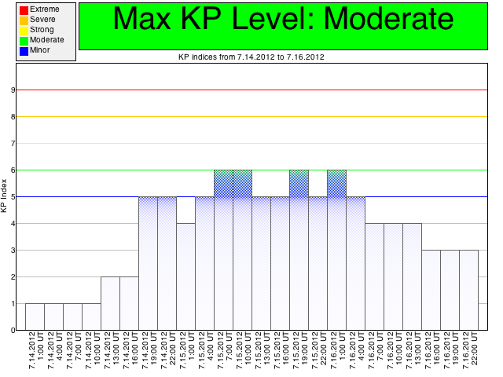
Geomagnetic Storm Caused
by the CME Arrival
Kp – index (German “Kennziffer” – characteristic digit)
Notes:
The strength of the geomagnetic storm is measured by so called Kp index, which characterizes degree of the disturbance of the Earth’ magnetic field ground base measurements. Kp goes from 0 to 9. This storm with Kp=6 is considered to be a moderate one.

Slide 17
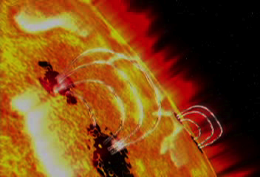
Physical Mechanism Behind
the Flares and CMEs
It is believed that solar magnetic field, releases energy, accelerating solar plasma and causing flares and CMEs. Magnetic reconnection.
Notes:
What is the mechanism behind the flares and CMEs. It is believed that the magnetic field can change its configuration in a constantly varying solar atmosphere and during this reconfiguration it releases energy accelerating
solar plasma causing flares and CMEs. The scientists are still debating on the details of the mechanisms, but the fact that the magnetic field is involved somehow is accepted by everybody.

Slide 18
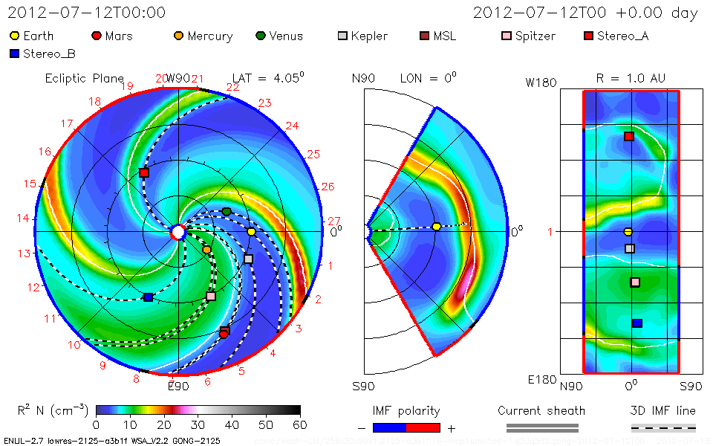
CME Modeling
Notes:
This movie shows WSA-ENLIL modeling of the same July 12, 2012 CME. In all three panels normalized solar wind density is plotted.
In the left panel is shown the view from the Solar north pole down to the ecliptic plane, where all the planets are moving around the sun. Yellow circle is the Earth, orange, closest to the sun, is the Mercury, green – Venus, red – Mars, red and blue squares are STEREO A and B satellites respectively. Strictly speaking the first panel shows cut through a plane passing through the Earth and is parallel to the Sun’s equatorial plane.
The second plane is a meridianal cut passing through the Earth. The latitude goes from -60 to 60 degrees.
The third panel shows Longitude-Latitude map of a quasi sphere at 1 AU cut for latitudes with absolute values more than 60 deg.
You can see that CME causes enormous disturbance throughout the whole heliosphere. Sometimes CMEs are called space hurricanes. For terrestrial (regular) weather we need to know the propagation path and strength of a hurricane. The same way in space weather we need to know the propagation path and strength (speed, mass) of a CME to estimate it’s possible impact.

Slide 19
SWx impacts of CME
Contribute to SEP (particle radiation): 20-30 minutes from the occurrence of the CME/flare
Result in a geomagnetic storm: takes 1-2 days arriving at Earth
Result in electron radiation enhancement in the near-Earth space: takes 1-3 days
Affecting spacecraft electronics – surfacing charging/internal charging:
Radio communication, navigation, power grids, pipelines, and so on
Notes:
Contribute to SEP (particle radiation): 20-30 minutes from the occurrence of the CME/flare
Result in a geomagnetic storm: takes 1-2 days arriving at Earth
Result in electron radiation enhancement in the near-Earth space: takes 1-3 days.

