Slide 1
Ionospheric Models and Their Uncertainties
Ludger Scherliess and Robert W. Schunk
Center for Atmospheric and Space Sciences
Utah State University
GEM Mini-Workshop
San Francisco
December 2015

Slide 2
Problems with Physics-Based Models
• Relatively Simple Math Formulations →Diffusion, MHD, etc.
• Uncertain Parameters
→ Chemical Rates, Collision Freq., etc.
• Incomplete or Approximate Coupling Kinetic & Fluid Formulations
• Spatial & Temporal Resolutions are Coarse
• Missing Physics
→ Entire Chapman Conference was dedicated to these problems
Notes:
2

Slide 3
The primary source of ionization is solar
EUV and X-ray radiation
Topside
O⁺+H ⇔ H⁺+O
F-Region
O+hν → O⁺+e*
O⁺+N₂ → NO⁺+N
O⁺+O₂ → O₂⁺+O
O⁺
700
Altitude (km)
He⁺ H⁺
F2
200
O⁺
F1
E
100
NO⁺ O₂⁺ N₂⁺
D
10⁵
10⁶
Electron Density (cm⁻³)
Typical daytime mid-latitude Ionosphere.
λ < 796 Å F-region λ ~ 796 – 1027 Å E-region

Slide 4
Transport Processes
Development of the Equatorial Ionization Anomalies
D. Anderson

Slide 5
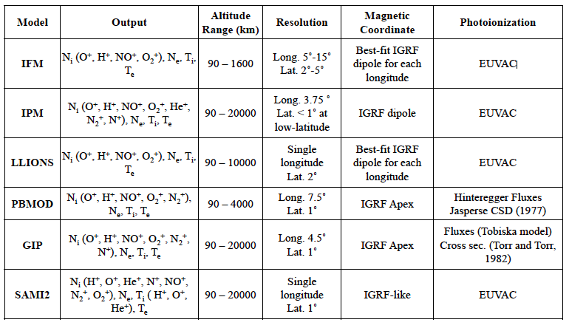
Stand-Alone Ionospheric Models
Notes:
5

Slide 6
Equatorial-PRIMO
(Problems Related to Ionospheric Models and Observations)
T.-W. Fang, D. Anderson, T. J. Fuller-Rowell, G. H. Millward
CIRES/University of Colorado
R. A. Akmaev, M. Codrescu
NOAA Space Weather Prediction Center
J. Sojka, L. Scherliess
Center for Atmospheric and Space Sciences, Utah State University
V. Eccles
Space Environment Corporation
J. Retterer
Air Force Research Laboratory
J. Huba
Plasma Physics Division, NRL
G. Joyce
Icarus Research, Inc.
A. D. Richmond, A. Maute
NCAR/HAO
G. Crowley
ASTRA
A. Ridley, G. Vichare
Center for Space Environment Modeling, University of Michigan

Slide 7
Equatorial Primo Study
Simulating Conditions
Models were run for
March equinox
F10.7 cm flux value of 120
geomagnetic quiet (e.g. Ap<5)
All stand-alone models used:
Scherliess-Fejer E×B drift model
NRLMSISE-00
HWM93
The Burnside factor was set to 1.
Results were compared in the Peruvian longitude (~ 284°E)
Notes:
7

Slide 8
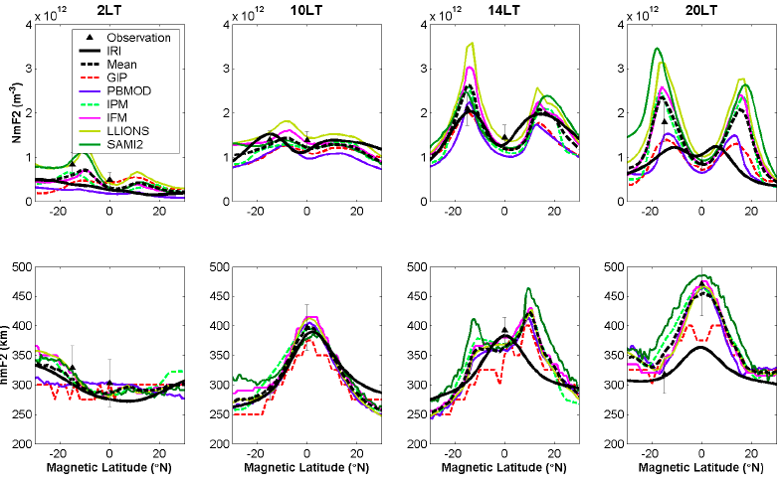
Equatorial Primo Study
Model comparison in Peruvian longitude (~ 284°E)
NmF2
hmF2
Fang et al., 2013
Differences in NmF2 exceed 100%
Notes:
8

Slide 9
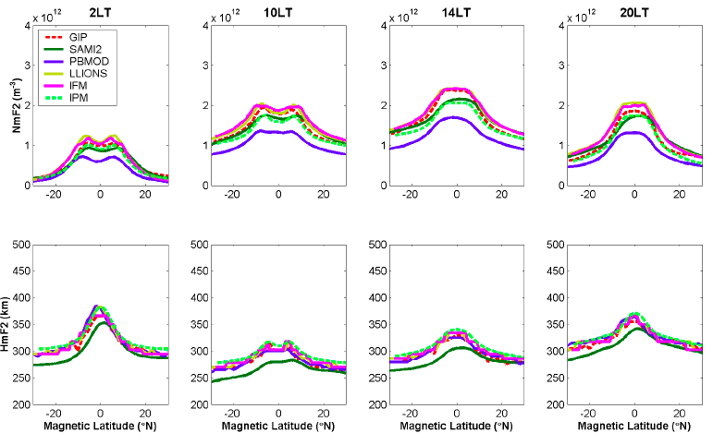
Equatorial Primo Study
Case 1: No ExB drift, no neutral wind (Production and Loss)
NmF2
hmF2
Fang et al., 2013
Notes:
9

Slide 10
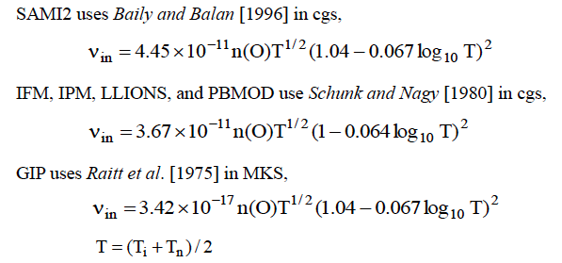
Equatorial Primo Study
All models used the same:
zonal and meridional neutral winds (HWM-93)
Neutral composition (NRL-MSIS00)
b. vertical drifts (S&F empirical model)
But they differ in the ion-neutral collision frequency (O-O+)
Notes:
10

Slide 11
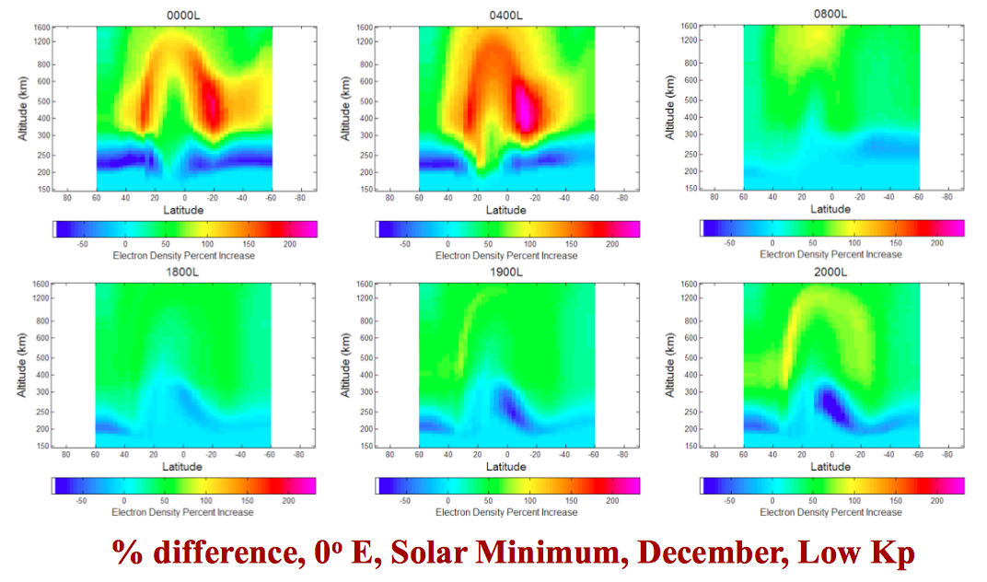
O⁺ - O Collision Frequency
Factor of 2 – Factor of 1
Jenniges et al. (2010)
Notes:
11

Slide 12
Determining Uncertain Parameters in IFM
→ Unbiasing the Model (Zhu et al. 2006)
• IFM TEC Compared to TOPEX TEC
• TOPEX Measures Vertical TEC Over Oceans (1340 km)
• 10 - Year TOPEX Data Base (1992-2003)
• 18-Sec Averaged Data = 11 Million TEC Values
• Comparisons Covered Different Seasonal, Solar Cycle, and Magnetic Activity Conditions
• Uncertain Parameters in the IFM Adjusted to Bring IFM into Better Agreement with TOPEX TEC
• Also Compared to 10-year Ionosonde Dataset
Notes:
12

Slide 13
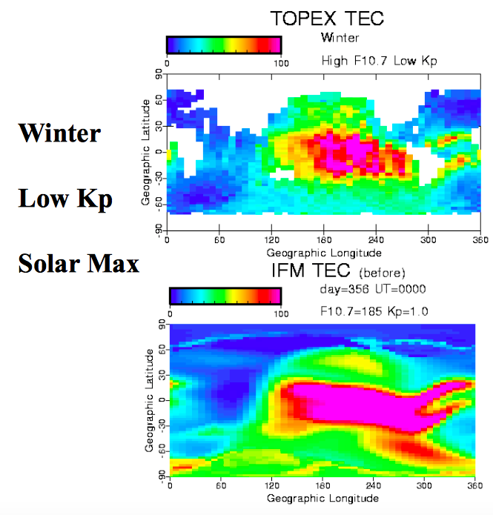
TOPEX TEC
IFM (before)
Zhu et al., 2006
Notes:
13

Slide 14
TEC Ratio:
IFM(before)/TOPEX
Notes:
14

Slide 15
TEC Ratio:
IFM(before)/TOPEX
TEC Ratio:
IFM(after)/TOPEX
Zhu et al., 2006
Notes:
15

Slide 16
TEC Ratio:
IFM(before)/TOPEX
IFM Parameters Adjusted:
• O⁺ - O Collision Frequency • Secondary Electron Production
• Zonal Neutral Wind • Equatorial Electrical Field
Zhu et al., 2006
Notes:
16

Slide 17
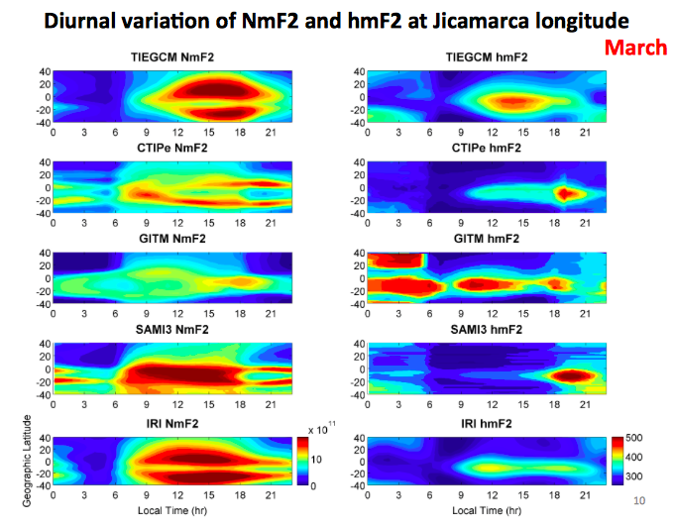
Are Coupled Models the Answer to the Problem?
Diurnal Variation of NmF2 and hmF2 at Jicamarca Longitude
NmF2
March
hmF2
Local Time
Local Time
Fang et al., 2014
Notes:
17

Slide 18
Independent Studies by CCMC have indicated:
The agreement between ionospheric models and observations is complicated.
Often stand-alone ionosphere models agree better with observations than coupled Ionosphere-Thermosphere (IT) models.
Data Assimilation models agree with the observations and can help to elucidate the problems with ionospheric models!
Notes:
18

Slide 19
Notes:
19

Slide 20
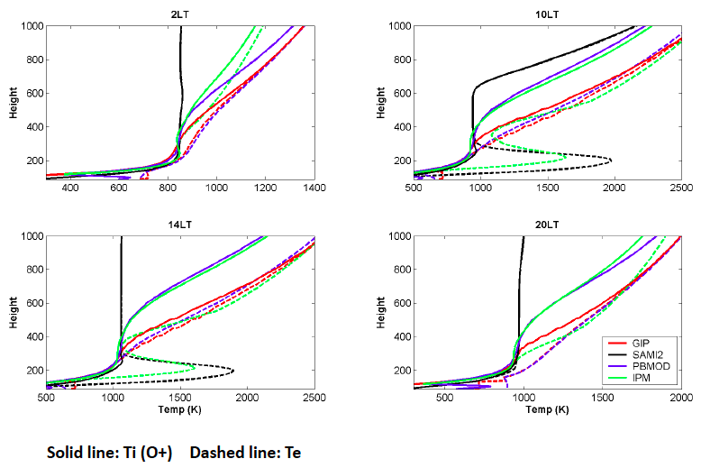
Equatorial Primo Study
Ion and Electron Temperatures
Fang et al., 2013
Notes:
20

