Slide 1
Validation of Ionospheric Models using COSMIC TEC Measurements
K. F. Dymond, S. A. Budzien, C. Coker, C. Metzler,
S. E. McDonald, and K. Zawdie
Space Science Division Naval Research Laboratory Washington, DC

Slide 2
Introduction
Assessed ionospheric models against slant TEC (STEC) to assess model accuracy
Most ionospheric studies validate ionospheric model output against vertical total electron content (TEC)
STEC is a more stringent test of the models because it assesses the model’s horizontal AND vertical gradients
Time interval of study: 2012 days 126-172 (May 5 – June 20)
Time interval was an arbitrary choice based on GAIM data availability from runs made at NRL
Runs using ground-based GPS, ionosondes, and COSMIC-RO
Models tested:
USU-GAIM – NRL runs assimilating ground-based GPS, ionosondes, and COSMIC-RO
IRI 2007 & 2012
NeQuick – European model
SAMI-3 runs (different time period Oct-Dec 2011)

Slide 3
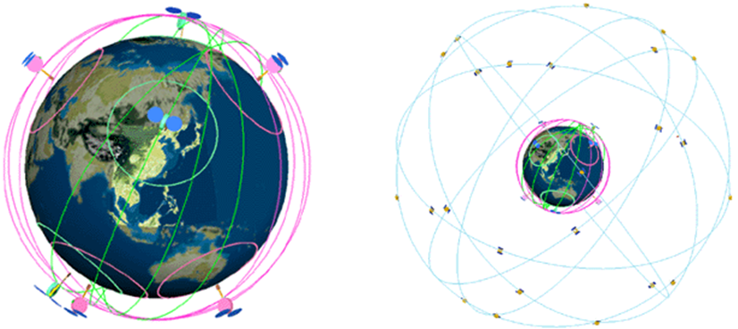
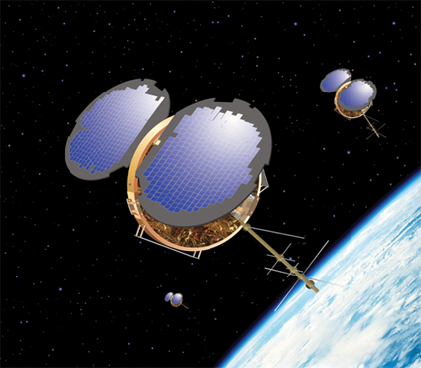
COSMIC Satellites Constellation Observing System for Meteorology, Ionosphere, & Climate
COSMIC is a joint mission between the US and Taiwan, (Republic of China)
6-satellites launched into LEO orbit on April 14, 2006
Principal instrument is the GPS Occultation Experiment (GOX)
~2500 occultations made per day
Slant TEC routinely inverted to produce electron density profiles
Products are available on-line at the UCAR CDAAC website

Slide 4
COSMIC STEC vs. Models
The Slant Total Electron Content for each model studied was calculated for each line of sight from all occultations
There were 44,872 COSMIC occultations available during this time interval
For a total of 20,834,046 lines-of-sight
Complete global and local time coverage
To minimize model representation error and to better inter-compare models
All models run on GAIM spatial and temporal grid: resulting in similar representation errors between models
Electron density interpolated onto line of sight using tri-cubic Catmull-Rom spline interpolators and integrated
8th order Simpsons’ rule integrations were used with 101 points along the LOS to minimize representation error
Testing indicated line-of-sight integration error <0.1%

Slide 5
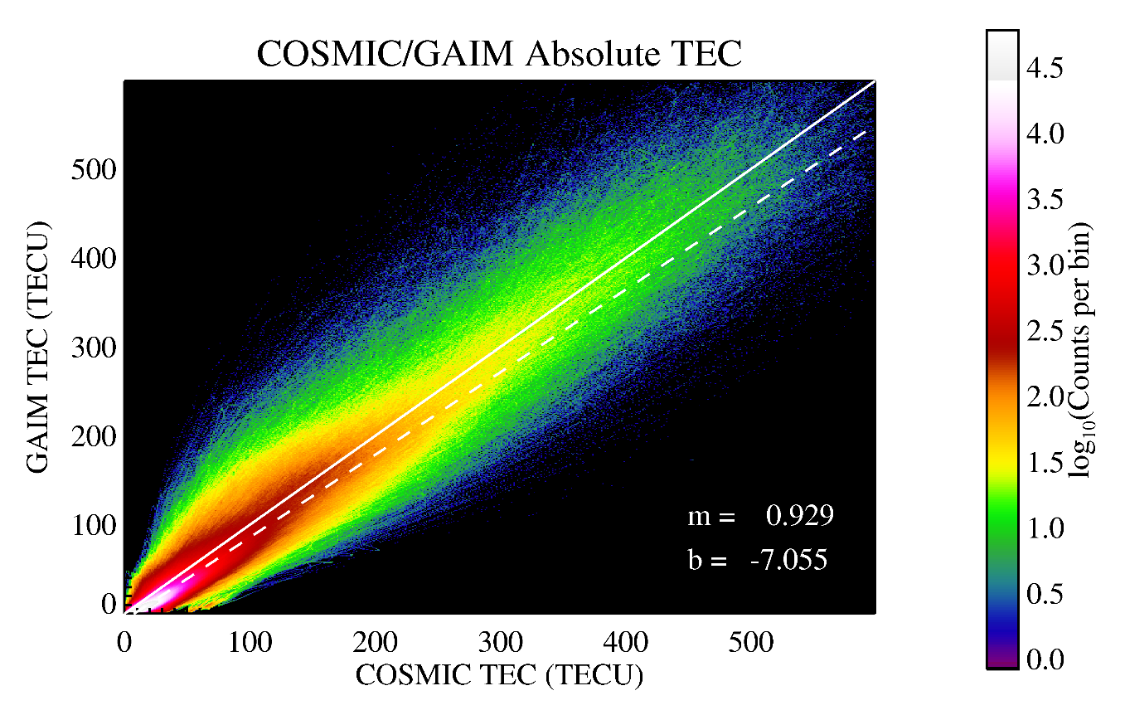
GAIM-NRL/COSMIC Comparison Absolute TEC
Base 10 logarithm of the frequency of occurrence of pairs of TEC values is shown
Solid white line indicates unity slope – perfect correlation
Dashed line indicates trend-line
High degree of correlation between GAIM and COSMIC TECS
There is a TEC bias present – indicates TEC from plasmasphere
Trend line slope is less than unity – GAIM is underestimating TEC by ~7%
The Scatter-plot comparison tells you how well GAIM data assimilation is doing in reproducing the observed ionosphere and any biases present

Slide 6
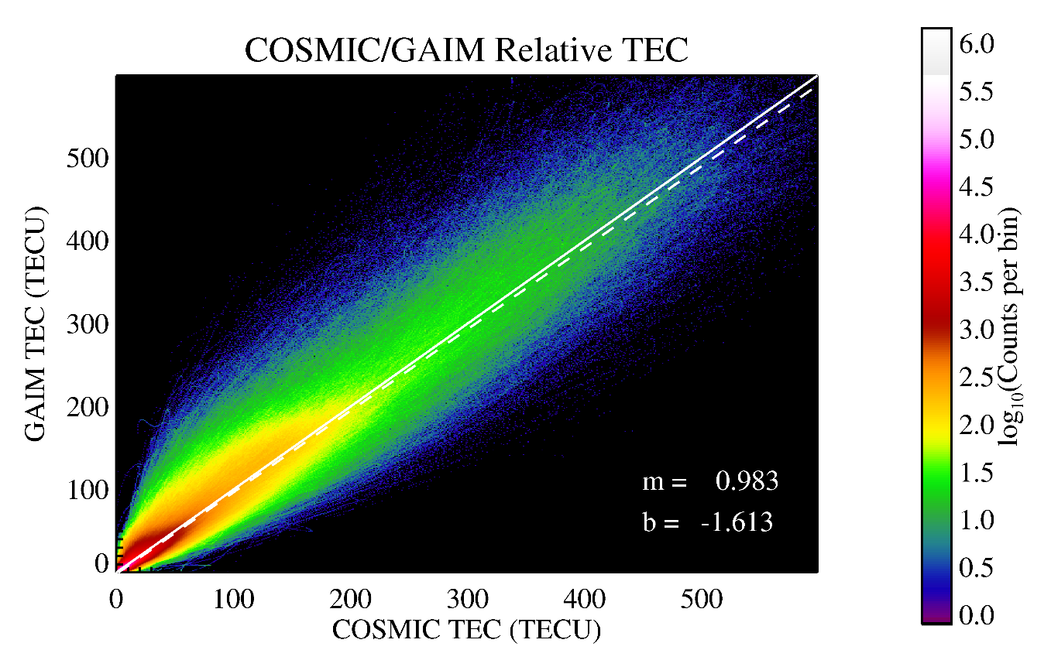
GAIM-NRL/COSMIC Comparison Relative TEC
Topside TEC at 0° elevation is subtracted from each profile
Removes some of the plasmasphere bias
White line indicates unity slope – perfect correlation
High degree of correlation between GAIM and COSMIC TECS
TEC bias much smaller than it was for absolute TEC
Trend line slope indicates GAIM underestimating TEC by ~2%
The Scatter-plot comparison tells you how well GAIM data assimilation is doing in reproducing the observed ionosphere

Slide 7
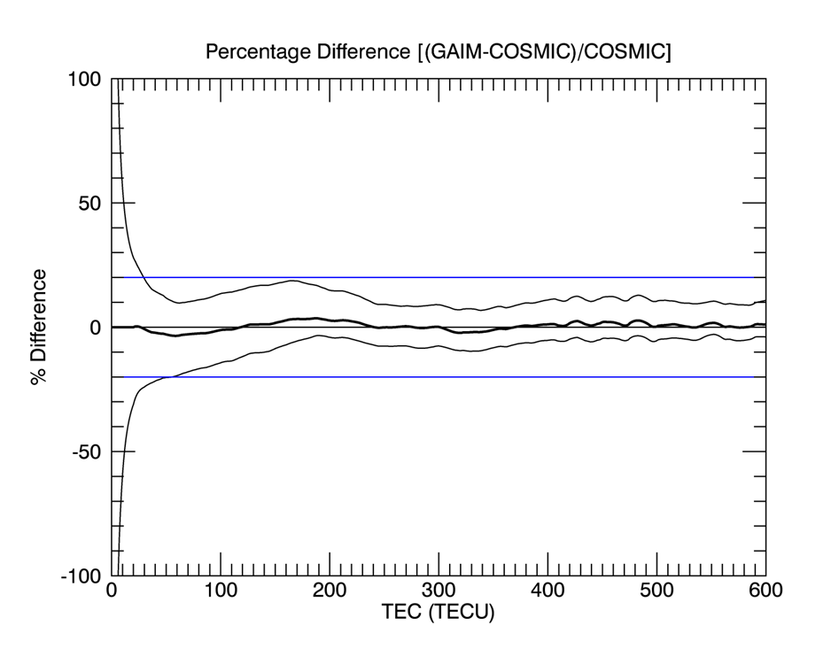
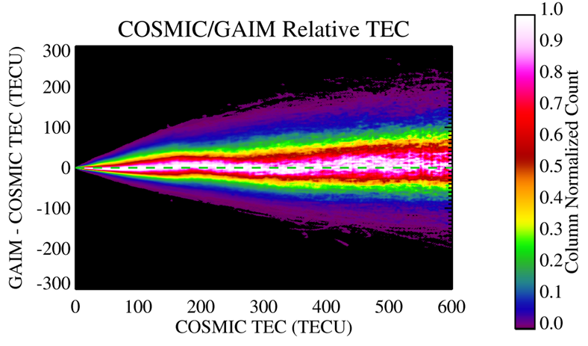
GAIM Model Scatter vs. TEC
Left image is scatter plot rotated by 45° and column normalized
Shows width of scatter distribution
Right image shows percentage difference vs. TEC
Agreement is good and scatter is ~±10%, slightly higher at low TECs

Slide 8
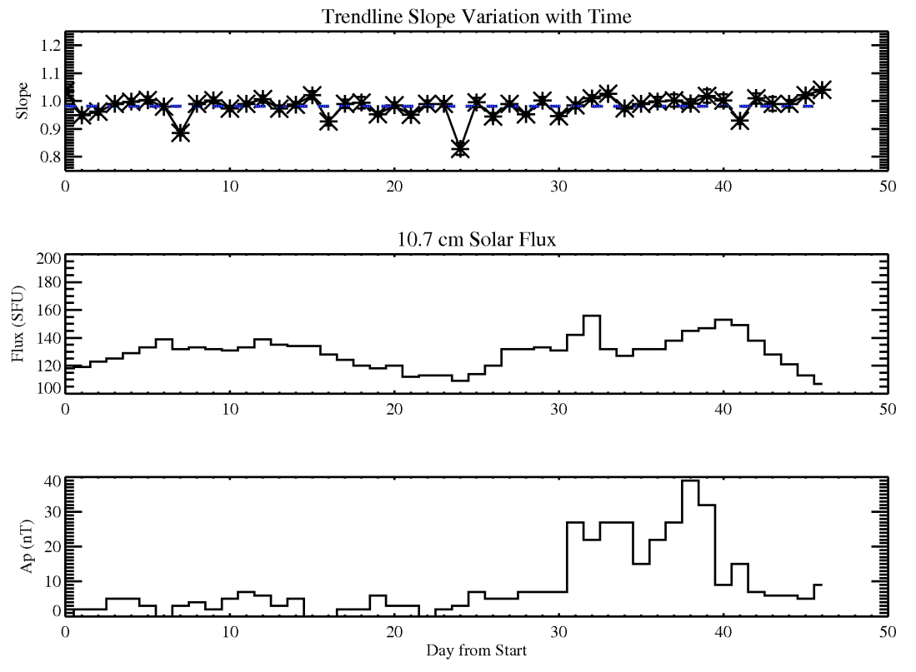
Cause of Scatter
Tested three potential causes of scatter
Geomagnetic and solar variability
Day-to-day variability of space weather & data availability
Model resolution (next page)
Top plots show variation of trend line slope as a function of time starting from May 5, 2012
Top panel shows variation of trend line slope with time, uncertainty in the slope is smaller than plot symbols
Center panel shows 10.7 cm solar flux variability – affects photochemical creation of the ionosphere
Bottom panel shows a_{p} (in nano-Teslas) geomagnetic index – an indicator of variations in plasma transport due to magnetospheric influences
No correlation is evident between geomagnetic indices and trendline slope ➔ scatter is not caused by geomagnetic or solar activity
Notes:
Geomagnetic and solar effects are not responsible for the scatter by themselves. GAIM tries to capture the effects of space weather through data assimilation, and apparently does a good job.

Slide 9
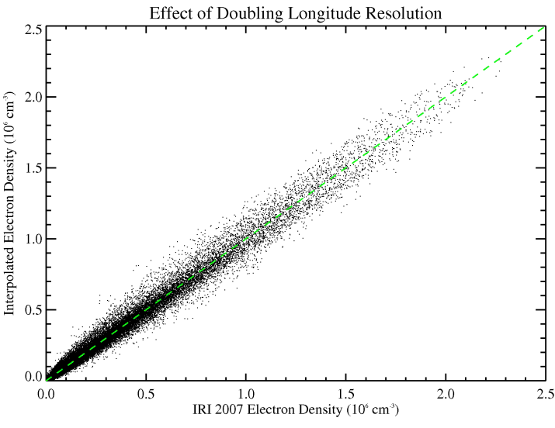
Model Spatial Resolution
Plot shows the effect of model resolution on the scatter
IRI2007 was used as a proxy for GAIM as its gradients should be similar to those in GAIM
IRI2007 was run at 7.5° longitude resolution and compared to interpolations of IRI2007 run at the 15° resolution of GAIM
Results indicate the model spatial resolution is one of the primary causes of the scatter
Notes:
Model spatial resolution is a problem. To decrease representation errors when performing line-of-sight integrations or ionospheric raytracing, interpolation of the GAIM electron densities is used. This study used tri-cubic spline interpolators. The results suggest that simply increasing the model resolution might improve the geolocation accuracy.

Slide 10
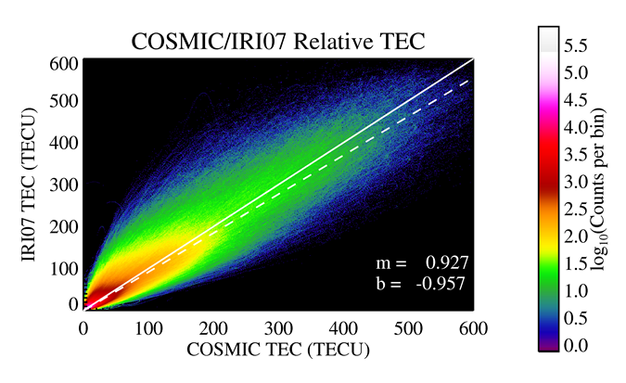
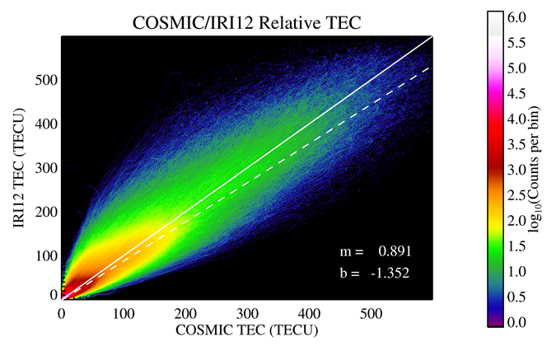
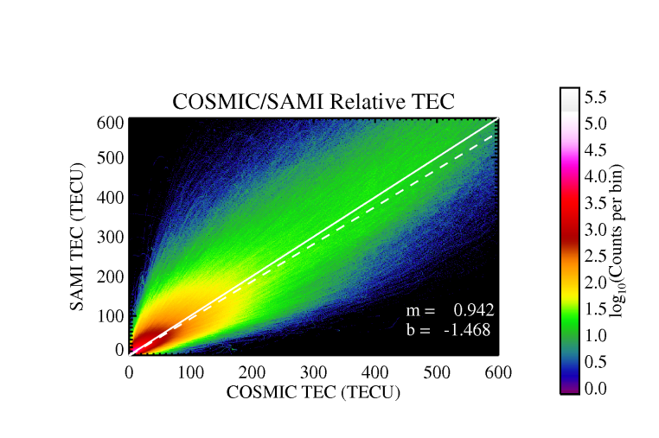
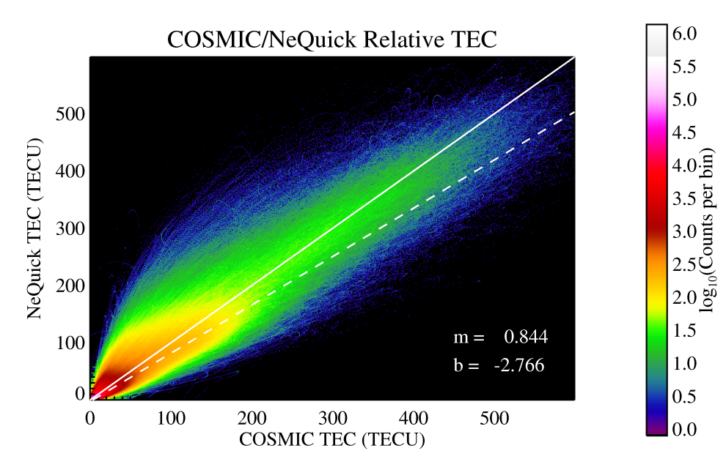
Results: Model Comparisons
(a)
(b)
(c)
(c)
Notes:
Solid white lines are of unity slope indicating perfect agreement between model and measurements. Dashed lines show the data trendlines. All models are in reasonable agreement with the data indicating that the models can be used in data assimilation schemes.

Slide 11
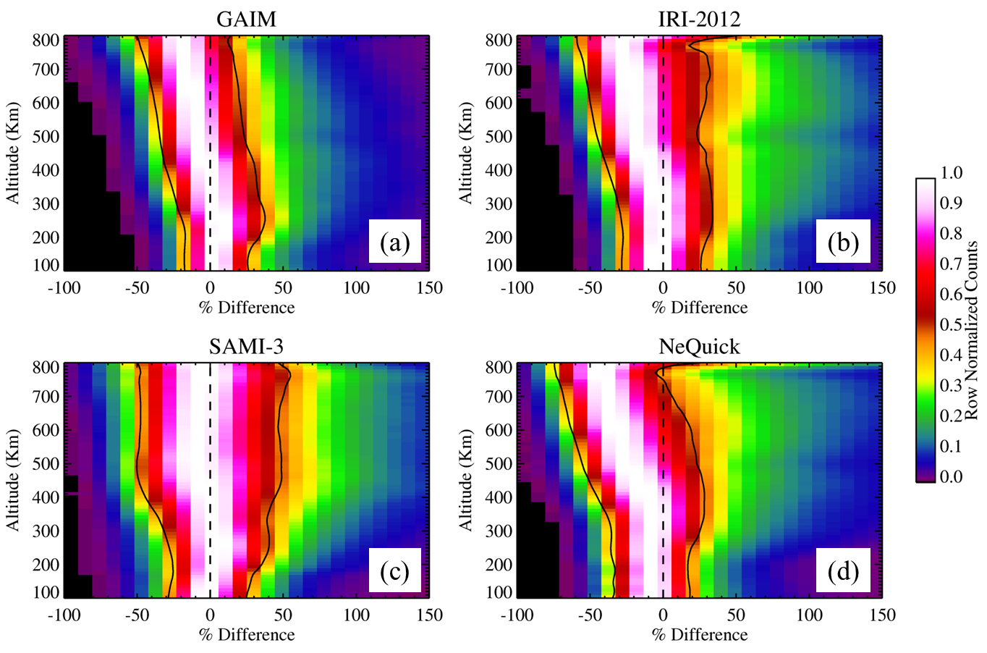
Topside TEC Errors

Slide 12
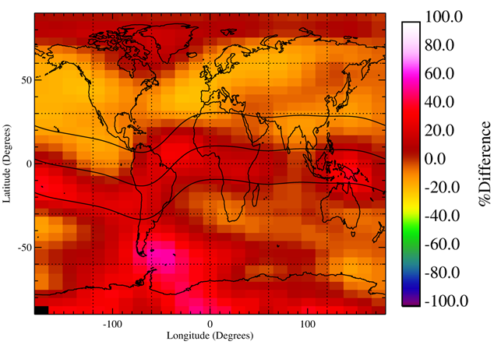
GAIM and Data Sources
Map of mean percentage difference between GAIM and COSMIC TECs
Areas with largest errors: Southern hemisphere, EIA, and Weddell Sea Anomaly ➔ Data poor regions!

Slide 13
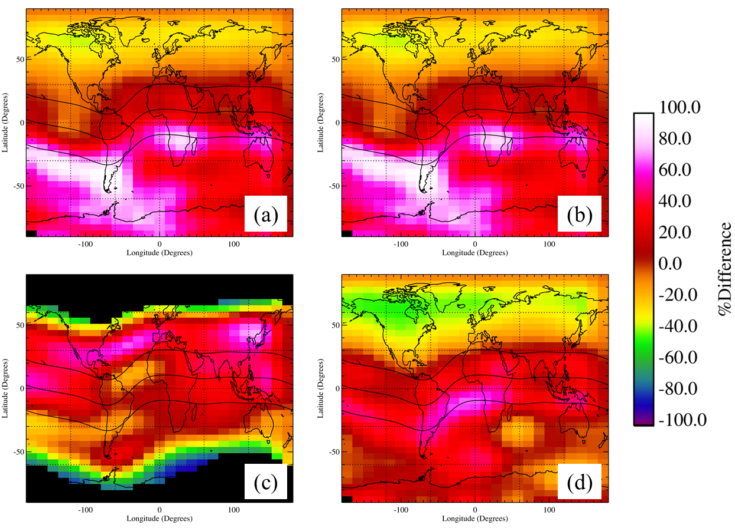
Where the Models Work Best
IRI-07
IRI-12
Sami-3
NeQuick

Slide 14
Summary
All models did a reasonable job of ionospheric specification
Topside biases toward lower TECs seen in all models
Plasma temperature might be too low
Or, light ion concentrations need to be investigated
GAIM & empirical models tended to perform better where there are measurements
Affected GAIM data assimilation
Affect empirical models causing N/S asymmetries
SAMI-3 showed hemispheric asymmetries that were opposite to the other models
Problem with meridional winds?

Slide 15
Backup Slides

Slide 16
Summary: GAIM
The GAIM model agreed very well with the measured COSMIC RO slant TECs
However, the scatter between the measurements and the model is problematic
This is approximately ±10% at all TEC values
A 1-σ error of 10 TECU at 100 TECU
Poor spatial resolution and few sources for ingested data cause this error
Also, there is a topside bias of ~-15% ➔ this can lead to vertical TEC and nmF2 errors
Might have been fixed when the vertical correlation length was increased to accommodate SSULI data

Slide 17
Summary: Other Models
The other models agreed reasonably well with the measured COSMIC RO slant TECs
However, the scatter between the measurements and the models is problematic
The scatter was larger than GAIM’s 10% at all TEC values ➔ especially for SAMI-3
Results might be improved by tweaking the model inputs to adjust to the geomagnetic and solar conditions
Also, there are a topside biases present
These are from 25-50% ➔ these can lead to vertical TEC and nmF2 errors
All models are showing N/S asymmetries larger errors in the Southern hemisphere, the EIA, and in the Weddell Sea Anomaly ➔ traditionally data poor areas

