Slide 1
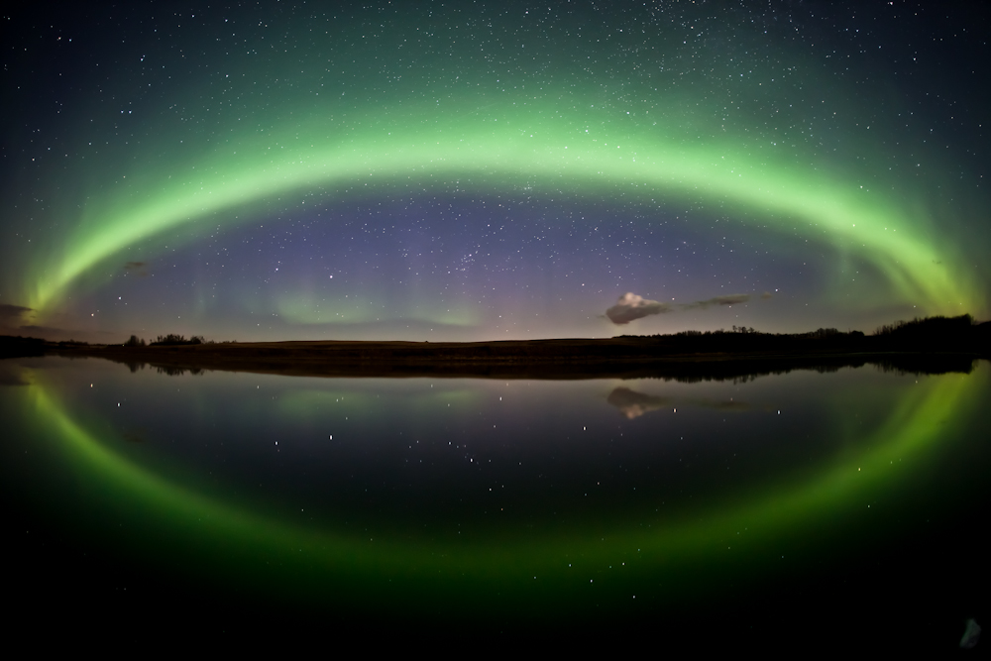
Auroral Precipitation Model Validation – What has been done
Started with equatorward boundary - discussed at previous mini-GEM workshops
Discussed different boundary definition criteria (physical boundary based, threshold-based) – the document is posted at the CCMC website
Invited the community’s participation in the model validation effort
Participating models: old Hardy, New Hardy, Ovation Prime, Weimer, coupled global MHD model with Fok ring current model, AMIE
Maj. Cory Lane (now Lt. Col. Lane) worked with CCMC on auroral model validation (paper of the results submitted to Space Weather Journal - Under review)
  During low to moderate Kp conditions, Ovation Prime has the best prediction efficiency and OH (Old Hardy) closely follows. SWMF-Fok and AMIE suffer
  High Kp: SWMF-Fok provides the best prediction effeciency
Connecting auroral properties/boundaries to other important physical parameters/processes in the same region such as Poynting flux, Joule heating, field-aligned currents, or total electron content, etc. so that a better understanding of the ITM coupling can be understood. Some of these have been explored. More remains to be done.

Slide 2
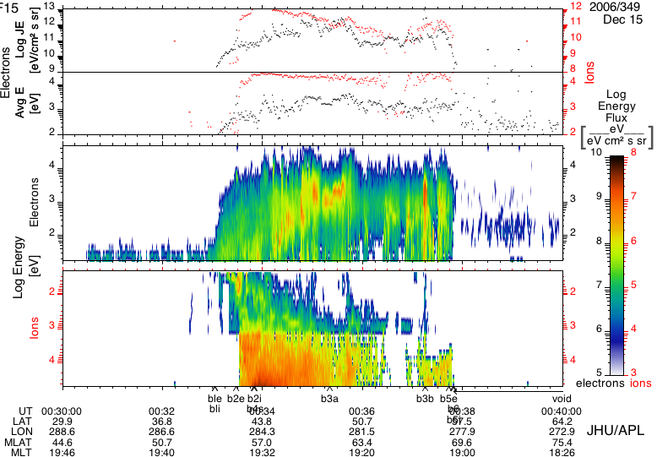
Poynting Flux vs Aurora Precipitation
Equatorward
Poleward
Dusk:
Eqbn: equatorward disturbance of Poynting flux
Pobn: last local maximum on the poleward side
Poleward

Slide 3
Nightside: Region 1 FAC vs Aurora Precipitation
Ohtani et al., 2009, JGR

Slide 4
Statistical relationship between FACs and e- precipitation
Ordered by IMF clock angle
Korth, H., Y. Zhang, B. J. Anderson,
T. Sotirelis, and C. L. Waters (2014),
Statistical relationship between largescale
upward field-aligned currents
and electron precipitation, J. Geophys.
Res. Space Physics, 119, 6715–6731,
doi:10.1002/2014JA019961.
Southward IMF: e- precipitation occurred primarily within and near large-scale upward currents. The correspondence less evident for northward IMF.
Better correlation in the dusk sector than other local time sectors between FACs and e- precipitation (due to different physical processes operating in different local time sectors).
TIMED/GUVI
AMPERE

