Slide 1
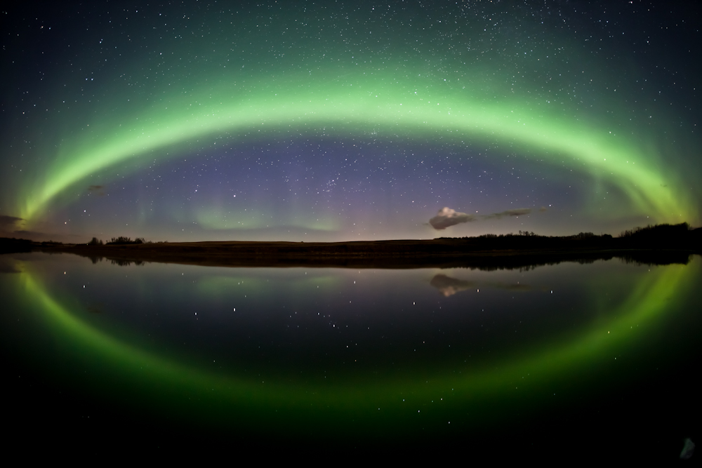
Auroral Boundaries Model Validation – What has been done

Slide 2
Challenge:
Identified boundaries in auroral region from observations and models
Relate boundaries to applications
Look for multi-point observations, multiple crossings, images
Correlations between boundaries associated with different parameters

Slide 3
Connecting auroral boundaries to important physical parameters/processes in the same region such
- Poynting flux, Joule heating,
field-aligned currents,
total electron content,
Auroral precipitation in different energy ranges, boundaries based on thresholds.
Key to magnetosphere-ITM coupling.

Slide 4
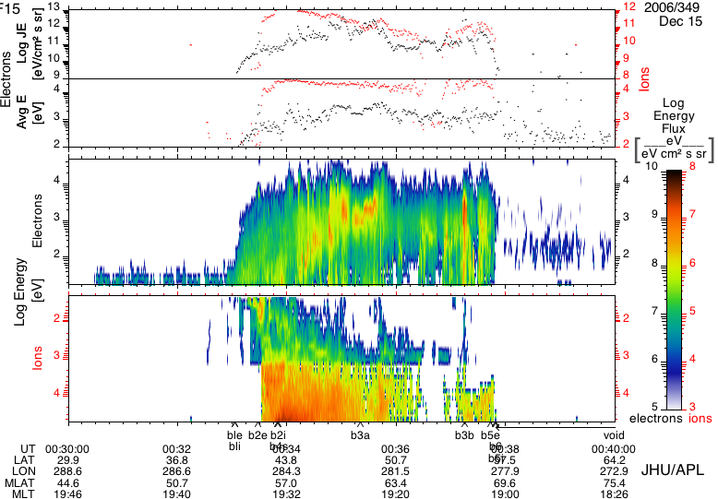
Poynting Flux vs Aurora Precipitation
Equatorward
Poleward
Dusk:
Eqbn: equatorward disturbance of Poynting flux
Pobn: last local maximum on the poleward side
Poleward

Slide 5
Nightside: Region 1 FAC vs Aurora Precipitation
Ohtani et al., 2009, JGR

Slide 6
Statistical relationship between FACs and e- precipitation
Ordered by IMF clock angle
Korth, H., Y. Zhang, B. J. Anderson,
T. Sotirelis, and C. L. Waters (2014),
Statistical relationship between largescale
upward field-aligned currents
and electron precipitation, J. Geophys.
Res. Space Physics, 119, 6715–6731,
doi:10.1002/2014JA019961.
Southward IMF: e- precipitation occurred primarily within and near large-scale upward currents. The correspondence less evident for northward IMF.
Better correlation in the dusk sector than other local time sectors between FACs and e- precipitation (due to different physical processes operating in different local time sectors).
TIMED/GUVI
AMPERE

