Slide 1
TEC and its Uncertainty
Ludger Scherliess
Center for Atmospheric and Space Sciences
Utah State University
GEM Mini-Workshop
San Francisco
December 2014

Slide 2
Total Electron Content (TEC)
Total number of electrons in a column
with cross section of 1m2
(1 TECU = 1016 electrons/m2)
1m²
Notes:
2

Slide 3
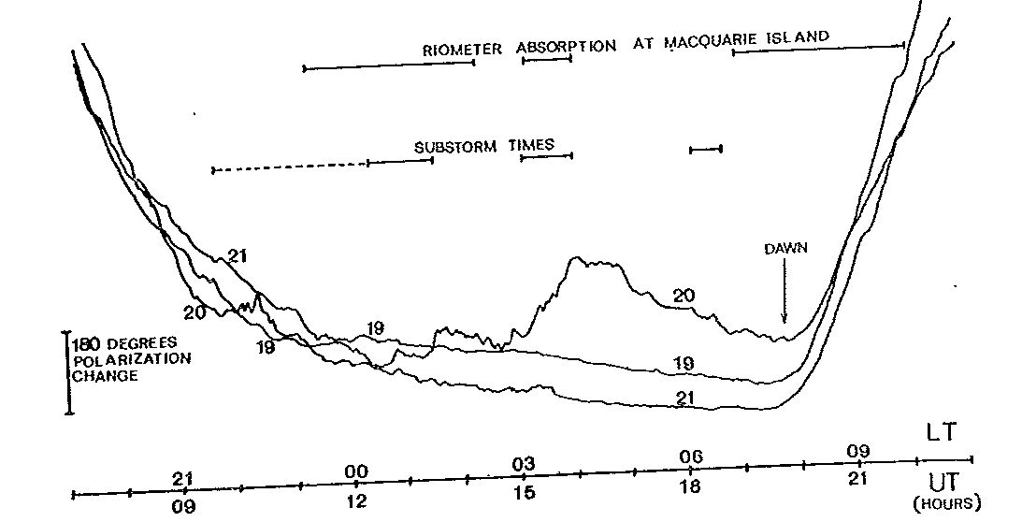
TEC Measurements
Use Ionospheric effects on radio wave propagation
  Faraday rotation of the polarization angle of a radio wave
  → Require magnitude of the geomagnetic field
TEC from Macquarie Island for 19-21 May, 1970
180º = 2.5 TECU
Essex and Watkins, 1973
3
3
Notes:
3

Slide 4
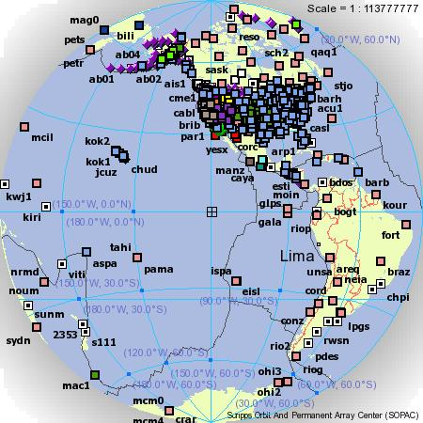
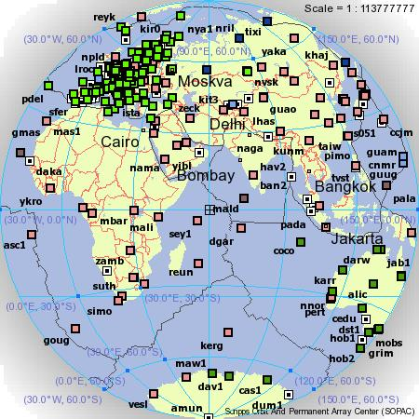
TEC Measurements
Use Ionospheric effects on radio wave propagation
  Ionospheric effects on GPS signals
  Time delay of signal
  Phase advance of carrier wave
SOPAC Online Map Interface (http://sopac.ucsd.edu/cgi-bin/smi)
4

Slide 5
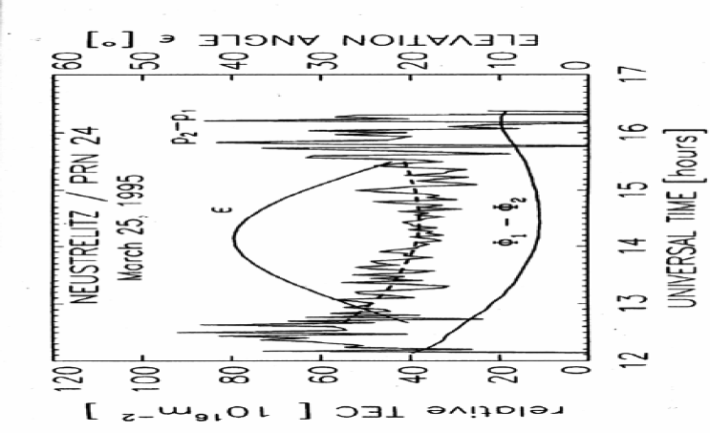
Differential Range and Differential Phase
A dual-frequency GPS receiver provides pseudorange and carrier phase measurements in both L1 and L2 frequencies
Differential Time Delay
Noisy
“Absolute” TEC
₊
Differential Phase
Accurate (0.01 TECU)
Relative TEC
Jakowski, 1996
Notes:
Differential Phase Method is the same as the differential time delay method except group velocity is replaced by phase velocity. This relative measurement is more accurate, but there is multiple 2 pi ambiguity in the relative phase.
Here, noisy one is absolute measurement and more accurate one is relative measurements,
Therefore, combination of the two methods (that is If you level up this one to absolute one) absolute and relative measurements provides better TEC data as I mentioned before.
5

Slide 6
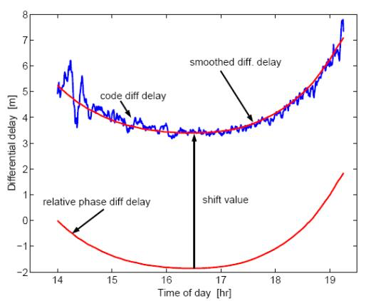
Differential Range and Differential Phase
A dual-frequency GPS receiver provides pseudorange and carrier phase measurements in both L1 and L2 frequencies
Leveling
Combination of the two methods by leveling the accurate but relative phase TEC to the noisy but absolute pseudorange values we obtain a better TEC estimate.
₊
Problem: Result is still biased (differential code biases)
Notes:
Differential Phase Method is the same as the differential time delay method except group velocity is replaced by phase velocity. This relative measurement is more accurate, but there is multiple 2 pi ambiguity in the relative phase.
Here, noisy one is absolute measurement and more accurate one is relative measurements,
Therefore, combination of the two methods (that is If you level up this one to absolute one) absolute and relative measurements provides better TEC data as I mentioned before.
6

Slide 7
Many ways to get GPS Biases
TEC_{abs} = TEC_{rel} + DCB_{GPS} + DCB_{REC}
Least-Squares
Kalman Filter
  Universität Bern Astronomisches Institut
    (http://aiuws.unibe.ch/ionosphere/)
    P1P2 and P1C1 files (satellite biases, IGS stations)
GAIM Models
  Use bias file for satellites and available stations
  Others build into Kalman filter
Biases lead to uncertainties in absolute TEC of the order of about 1-4 TECU

Slide 8
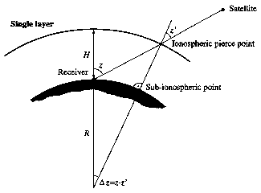
Slant Total Electron Content (sTEC)
To convert sTEC to vTEC often a so-called single-layer model is used.
All free electrons are assumed to be contained in a thin shell at altitude H.
The altitude of this idealized layer is often set to 400 km approximately corresponding to the altitude of maximum electron density.
Notes:
8

Slide 9
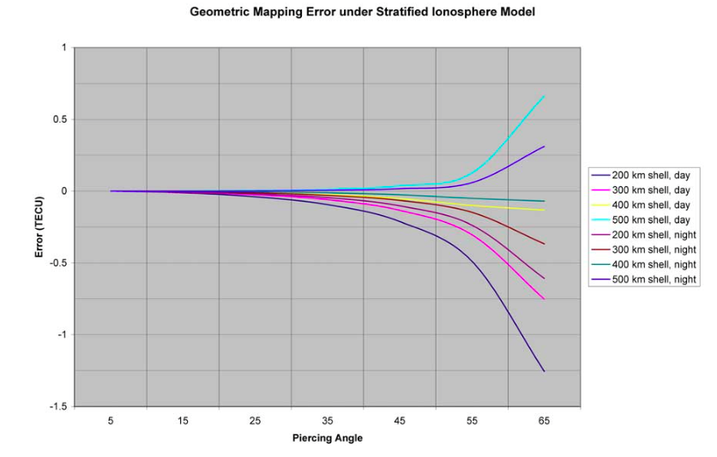
Mapping of sTEC to vTEC
Errors can reach as high as 14% on days of no strong ionosphere activity
Smith et al., 2008
Notes:
9

Slide 10
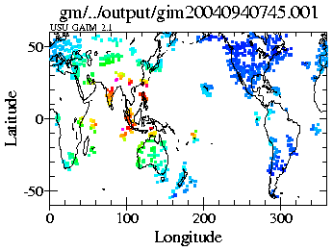
Example of GPS TEC measurements
Slant TEC Values have been mapped to the Vertical
Plotted at the 300 km pierce-point

Slide 11
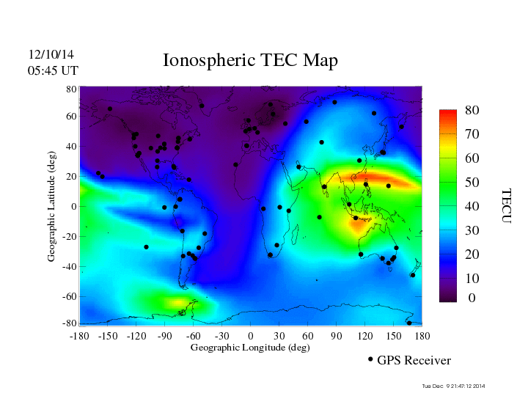
2D TEC Maps
http://iono.jpl.nasa.gov/latest_rti_global.html

Slide 12
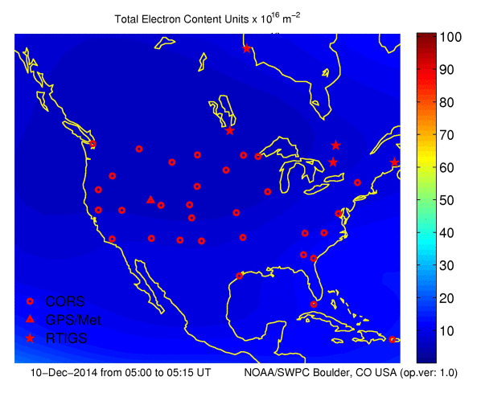
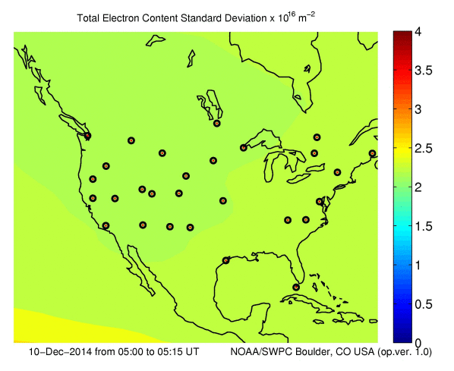
TEC Maps
TEC
Standard Deviation
http://origin-www.swpc.noaa.gov/products/us-total-electron-content

Slide 13
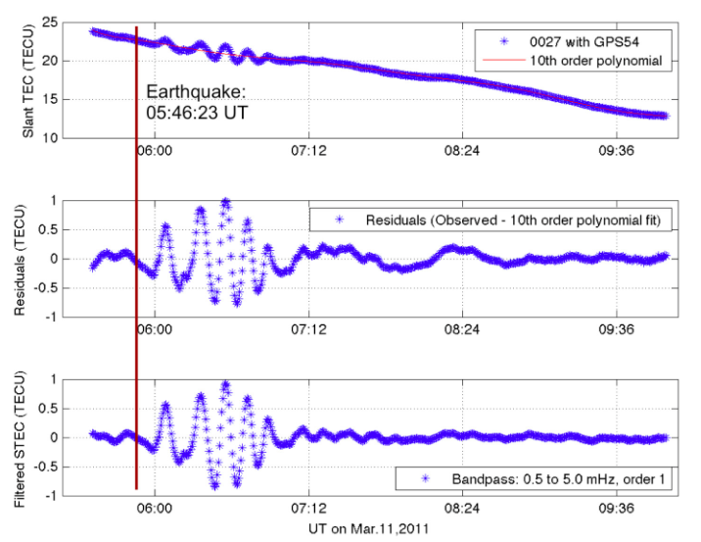
Differential (Relative) TEC
Uninterrupted GPS data along a particular receiver-satellite link with no cycle slips is very precise (~0.01 TECU)
Time Evolution of relative TEC (high precision) can be observed over several hours.
Errors due to instrumental biases cancel.
High relative accuracy can be achieved.
Useful to capture transient events and/or gradients.
However, often absolute values are of importance.
Galvan et al., 2014
Tohoku-Oki Earthquake and Tsunami in Earth's Upper Atmosphere

Slide 14
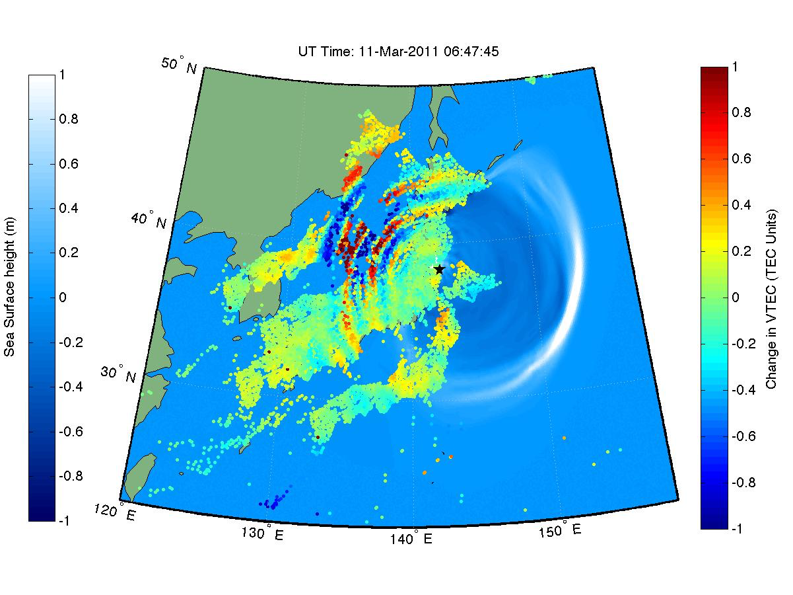
Differential (Relative) TEC
Tohoku-Oki Earthquake and Tsunami in Earth's Upper Atmosphere
http://photojournal.jpl.nasa.gov/catalog/PIA14430

Slide 15
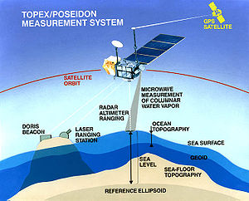
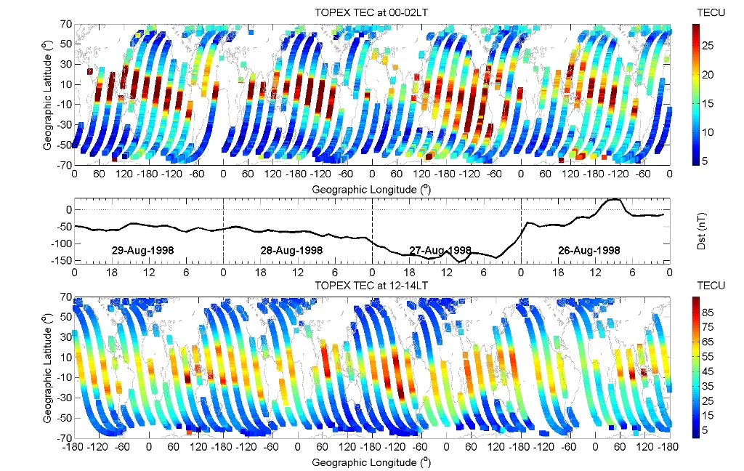
Vertical Total Electron Content from TOPEX/Jason
TOPEX and Jason satellites provide vertical TEC (up to about 1300 km altitude) over the oceans from 1992 until now.
http://lion.iggcas.ac.cn:8080/index.php/News/view2/id/34
Largest errors are associated with biases of the order of 3-5 TECU.
Notes:
15

Slide 16
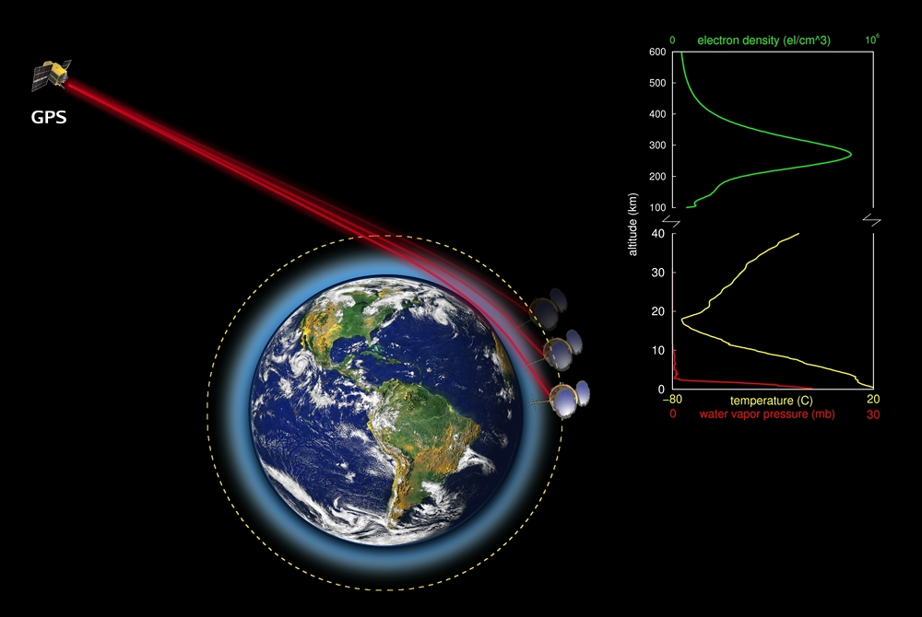
Slant Total Electron Content (sTEC)
COSMIC-2 Accuracy Requirements:
Relative TEC: 0.3 TECU Accuracy
Absolute TEC: 3 TECU Accuracy
Yue et al., 2014
Notes:
16

