Slide 1
Modeling Challenges in TEC
and Neutral Density
Geoff Crowley
Chief Scientist/President
ASTRA
Boulder, Colorado
USA

Slide 2
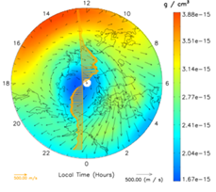
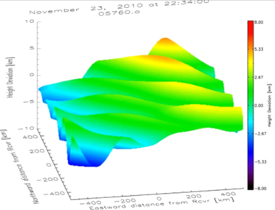
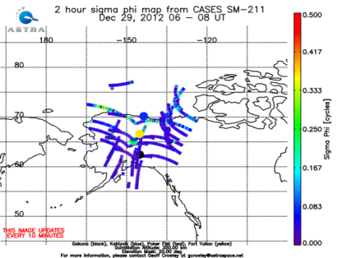
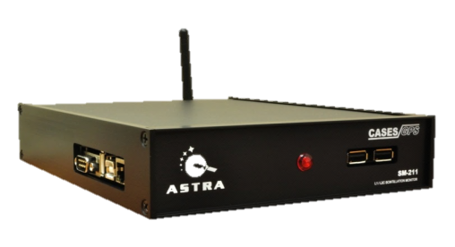
ASTRA: Space Weather Focus
Modeling
Data Assimilation
Data
Services
Ground-based Instrument Development
Space Systems
Physics-Based Modeling
(TIMEGCM)
High-latitude Electrodynamics
Space Based Data
GPS-based Space Weather Monitor
CubeSat Missions
NSF: DICE & LAICE
AF: DIME, SIPS & TSS
Global
Ionosphere
Ground Based Data
E-fields and Magnetometers
Real-Time Specification of Ionosphere/ Thermosphere
NASA: SORTIE & MiRaTa
Forensic Space Weather Analysis
Low Power Ionospheric Sounder
Plug-N-Play Avionics
Thermospheric Neutral Density
CubeSat Instruments
Scanning
UV Photometer
E-field Double Probe
Satellite Drag & Ballistic Coefficients
Space weather Phone Apps
HF TID Mapper
RF Waves & Sounder
Wind Profiler
Lidar Systems
GPS-based Space Weather Monitor
Magnetometer & Langmuir Probe
ASTRA • www.astraspace.net
303-993-8039 • solutions@astraspace.net © 2014 Atmospheric & Space Technology Research Associates, LLC
Satellite Aerodynamics

Slide 3
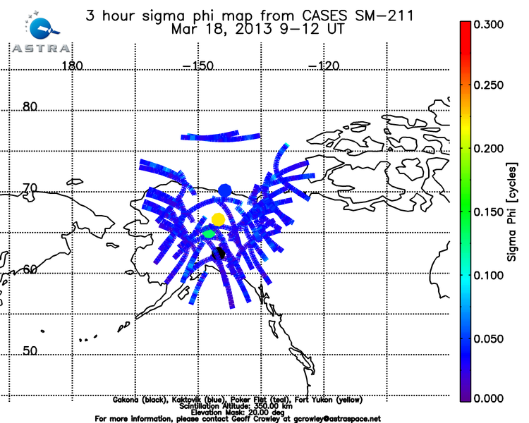
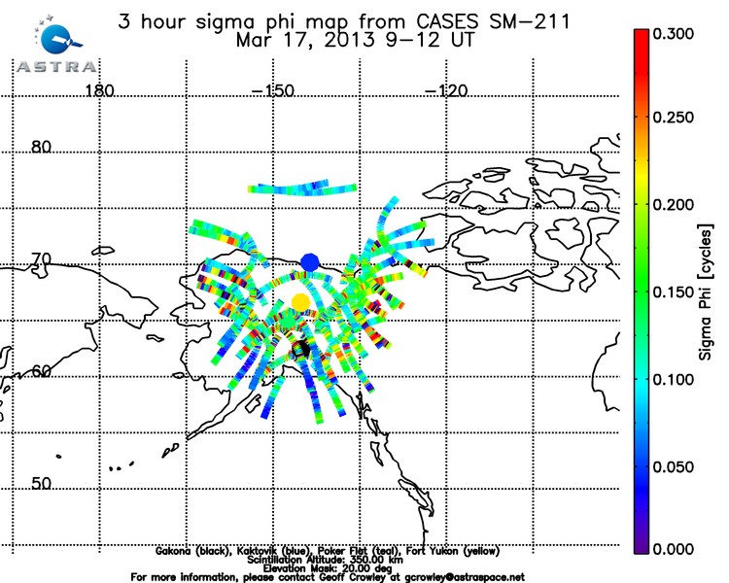
http://www.youtube.com/4spaceweather
We build GPS Receivers for TEC and Scintillation Monitoring
Quiet Conditions
Active Conditions

Slide 4
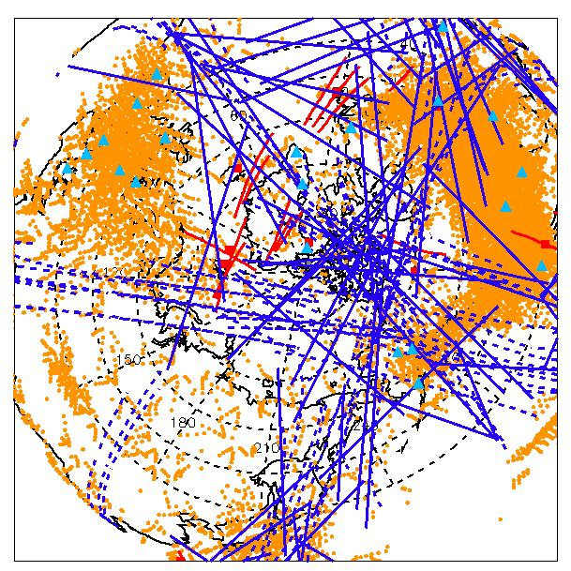
Other Ionospheric Instruments
Ionospheric data are available from a number of instruments

Slide 5
ASTRA IDA4D Model
We assimilate TEC and other datasets to produce global 4-D Ne distribution

Slide 6
Title of slide goes here
Big Ideas
Use slant TEC instead of vertical TEC
because you are moving the structure to a location when it may not belong there (pierce-point or receiver location)
All GPS receivers have biases that need to be carefully removed (~ 1 TECU)
Some receivers have other problems due to receiver design
All data have complications that make life difficult (TEC, in-situ, IS radar, UV, etc)

Slide 7
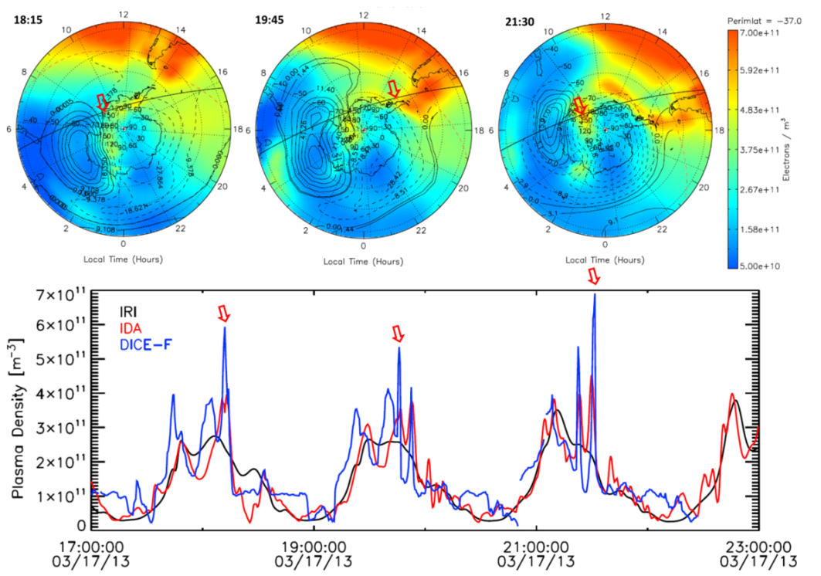
How can we validate models?
(whether they are full physics, or assimilative)
Method A: compare with data
Always preferred, but recall data may have biases (error bars)
There will always be areas of agreement and disagreement
DICE plasma density observations compared with IDA4D assimilation of the south polar ionosphere. Note that the enhanced densities observed by DICE (red arrows in the bottom plot) correspond to when the DICE satellite passes through a tongue of ionization during successive passes (red arrows).

Slide 8
How can we validate models?
(whether they are full physics, or assimilative)
Method A: compare with data
Always preferred, but recall data may have biases (error bars)
There will always be areas of agreement and disagreement
You may have assimilated the control data into the assimilative model
Does the assimilative model agree with the assimilated control data?
Can you re-run the assimilation without the control dataset?
Method B: compare with another model
Assuming one model reproduces the real world, we can use it as a standard to measure the performance of other models (big assumption!)
Presumably an assimilative model is expected to be best long-term
(Assumes lots of high quality data – e.g. ECMWF)
There will always be areas of agreement and disagreement

Slide 9
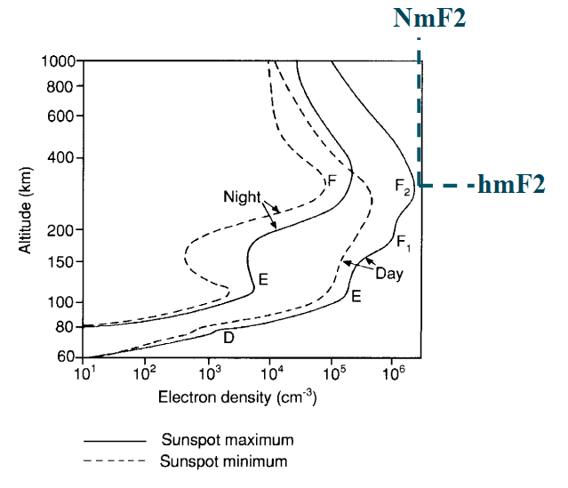
Title of slide goes here
Metrics for Validation
Depends on customer needs (no absolute)
Similar problem for water vapor in troposphere (i.e. height profile)
Types of application:
In-situ
Profiles
Integrated
Types of Metric
% error in NmF2 (local, global)
% error in HmF2 (local, global)
% error in Ne(h)
% error in TEC
RMS, etc

Slide 10
ASTRA can provide a clean data set of Ne and TEC for March 17, 2013 SED Event
- Including Ne values from DICE Cubesats

Slide 11
March 17th SED Observations

