Slide 1
Challenges in Data Availability for Model Validation
Yongliang Zhang and Larry Paxton
JHU/APL
CEDAR Workshop, June 20, 2016

Slide 2
Outline
Data availability and coverage
Understanding limitations in data
  Error level, bias, contaminations, spatial/time resolutions
Understanding limitations in models
  Assumptions, error levels, spatial/time resolutions
Model-Data comparison
  Data reduction (global averaged)
  4-D comparison (spatial and time)
  Impact of limited data coverage
  Improving physical understanding
  Recommendation for future improvement

Slide 3
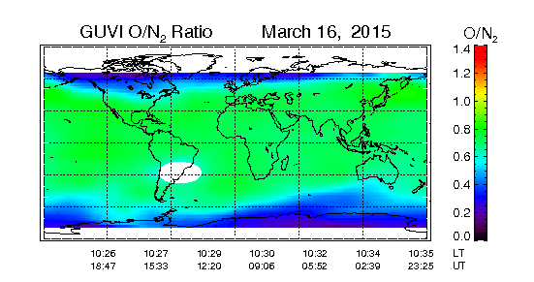
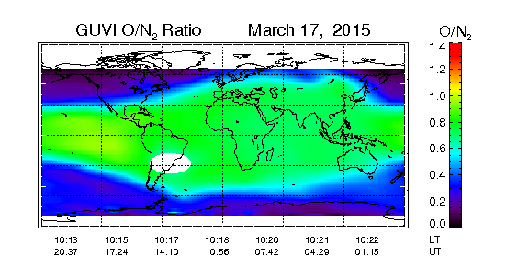
Data Availability and Coverage
Quiet time
(1) Global coverage (one day), (2) pixel dependent UT, (3) roughly same LT
Variation in time and space
Storm time

Slide 4
GUVI and SSUSI: 25 km or less resolution, slightly different UT for each pixel, revisit time ~98min, relatively accurate mapping.
IMAGE SI-12 proton aurora, global coverage,
2-min, 100-200km resolutions, mapping accuracy

Slide 5
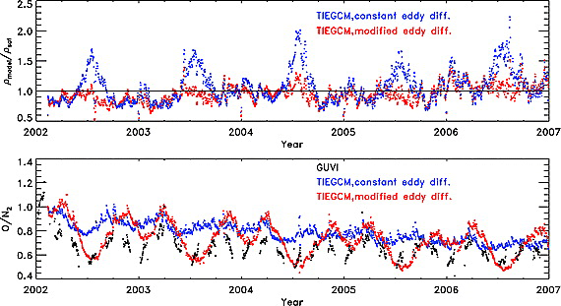
Global Average
Qian et al., 2009 JGR

Slide 6
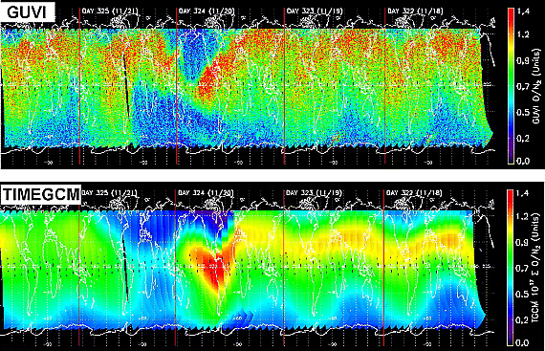
O/N2: TIMEGCM and GUVI
Spatial distribution: Similarity (quiet time) and difference (storm time)
Global average: May be similar between model and data
Meier et al., 2005 JGR

Slide 7
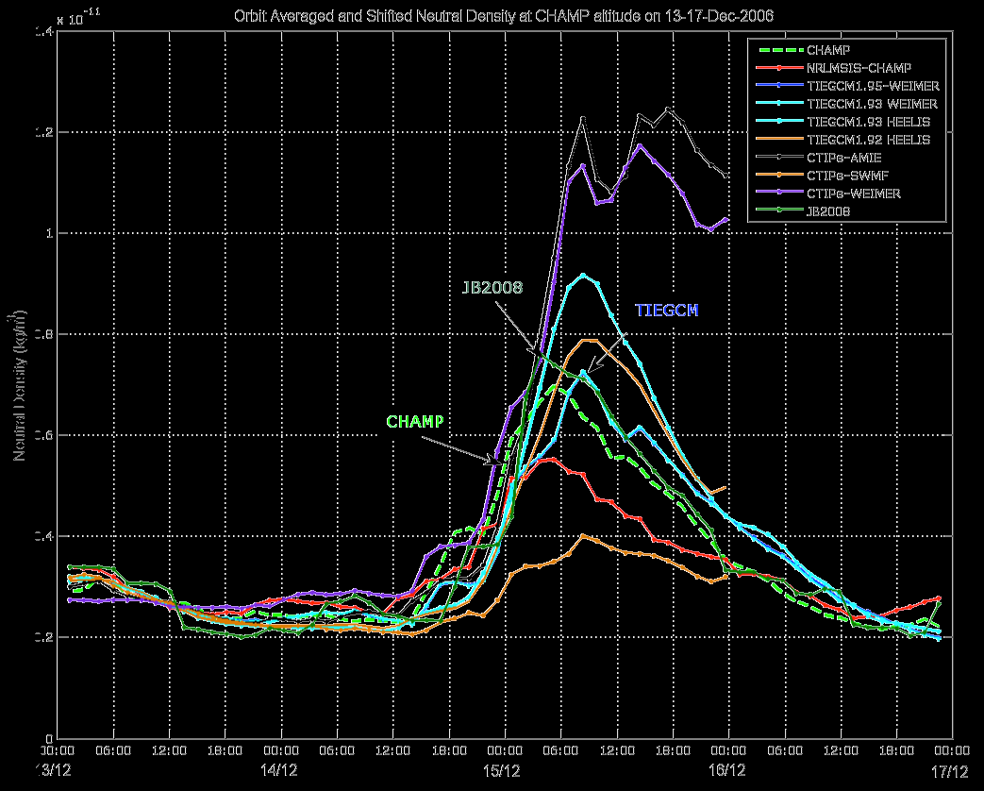
Neutral density comparison: CHAMP (orbital averaged) and models
Orbital average: ignore the spatial variation
2014 GEM mini-workshop report by Emine Ceren Kalafatoglu, Ja Soon Shim, Masha Kuznetsova, Zerefsan Kaymaz

Slide 8
Questions raised by model-data comparison
For neutral density
  Limitation by comparing global average only (unknown global morphology)
  Competition between heating and cooling
  Correct portions of Joule and particle heating (validation by multiple data sets)
  Correct cooling (CO2, NO, adiabatic) specification
Biases (Systematic versus morphological)
  Morphological bias may indicate missing physics?
  Systematic bias may suggest a simple issue?
  The ideal case: model results match multiple observations in 3-D space and over a sufficient time interval.
  The reality: Model results match data over a limited space and time. Solutions: bring in different data sets/types (e.g. aurora /particle+ ionosphere + neutral, etc).

