Slide 1


Baseline ionospheric climatology models beyond IRI
Shunrong Zhang
MIT Haystack Observatory
With contributions from Evan Thomas (VT/Dartmouth)

Slide 2
topics
ISR-based ionospheric climatology
  Incoherent scatter radar ionospheric model (ISRIM)
  Ionospheric climatology (and long-term changes)
GPS-based TEC modeling
  NA TEC climatology and modeling
  Stormtime TEC response: statistics

Slide 3
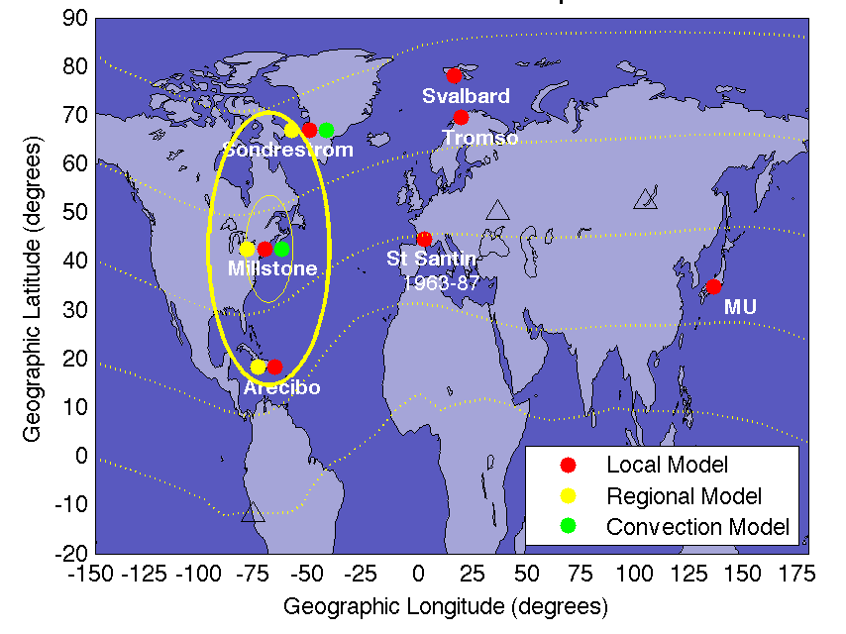

ISRIM: incoherent scatter radar ionospheric model
ISRIM local climatology
ISRIM regional climatology
ISRIM local variability
ISRIM convection
All online
Zhang et al. (2005); Zhang et al. (2007); Zhang and Holt (2008); Zhang et al. (2008)

Slide 4
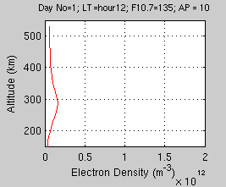
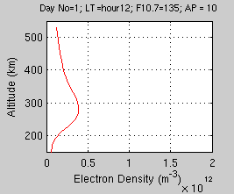
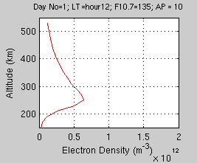
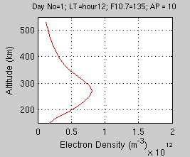
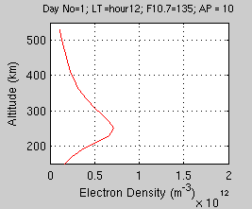
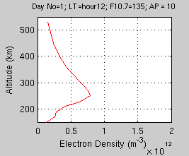
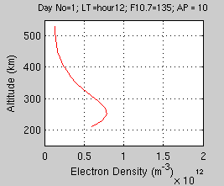
Midday Ne Profiles progressing with the day number (Season)
Svalbard
Sondrestrom
Curve Color Code
Winter
Spring
Summer
Autumn
Tromso
Millstone
St. Santin
Shigariki
Arecibo

Slide 5
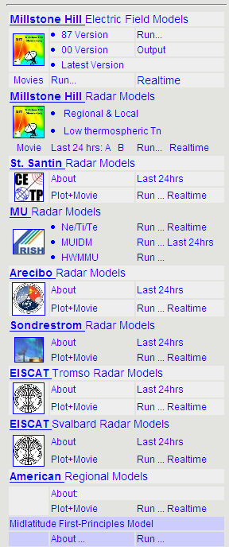
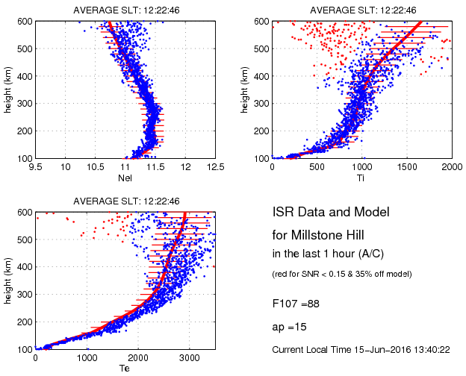
Virtual ISR
Based on ISR empirical models
Operating 24/7; Updating every 30 min
Real-time model-data comparison
http://madrigal.haystack.mit.edu/models/

Slide 6
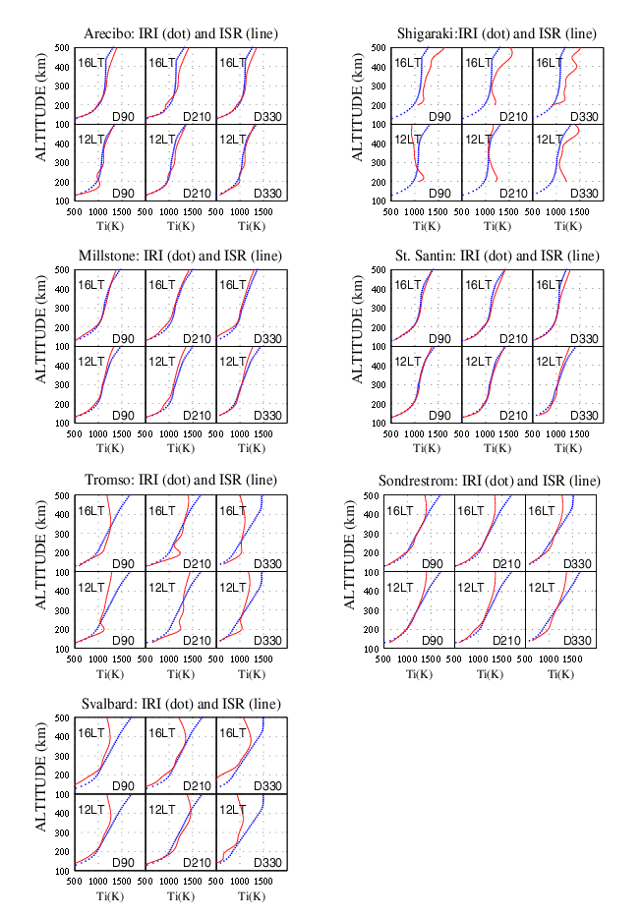
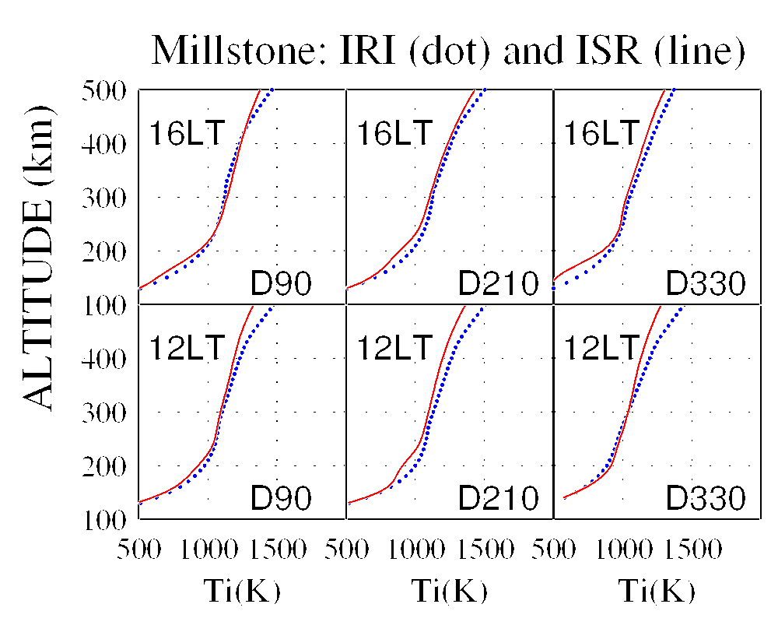
Compared to IRI: Ti

Slide 7
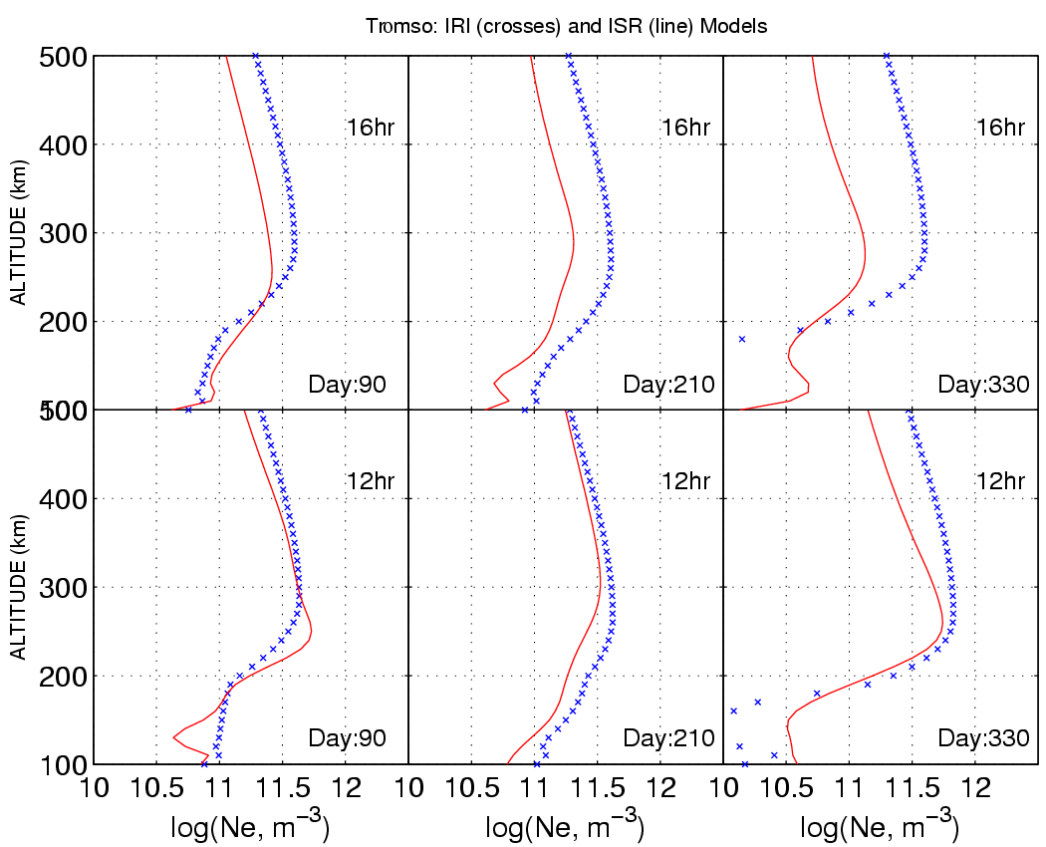
Comparison with IRI @ Tromso
Median solar activity

Slide 8
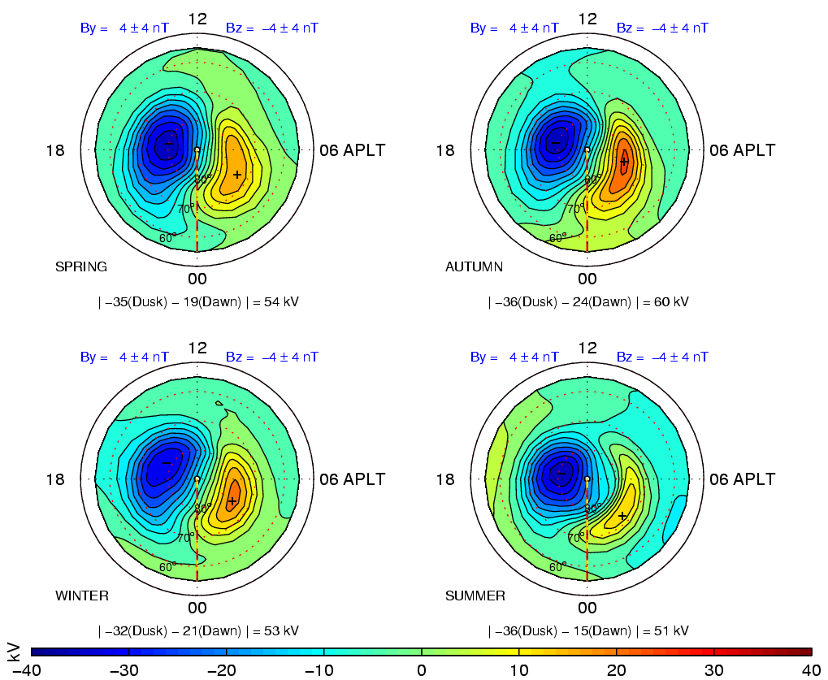
ISR Convection Model
Bz = [-8 0] nT
By = [0 8] nT
Larger potential drops in solstice than in equinox
Cell rotation in summer relative to winter

Slide 9
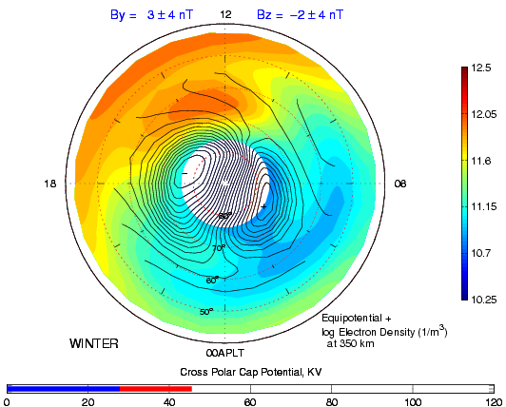
Combined ISRIM + Convection

Slide 10
Mean TEC (EOF mode 1)

Slide 11
East-west Symmetry (EOF mode 2)

Slide 12

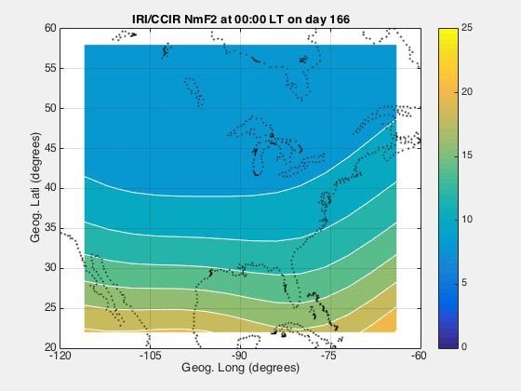
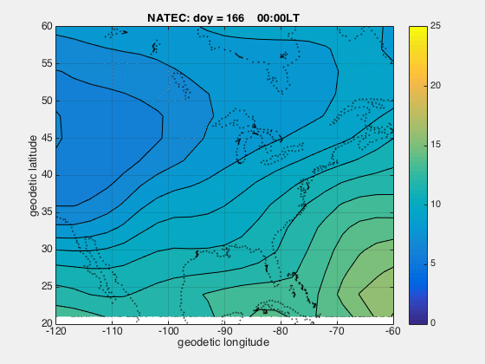
North America TEC Model (NATEC)
IRI TEC vs NATEC (Summer)

Slide 13
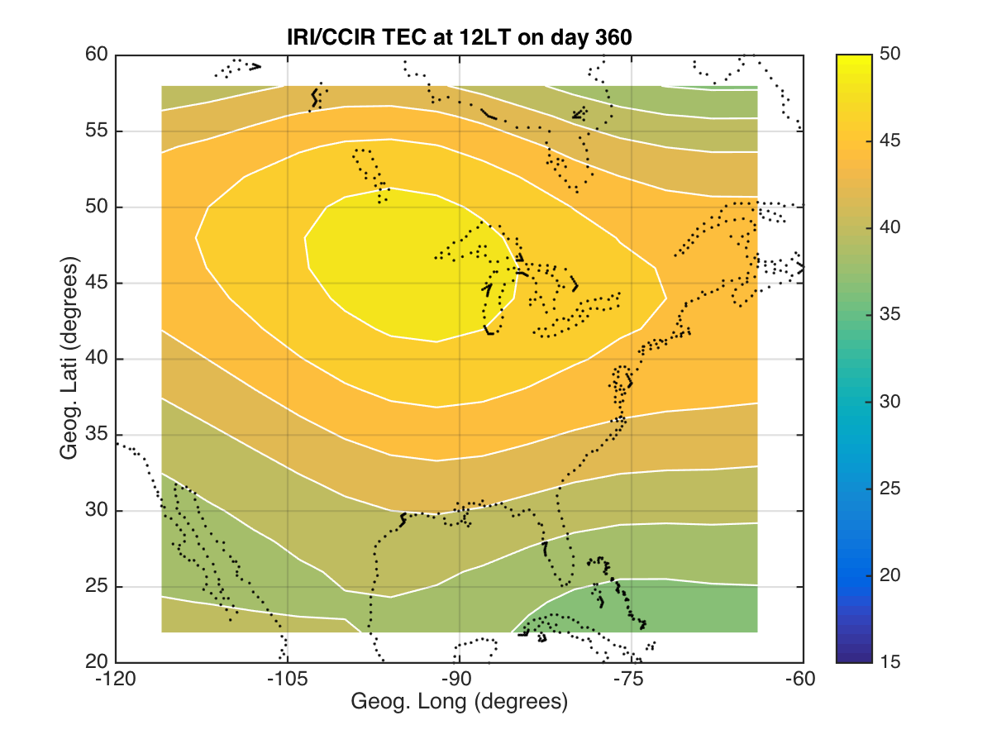
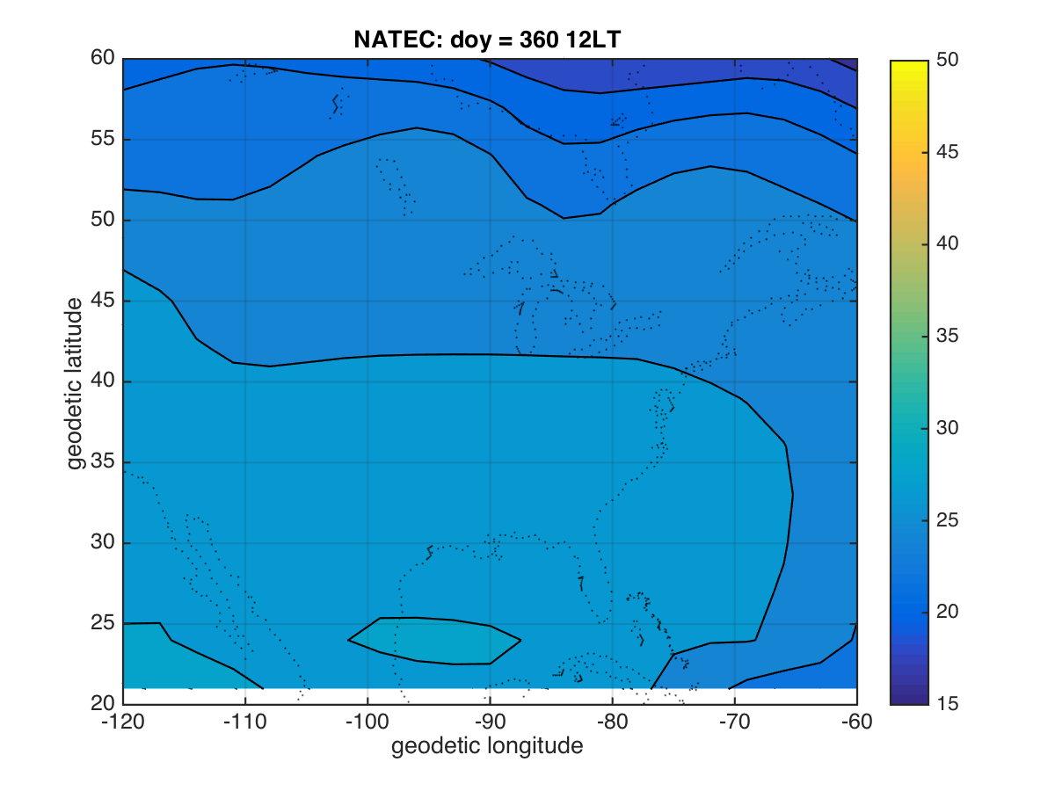
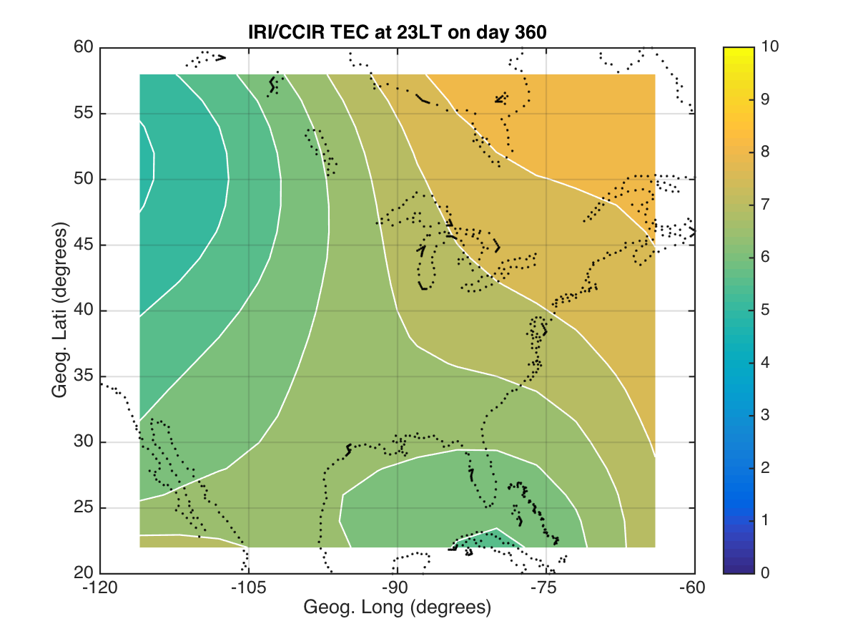
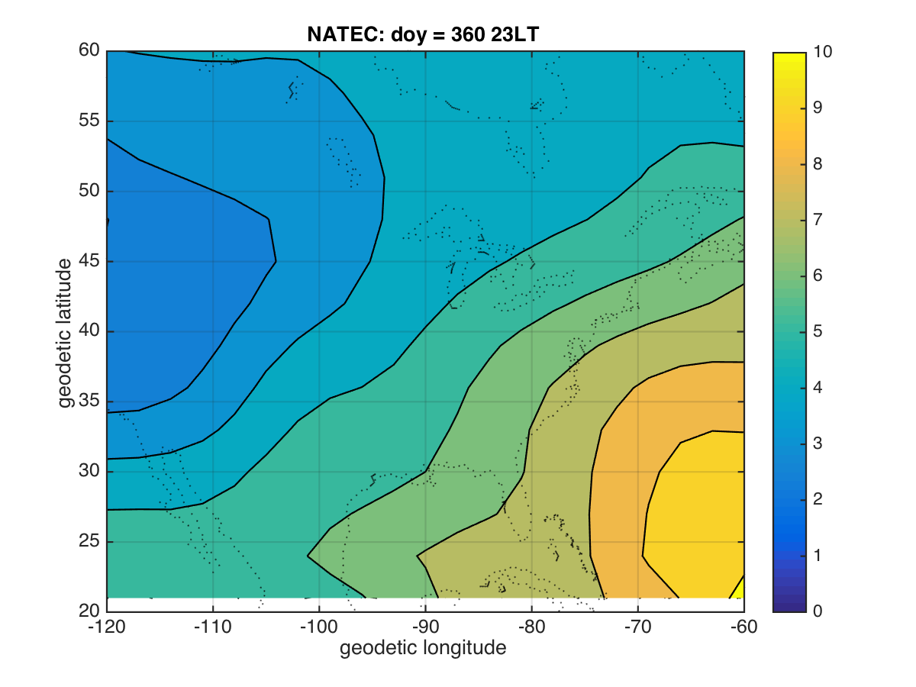
IRI TEC vs NATEC (winter)
12LT
23LT

Slide 14
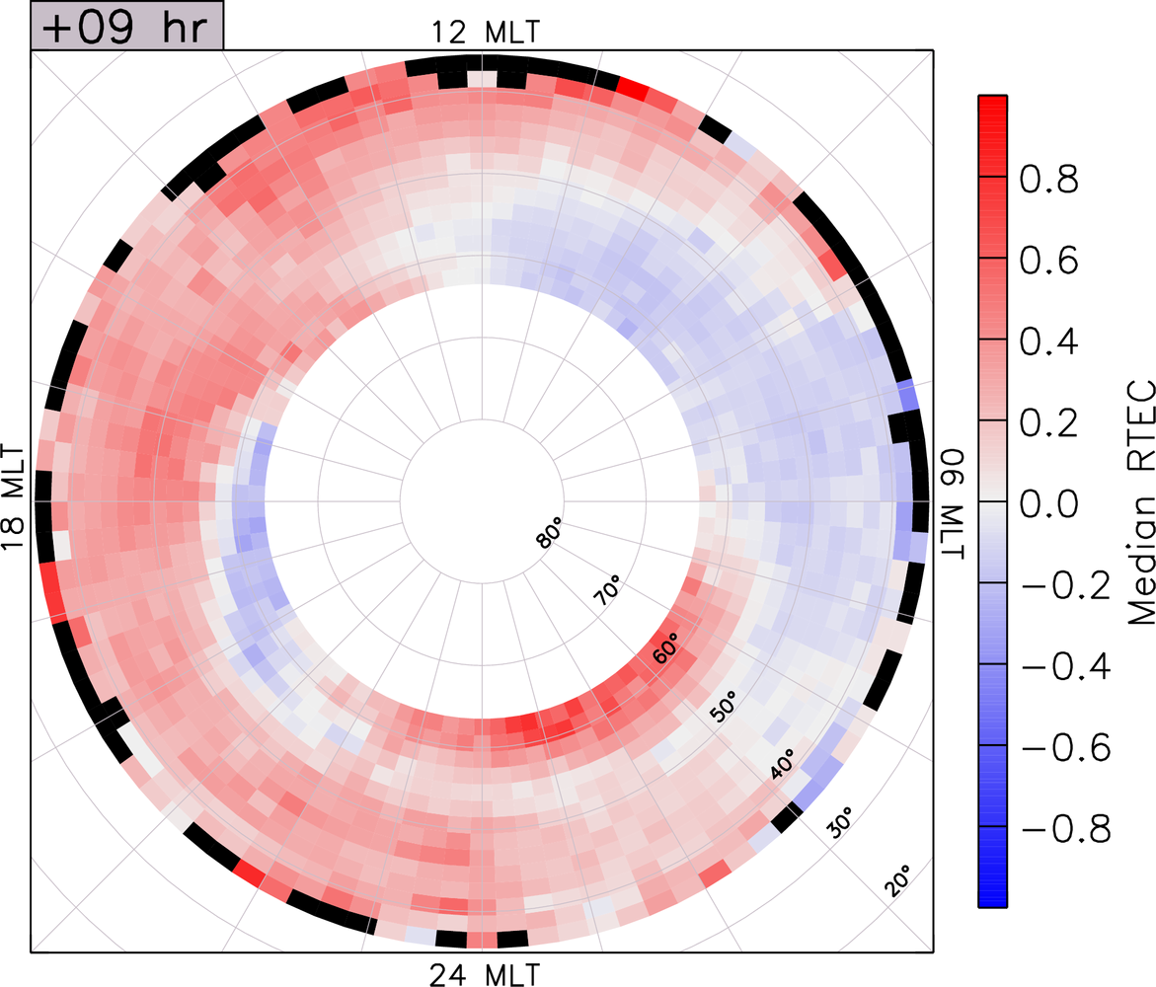
SED plume
Composition bulge
SAPS density trough
Thomas et al (2016) JGR
Auroral enhancement
14

Slide 15
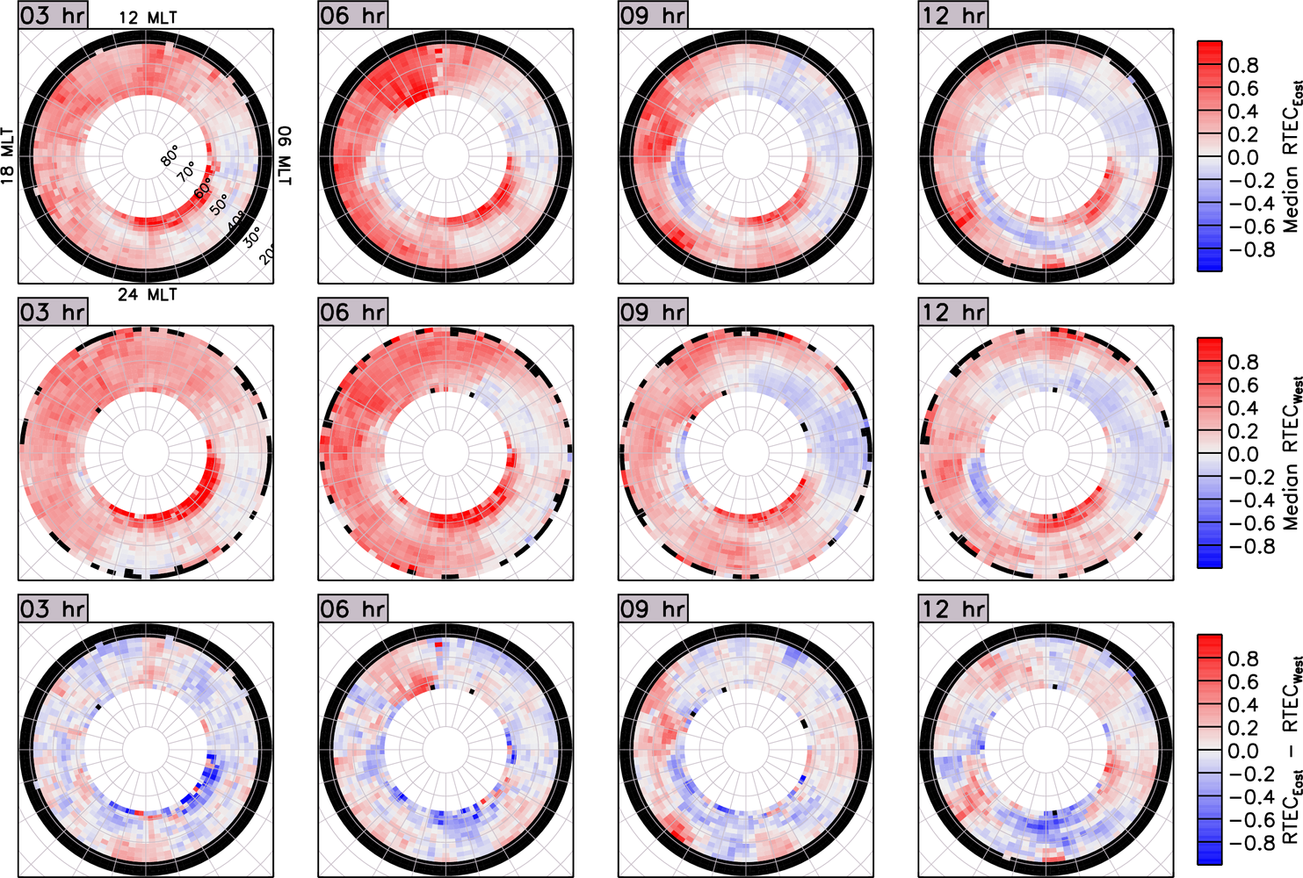
Thomas et al (2016) JGR

Slide 16
Concluding remarks
Global vs regional/local model ?
Need sophisticated local/regional climatology models
  To capture meso-scale IT structures
  To enable science advances beyond just the most fundamental physics
  Dense network of geospace sensors

