Slide 1

Precipitation into the ionosphere applied to spacecraft charging.
L. Rastaetter, J. Minow

Slide 2
Satellite charging:
Low Earth Orbiting (LEO) satellites may be subject to surface charging events caused by:
  precipitation (above certain particle energies)
  (absence of) sunlight
  electrical changes at photovoltaic arrays
  at day-night transitions
Models to provide real time warning or post-event analysis:
  RBE - electrons between 10 and 300 keV
  CIMI - electrons: 10 to 3000 keV, ions: 0.1 to 300 keV
  - ions from 1 to 300 keV
    ions

Slide 3
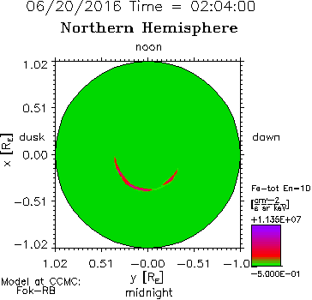
Precipitation from model
Example: Fok RBE, differential electron fluxes provided by model on ionospheric grid.
At 10 keV:
To determine threat of charging,
…
we need total flux above certain energy
…
in night side
…
when plasma density is low…

Slide 4
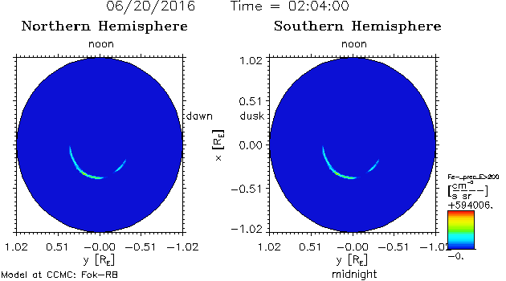
Integrated flux
specify threshold energy (200 keV) -> integrated flux
Fe-_prec_E>200 [1/cm² s sr]

Slide 5
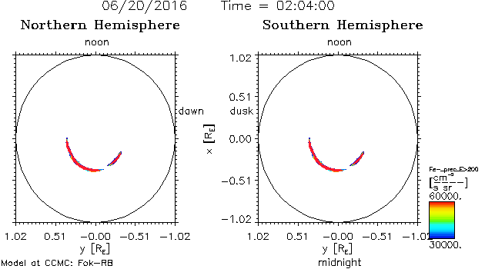
Apply flux threshold:
Fe-_prec_E>200 > 30000/(cm² s sr)

Slide 6
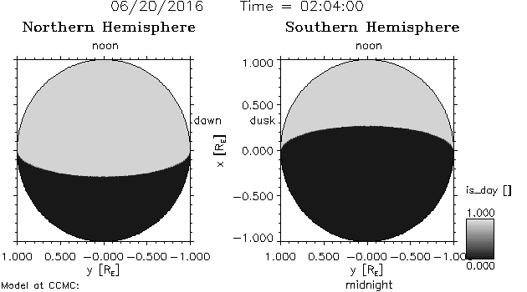
Day or Night
Sunlit Region:
Is_Day=XGSE>RE tan(p) OR RGSE>RE [1+XGSE*tan(p)]
RGSE=sqrt(YGSE²+ZGSE²) tan(p)=RS/AU
Day/Night
on
Earth Surface

Slide 7
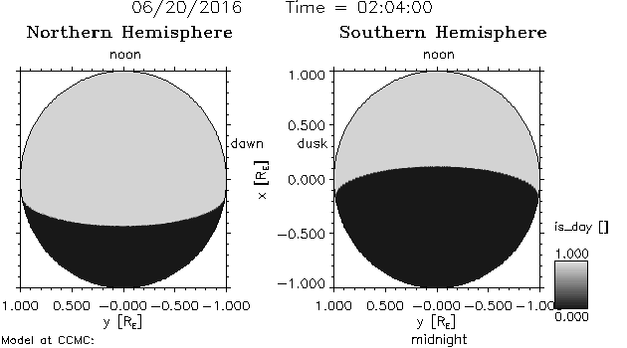
Combination: min(E), min(Flux), day/night
Is_Day
at
110 km
altitude
Day-night image overlaid with 25% opacity

Slide 8
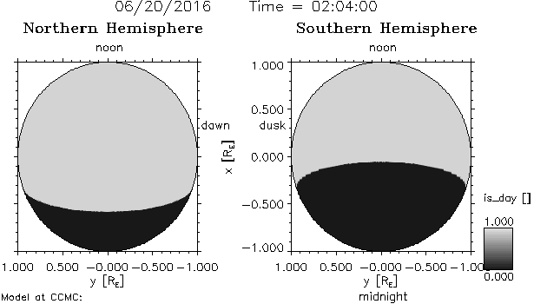
Map between satellite altitude
Example: ISS at ~400 km altitude
  calculate day-night at 400 km
  map satellite position and day-night to 110 km where the flux grid is located

Slide 9
Status and Plans:
Satellite tracking:
  Have mapping facilities for ionosphere
  Have time series extraction at mapped positions
Add:
  Integrated fluxes w. energy threshold
  Add day-or-night status flag (analytic, based on position transformed to X,Y,Z in GSE)
  distance to region with thresholds (Energy: E0, Flux: F0) exceeded:
  Fe-_prec_E_gt_E0 > F0 and nightside
  Apply to ensemble of models:
    Fok-RB, CIMI (stand-alone)
    SWMF-CRCM (coupled)

