Slide 1
GITM Results

Slide 2
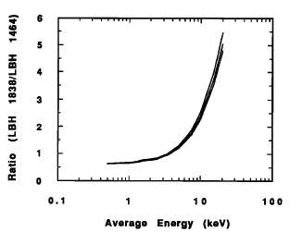
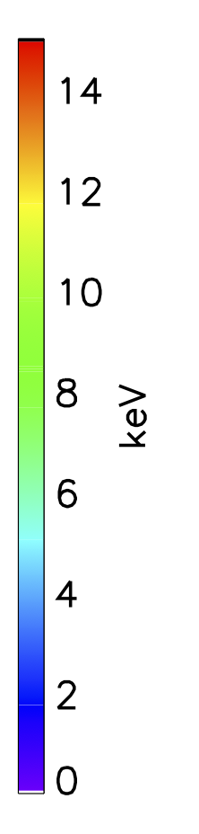
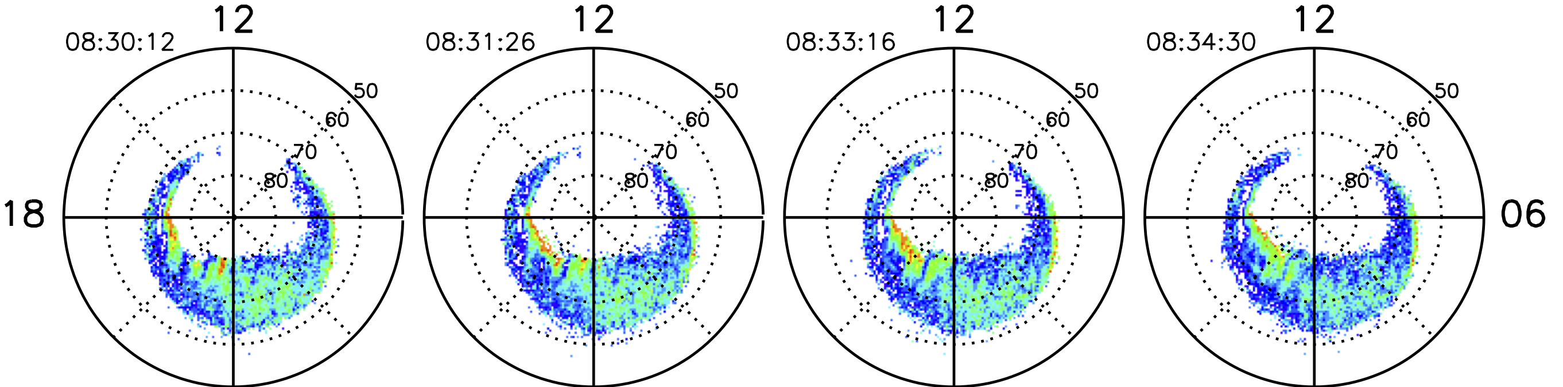

[Germany 1994]
Step 1- Ratio of LBHs/LBHs
Step 2 – Calc. Average energy (Germany et al. 1994)
Step 3 – Put Energy flux (LBHl) and Avg. Energy into GITM

Slide 3
Substorm vs. SMC
Poster on Weds.
Onset
+30 min
+60 min
Onset
+30 min
+60 min

Slide 4
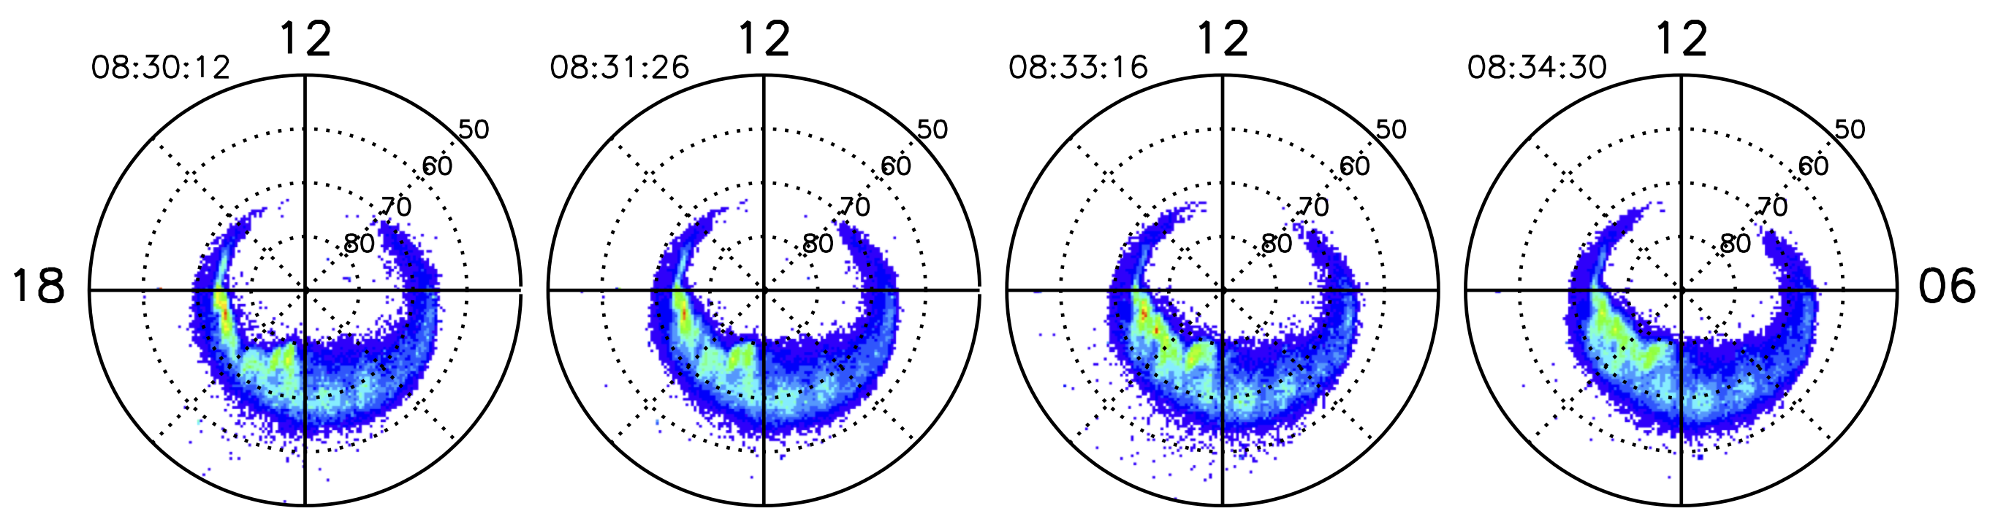
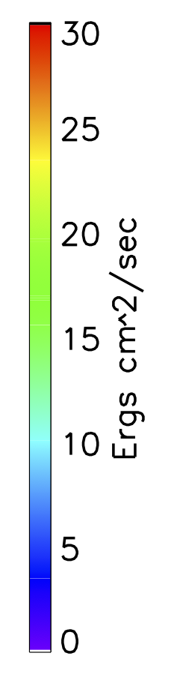
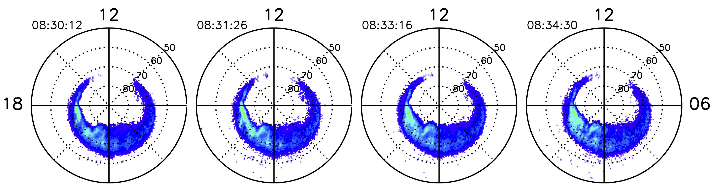
Step 1 – Linearly interpolate LBHl and LBHs for time overlap
L
LBHl
LBHs

Slide 5
Step 1 – Linearly interpolate LBHl and LBHs for time overlap
L
LBHl
LBHs

Slide 6
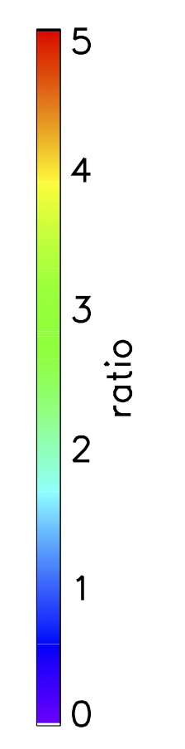
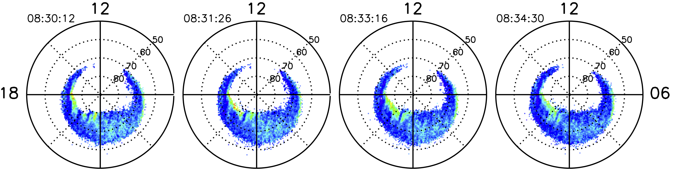
Step 2 – Calculate ratio of LBHl/LBHs
L

