Slide 1
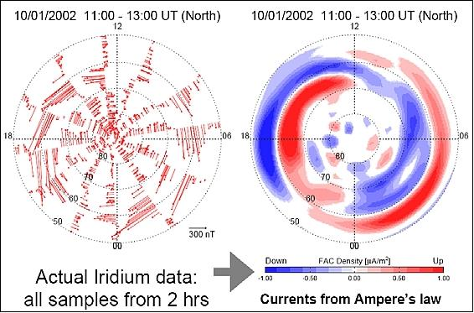
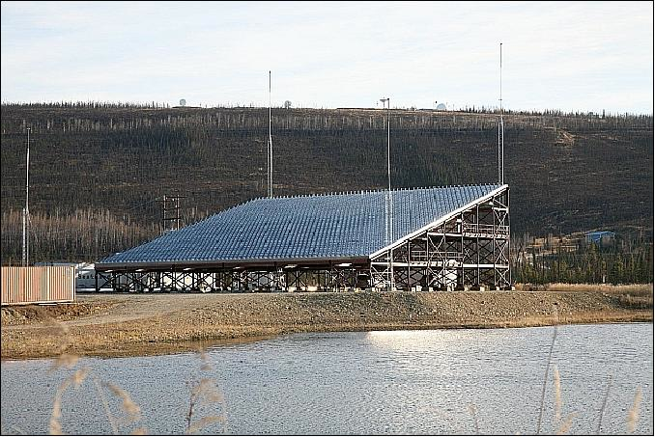
AMPERE-PFISR Study of
Field-Aligned Currents and Conductivities
Bob Robinson and Katie Garcia-Sage
The Catholic University of America
NASA Goddard Space Flight Center
Notes:
The purpose of this study is to show that field-aligned currents can be used to determine ionospheric conductivities.

Slide 2
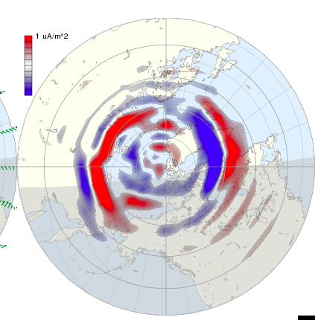
PFISR has been measuring ionospheric electron densities, ion and electron temperatures, and plasma drifts almost continuously every 10 minutes since 2009. With AMPERE, it provides ~1.5 million simultaneous measurements of field-aligned currents and ionospheric parameters, including conductivities.
Notes:
The study makes use of simultaneous and coincident measurements of conductivity made by the Poker Flat Incoherent Scatter Radar and field-aligned currents made by AMPERE.

Slide 3
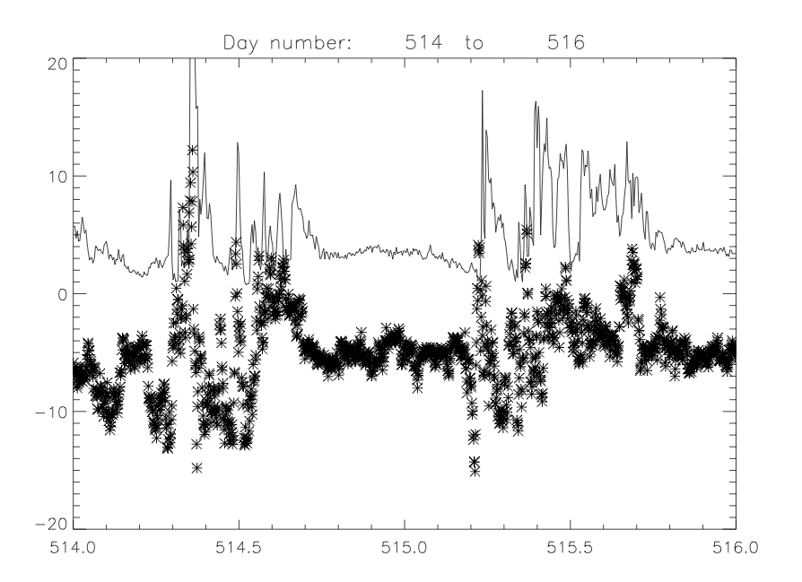
1.5
0
-1.5
Conductance (mhos)
J-parallel (μAmps/m2)
Notes:
Another example of two consecutive active days.

Slide 4
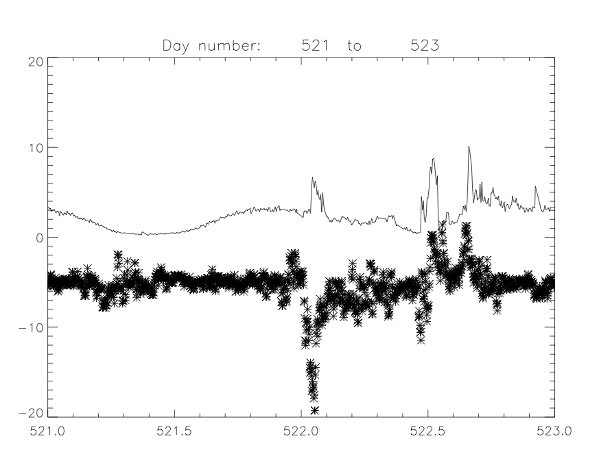
1.5
0
-1.5
Conductance (mhos)
J-parallel (μAmps/m2)
Notes:
Another example, this one showing an enhancement in conductivity in a region of downward current.

Slide 5
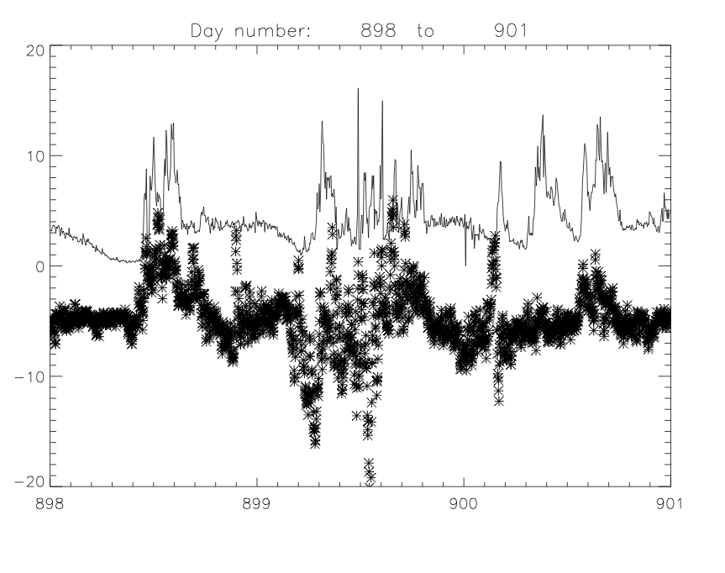
1.5
0
-1.5
Conductance (mhos)
J-parallel (μAmps/m2)
Notes:
Three more days.

Slide 6
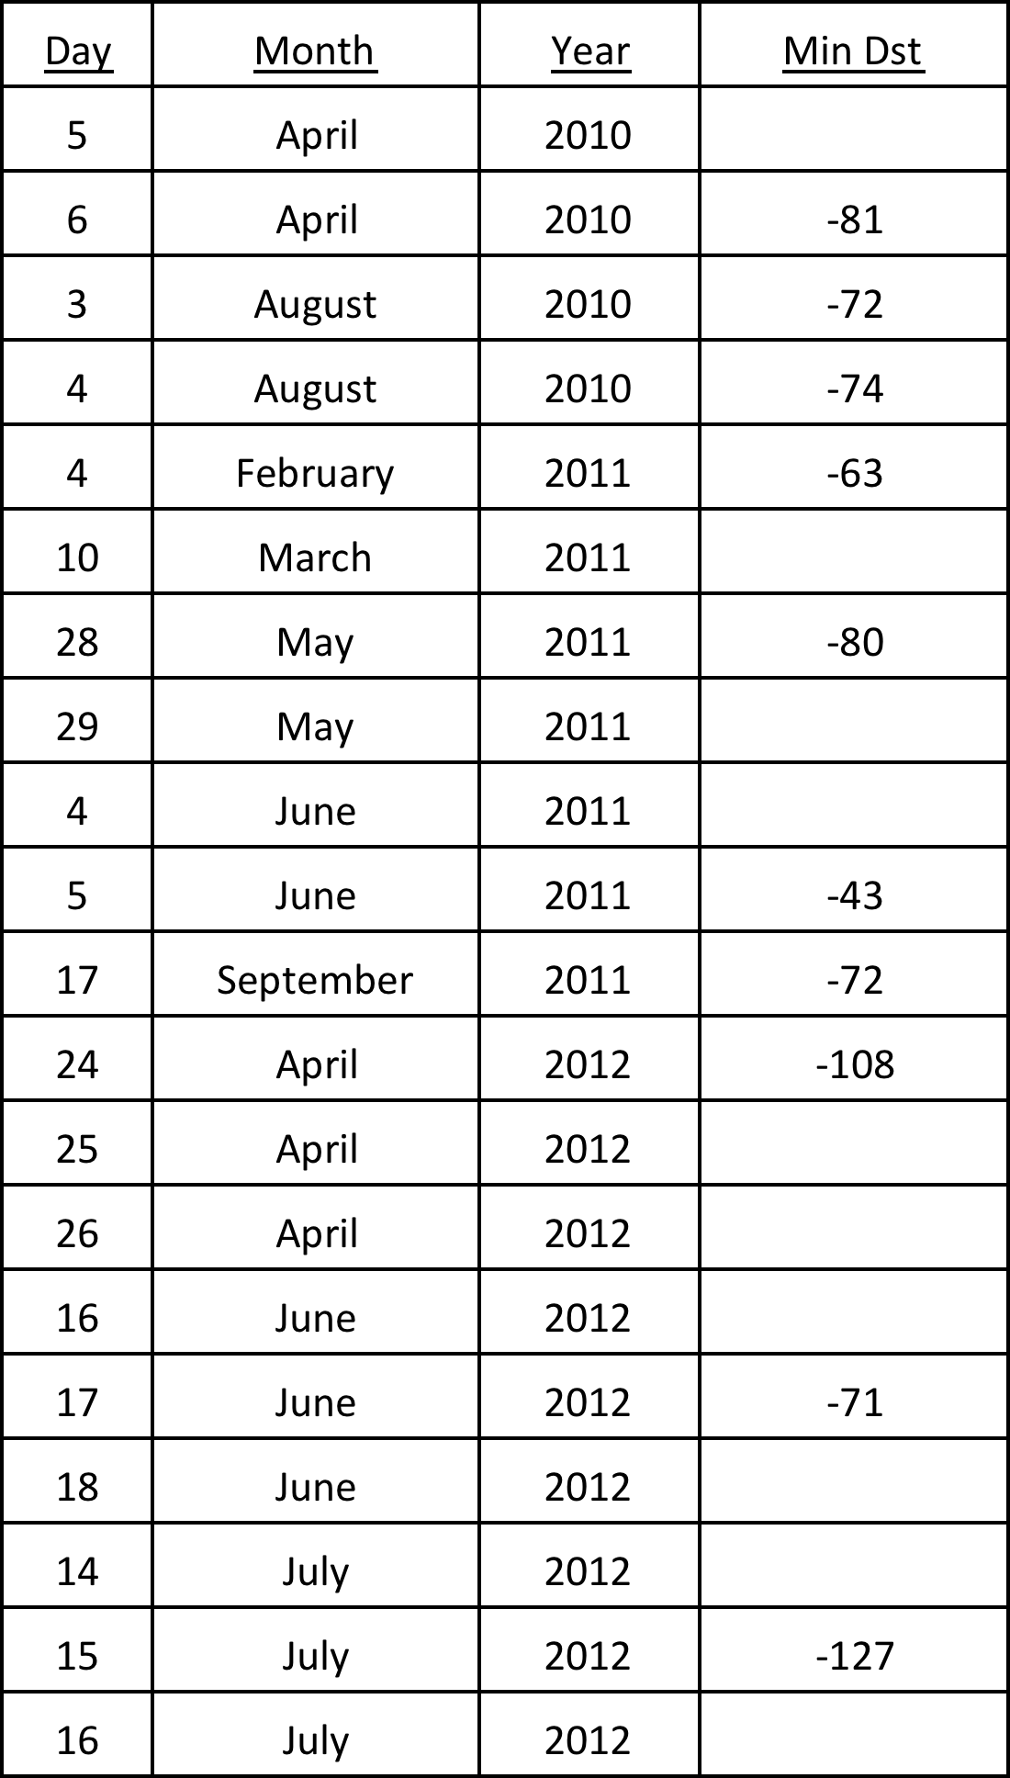
17 Geomagnetically Active Days Used for AMPERE-PFISR Study
Notes:
17 magnetically active days were used in the study, although quiet time data are included in the database as well.

Slide 7
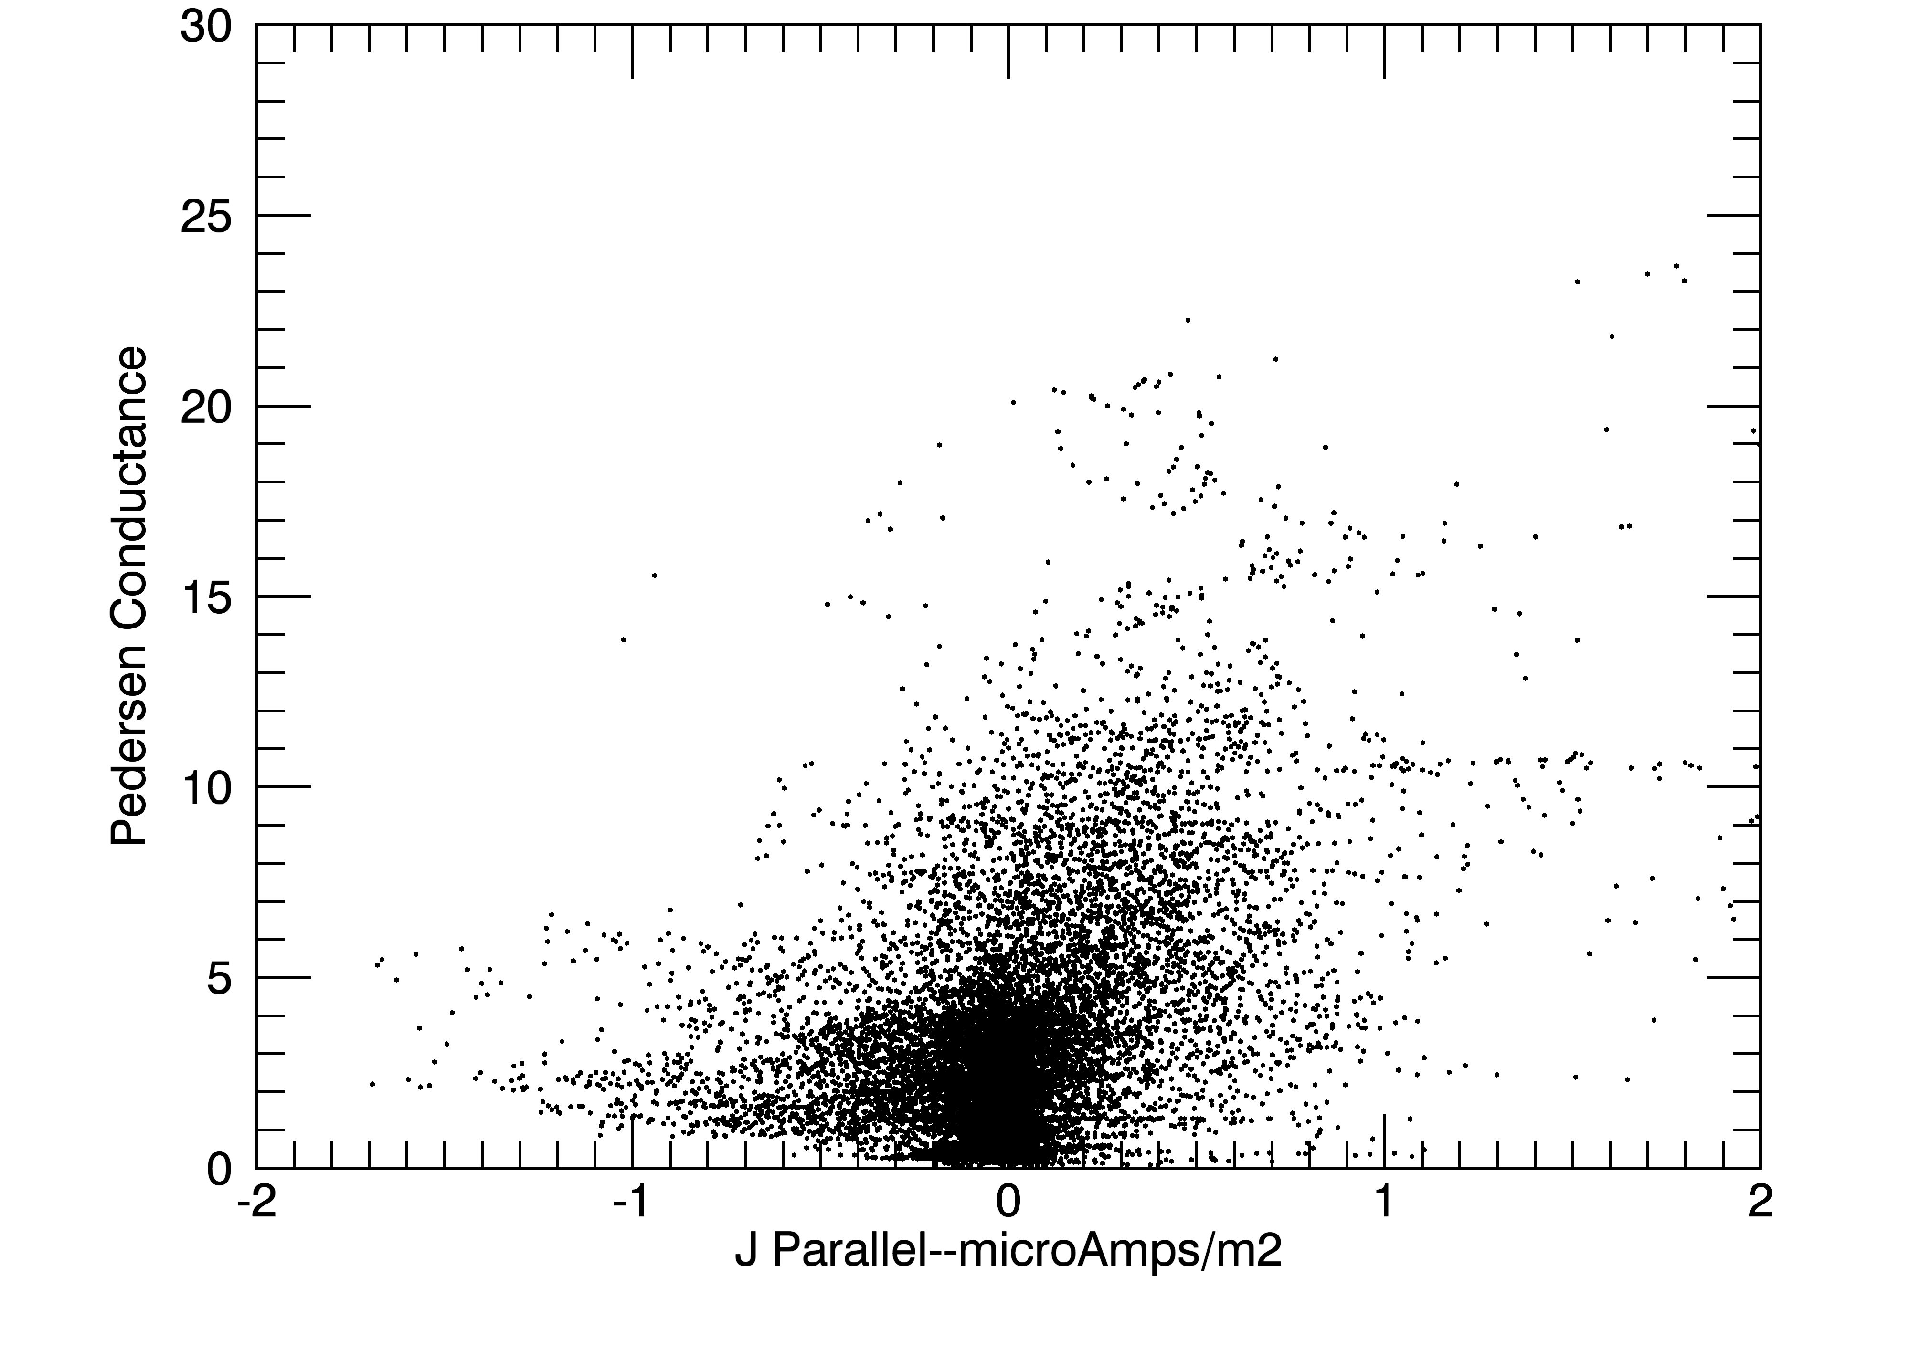
Notes:
A scatter plot showing all the data. Upward field-aligned currents are positive. Downward currents are negative.

Slide 8
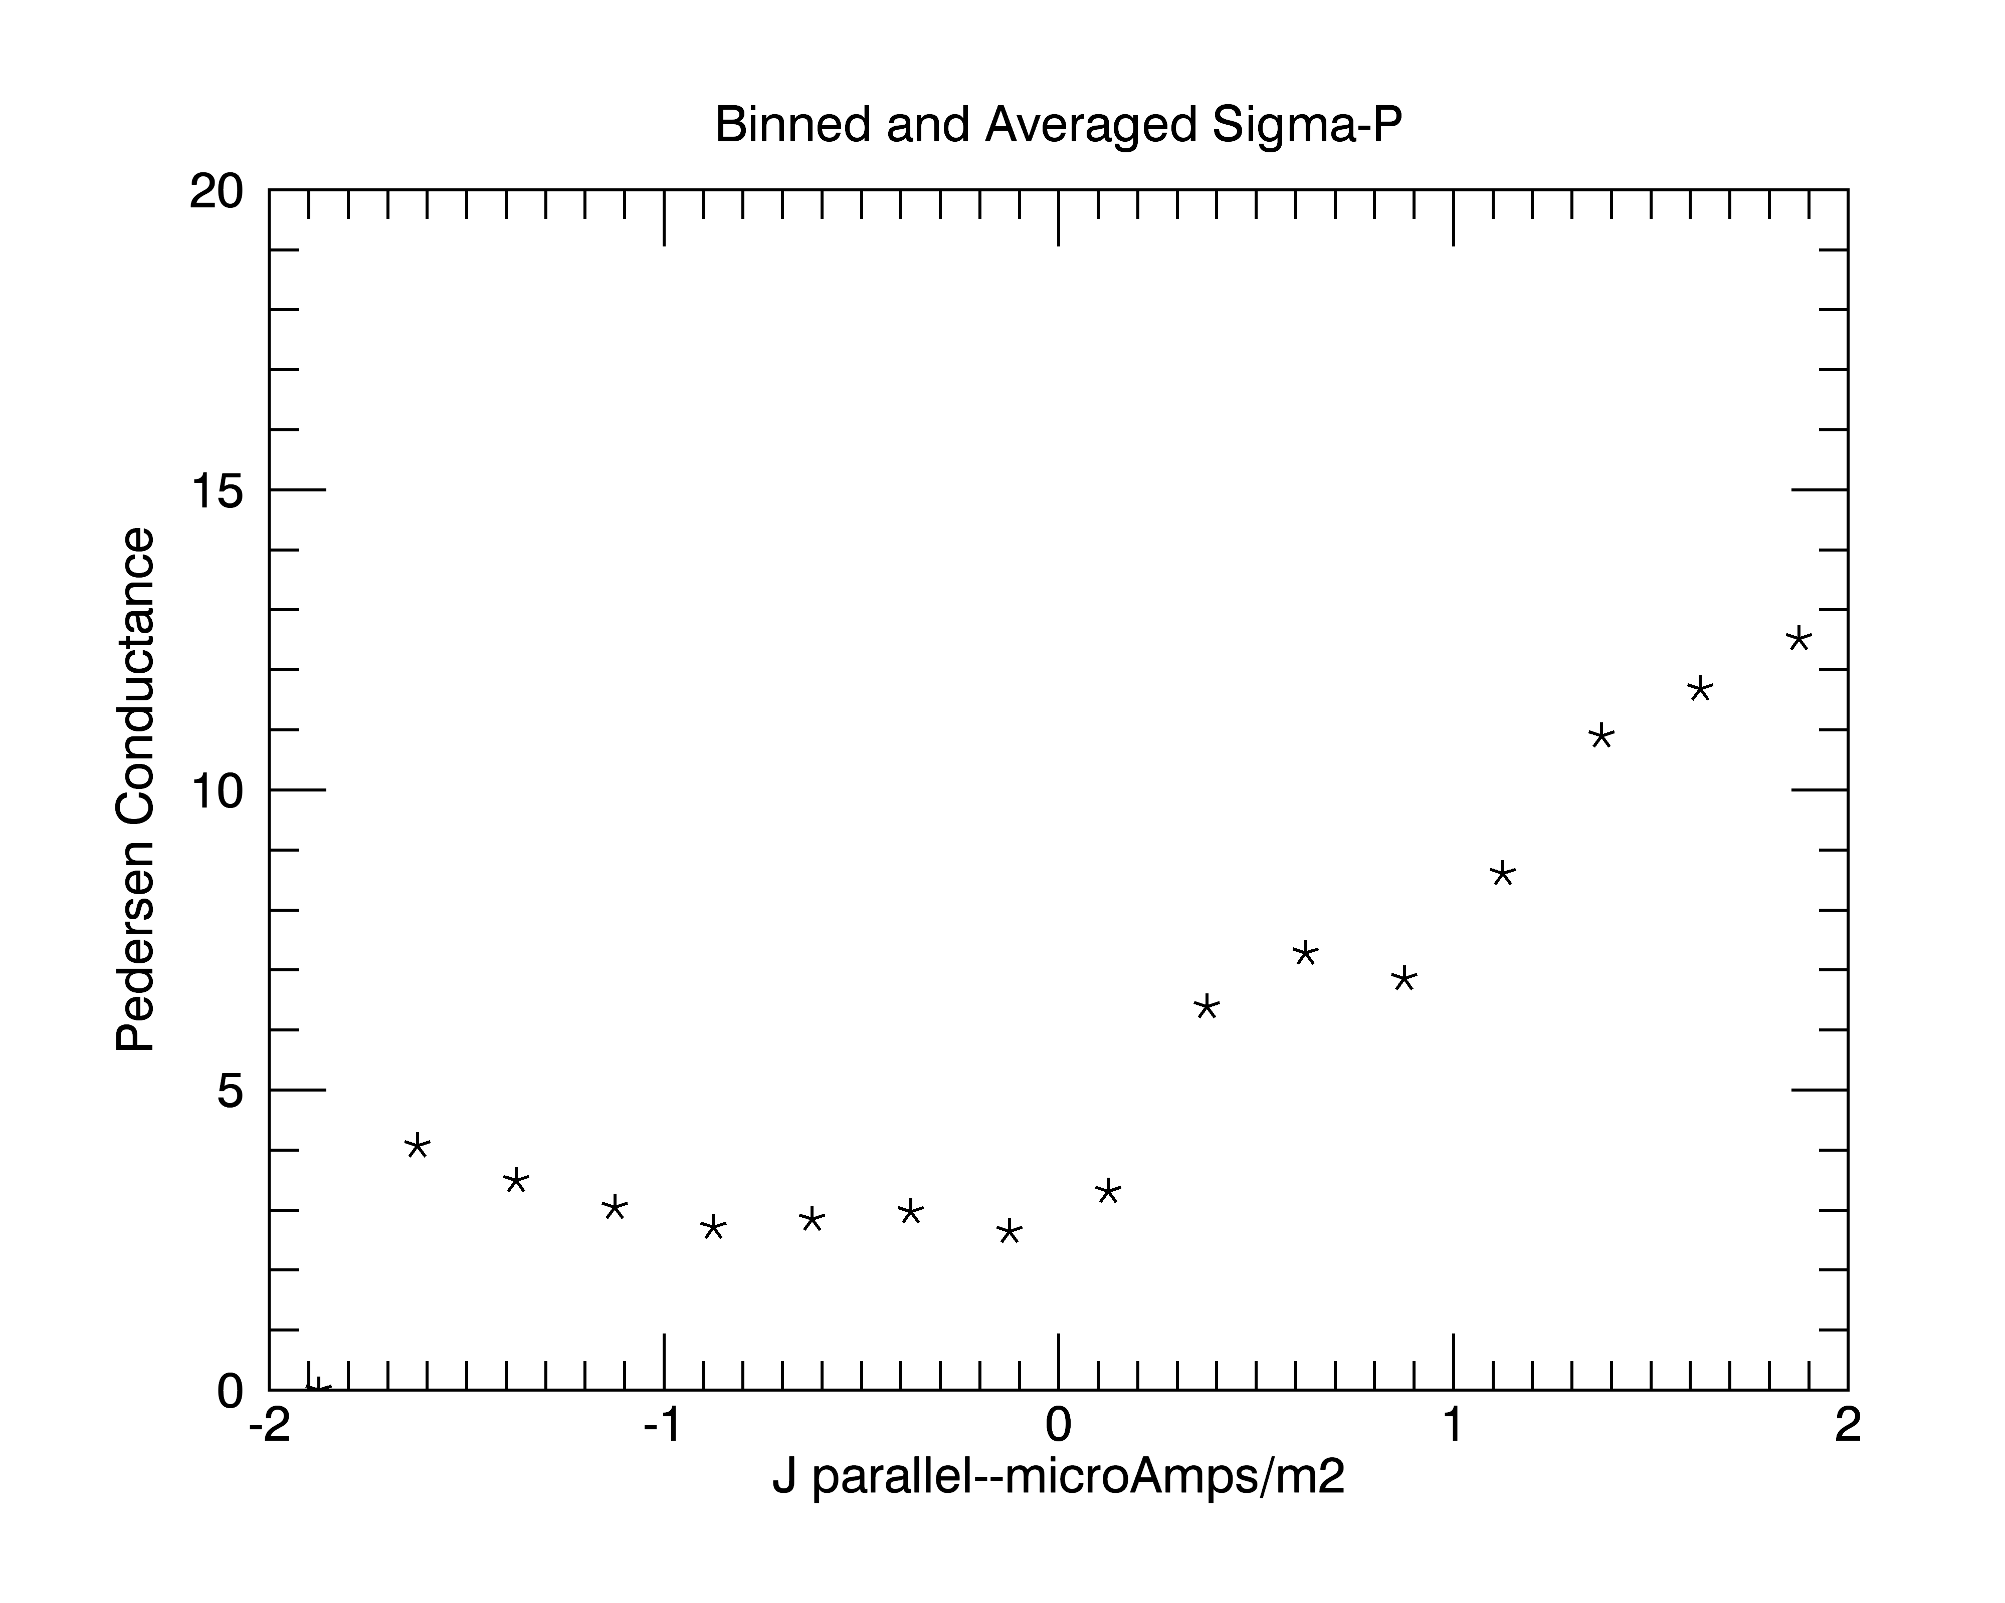
Notes:
Binned and averaged values showing how field-aligned currents are related to Pedersen Conductance. Conductance increases with field-aligned current in both downward and upward current regions, but conductances increase more with current in the upward current regions. Averages are for data for solar zenith angels greater than 70 degrees.

Slide 9
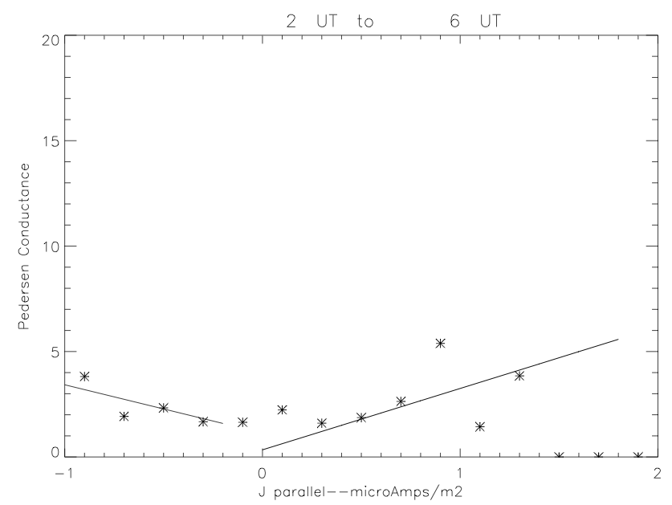
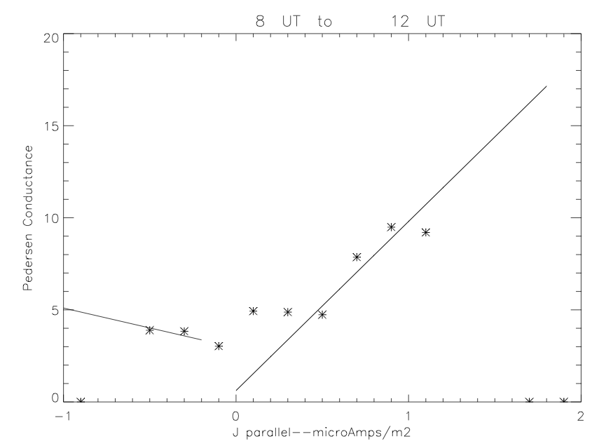
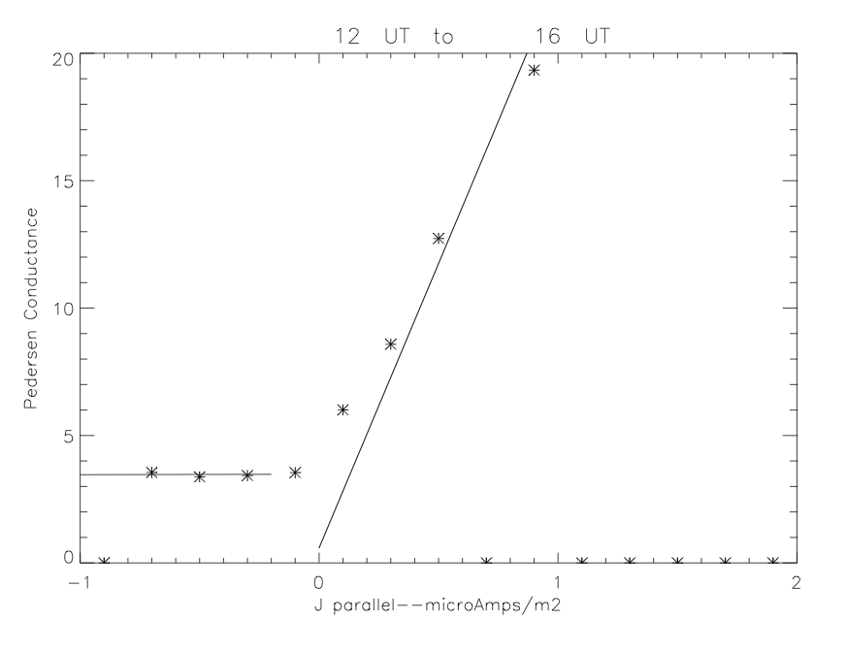
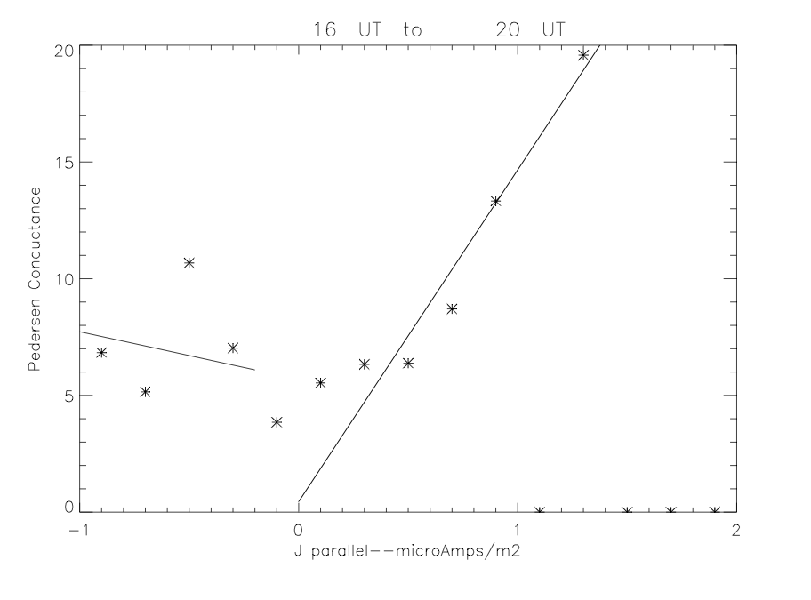
Notes:
Sorting the data into broad UT (MLT) intervals, shows that the functional dependence between field-aligned currents and conductivities is dependent on local time, as one would expect because the field lines map to different parts of the magnetosphere. UT intervals correspond to 15 to 19, 21 to 01, 01 to 05, 05 to 09 MLT.

Slide 10
Pedersen Conductance
+2
0
-2
J-parallel
Upward current
Hall to Pedersen Ratio
Downward current
Notes:
When combined, the statistical results yield an MLT-dependent transfer function between field-aligned currents and conductivities. The top panel shows how the Pedersen Conductance varies with local time and field-aligned current. The bottom panel shows the average Hall to Pedersen conductance ratio as a function of MLT for both upward and downward field-aligned current regions.

Slide 11
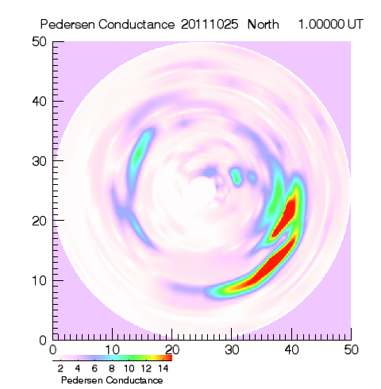
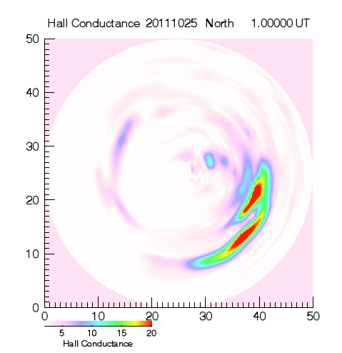
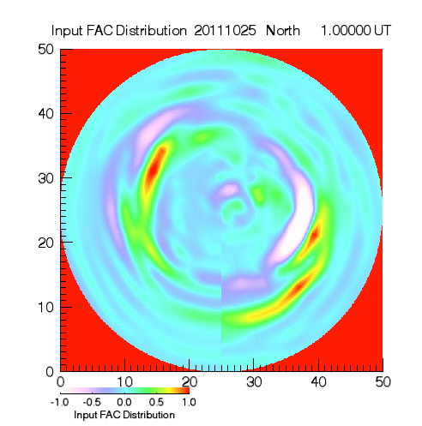
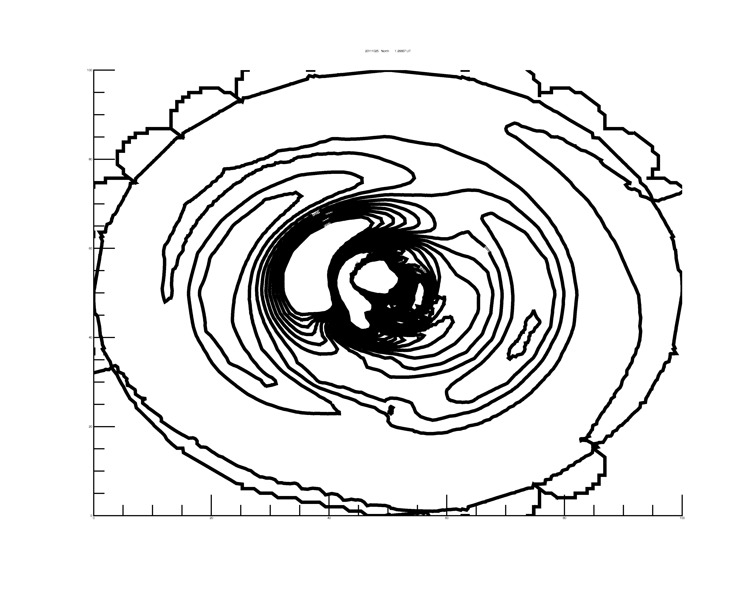
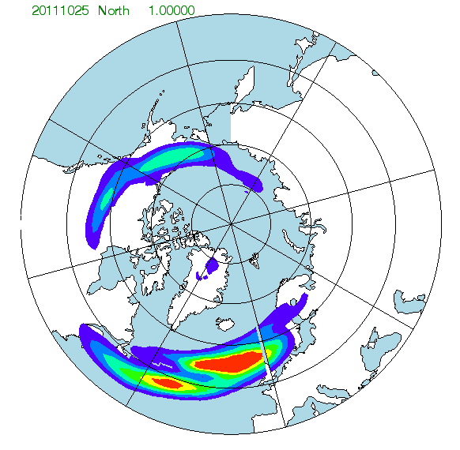
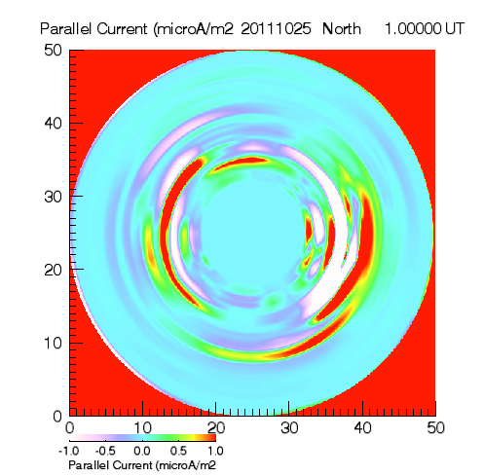
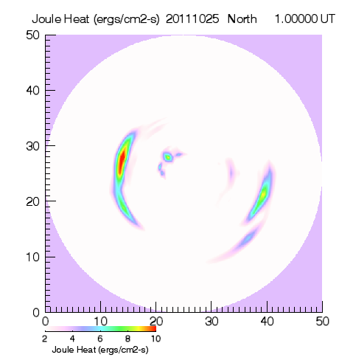
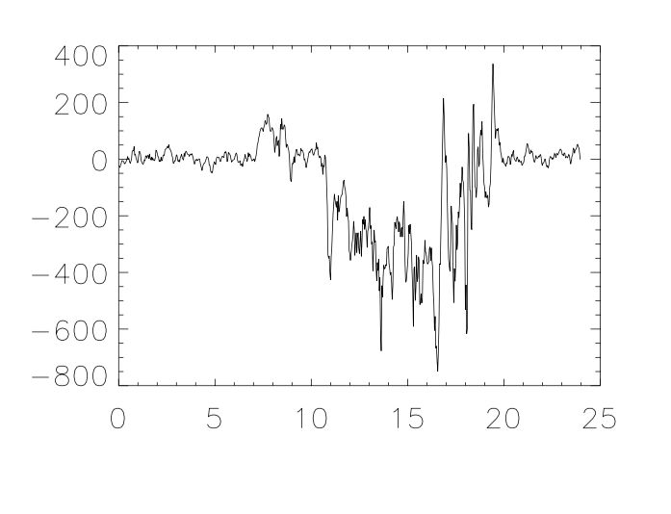
Begin with AMPERE
Field-aligned currents
Pedersen Conductance
Hall Conductance
Convection Pattern
Ionospheric Currents
Joule Heat
Ground Magnetometer Perturbations
Self-Consistency Check with Derived Field-aligned Currents
Notes:
The Pedersen and Hall conductances can be combined with the original field-aligned currents to calculate the self-consistent electrostatic potential using Ohm’s Law and current continuity. With the conductances and electric fields known, horizontal ionospheric currents and Joule heat can be calculated, also self-consistently with the measured field-aligned currents. Self consistency is checked by recomputing the field-aligned currents from the divergence of the horizontal currents. The final check is to use the ionospheric currents to predict ground-based magnetic perturbations,which can be compared to observations.

Slide 12
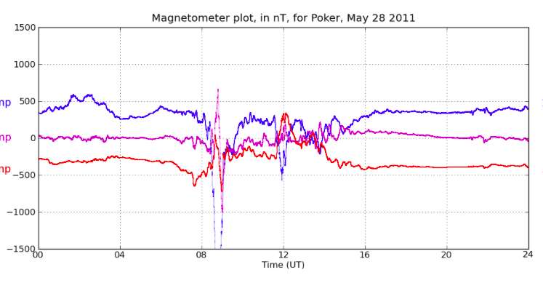
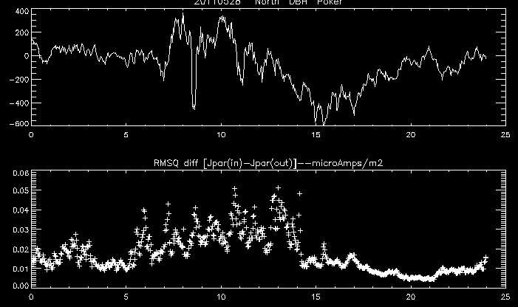
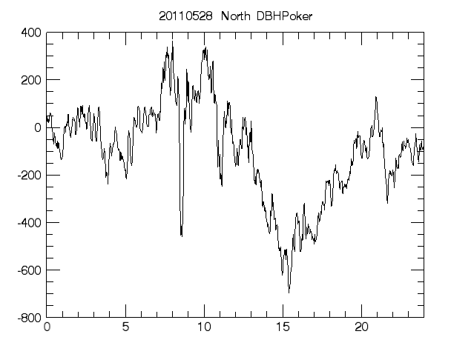
Notes:
The data for May 28, 2011, shows a narrow feature at about 8:30 UT. The actual perturbation is more than 1500 nT, three times stronger than the predicted value. The electrojet maps during this time interval is shown in the next slide.

Slide 13
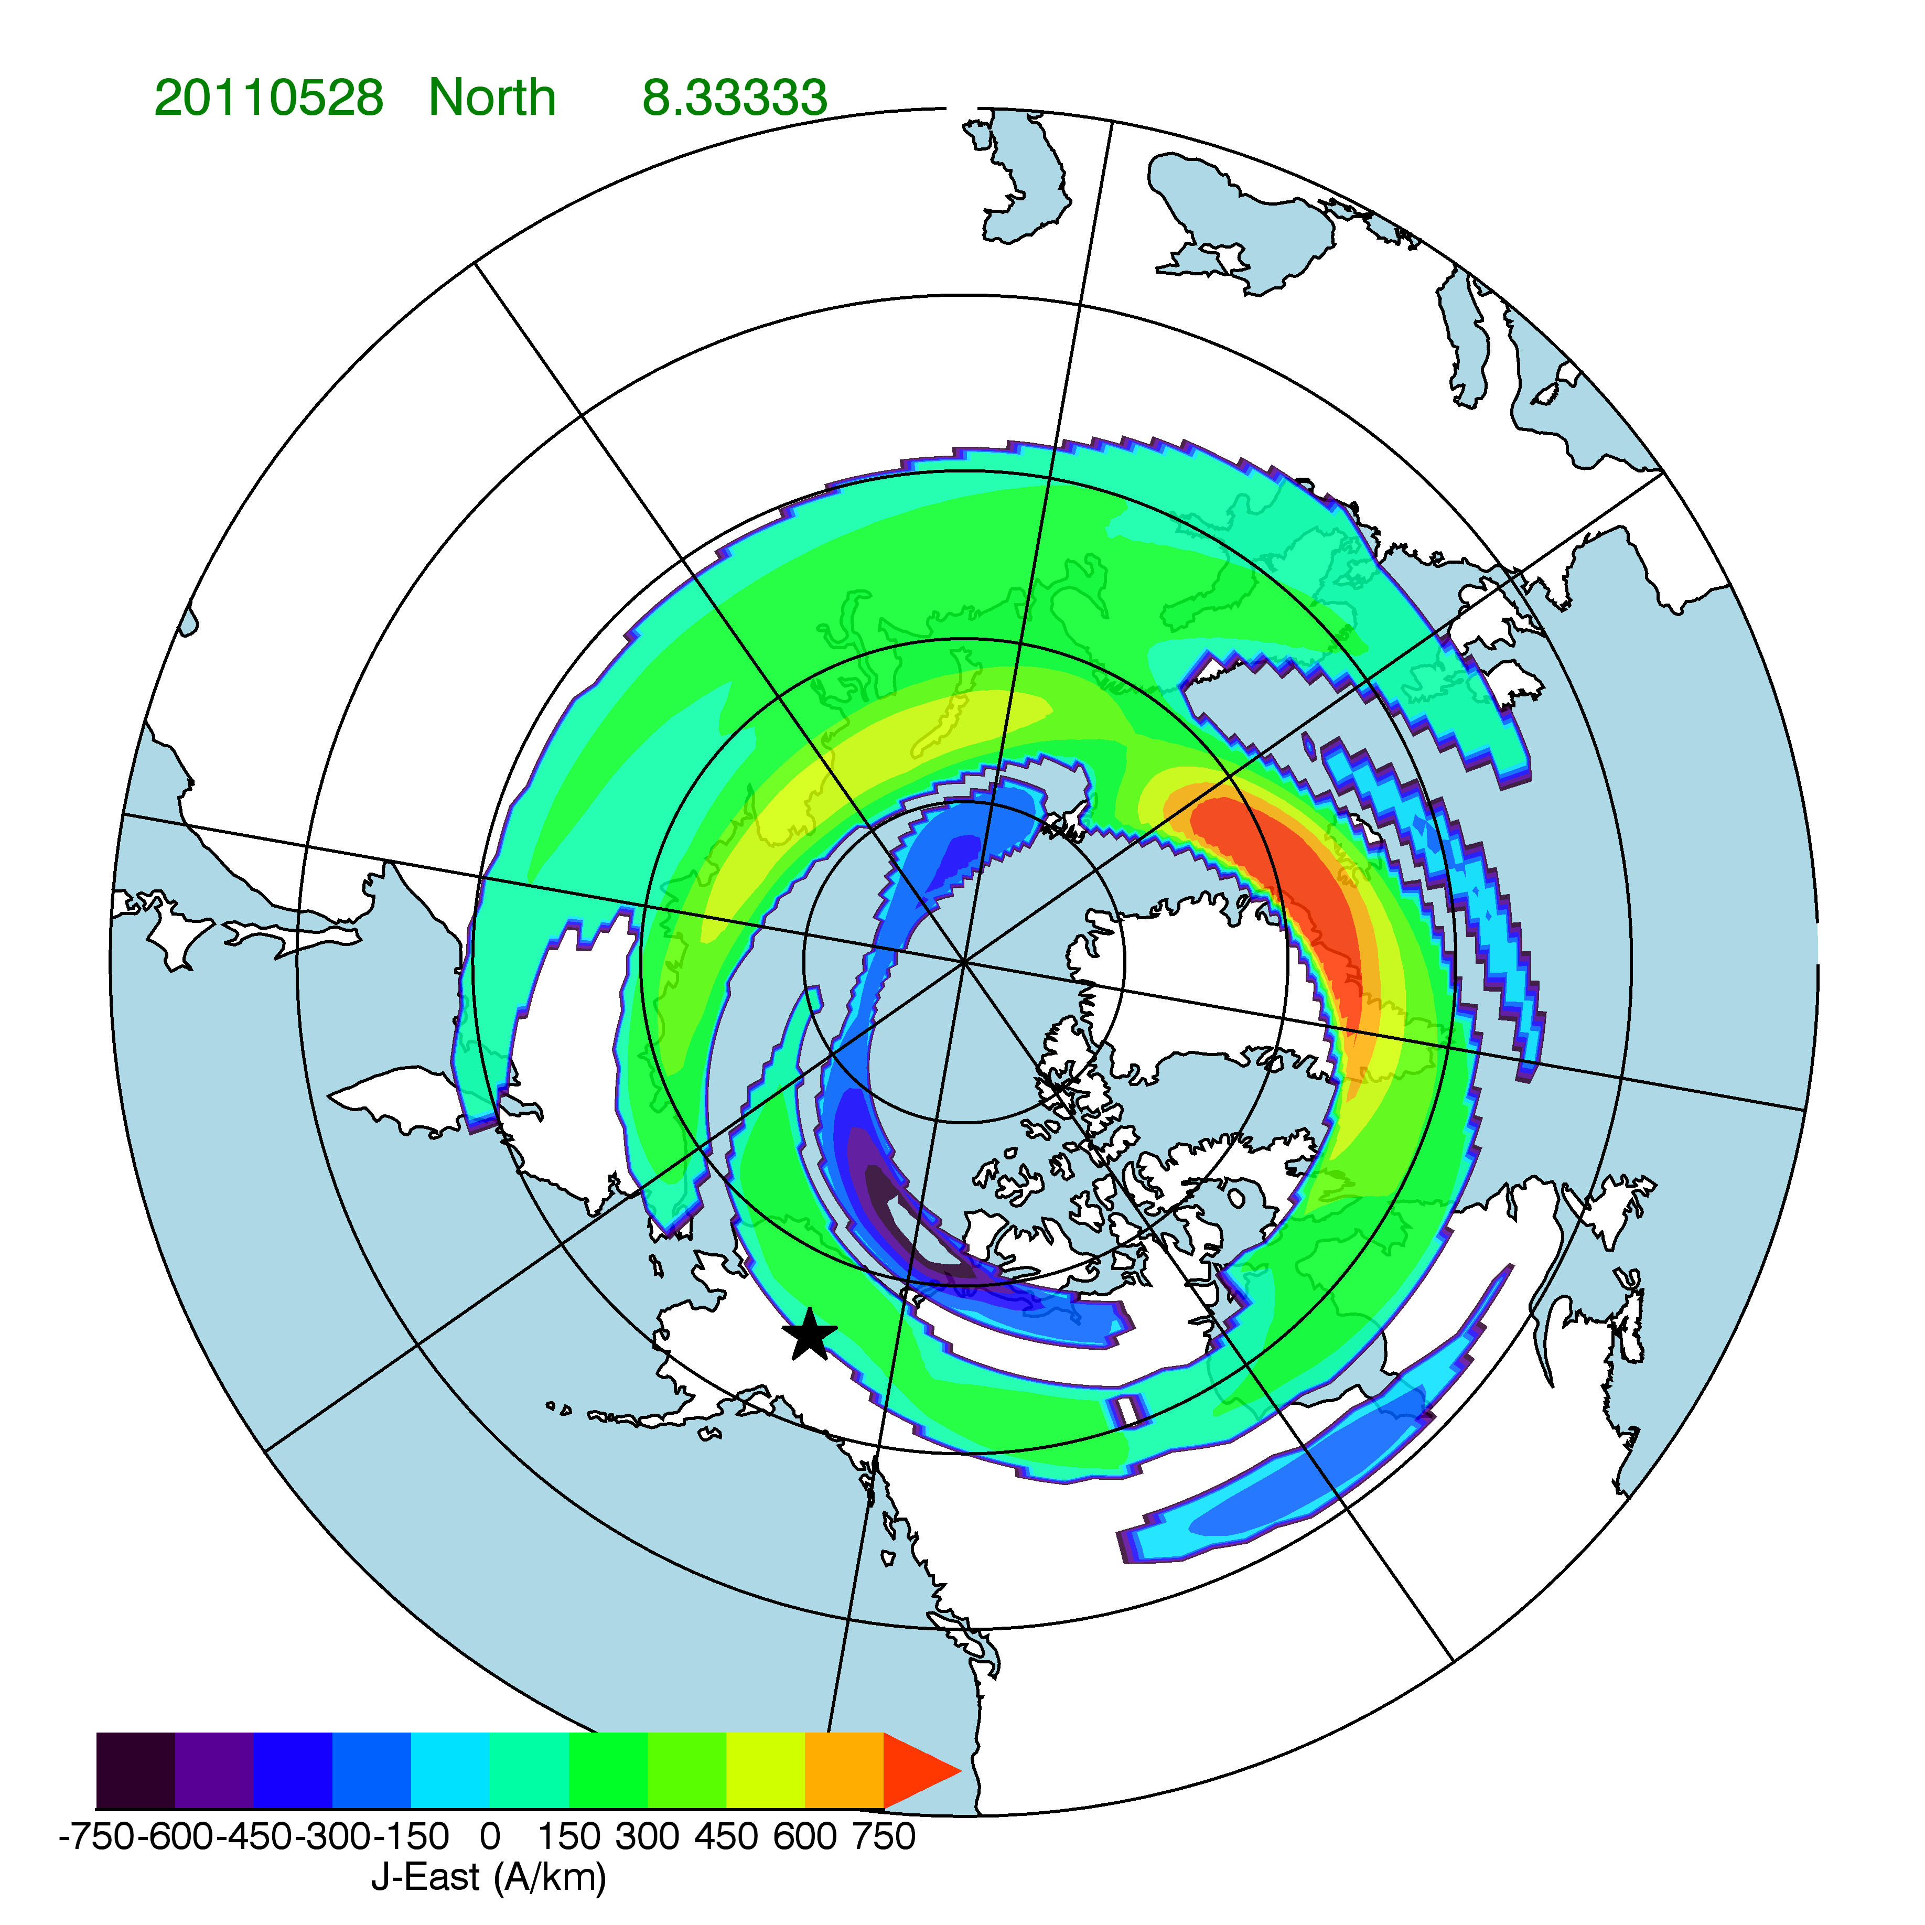
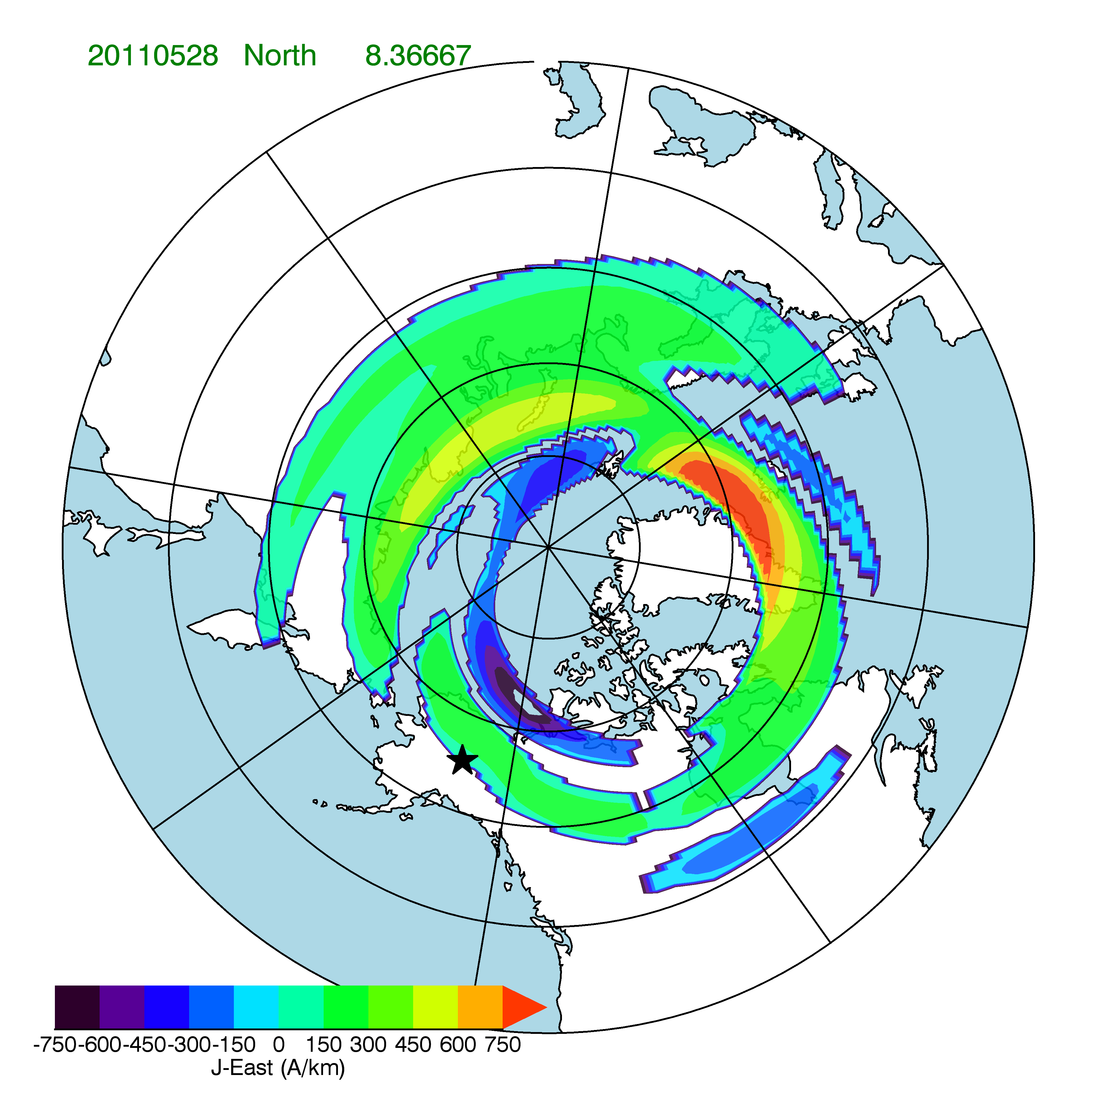
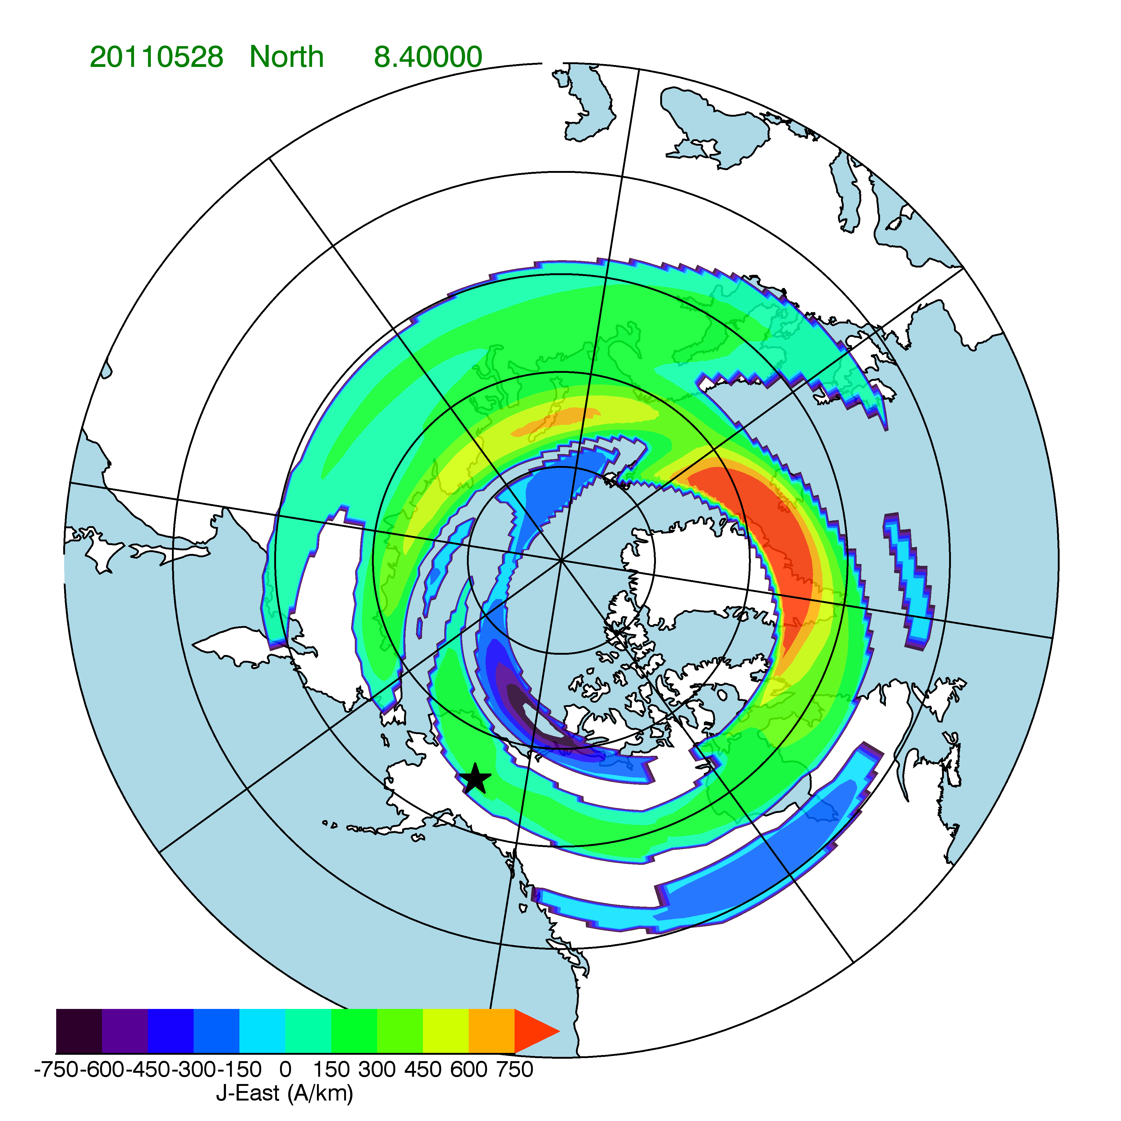
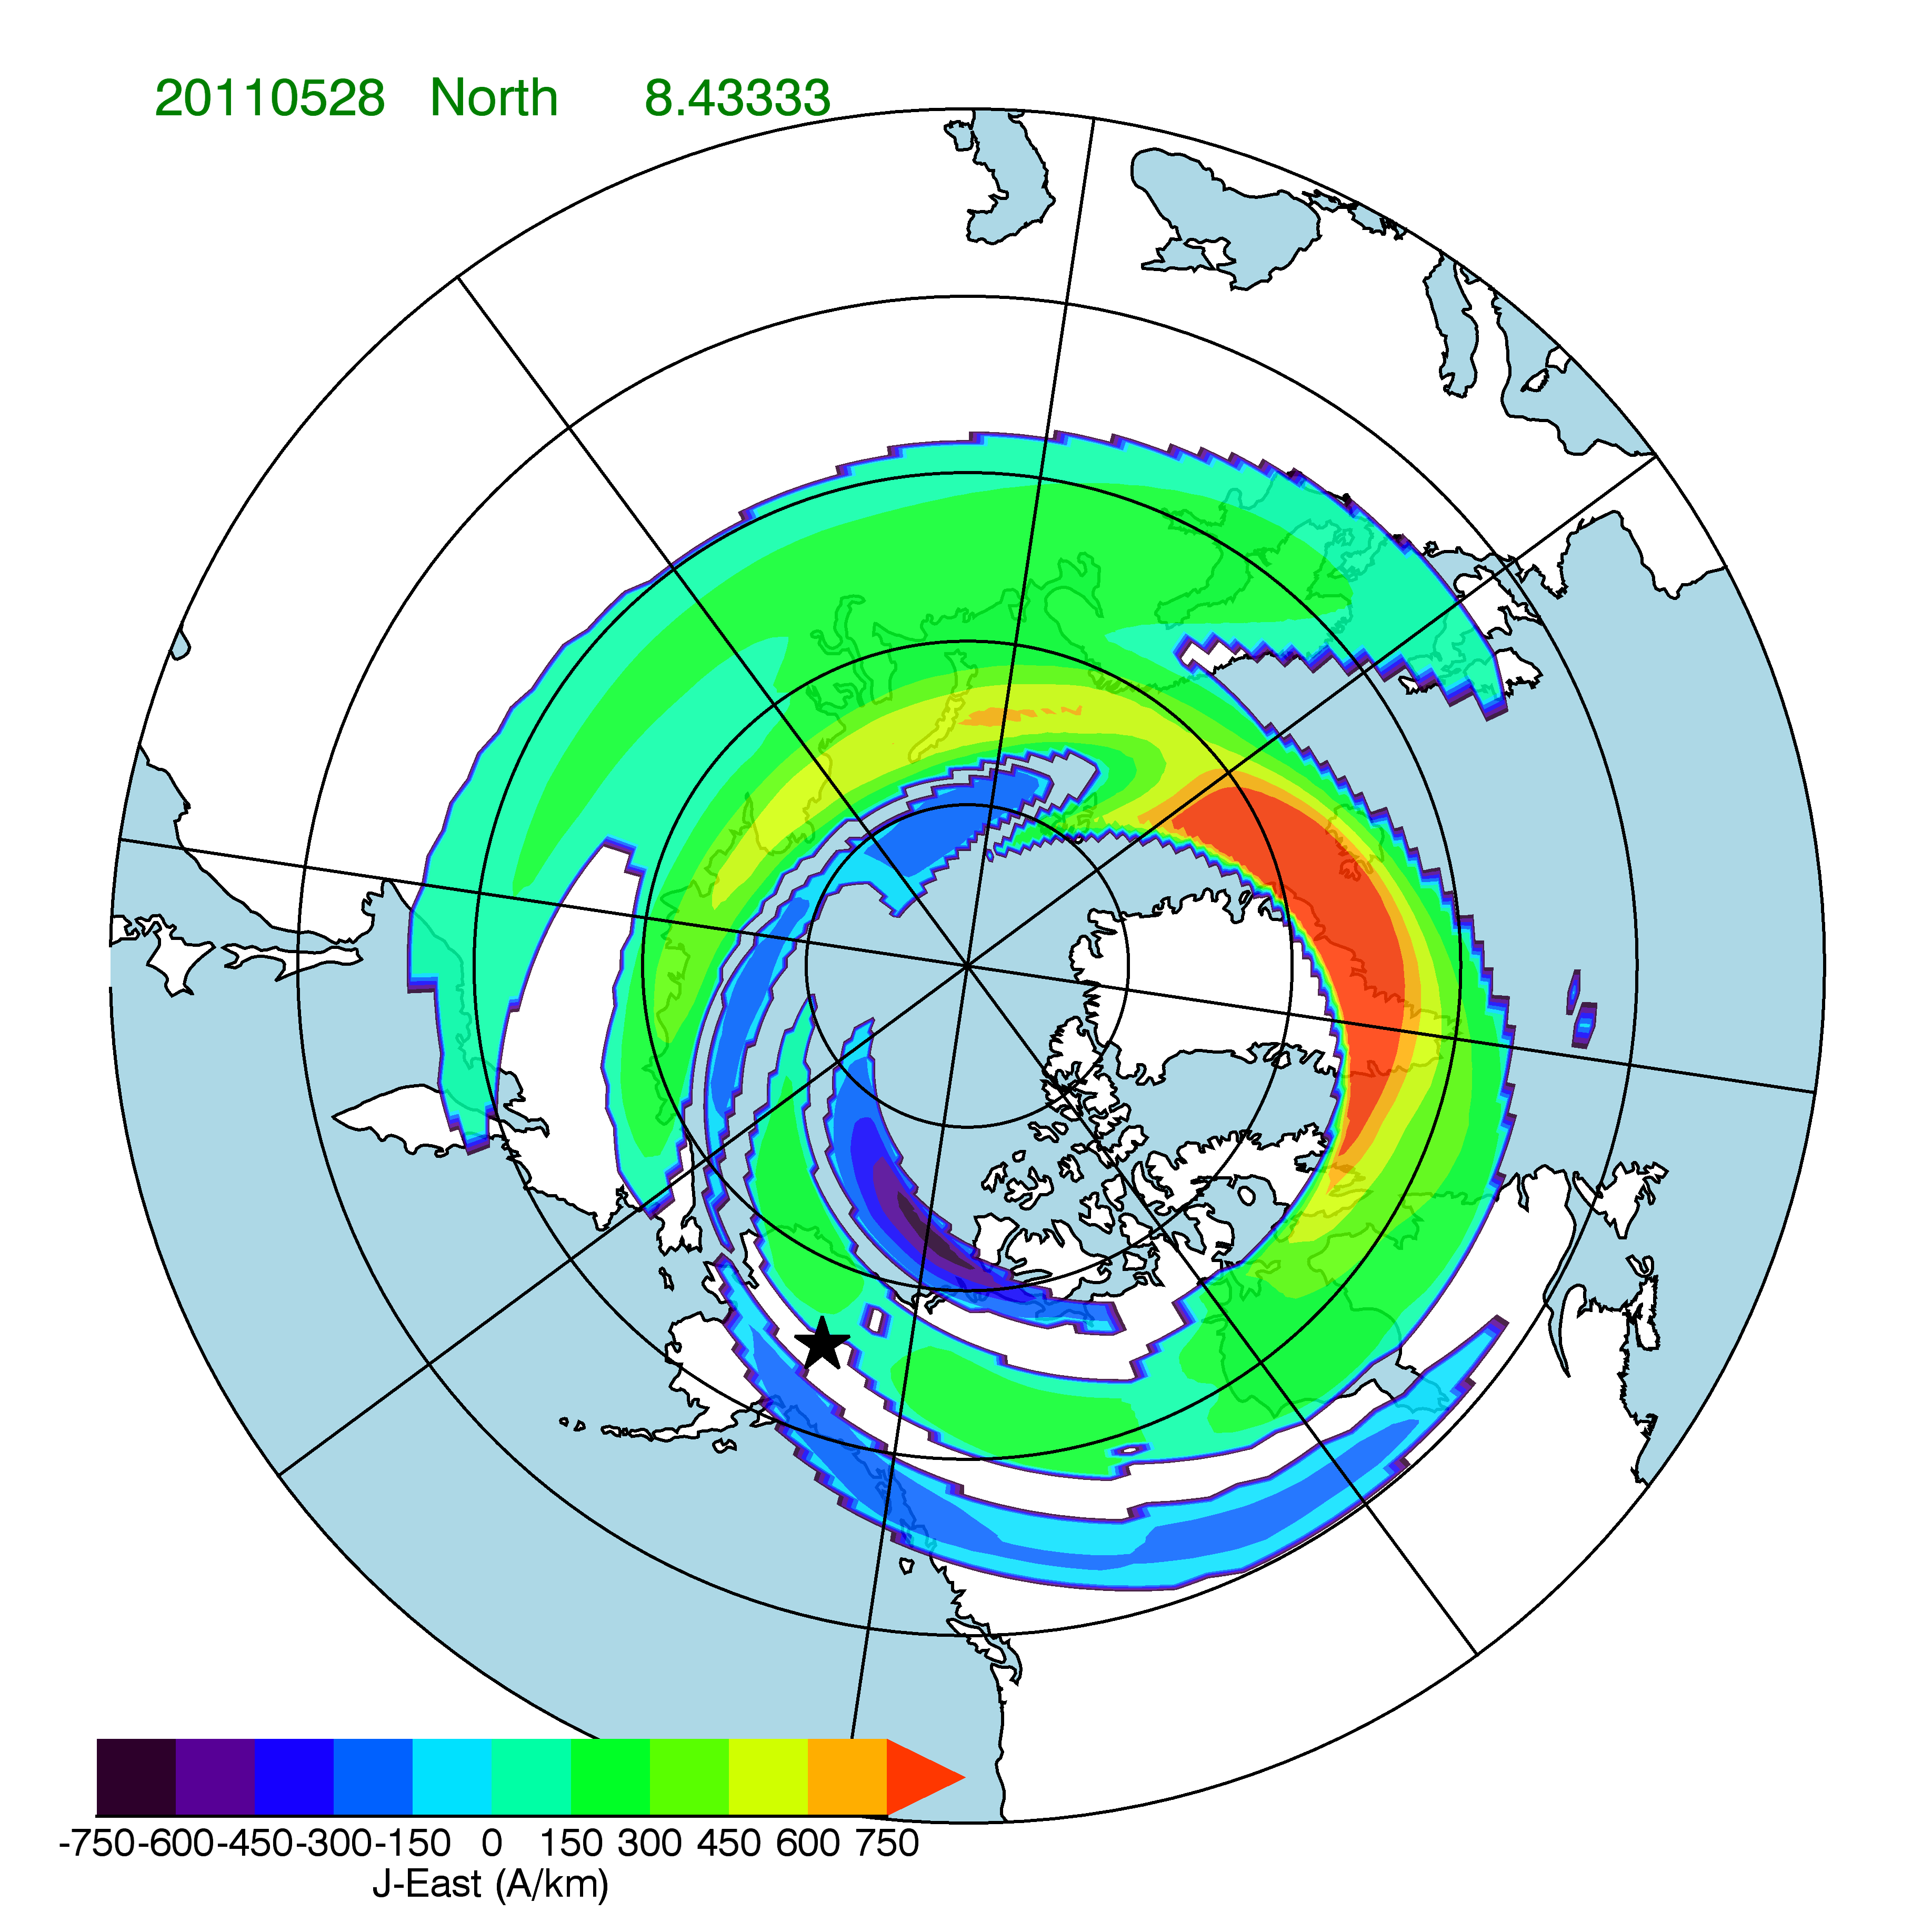
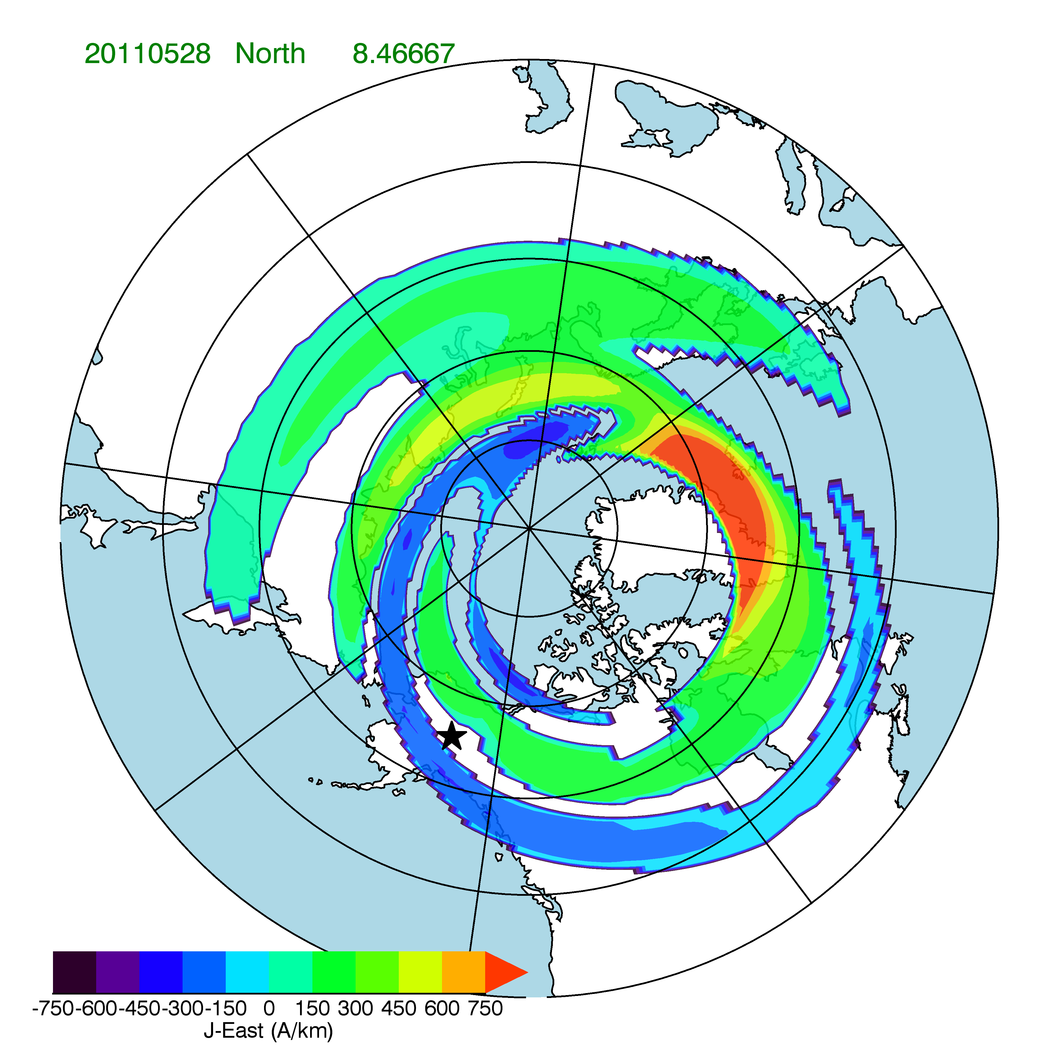
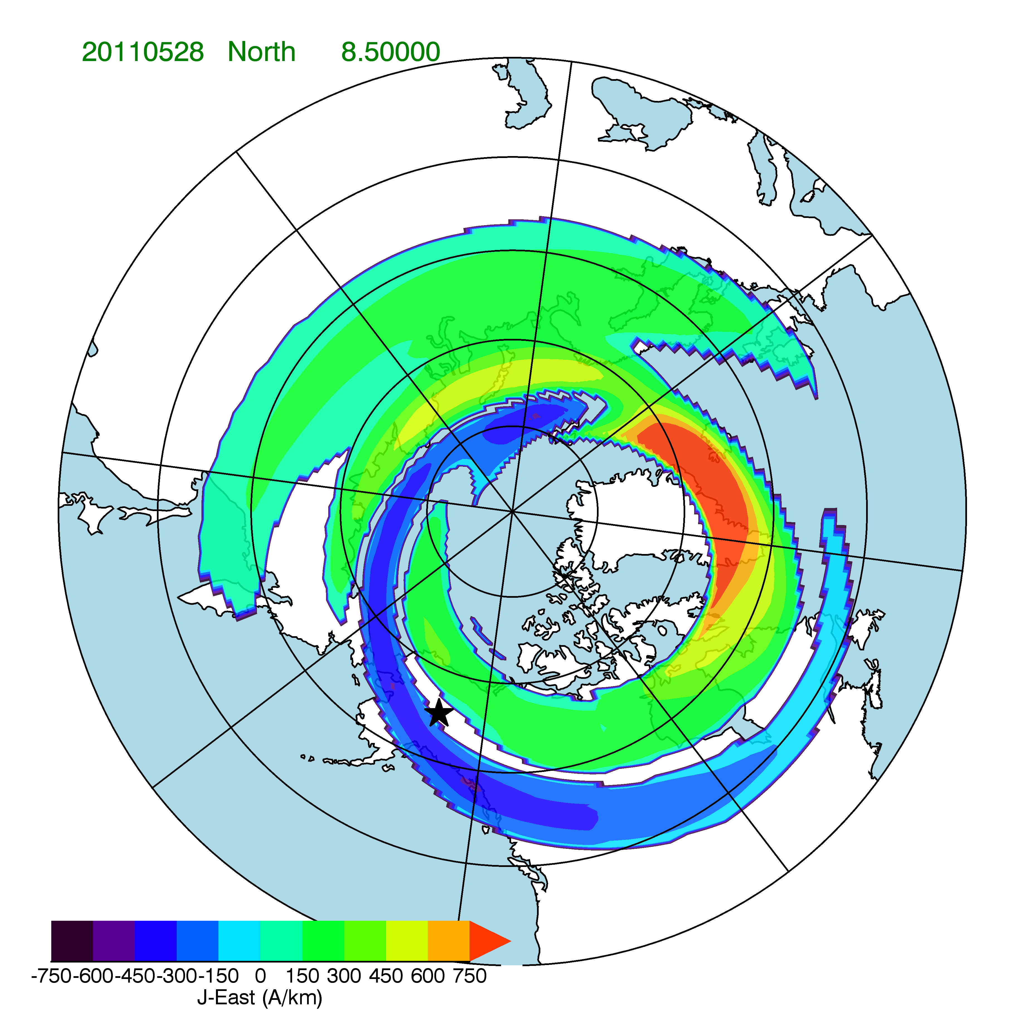
Ionospheric Current Evolution in a Westward Traveling Surge
Notes:
These maps at two-minute intervals between 8:20 and 8:30 UT show that the sharp negative bay in the magnetometer data is from a westward traveling surge, beginning from a localized westward electrojet in the post-midnight sector. The surge extends almost 12 hours of local time in two minutes. The magnitude of the predicted magnetic deflection depends on accurately computing the contributions from all currents in the vicinity of Poker Flat, which is between two oppositely directed electrojets.

Slide 14
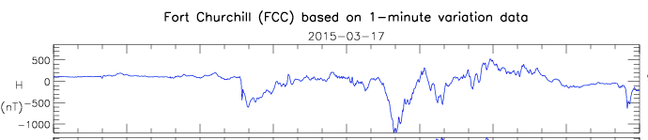
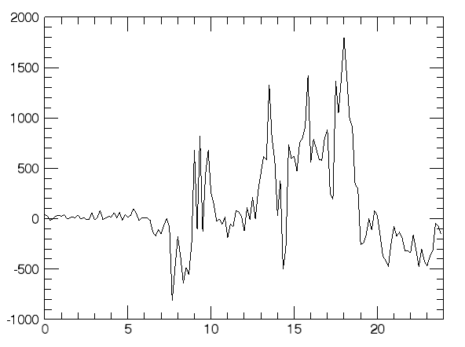
Notes:
Just to show that the technique works for other magnetometer stations besides Poker Flat.

Slide 15
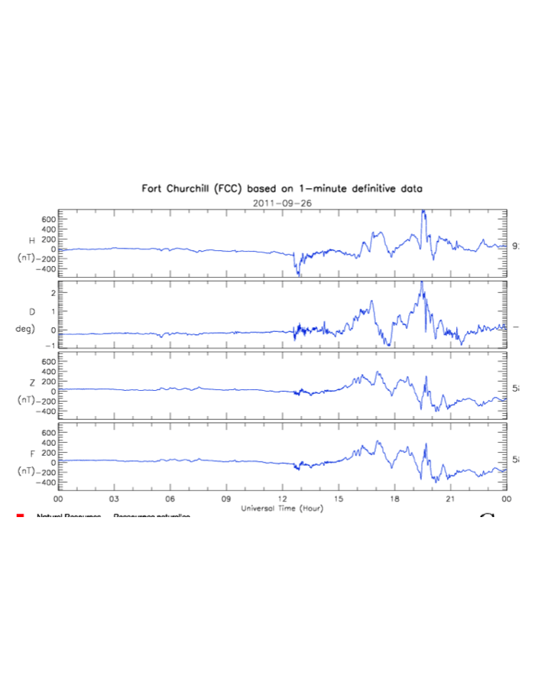
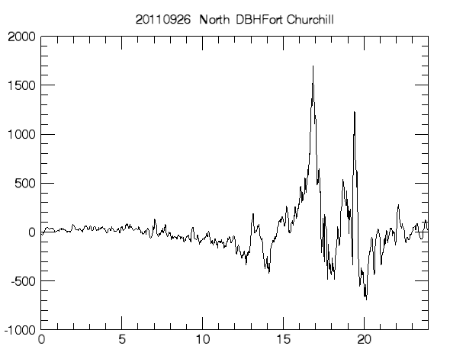
Notes:
And another showing some very narrow features, and some notable differences between measured and predicted values.

Slide 16
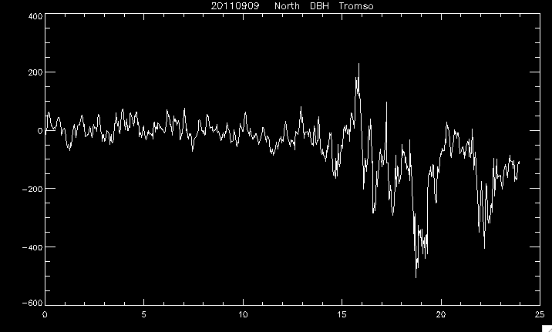
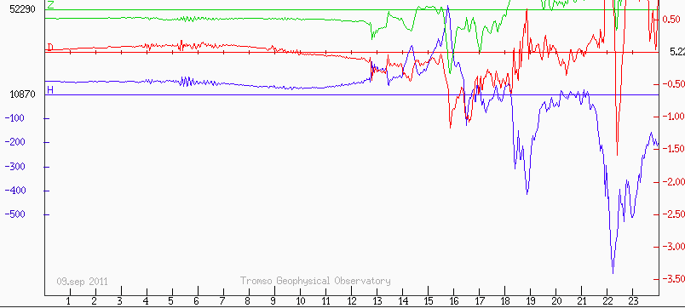
Notes:
This example is from Tromso. All three of the prominent features in the Tromso magnetometer are replicated.

Slide 17
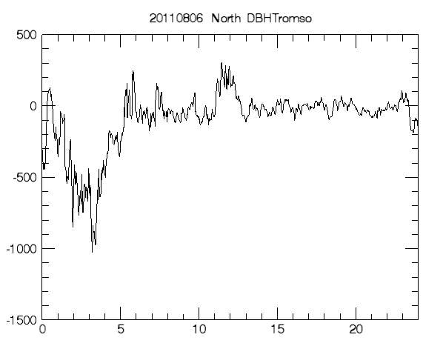
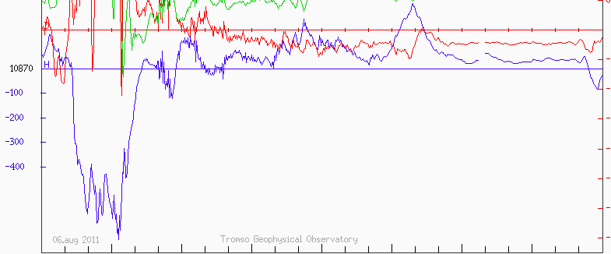
Notes:
And another, except that the feature near 16 UT is not replicated.

Slide 18
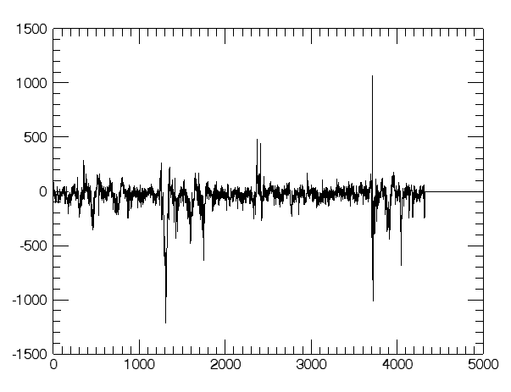
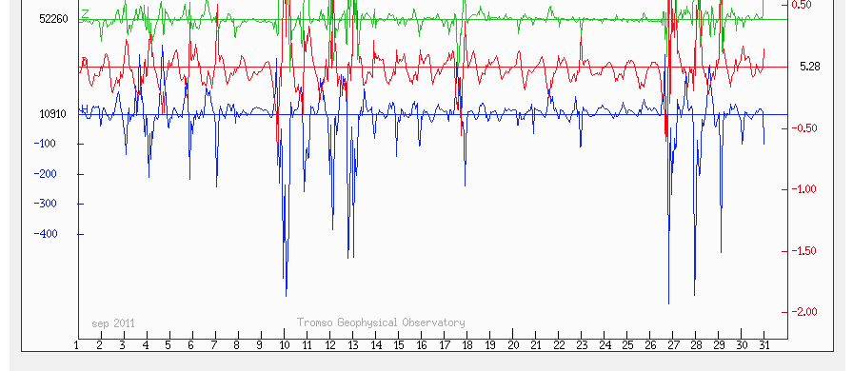
September 2011
From AMPERE
Tromso Magnetometer
Notes:
This shows a one-month comparison of measured versus calculated magnetometer perturbations at Tromso. All the major magnetometer deflections are replicated.

Slide 19
Conclusions
A conductivity model based on field-aligned currents gives:
  Spatial and temporal consistency between the field-aligned currents and enhanced conductivity regions
  Horizontal currents that reproduce magnetic perturbations measured by ground-based magnetometers
Field-aligned currents represent a “key” parameter that constrains the state of the ionosphere-magnetosphere coupled system
Note to modelers:
  Concentrate on getting field-aligned currents right
  If possible, assimilate FAC data (from AMPERE)
  Use field-aligned currents for validation

Slide 20
Improvements
Use a larger PFISR database for better statistics
Incorporate data from Sondrestrom, Tromso, Sodankyla
Verify conductance contribution from solar EUV
Check model used for conductance calculation
Check model used for energy flux calculation
Check magnetic/geographic coordinate transformations
Improve handling of conductances in regions of small field-aligned currents
Fix the electrostatic potential calculation at high latitudes
Better integration of currents to determine ground-based perturbations; inclusion of image current contributions
Perform validation studies using ground-based magnetometers, satellite and ground-based optical imagery, satellite-based particle precipitation measurements
Identify unique signatures in field-aligned currents corresponding to specific types of aurora
Understand and, if necessary, compensate for energy flux and conductance in the midnight gap.

Slide 21
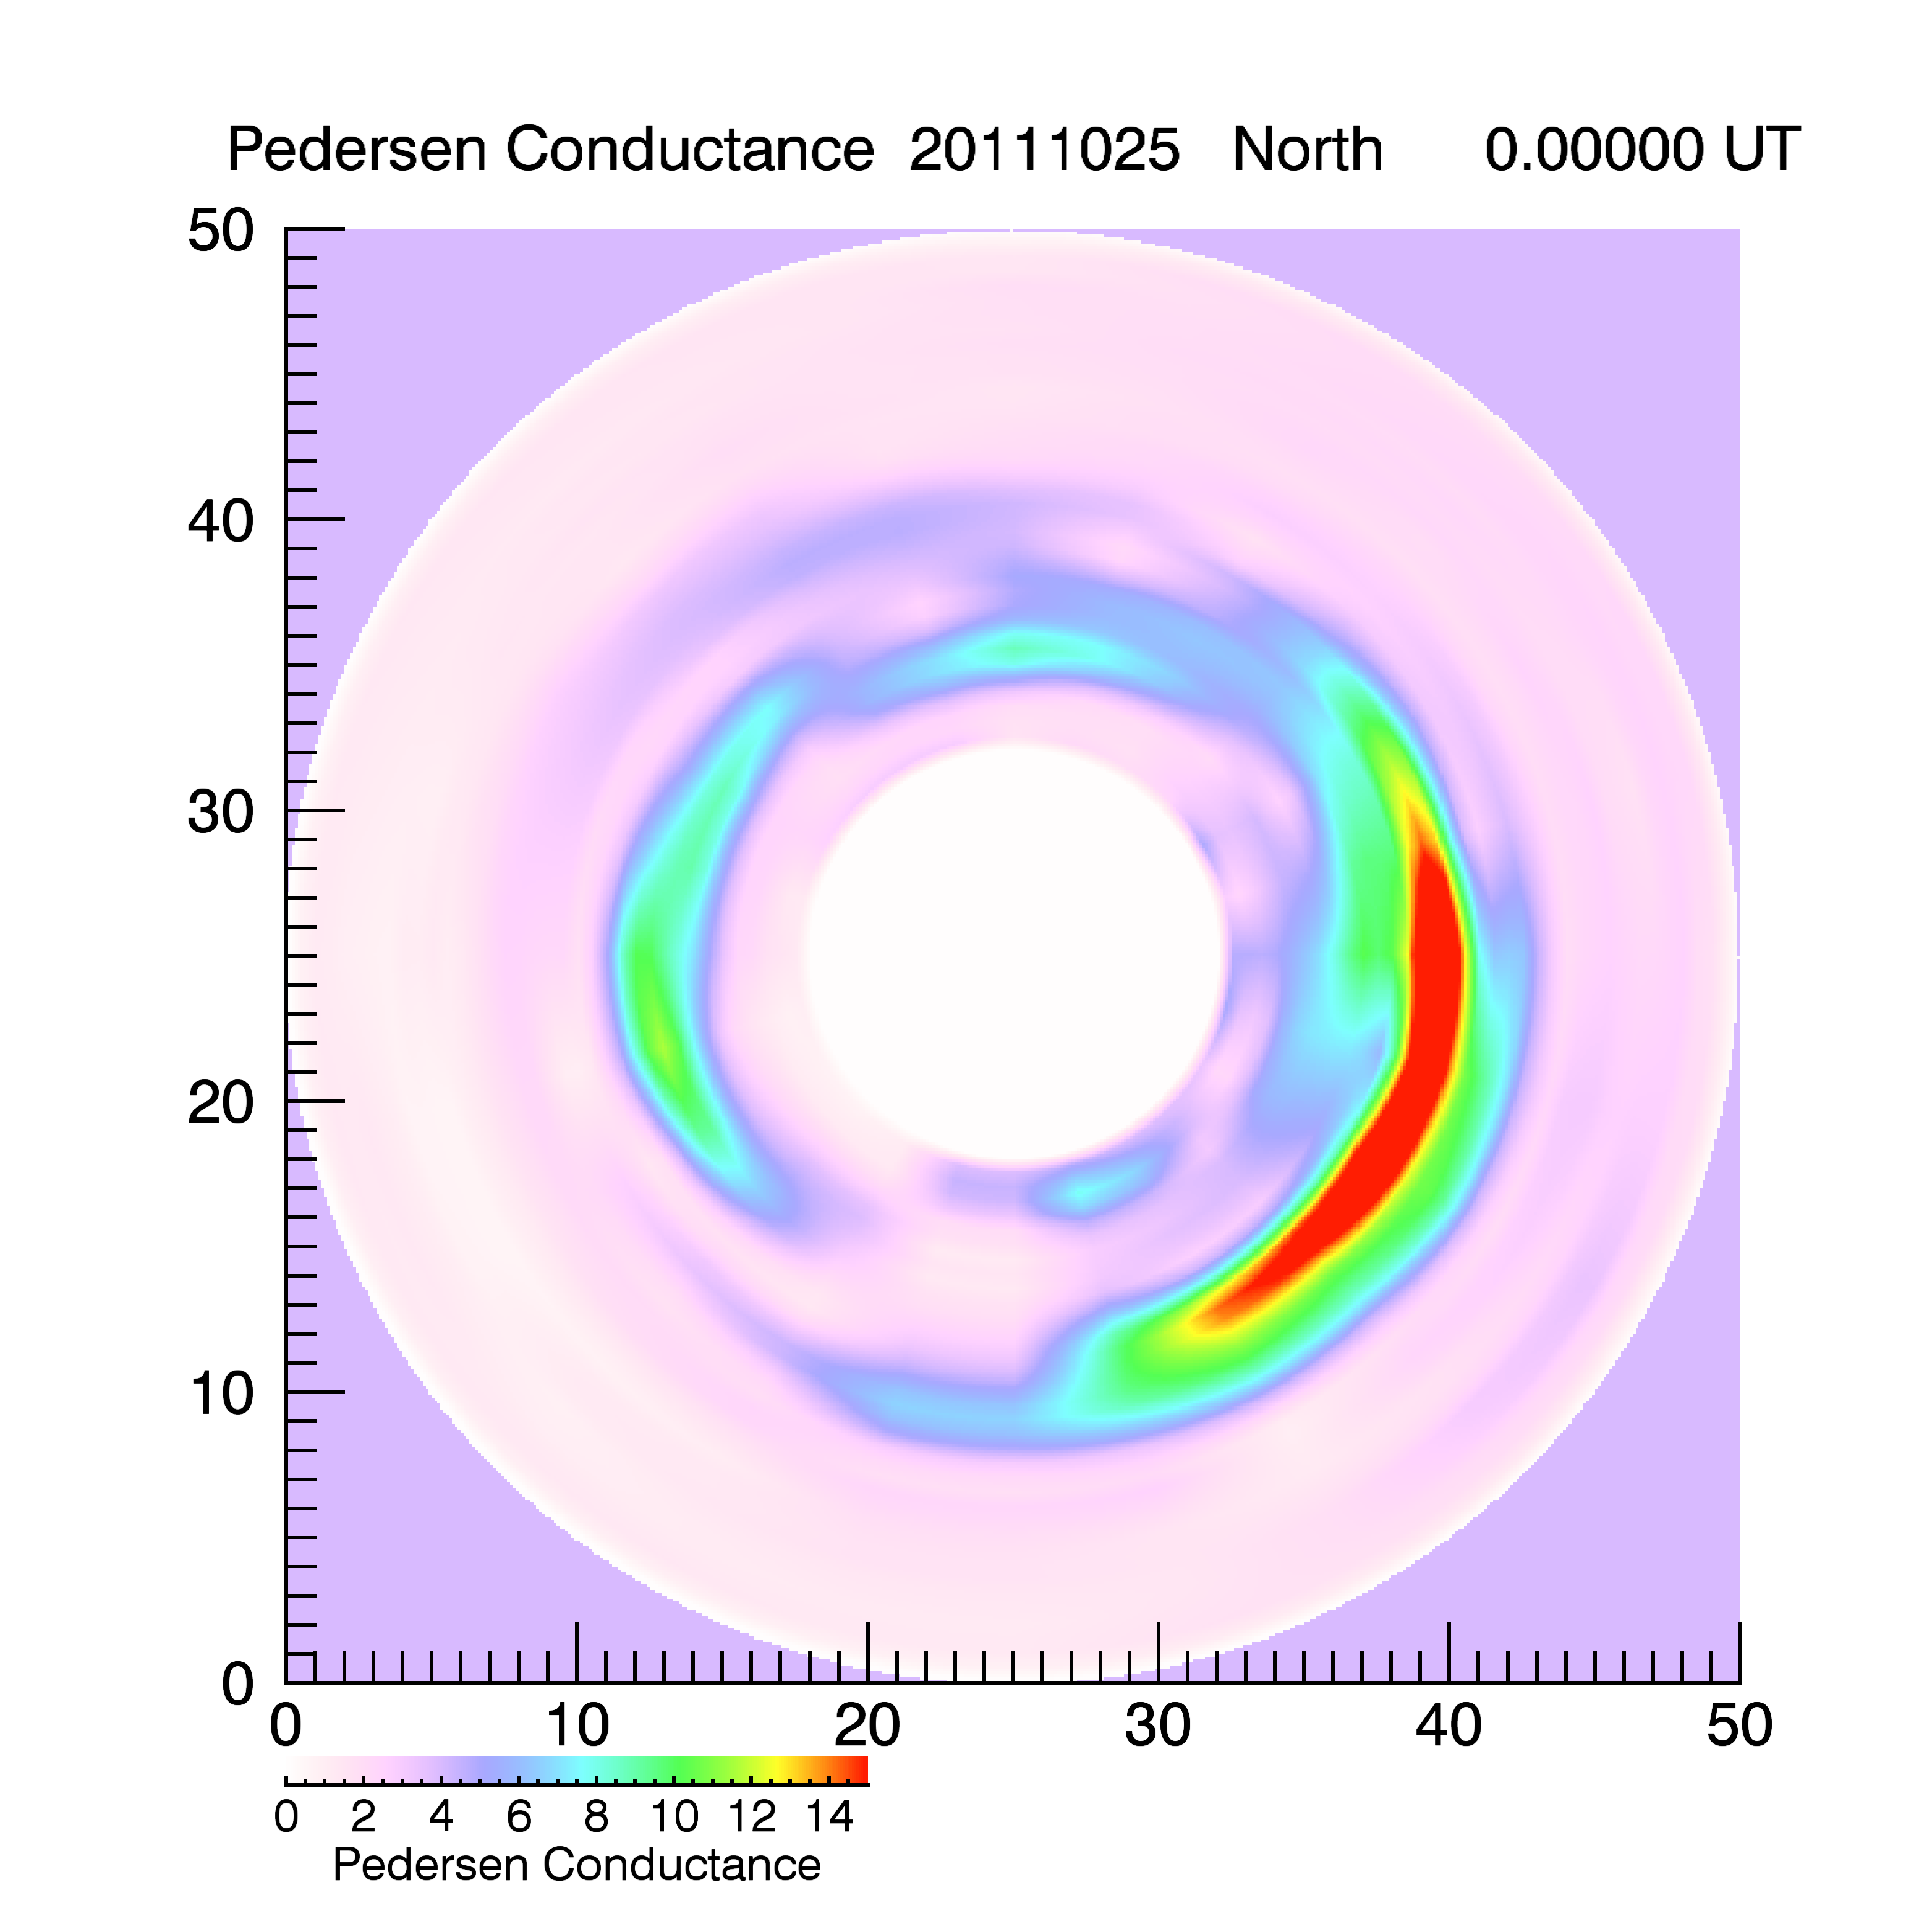
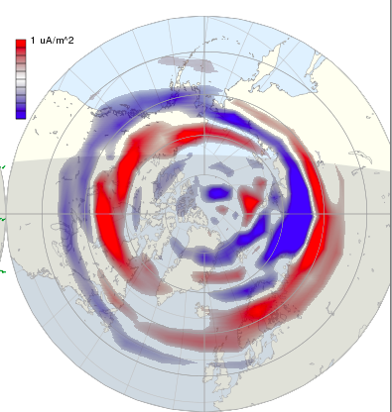
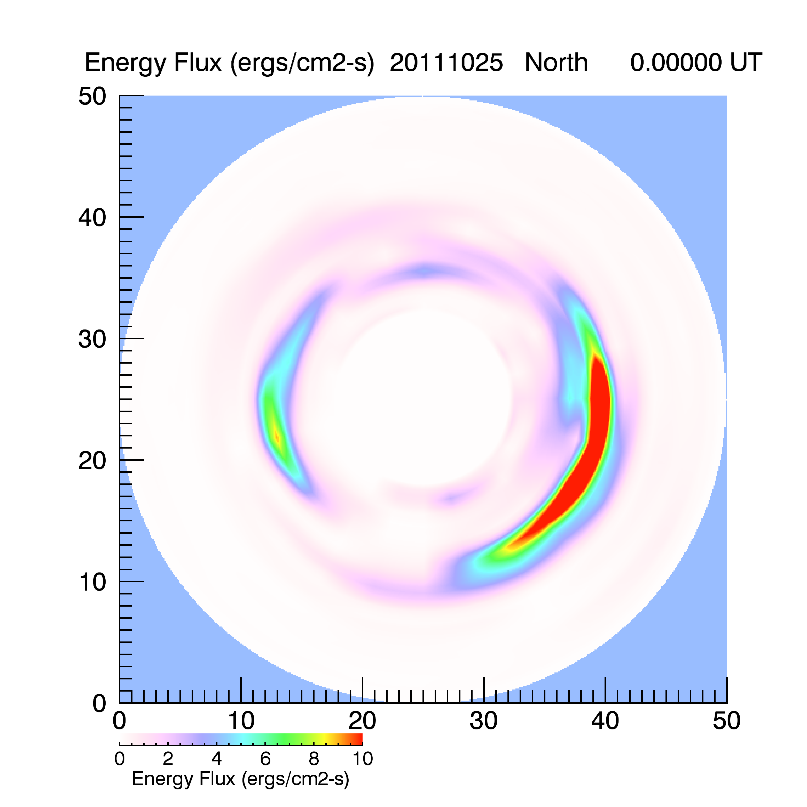
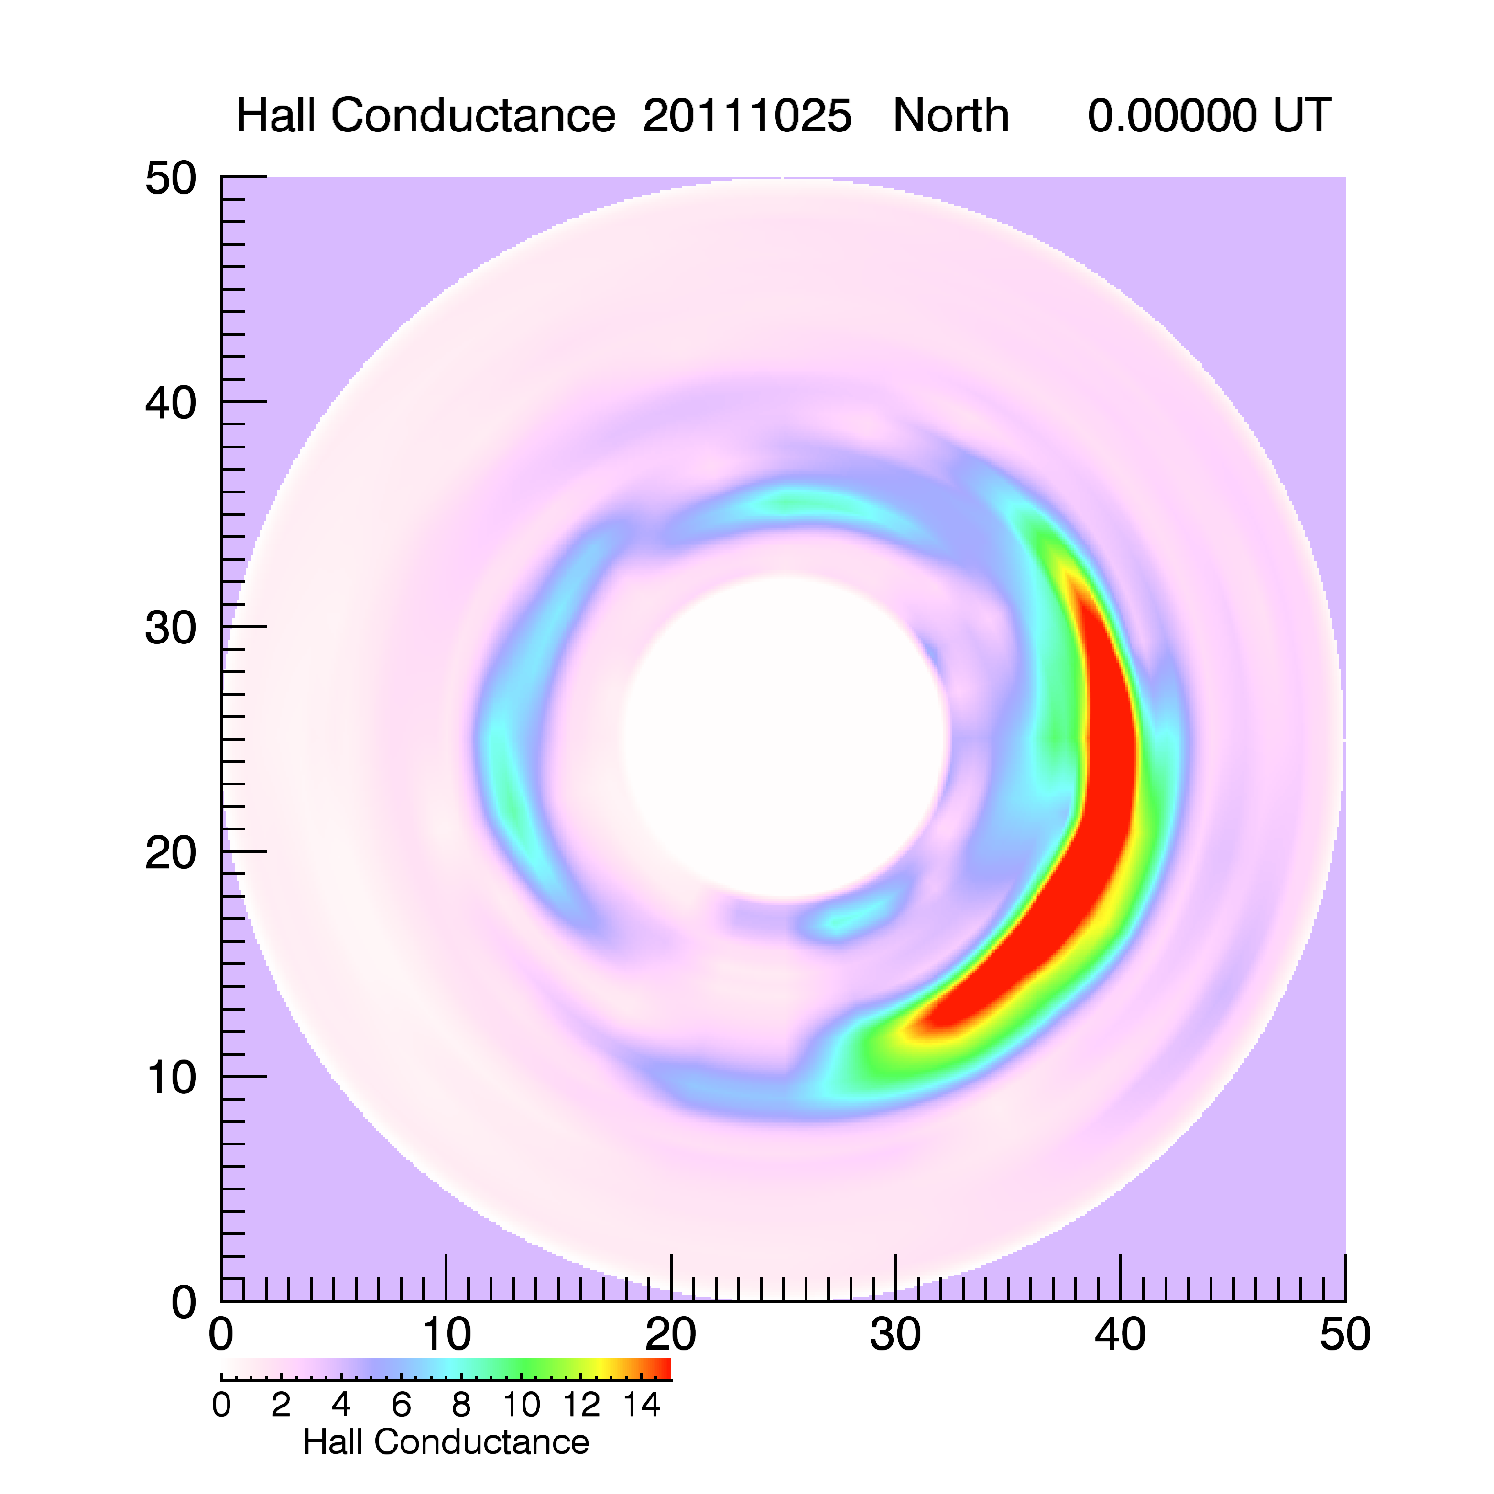
Notes:
To validate the technique, the Hall and Pedersen conductances at each point were used to estimate the energy flux. By integrating the energy flux over the entire hemisphere, we get the total power into the high laittude auroral zone. This can be compared with the Hemispherical Power Index provided by OVATION Prime.

Slide 22
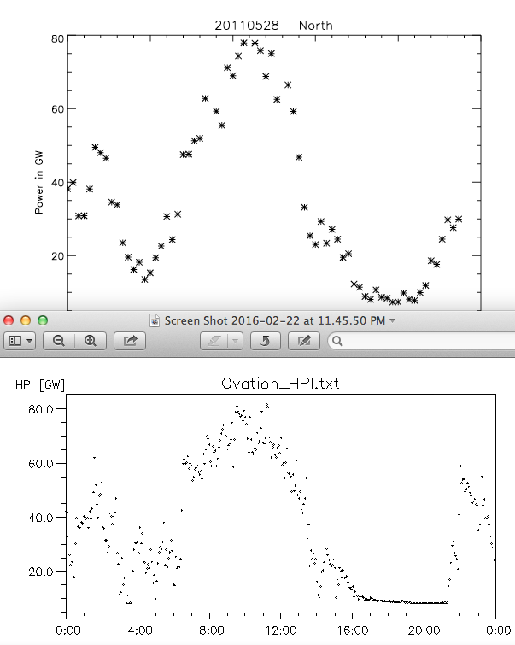
Notes:
The technique gives excellent agreement with hemispherical power as determined from OVATION-Prime.

Slide 23
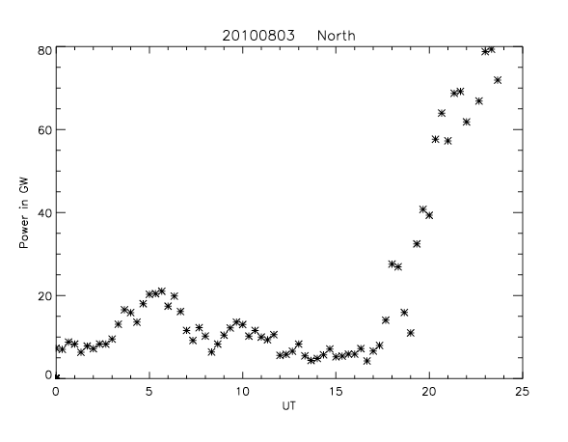
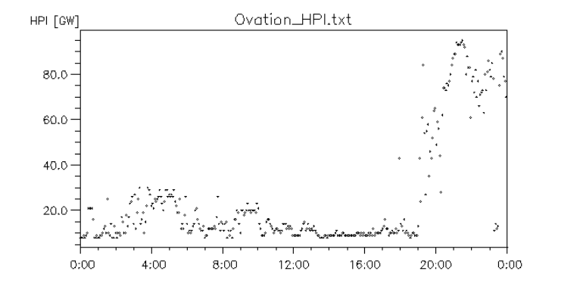
Notes:
On average, OVATION-Prime gives values 10 to 20 percent higher than those determined from field-aligned currents.

Slide 24
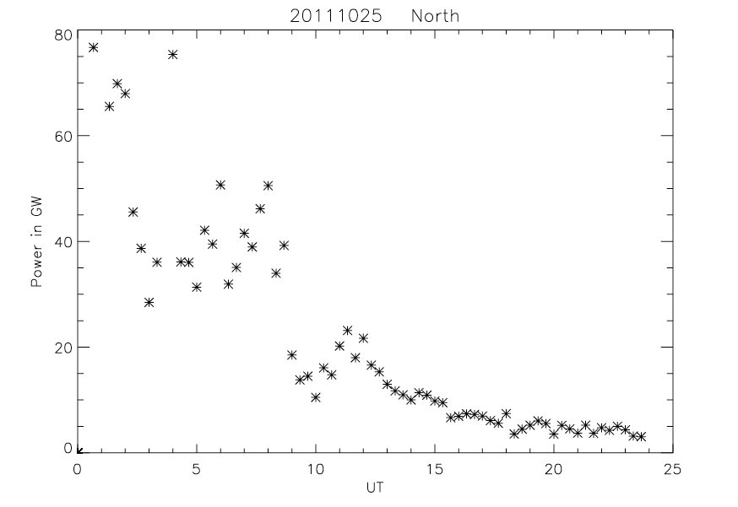
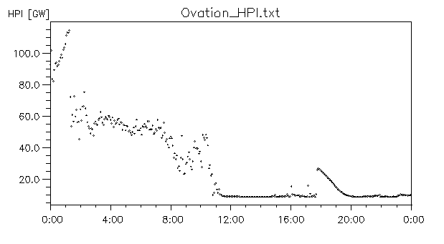

Slide 25
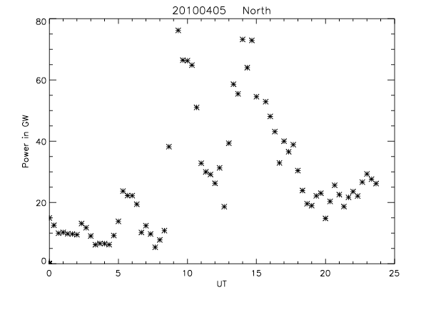


Slide 26



Slide 27


Predicted Ground DB
March 17, 2015
Poker Flat
Notes:
Preliminary comparisons have been made using the ionospheric currents to calculate the H component of the ground-based magnetometer data (blue trace). This example shows good correlation between the two data sets for the Poker Flat magnetometer. Although the magnitudes of the perturbations differ, the technique replicates many of the rapid temporal variations seen in the magnetometer data.

Slide 28

Eastward Current Over Poker Flat (A/km)
October 11, 2010
Poker Flat
Notes:
Another example of good (but not perfect!) agreement between measured and predicted magnetic perturbations.

Slide 29


Predicted H component perturbation
Notes:
This shows the data for the other Valentine’s Day storm—2013. The maps of the electrojets at the two times indicated by yellow lines are shown in the next slide.

Slide 30


Notes:
Another example from Tromso.

Slide 31


Westward Eastward
Notes:
Blue areas represent westward electric fields. Green areas are eastward. (The blank area in the middle of the westward electrojet in the right panel is because the color bar saturated.)

Slide 32


Notes:
Another example from Fort Churchill.

Slide 33

1.5
0
-1.5
Conductance (mhos)
J-parallel (μAmps/m2)
Notes:
An example of conductivity and field-aligned current measurements made simultaneously and coincidentally at Poker Flat, Alaska as a function of UT over two active days. Magnetic midnight at Poker Flat is around 11 UT.

Slide 34

1.5
0
-1.5
Conductance (mhos)
J-parallel (μAmps/m2)
Notes:
Another example, this one only one day.

Slide 35

1.5
0
-1.5
Conductance (mhos)
J-parallel (μAmps/m2)
Notes:
Three consecutive days.

