Slide 1
Geospace Model Validation
Phase II
K-Values
Alex Glocer
Lutz Rastaetter, Masha Kuznetsova, Antti Pulkkinen,
Chris Balch, Howard Singer, and James McCollough
2013 GEM Workshop

Slide 2
Motivation and Approach
Motivation: Can models predict a regional K that better represents a local geomagnetic disturbance better than the global Kp?
Approach
  Calculating K values specific to each magnetometer (for both data and models).
  We do this by finding the δΒ = ΔΒ_{max} – ΔΒ_{min} for the horizontal component over a three hour sliding window and applying station specific look up table to get K.
  We then consider two thresholds for K: High activity (K≥6) and very high activity (K≥8).
  Contingency (Hit/Miss) tables and skill scores are determined for each model.
  Tables and scores can be determined individually for each magnetometer or grouped (high latitude and mid latitude).

Slide 3
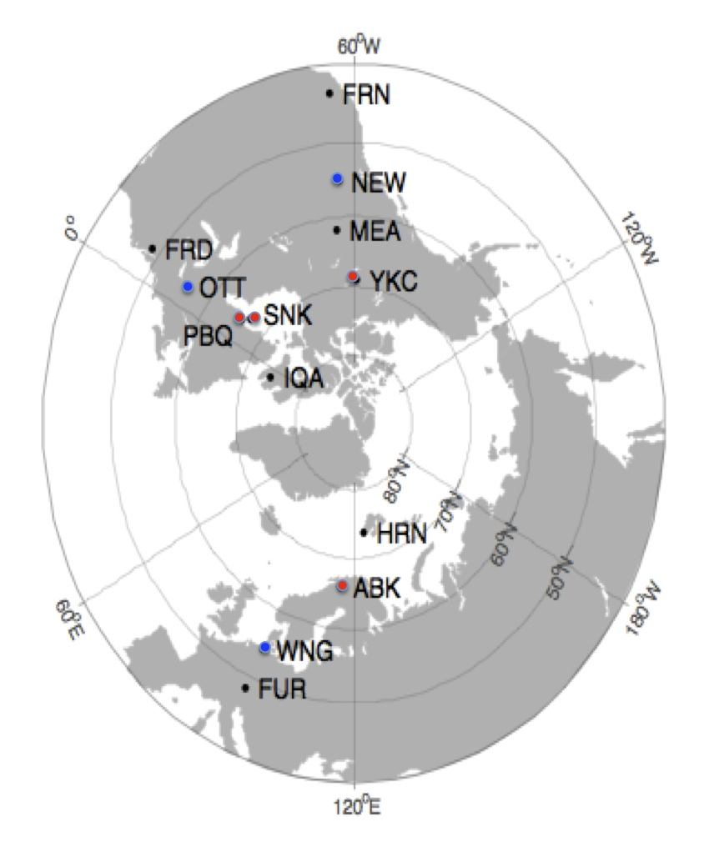
Magnetometer stations
Station list defined for 2008 GEM Challenge:
ABK, FRD, FRN, FUR, HRN, IQA,
MEA, NEW, OTT, PBQ/SNK, WNG, YKC
Stations in low to high latitudes
covering large longitude range
  Subset of list is used for dBdt
  and k study.
Station data missing:
  ABK (Abisko) for 2011 event
  PBQ (Poste de la Baleine) for 2010, 2011 events.
  Was replaced by nearby SNK (Sanikiluaq) in 2009.

Slide 4
Events
Events from GEM 2008-2009 study:
  2003/10/29 06:00 – 2003/10/30 06:00
  (DST=-353 nT, KP=9, part of “Halloween Storm”)
  2006/12/14 12:00– 2006/12/16 00:00
  (DST=-162 nT, KP=8+, “AGU storm”)
  2001/08/30 00:00 – 2001/09/01 00:00 (DST= -40 nT, KP=4)
  2005/08/30 09:30 – 2005/09/01 12:00 (DST=-122 nT, KP=7)
New events selected for this study:
  2010/04/05 00:00 – 2010/04/06 09:00 (DST= -67 nT, KP=8-)
  2011/08/05 09:00 – 2011/08/06 09:00 (DST=-113 nT, KP=8-)

Slide 5
Model runs
Magnetosphere MHD:
9_SWMF: real time setup with 1M cells and RCM inner magnetosphere
(version of Jan. 31, 2011)
4_OPENGCCM: OpenGGCM V. 4.0 real-time setup 3.88M cells,
(model released, Feb. 8, 2011, with updates through Aug. 2011)
1_CMIT-LFM: 53x48x64 grid, real-time setup (LTR-2_1_1, of Jan. 14, 2011)
All magnetosphere models track changing dipole tilt.
Magnetosphere models designed to run in real-time on 64 processors
on current hardware at CCMC (2 times slower on 2008 hardware).
Statistical models:
5_WEIMER: results of Weimer deltaB model (version of Apr. 19, 2011)
3_WEIGEL: Weigel deltaB model, optimized for dB/dt (version of Feb. 13, 2011)
WingKP: will be added to this list of models in the final iteration.

Slide 6
Timeline data
Directly written by model:
  Weimer, Weigel: models’ only output
CCMC post-processing:
  SWMF, CMIT-LFM, OpenGGCM:
    Biot-Savart integration over
      magnetosphere currents,
      field-aligned currents (FAC) between magnetosphere and ionosphere along dipole field lines,
      ionosphere currents (from electrodynamics outputs).

Slide 7
Summary of Changes
Since the initial presentation of this work at the mini-GEM workshop we have refined the analysis
Significant changes:
  Issues identified in the model execution of OpenGGCM during the dB/dt validation study meant all OpenGGCM cases were rerun. Resulted in major improvement in model performance in metric study.
  The LFM cases were reanalyzed with the full magnetic field information. Resulted in modest change to model performance in metric study.
  Analysis of Weigel model was missing one magnetometer for two events. Has been corrected in current skill scores.
  Some minor errors in skill score calculations were corrected.
  WingKp is in the process of being added

Slide 8
Visualization
SWMF
Data-Model Comparisons of K-Values at YKC
- Data is solid, Model is dashed
- Preliminary plots are available on the web
Weigel
OpenGGCM
Weimer
LFM-MIX

Slide 9
All High Latitude Stations
Threshold K=6
Model | N Event | N No Event | N Hits | N False Hit | N Misses | N No Hit
SWMF | 738 | 612 | 461 | 30 | 277 | 582
SWMF,a | 738 | 612 | 439 | 25 | 299 | 587
OpenGGCM | 738 | 612 | 475 | 135 | 263 | 477
LFM-MIX | 738 | 612 | 136 | 0 | 602 | 612
WEIMER | 738 | 612 | 266 | 3 | 472 | 609
WEIGEL | 738 | 612 | 280 | 20 | 458 | 592
Definitions:
N Event – Number of cases where observation exceeded threshold
N No Event – Number of cases where observation did NOT exceed threshold
N Hits – Number of cases where model and observation exceed threshold
N False Hits – Number of cases where model exceeded threshold but observation did not
N Misses – Number of cases where observation exceeded threshold but model did not
N No Hit – Number of cases where neither model nor observation exceeded threshold

Slide 10
All Mid Latitude Stations
Threshold K=6
Model | N Event | N No Event | N Hits | N False Hit | N Misses | N No Hit
SWMF | 431 | 991 | 293 | 55 | 138 | 936
SWMF,a | 431 | 991 | 264 | 20 | 167 | 971
OpenGGCM | 431 | 991 | 258 | 247 | 173 | 744
LFM-MIX | 431 | 991 | 194 | 32 | 237 | 959
WEIMER | 431 | 991 | 219 | 6 | 212 | 985
WEIGEL | 431 | 991 | 201 | 12 | 230 | 979
Definitions:
N Event – Number of cases where observation exceeded threshold
N No Event – Number of cases where observation did NOT exceed threshold
N Hits – Number of cases where model and observation exceed threshold
N False Hits – Number of cases where model exceeded threshold but observation did not
N Misses – Number of cases where observation exceeded threshold but model did not
N No Hit – Number of cases where neither model nor observation exceeded threshold

Slide 11
All High Latitude Stations
Threshold K=8
Model | N Event | N No Event | N Hits | N False Hit | N Misses | N No Hit
SWMF | 210 | 1140 | 81 | 33 | 129 | 1107
SWMF,a | 210 | 1140 | 88 | 27 | 122 | 1113
OpenGGCM | 210 | 1140 | 71 | 70 | 139 | 1070
LFM-MIX | 210 | 1140 | 9 | 0 | 201 | 1140
WEIMER | 210 | 1140 | 23 | 7 | 187 | 1133
WEIGEL | 210 | 1140 | 76 | 39 | 134 | 1101
Definitions:
N Event – Number of cases where observation exceeded threshold
N No Event – Number of cases where observation did NOT exceed threshold
N Hits – Number of cases where model and observation exceed threshold
N False Hits – Number of cases where model exceeded threshold but observation did not
N Misses – Number of cases where observation exceeded threshold but model did not
N No Hit – Number of cases where neither model nor observation exceeded threshold

Slide 12
All Mid Latitude Stations
Threshold K=8
Model | N Event | N No Event | N Hits | N False Hit | N Misses | N No Hit
SWMF | 168 | 1254 | 124 | 40 | 44 | 1214
SWMF,a | 168 | 1254 | 104 | 25 | 64 | 1229
OpenGGCM | 168 | 1254 | 41 | 47 | 127 | 1207
LFM-MIX | 168 | 1254 | 33 | 11 | 135 | 1243
WEIMER | 168 | 1254 | 57 | 6 | 111 | 1248
WEIGEL | 168 | 1254 | 38 | 4 | 130 | 1250
Definitions:
N Event – Number of cases where observation exceeded threshold
N No Event – Number of cases where observation did NOT exceed threshold
N Hits – Number of cases where model and observation exceed threshold
N False Hits – Number of cases where model exceeded threshold but observation did not
N Misses – Number of cases where observation exceeded threshold but model did not
N No Hit – Number of cases where neither model nor observation exceeded threshold

Slide 13
Skill Scores: All High Latitude Stations
K Threshold = 8
K Threshold = 6
Model | Heidke skill score | Critical Success Index | POD | POFD
SWMF | 0.44 | 0.33 | 0.39 | 0.03
SWMF,a | 0.48 | 0.37 | 0.42 | 0.02
OpenGGCM | 0.32 | 0.25 | 0.34 | 0.06
LFM-MIX | 0.07 | 0.04 | 0.04 | 0.00
WEIMER | 0.16 | 0.11 | 0.11 | 0.01
WEIGEL | 0.40 | 0.31 | 0.36 | 0.03
Heidke skill score | Critical Success Index | POD | POFD
0.56 | 0.60 | 0.62 | 0.05
0.53 | 0.58 | 0.59 | 0.04
0.42 | 0.54 | 0.64 | 0.22
0.17 | 0.18 | 0.18 | 0.00
0.33 | 0.36 | 0.36 | 0.00
0.33 | 0.37 | 0.38 | 0.03
Definitions:
Heidke Skill Score = 2(H*N-M*F)/[(H+M)*(M+N)+(H+F)*(F+N)]
Critical Success Index (Threat Score) = H/(H+M+F)
Probability Of Detection (POD) = H/(H+M)
Probability Of False Detection (POFD) = F/(F+N)
(perfect=1, no skill=0)
(perfect=0)

Slide 14
Skill Scores: All Mid Latitude Stations
K Threshold = 8
K Threshold = 6
Model | Heidke skill score | Critical Success Index | POD | POFD
SWMF | 0.71 | 0.60 | 0.74 | 0.03
SWMF,a | 0.67 | 0.54 | 0.62 | 0.02
OpenGGCM | 0.26 | 0.19 | 0.24 | 0.04
LFM-MIX | 0.28 | 0.18 | 0.20 | 0.01
WEIMER | 0.46 | 0.33 | 0.34 | 0.00
WEIGEL | 0.33 | 0.22 | 0.23 | 0.00
Heidke skill score | Critical Success Index | POD | POFD
0.66 | 0.60 | 0.68 | 0.06
0.66 | 0.59 | 0.61 | 0.02
0.33 | 0.38 | 0.60 | 0.25
0.48 | 0.42 | 0.45 | 0.03
0.58 | 0.50 | 0.51 | 0.01
0.53 | 0.45 | 0.47 | 0.01
Definitions:
Heidke Skill Score = 2(H*N-M*F)/[(H+M)*(M+N)+(H+F)*(F+N)]
Critical Success Index (Threat Score) = H/(H+M+F)
Probability Of Detection (POD) = H/(H+M)
Probability Of False Detection (POFD) = F/(F+N)
(perfect=1, no skill=0)
(perfect=0)

Slide 15
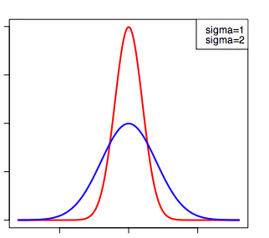
Another Approach
Regional K Distribution Metric
The basic idea find the distribution of model Y results when station x is reporting a particular K.
To get reasonable statistics, results for each station is compiled across events.
As a starting point, we calculated the distribution for K=4,6,8 at a randomly chosen station (WNG).
Model Results in K = 6
All events, station x
Model Y
Number Occurrences
Wing Kp
5
9
0
Station K

Slide 16
145 cases of K=4

Slide 17
168 cases of K=6

Slide 18
48 cases of K=8

Slide 19
Next Steps/Discussion
Comparison with global Kp prediction is still desired, and we plan to include it in the final analysis.
This presentation and all data (already on the web) will be made available to community for comment.
We plan to start writing the paper shortly, and comments from modeling community are most welcome.

